Slide 1
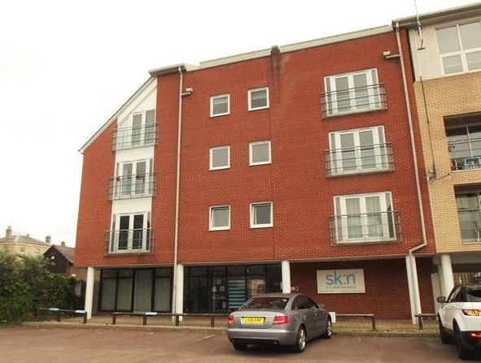
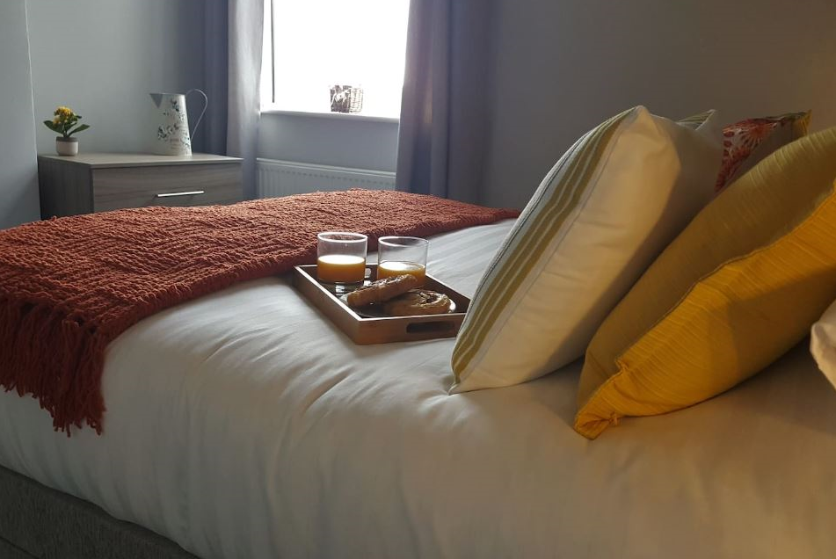
Vetrelax Chelmsford City Executive Apartment Navigation road
Key Features
Sleeps 7 people (incl. sofa beds).
Free WIFI.
Free Parking.
Free Laundry facilities.
3 mins walk to city centre.
Spacious Duplex with Balcony.
2 Bathrooms.
Fully Equipped kitchen.
Close to Station.

Slide 2
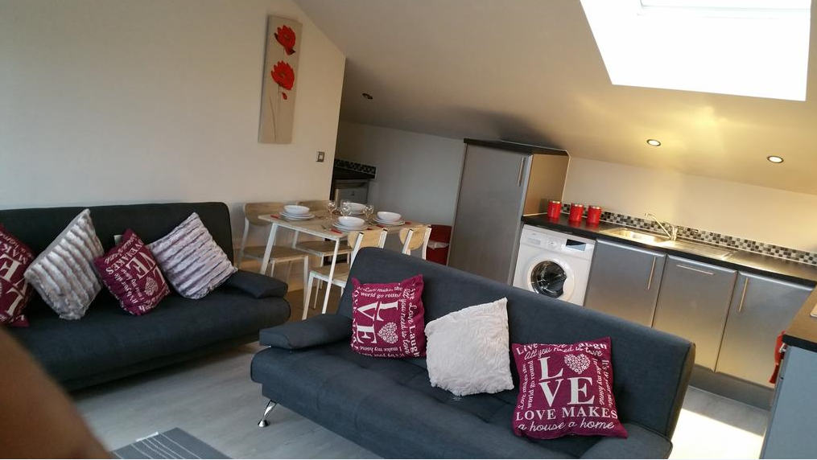
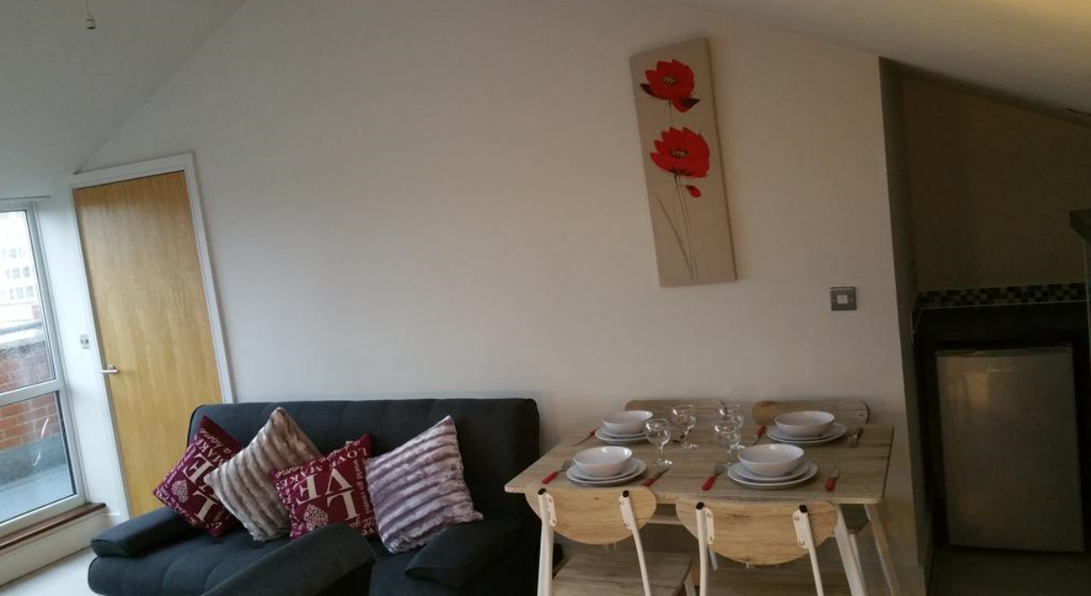
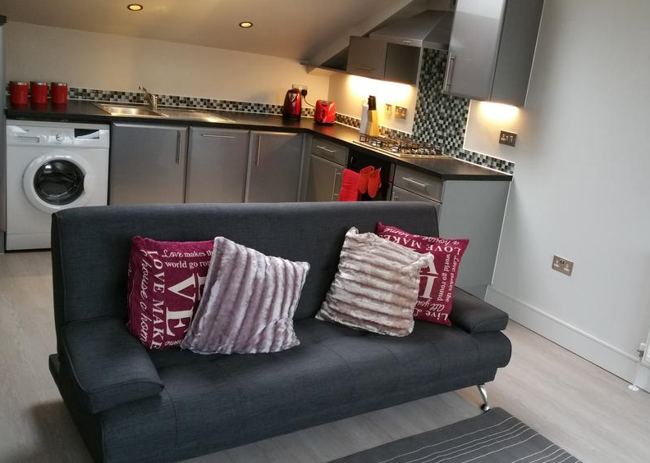
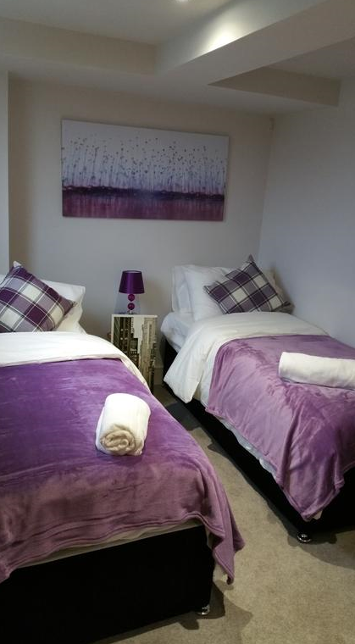
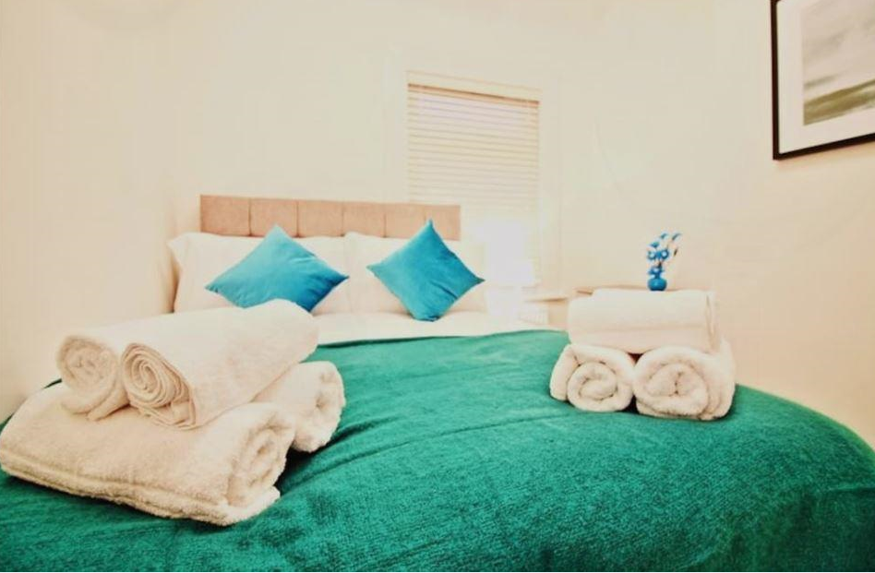

Slide 3
