Slide 1
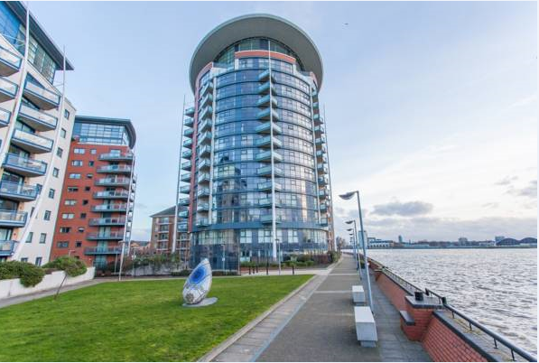
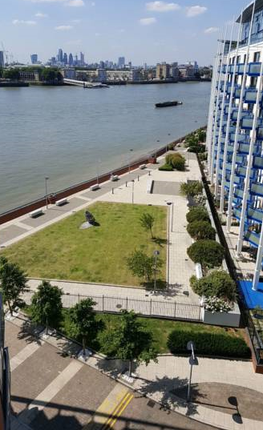
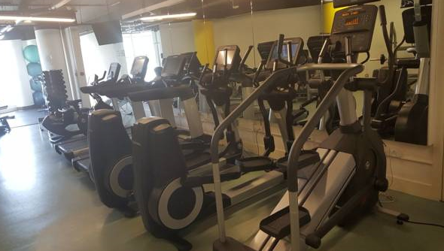
Vetrelax Orion Canary Wharf Apartment
Orion Point
Key Features
Sleeps 6 people.
Onsite gym & restaurant.
Spacious Apartment with sea view.
Free WIFI.
Free Parking.
Close to station and public transport.
Balcony with view of the city & sea.
Free Laundry facilities.
Close to Canary wharf.
Fully Equipped kitchen.

Slide 2
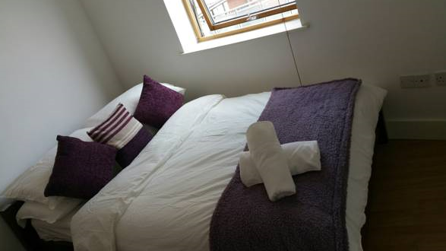
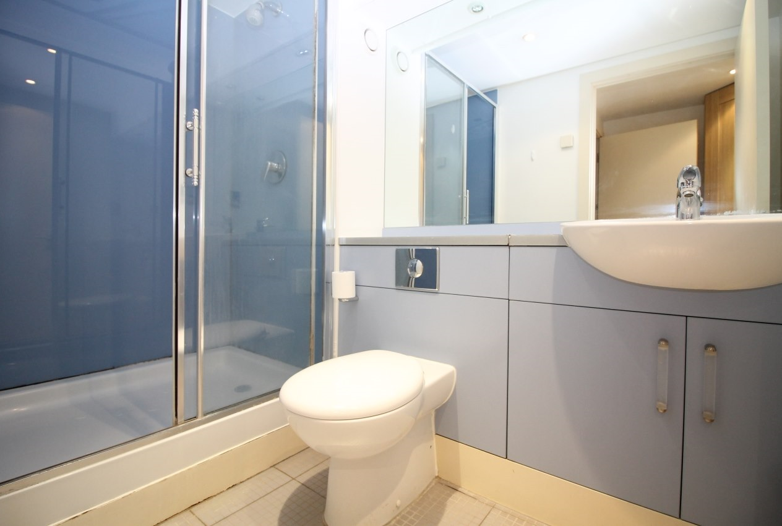
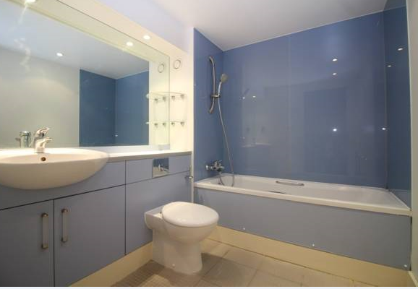
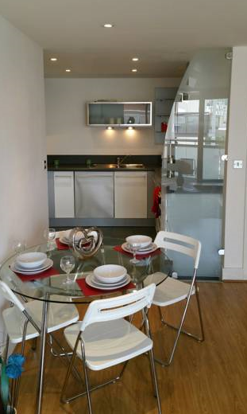
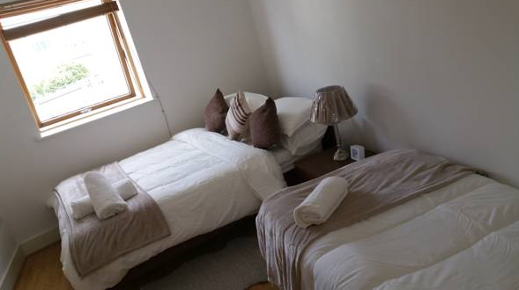

Slide 3
