Slide 1
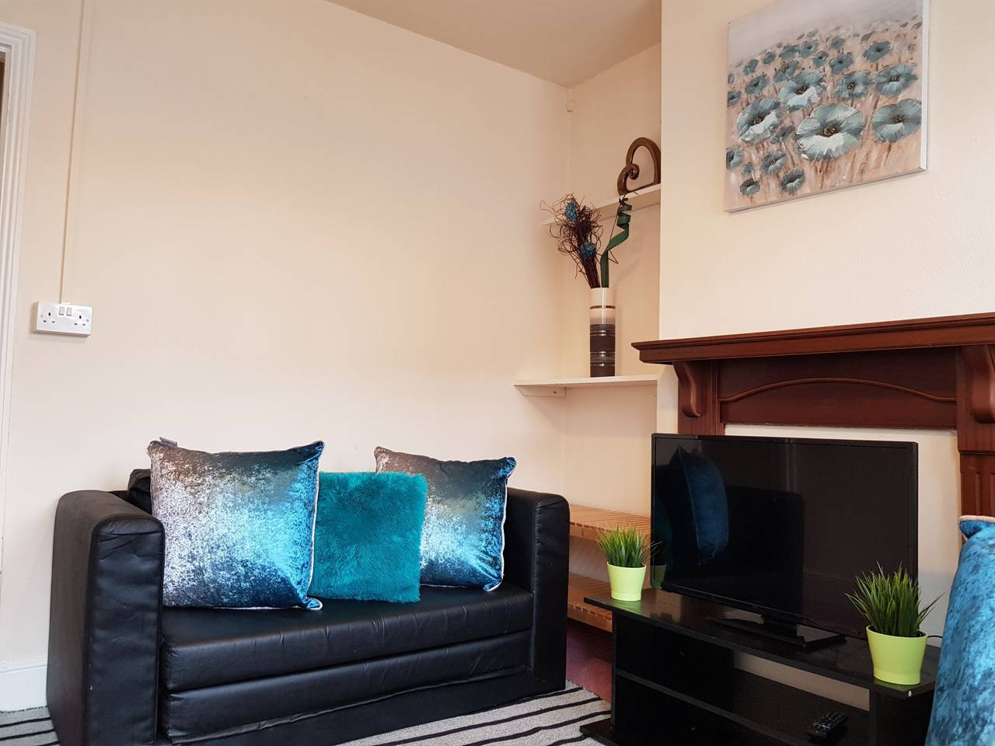
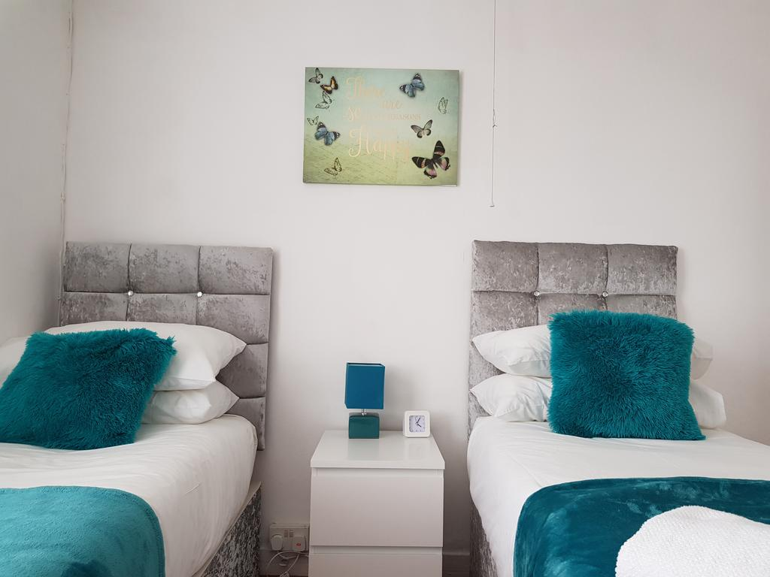
Vetrelax Chelmsford Orchard Apartment Orchard Street, Chelmsford.
Key Features
Sleeps 5 people (incl. sofa bed).
Free WIFI.
Free Parking.
Spacious house with garden.
Laundry Facilities
Fully Equipped kitchen.
Close to city centre.

Slide 2
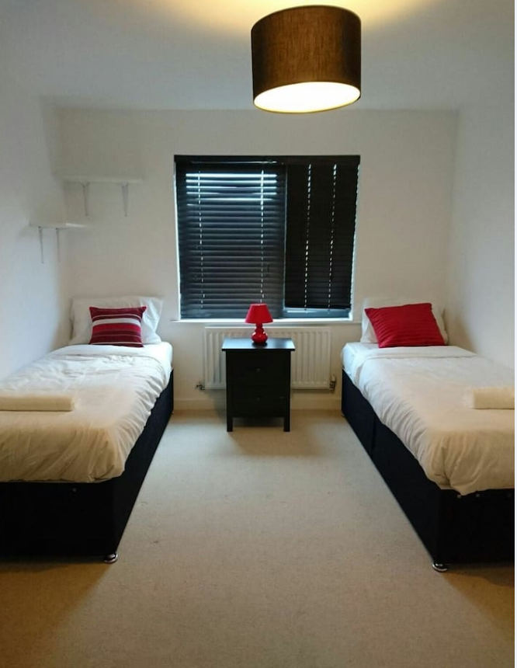
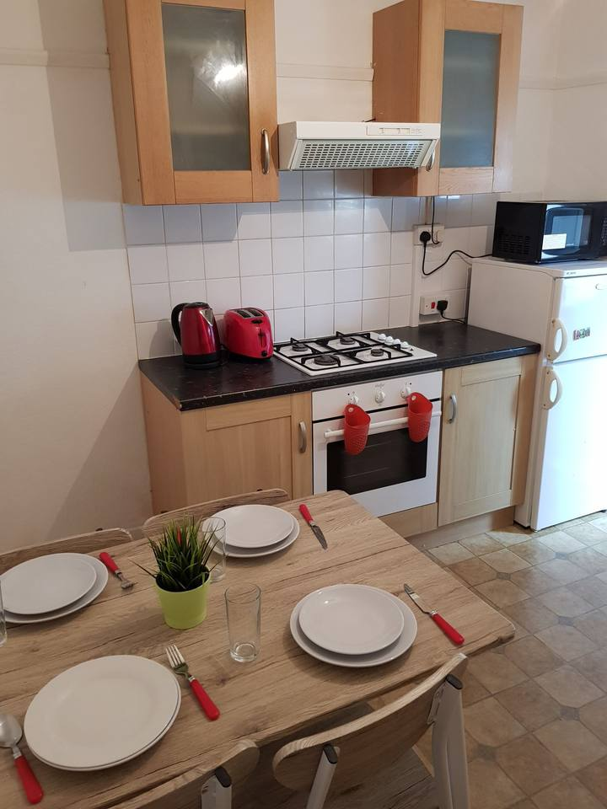
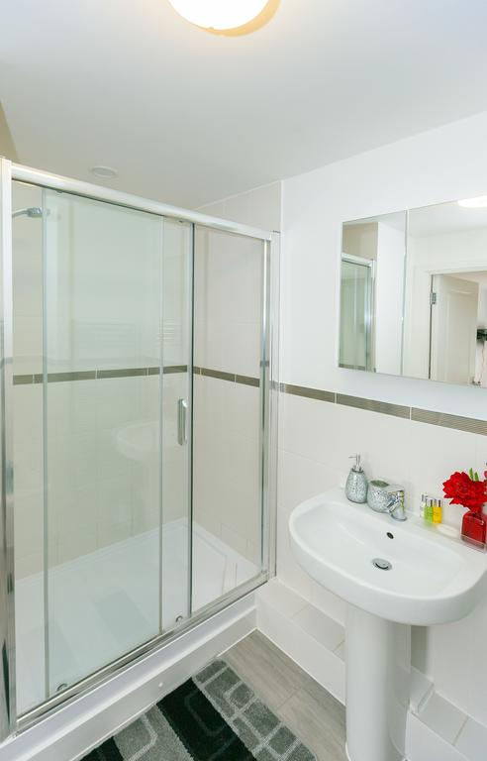

Slide 3
