Slide 1
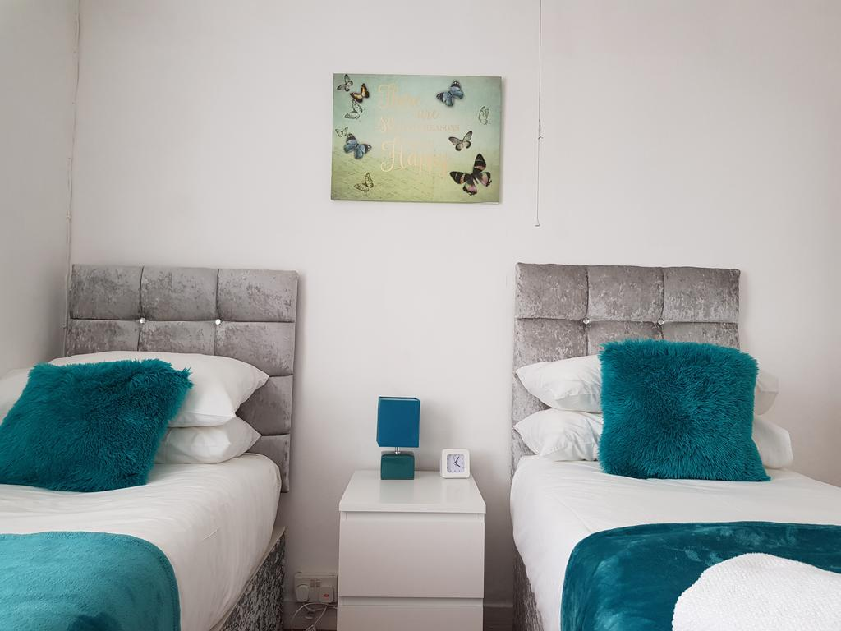
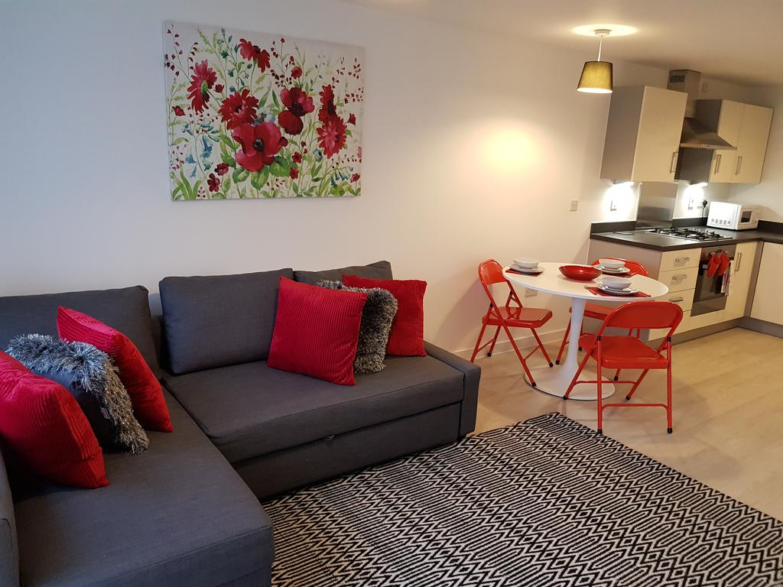
Vetrelax Blake Lodge Blake Avenue, Basildon.
Key Features
Sleeps 6 people (incl. sofa bed).
Free WIFI.
Free Parking.
Spacious apartment.
Laundry Facilities
Fully Equipped kitchen.
Close to city centre and train station.

Slide 2
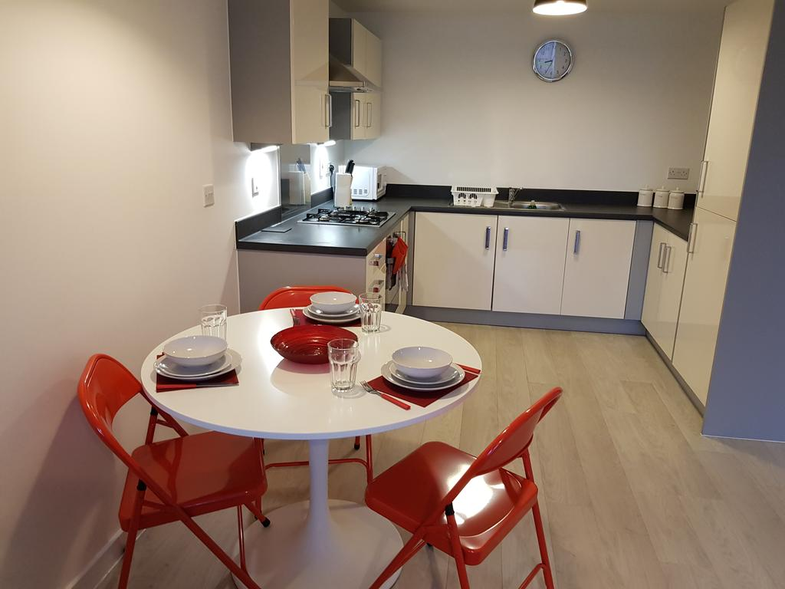
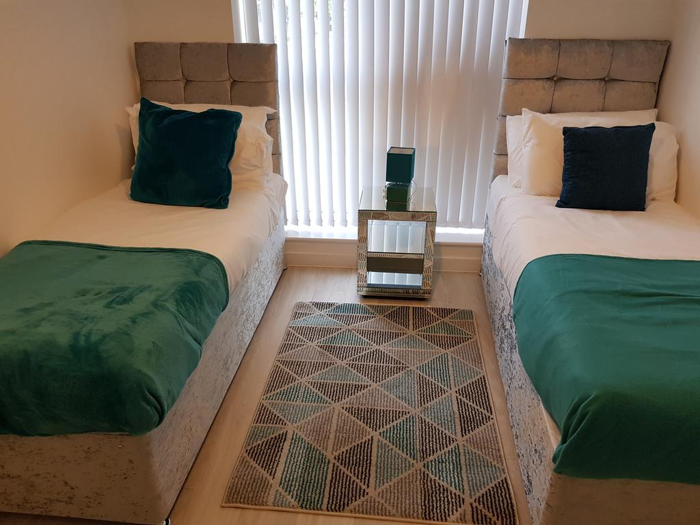
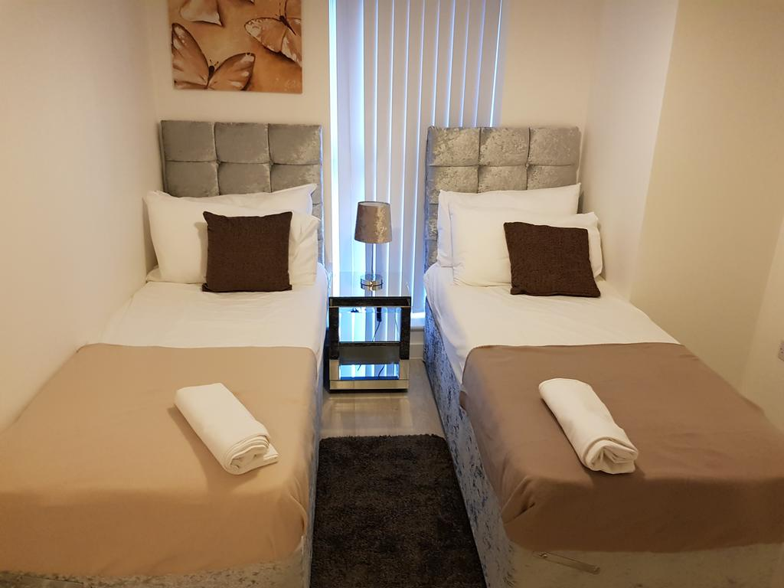

Slide 3
