Slide 1
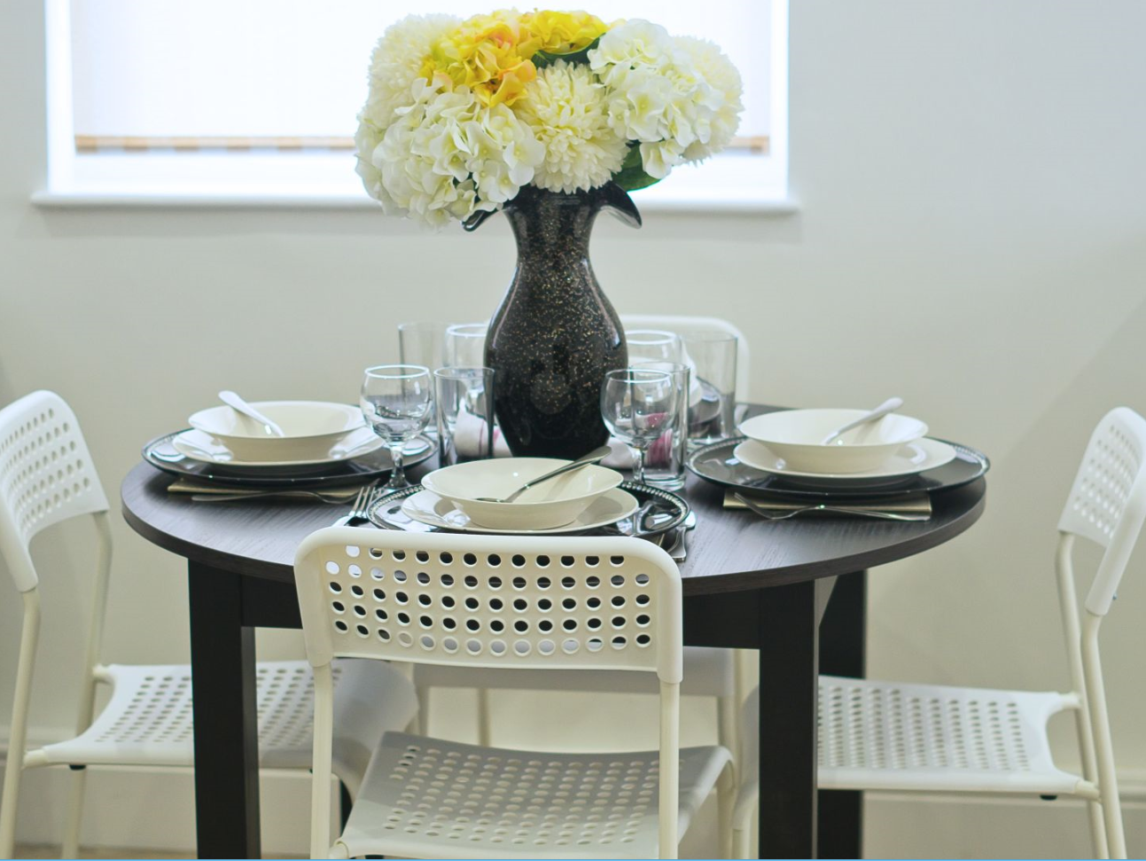
Vetrelax Cherrydown Apartment Cherrydown East, Basildon.
Key Features
Sleeps 6 people (incl. sofa beds).
Free WIFI.
Fully Equipped kitchen.
Close to city centre and train station
Spacious apartment with Elevator.
2 Bathrooms.
Laundry Facilities
Free complimentary Parking.

Slide 2
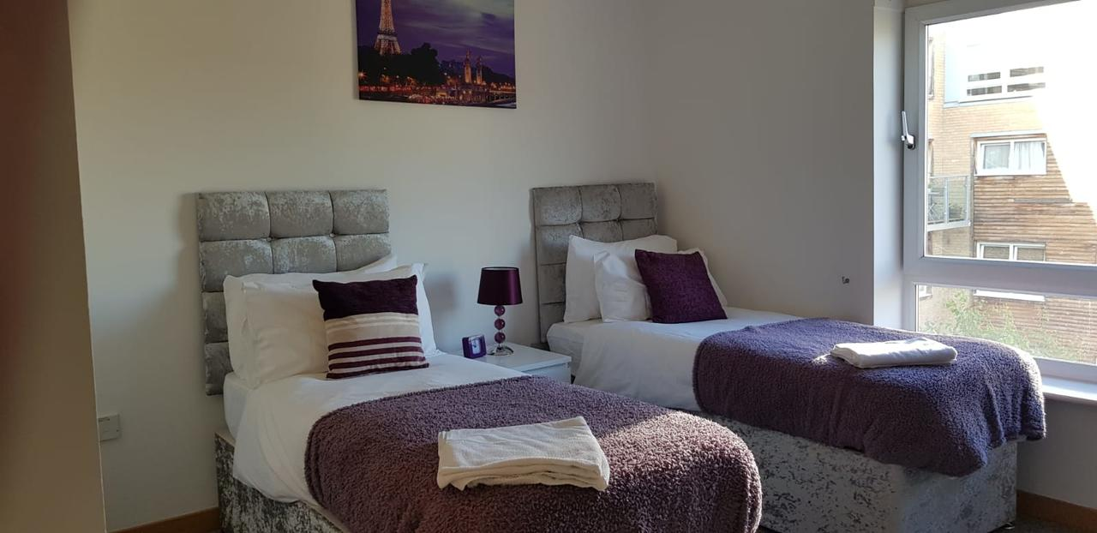
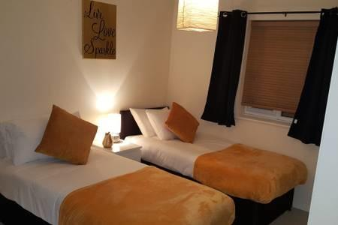
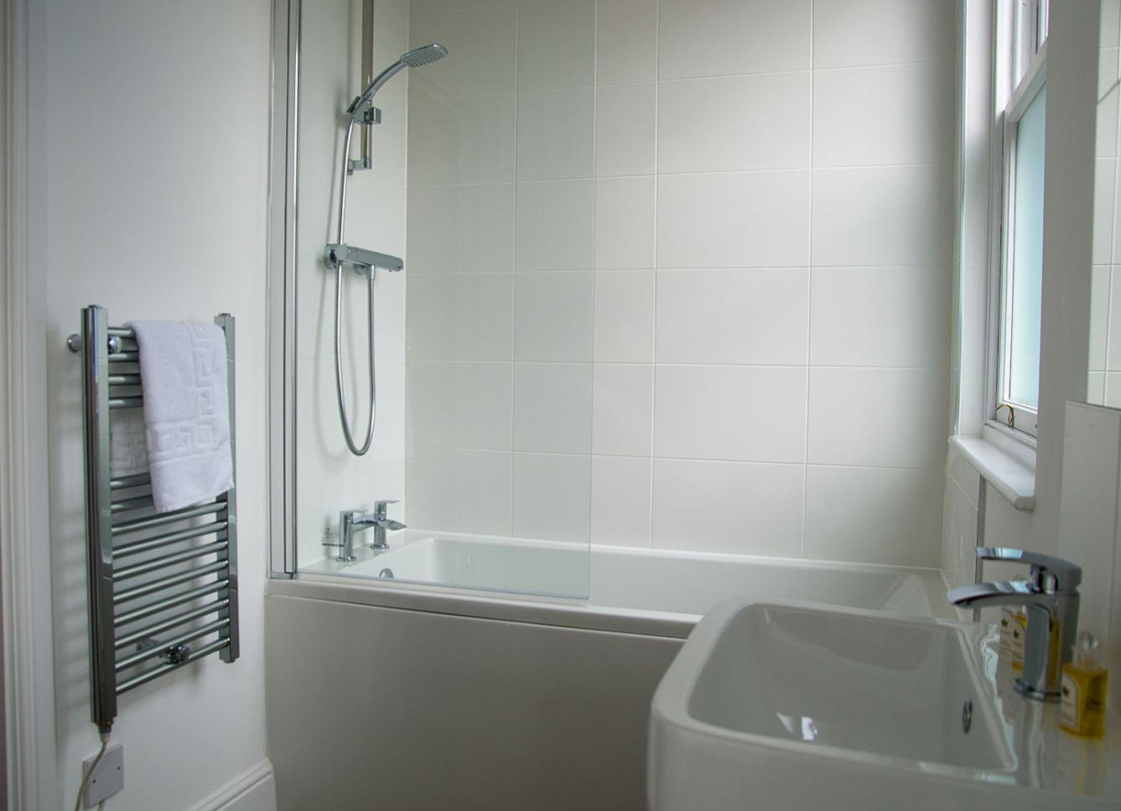
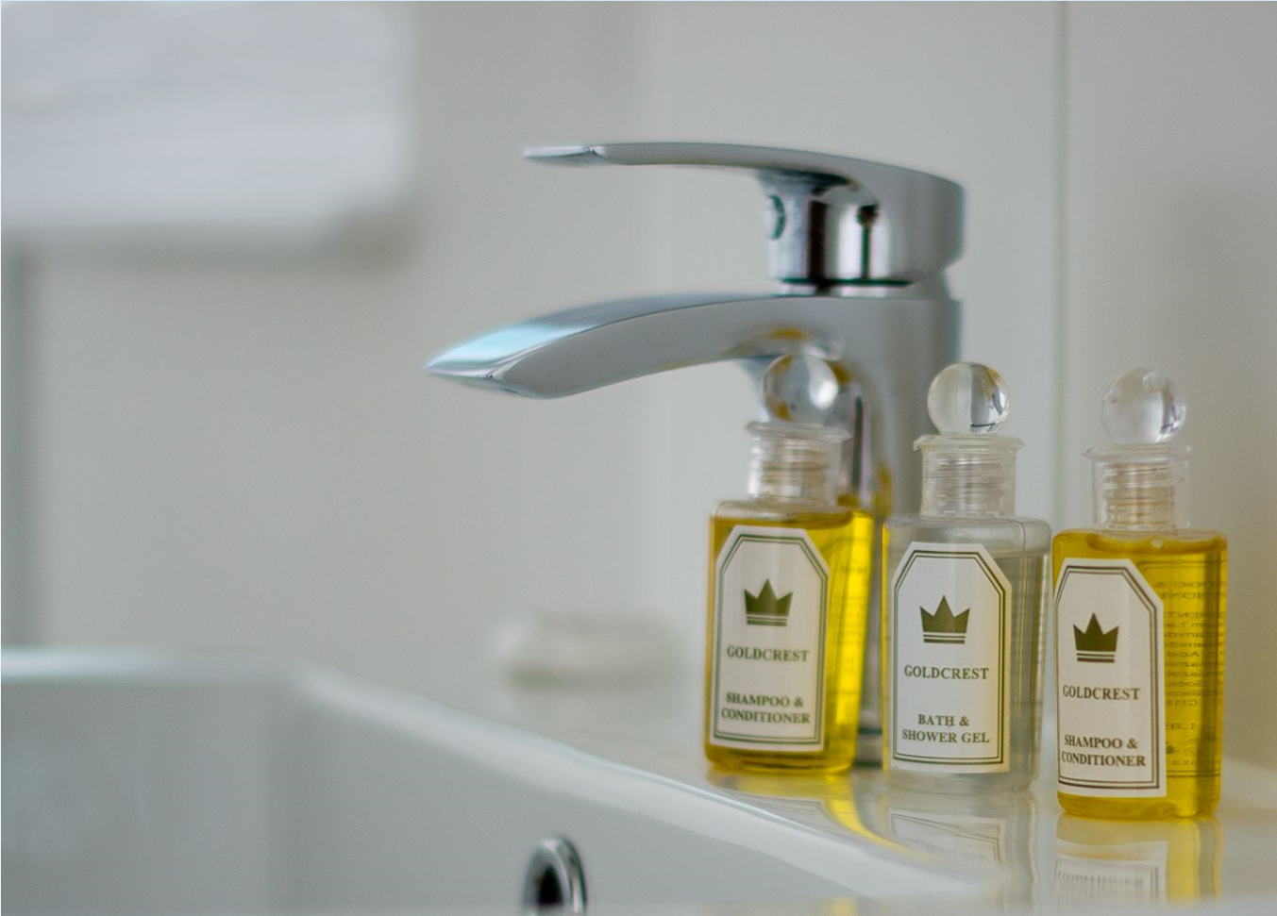

Slide 3
