Slide 1
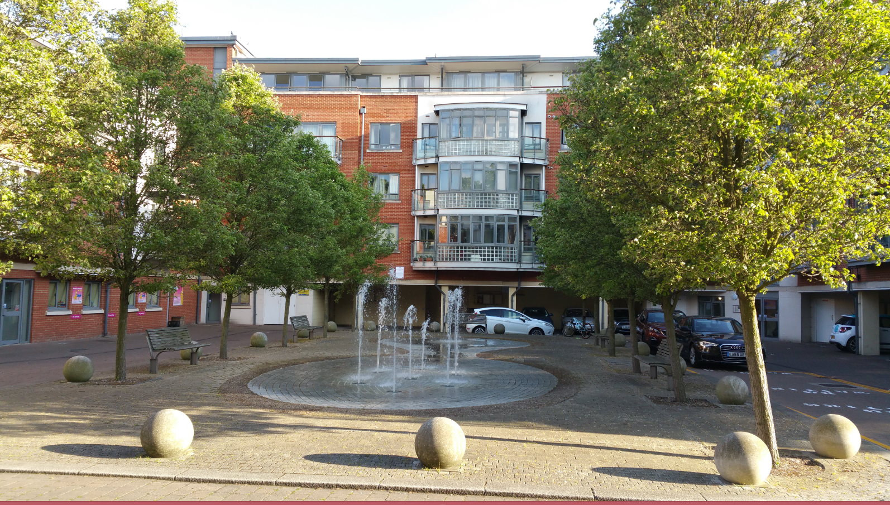
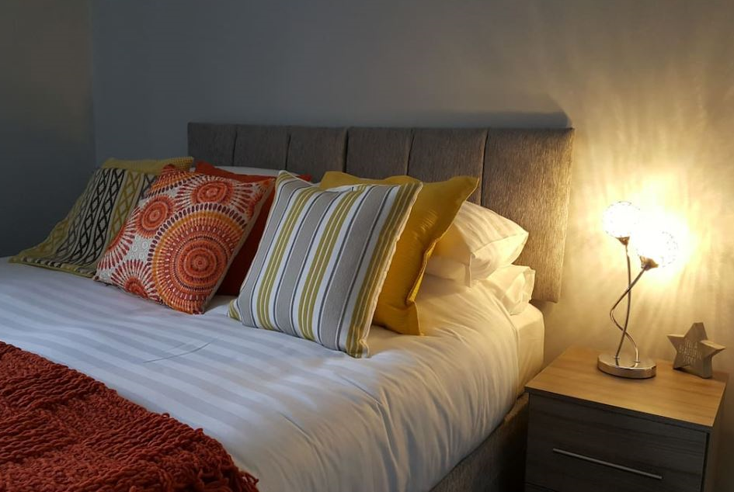
Vetrelax Chelmsford City Luxury Apartment Victoria Court, New Street.
Key Features
Sleeps 5 people (incl. sofa bed).
Free WIFI.
Free Parking.
Inbuilt Music system with speakers
3 mins walk to Station.
Spacious flat with Balcony.
2 Bathrooms.
Laundry Facilities
Fully Equipped kitchen.
Close to city centre.

Slide 2
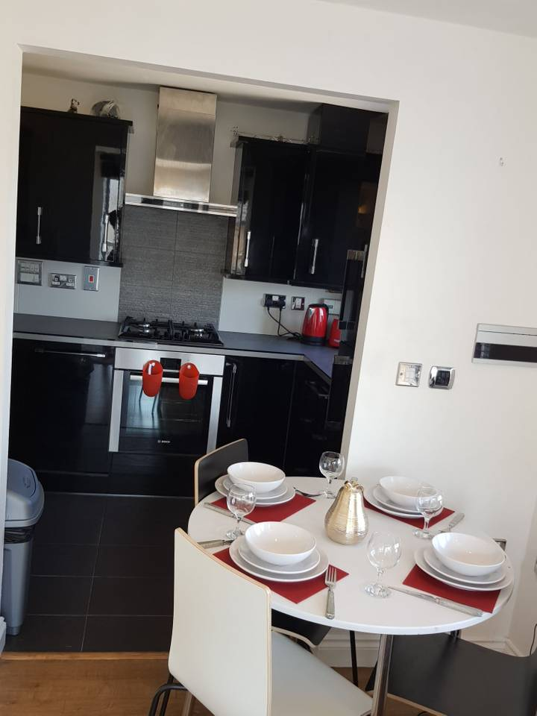
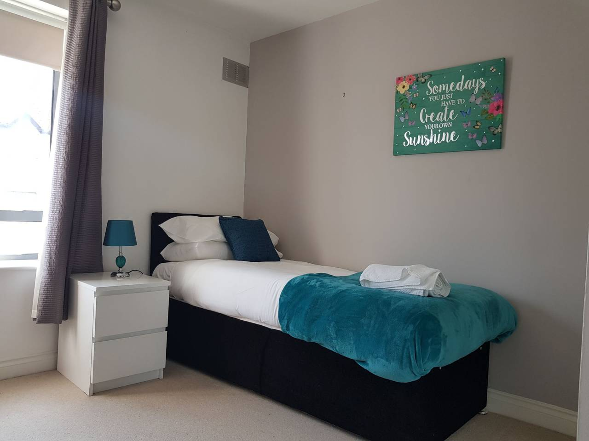
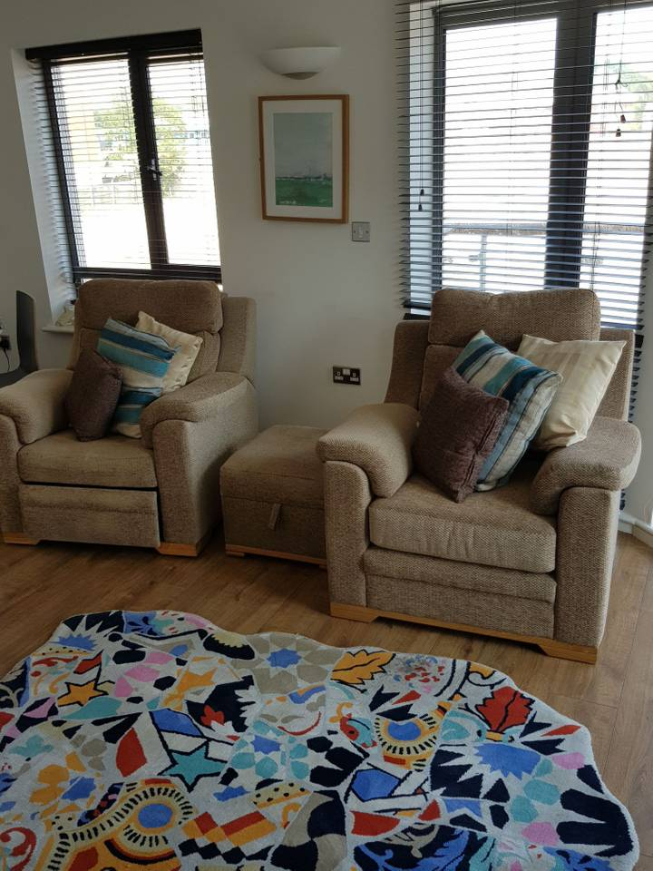
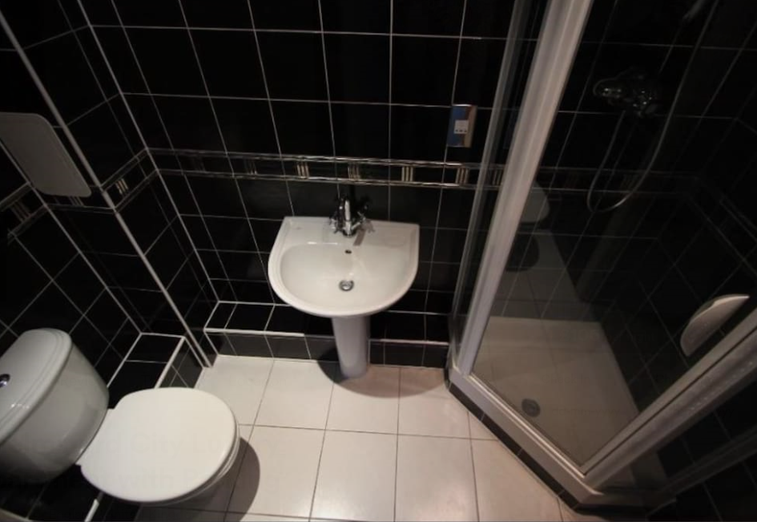

Slide 3
