Slide 1
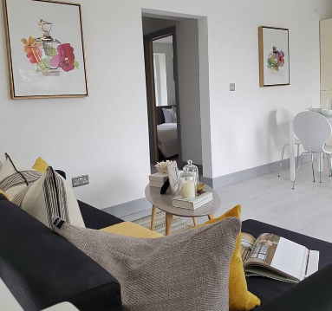
Southend Nelson Apartment Nelson street, Southend.
Key Features
Sleeps 6 people (incl. sofa beds).
Free WIFI.
Fully Equipped kitchen.
Close to city centre and the beach
Spacious apartment.
2 Bathrooms.
Laundry Facilities

Slide 2
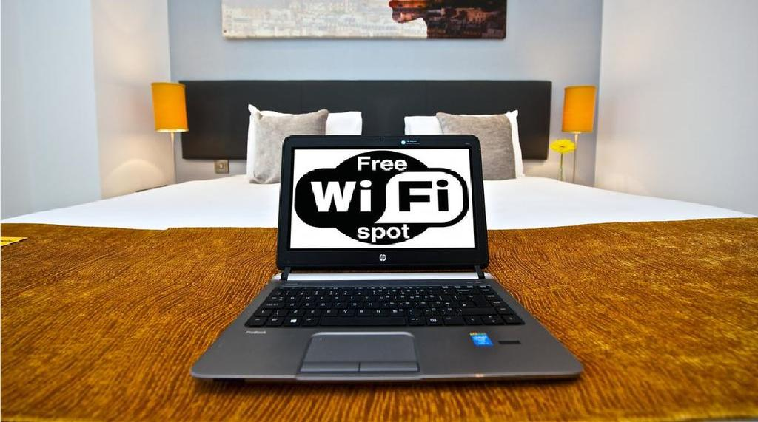
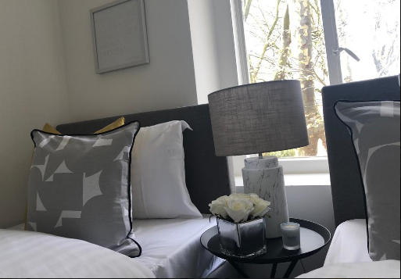
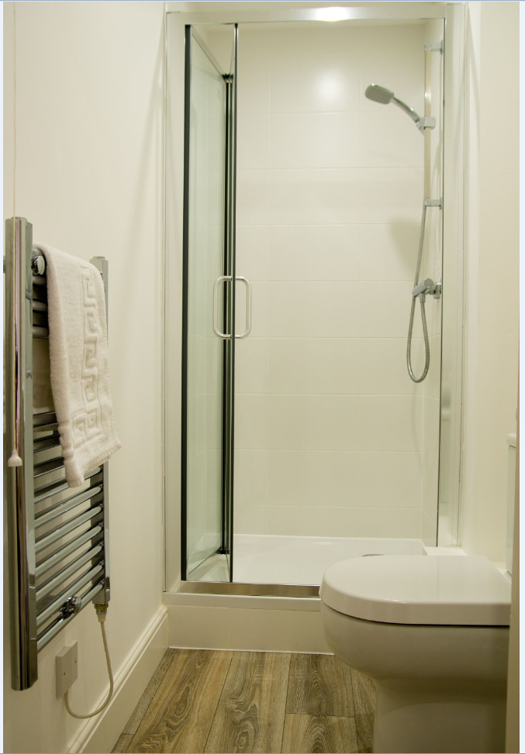
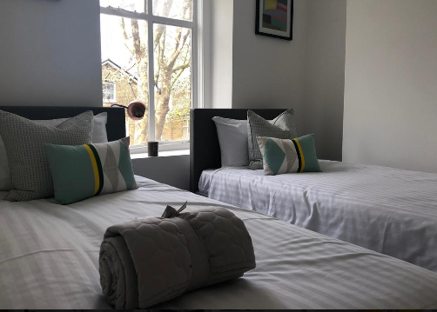
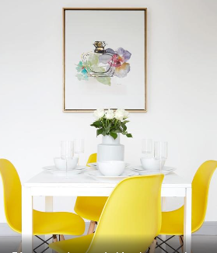

Slide 3
