Slide 1
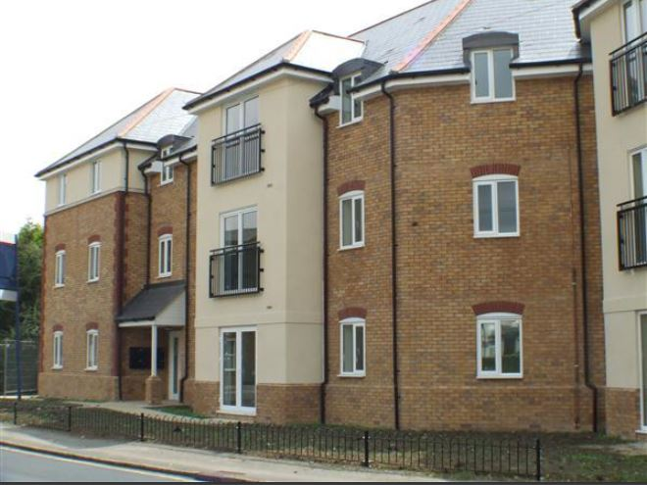
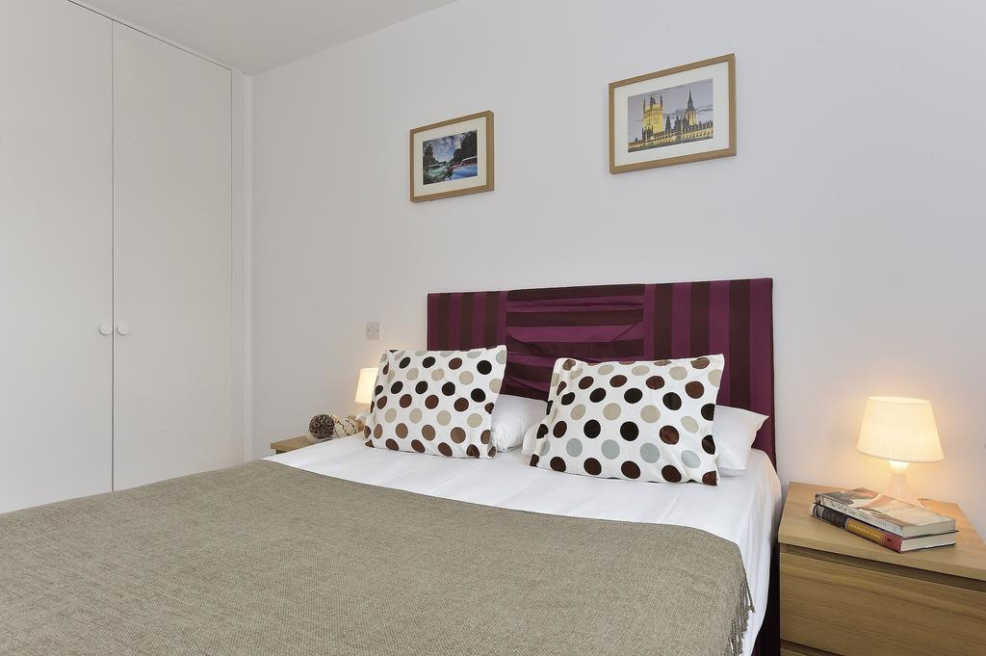

Vetrelax Chelmsford Writtle Apartment
Writtle road, Chelmsford.
Key Features
Sleeps 6 people (incl. sofa beds).
Free WIFI.
Close to city centre.
Fully Equipped kitchen.
Spacious Ground floor flat.
2 Bathrooms.
Laundry Facilities
Free Parking.

Slide 2
