Slide 1
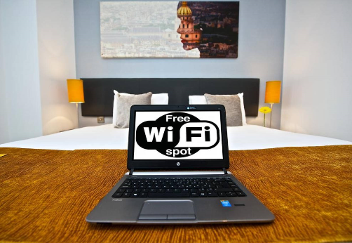
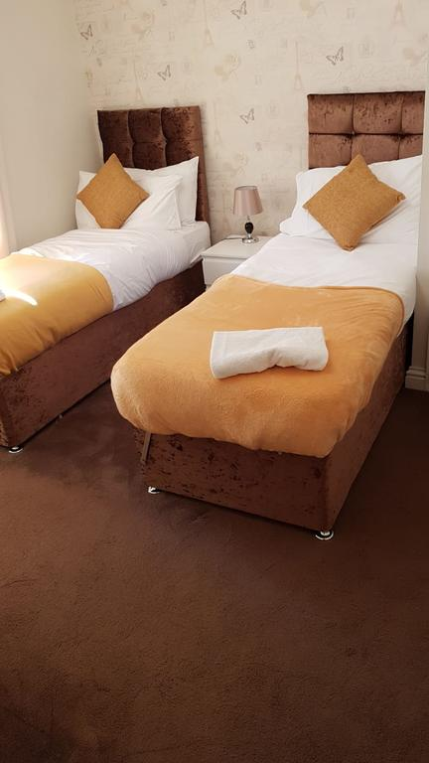
Vetrelax Romford MercuryApartment Centrum Court, Ipswich.
Key Features
Sleeps 6 people (incl. sofa beds).
Free WIFI.
2mins from train station.
Lake views
Balcony
Fully Equipped kitchen.
Laundry Facilities
Free Parking.

Slide 2
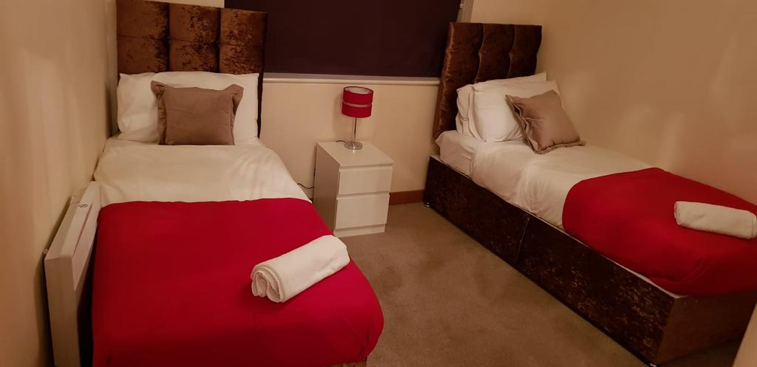
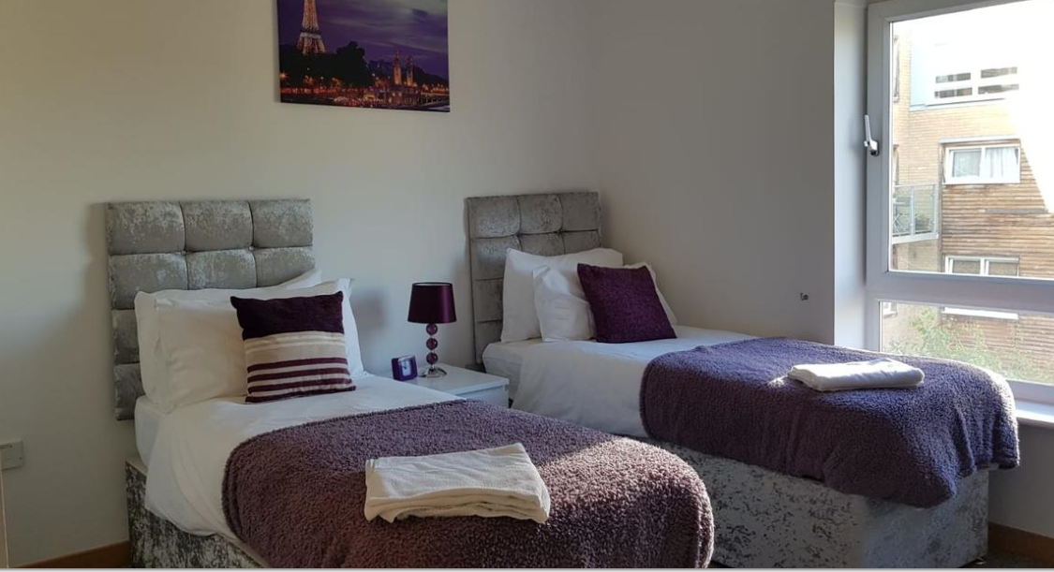
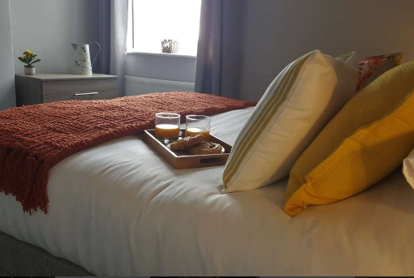
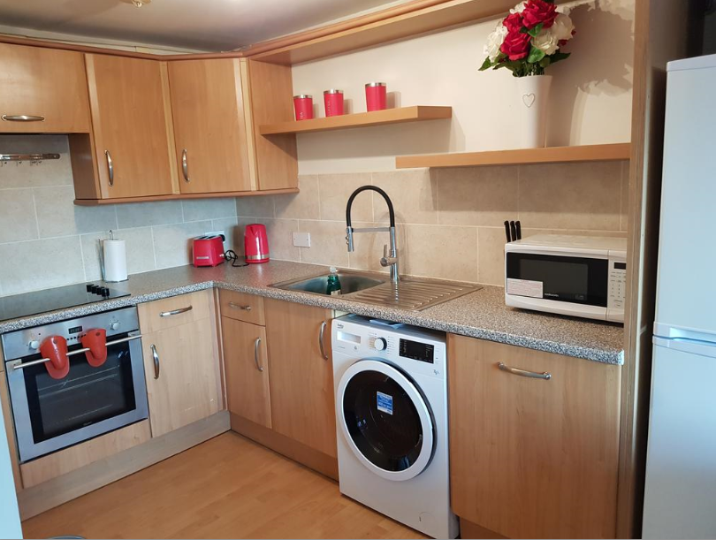

Slide 3
