Slide 1
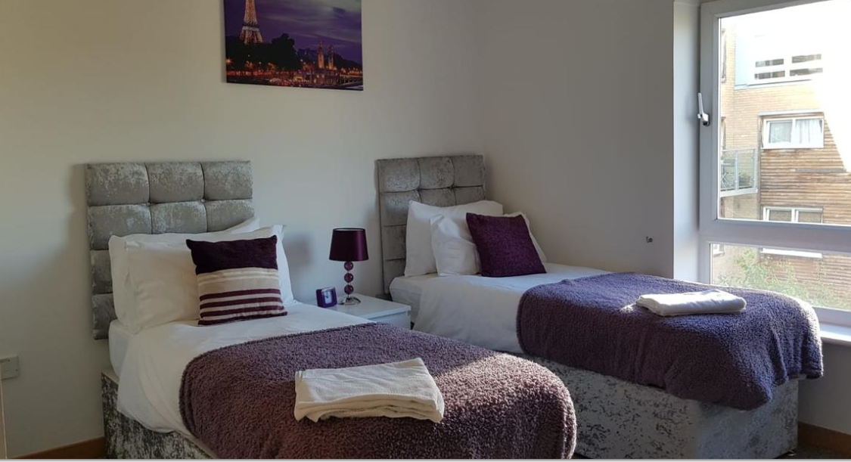
Vetrelax Romford MercuryApartment Mercury Gardens, Romford.
Key Features
Sleeps 6 people (incl. sofa beds).
Free WIFI.
City centre Apartment.
Fully Equipped kitchen.
Laundry Facilities
Free Parking.

Slide 2
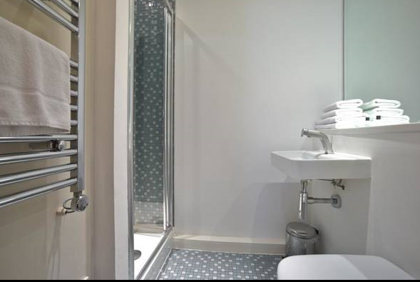
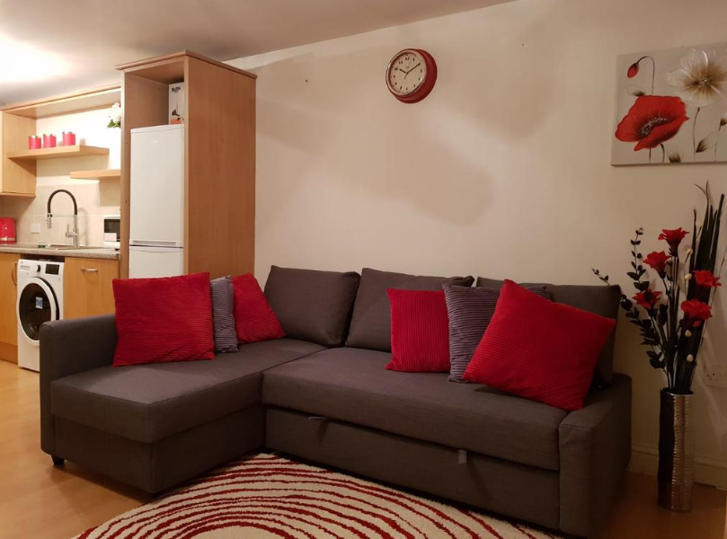
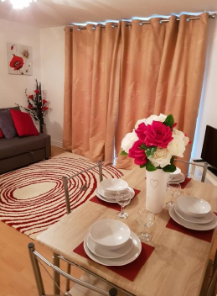
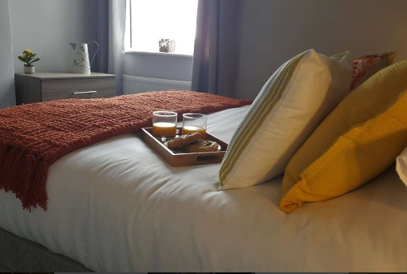
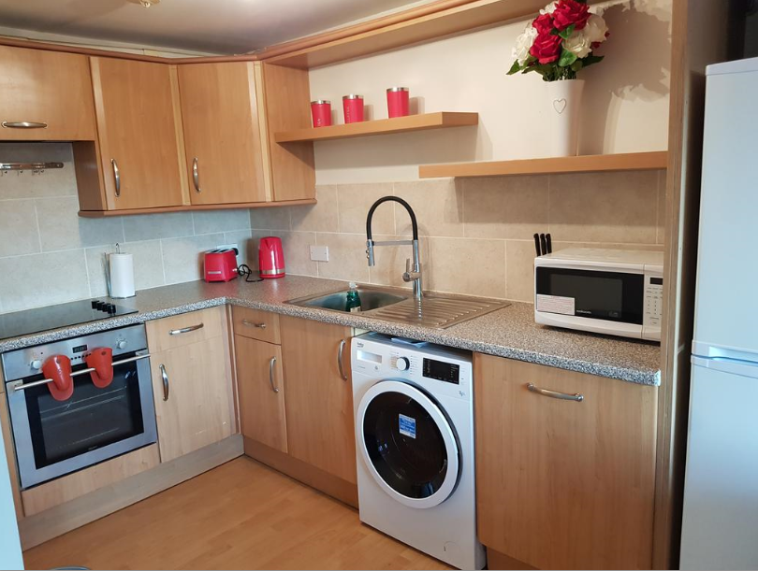

Slide 3
