Slide 1
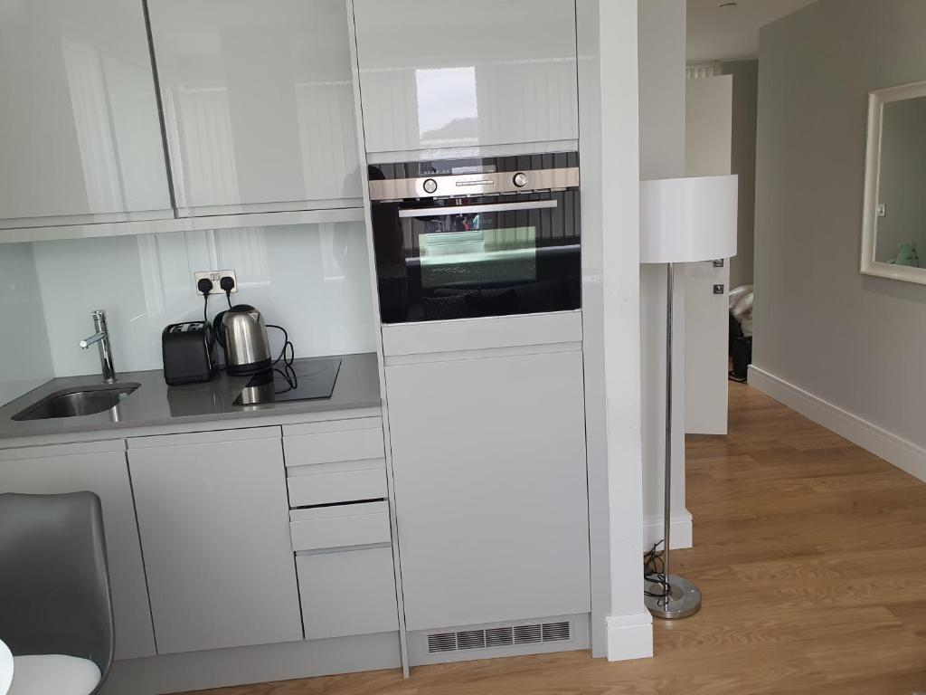
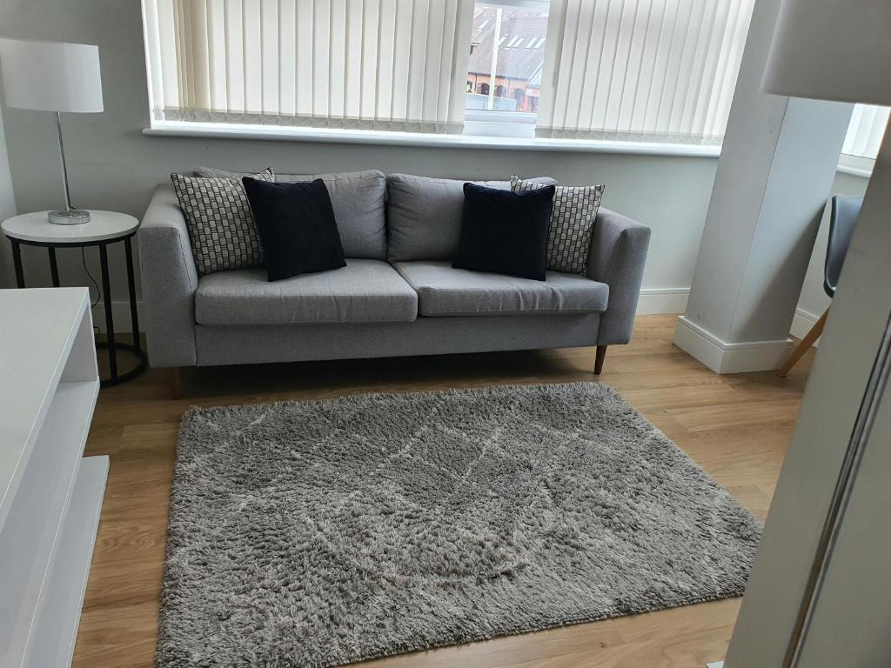
Vetrelax Chelmsford Roseberry Apartment Springfield Road, Chelmsford
Key Features
Sleeps 4 people (incl. sofa beds).
Free WIFI.
Close to city centre and train station
Fully Equipped kitchen.
Spacious flat with city view.
Private bathroom.
Laundry Facilities
Free complimentary Parking.

Slide 2
