Slide 1
T Test
A number of t tests are available, including:
• The One-Sample T Test
• The Paired-Samples Test
• The Independent-Samples T Test

Slide 2
The One-Sample T Test procedure:
• Tests the difference between a sample mean and a known or hypothesized value
• Allows you to specify the level of confidence for the difference
• Produces a table of descriptive statistics for each test variable

Slide 3
A Production-Line Problem
A manufacturer of high-performance automobiles produces disc brakes that must measure 322 millimeters in diameter. Quality control randomly draws 16 discs made by each of eight production machines and measures their diameters.
This example uses the file brakes.sav. See Sample Files for more information. Use One Sample T Test to determine whether or not the mean diameters of the brakes in each sample significantly differ from 322 millimeters.
A nominal variable, Machine Number, identifies the production machine used to make the disc brake. Because the data from each machine must be tested as a separate sample, the file must first be split into groups by Machine Number.

Slide 4
Paired-Samples T Test
One of the most common experimental designs is the "pre-post" design. A study of this type often consists of two measurements taken on the same subject, one before and one after the introduction of a treatment or a stimulus. The basic idea is simple. If the treatment had no effect, the average difference between the measurements is equal to 0 and the null hypothesis holds. On the other hand, if the treatment did have an effect (intended or unintended!), the average difference is not 0 and the null hypothesis is rejected.
The Paired-Samples T Test procedure is used to test the hypothesis of no difference between two variables. The data may consist of two measurements taken on the same subject or one measurement taken on a matched pair of subjects.
Additionally, the procedure produces:
• Descriptive statistics for each test variable
• The Pearson correlation between each pair and its significance
• A confidence interval for the average difference (95% or a value you specify)

Slide 5
Does Diet Make a Difference?
A physician is evaluating a new diet for her patients with a family history of heart disease. To test the effectiveness of this diet, 16 patients are placed on the diet for 6 months. Their weights and triglyceride levels are measured before and after the study, and the physician wants to know if either set of measurements has changed.
This example uses the file dietstudy.sav. See Sample Files for more information. Use Paired-Samples T Test to determine whether there is a statistically significant difference between the pre- and post-diet weights and triglyceride levels of these patients.

Slide 6
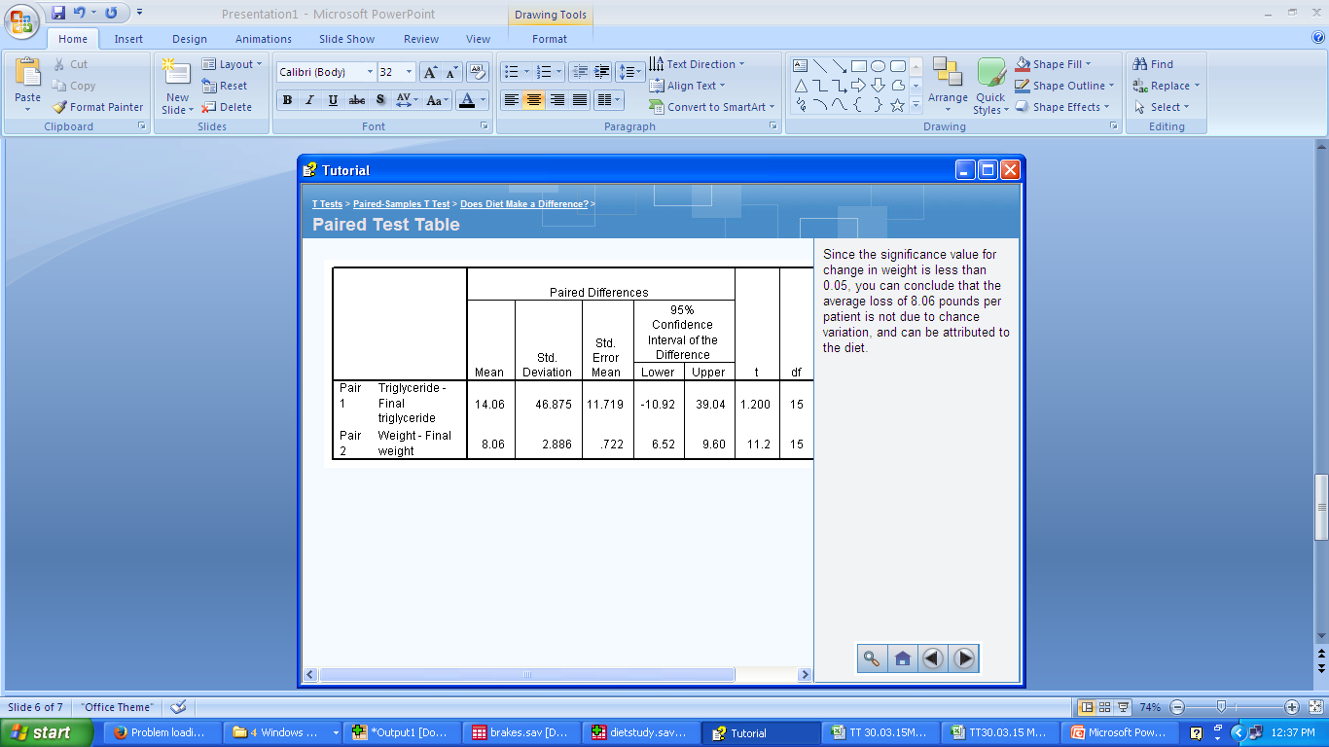

Slide 8
Independent-Samples T Test
Usually, the groups in a two-sample t test are fixed by design, and the grouping variable has one value for each group. However, there are times when assignment to one of two groups can be made on the basis of an existing scale variable. For example, consider math and verbal test scores. You would like to perform a t test on verbal scores, using the students above and below a given cutoff score on the math as the independent groups. With the Independent-Samples T Test procedure, all you need to provide is the cut point. The program divides the sample in two at the cut point and performs the t test. The virtue of this method is that the cut point can easily be changed without the need to re-create the grouping variable by hand every time.

Slide 9
Testing Two Independent Sample Means
An analyst at a department store wants to evaluate a recent credit card promotion. To this end, 500 cardholders were randomly selected. Half received an ad promoting a reduced interest rate on purchases made over the next three months, and half received a standard seasonal ad.
This example uses the file creditpromo.sav. See Sample Files for more information. Use Independent-Samples T Test to compare the spending of the two groups.

Slide 10
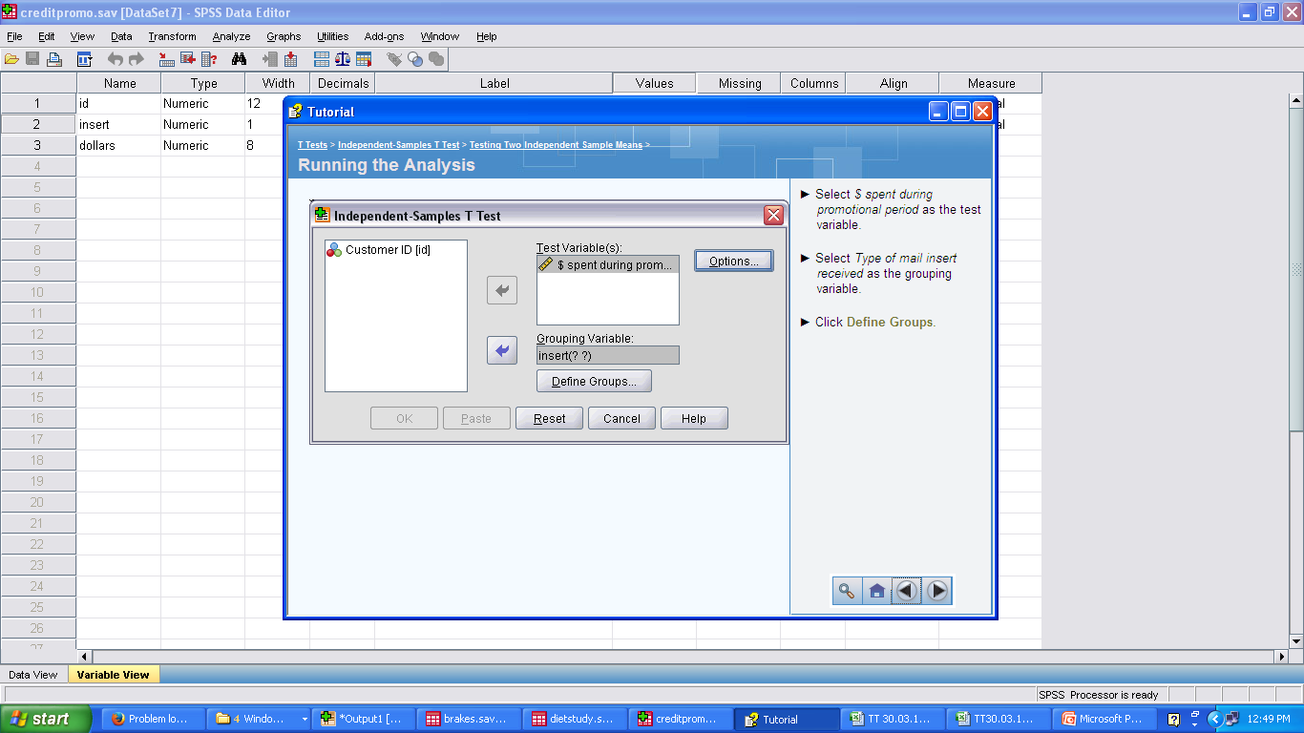

Slide 11
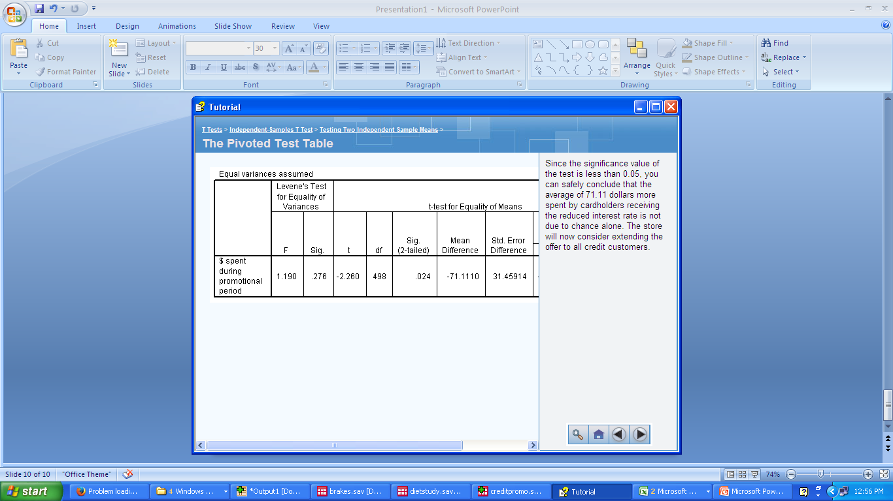

Slide 12
Using a Cut Point to Define the Samples
Churn propensity scores are applied to accounts at a cellular phone company. Ranging from 0 to 100, an account scoring 50 or above may be looking to change providers. A manager with 50 customers above the threshold randomly samples 200 below it, wanting to compare them on average minutes used per month.
This example uses the file cellular.sav. See Sample Files for more information. Use Independent-Samples T Test to determine whether these groups have different levels of cell-phone usage.

Slide 13
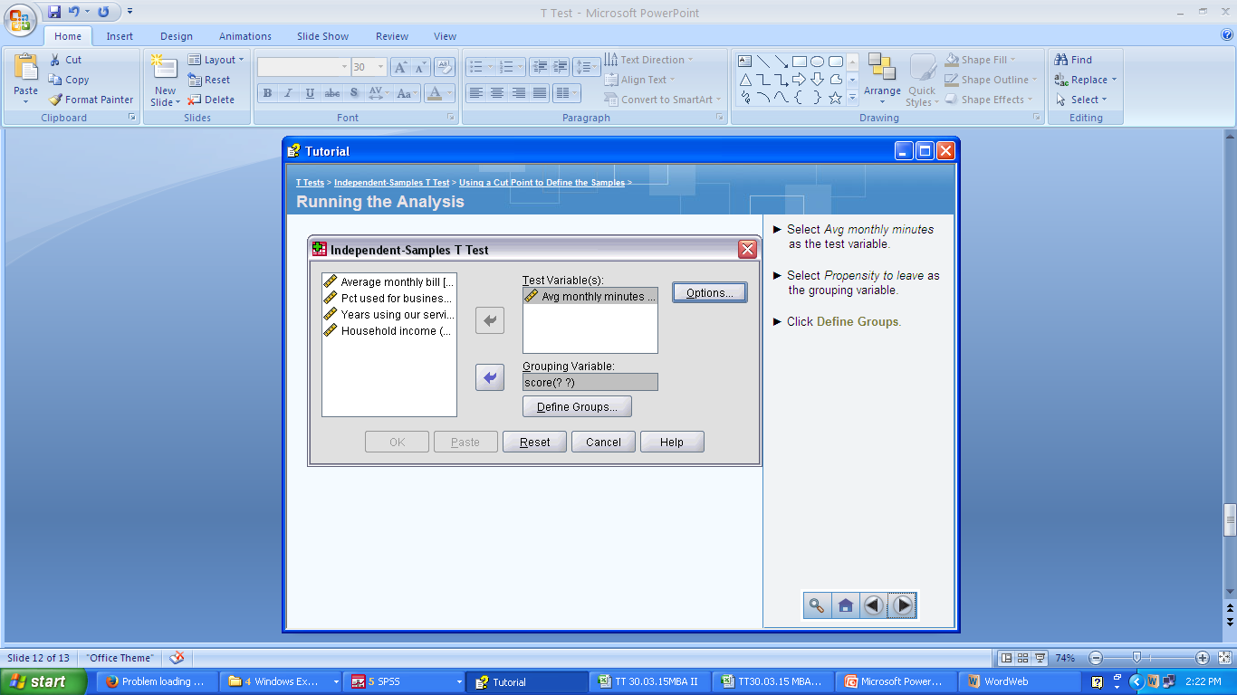

Slide 14
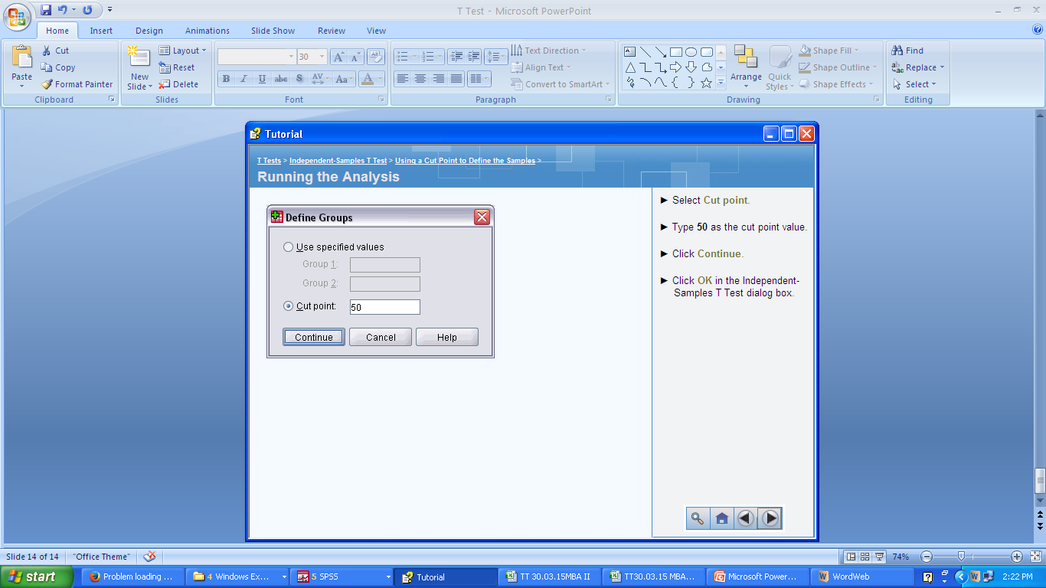

Slide 15
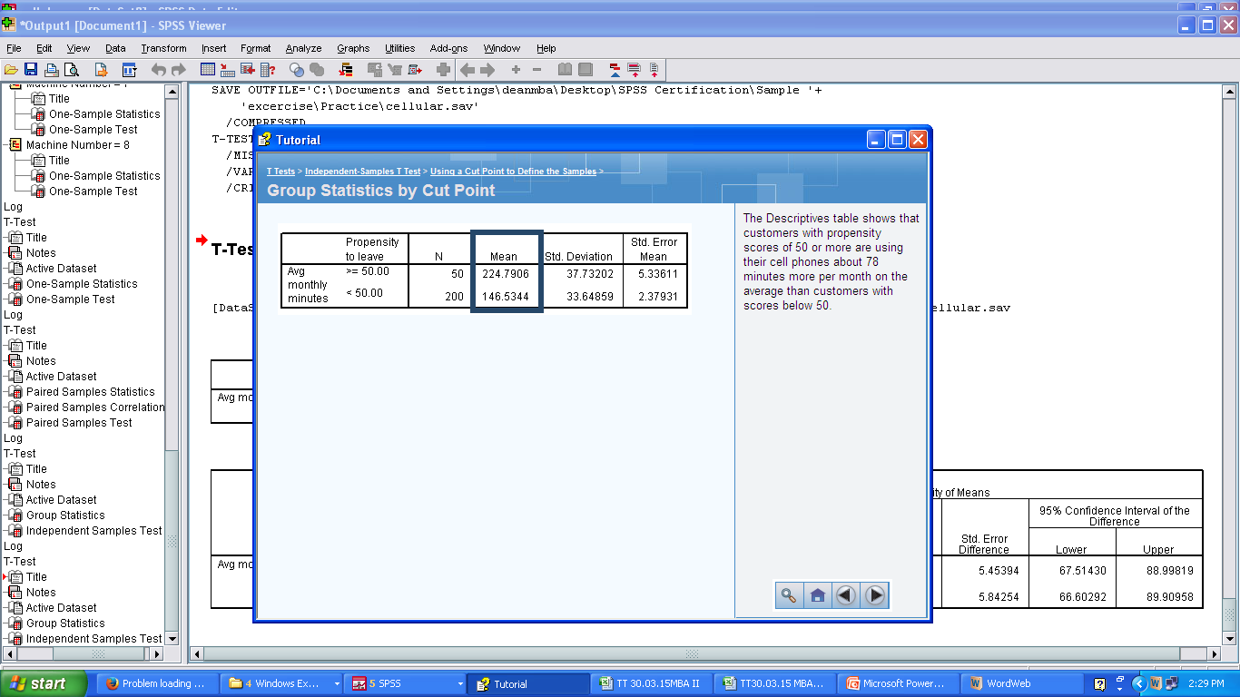

Slide 16
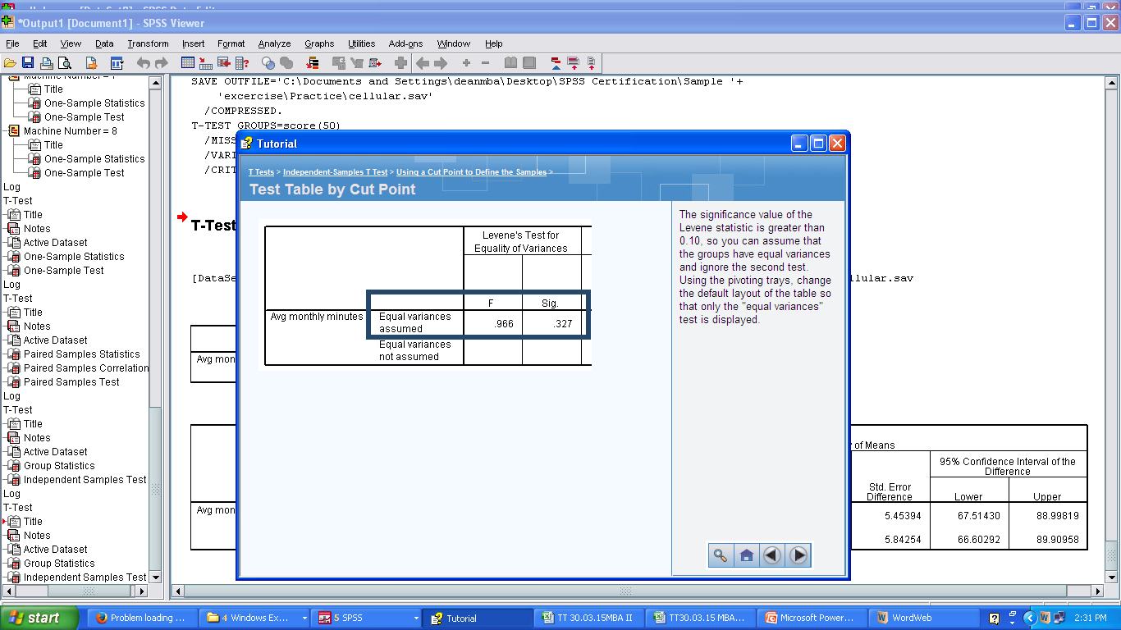

Slide 17
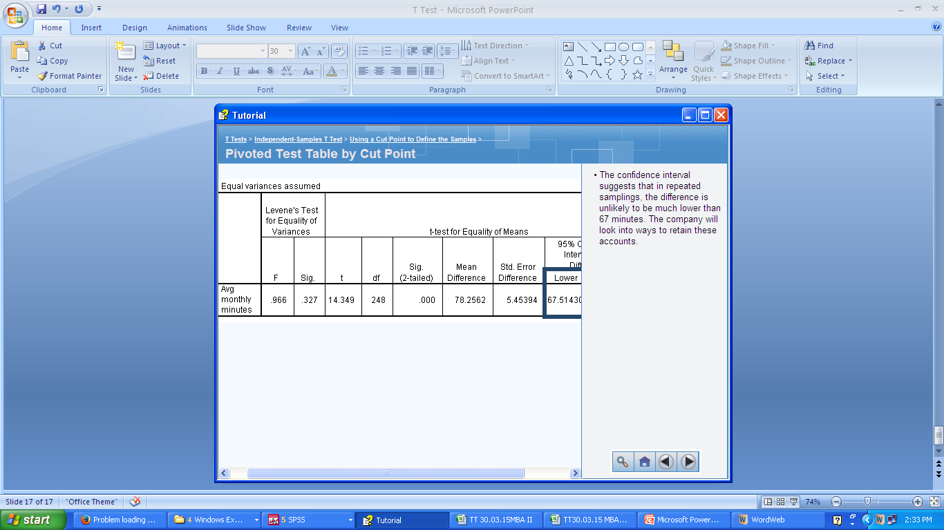

Slide 18
Conclusion:
The p value is less than 0 therefore null hypothesis is rejected means there is a significant difference between average monthly minutes used by those having propensity to leave score >= 50 and <50.
And The Descriptive table shows that customers with propensity scores of 50 or more are using their cell phones about 78 minutes more per month on the average than customers with scores below 50.
And therefore The company will look into ways to retain these accounts i.e. customers with propensity scores of 50 or more

Slide 19
chi-square tests
chi-square tests measures relationship between the two variables
Is there a significant association between two variables e.g. respondent income and Purchase intention or PDA ownership and different income categories as depicted in example on next slide.
H0 : There is no significant association between PDA ownership and different income categories
H1: There is significant association between PDA ownership and different income categories means both are indeed related.

Slide 20
Crosstabulation Tables
Crosstabulation tables (contingency tables) display the relationship between two or more categorical (nominal or ordinal) variables. The size of the table is determined by the number of distinct values for each variable, with each cell in the table representing a unique combination of values. Numerous statistical tests are available to determine whether there is a relationship between the variables in a table.
This chapter uses the file demo.sav. See Sample Files for more information.

Slide 21
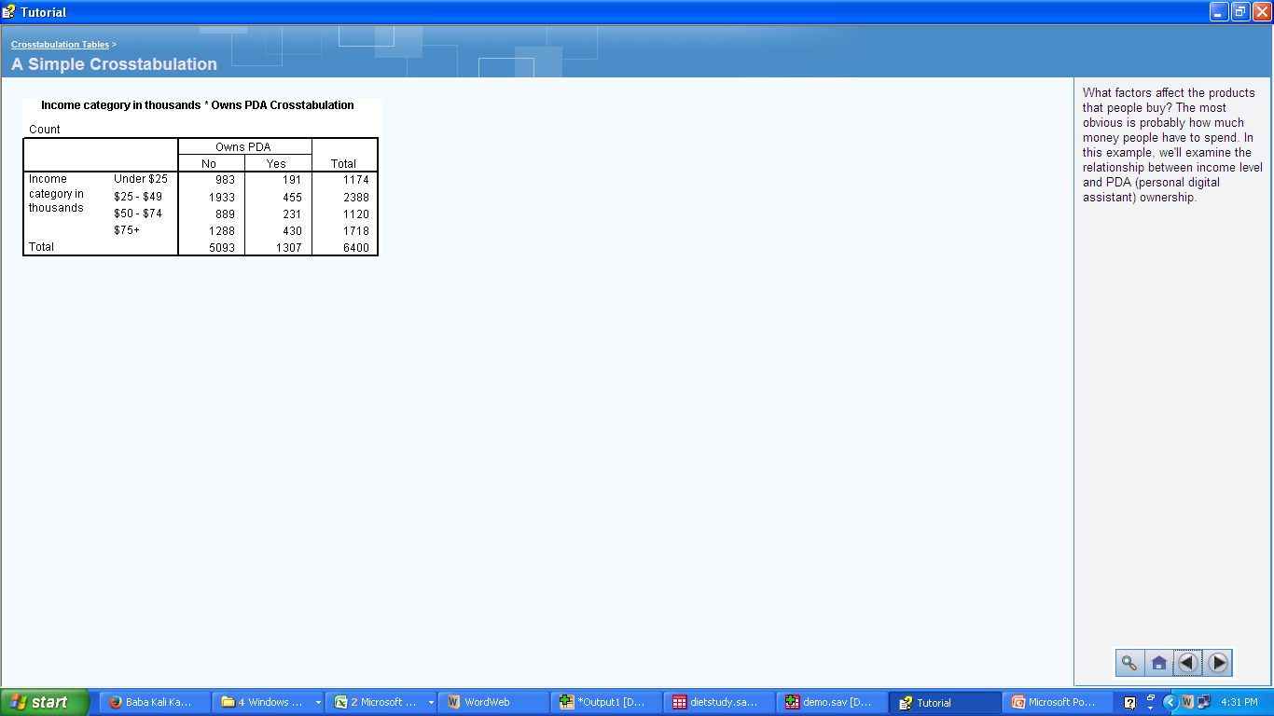

Slide 22
Significance Testing for Cross- tabulations
The purpose of a crosstabulation is to show the relationship (or lack thereof) between two variables.
Although there appears to be some relationship between the two variables, is there any reason to believe that the differences in PDA ownership between different income categories is anything more than random variation?
A number of tests are available to determine if the relationship between two crosstabulated variables is significant. One of the more common tests is chi-square. One of the advantages of chi-square is that it is appropriate for almost any kind of data.

Slide 23
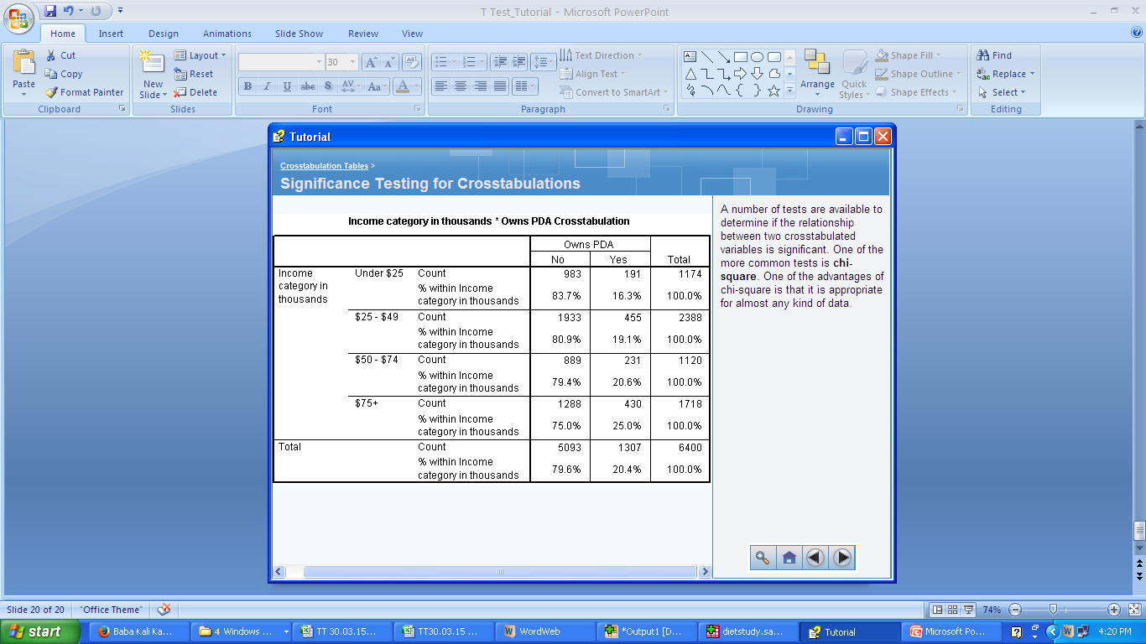

Slide 24
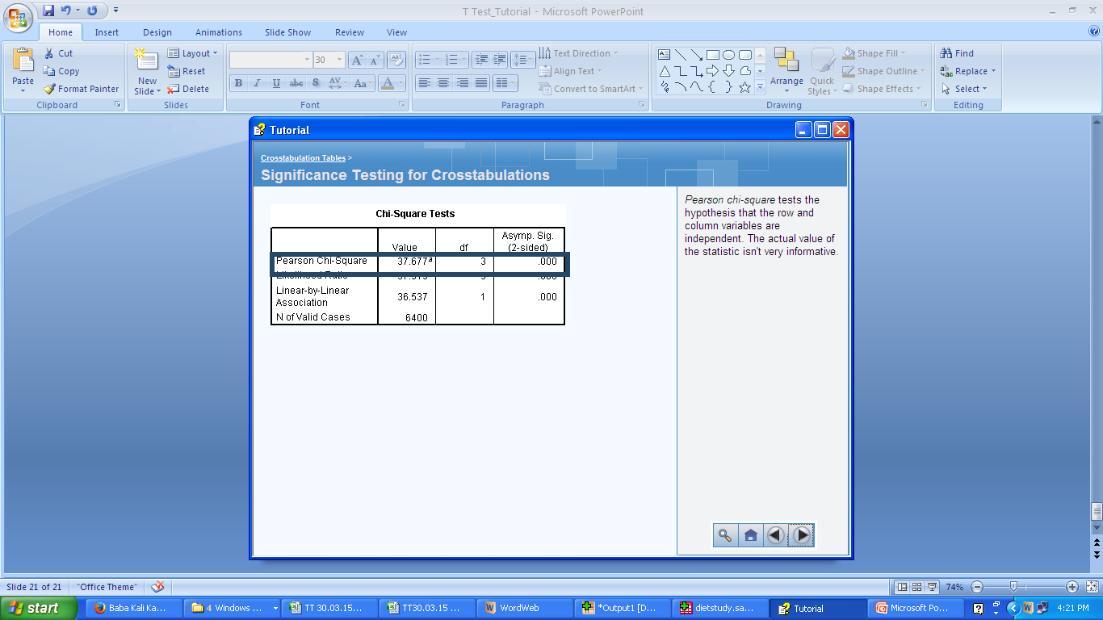

Slide 25
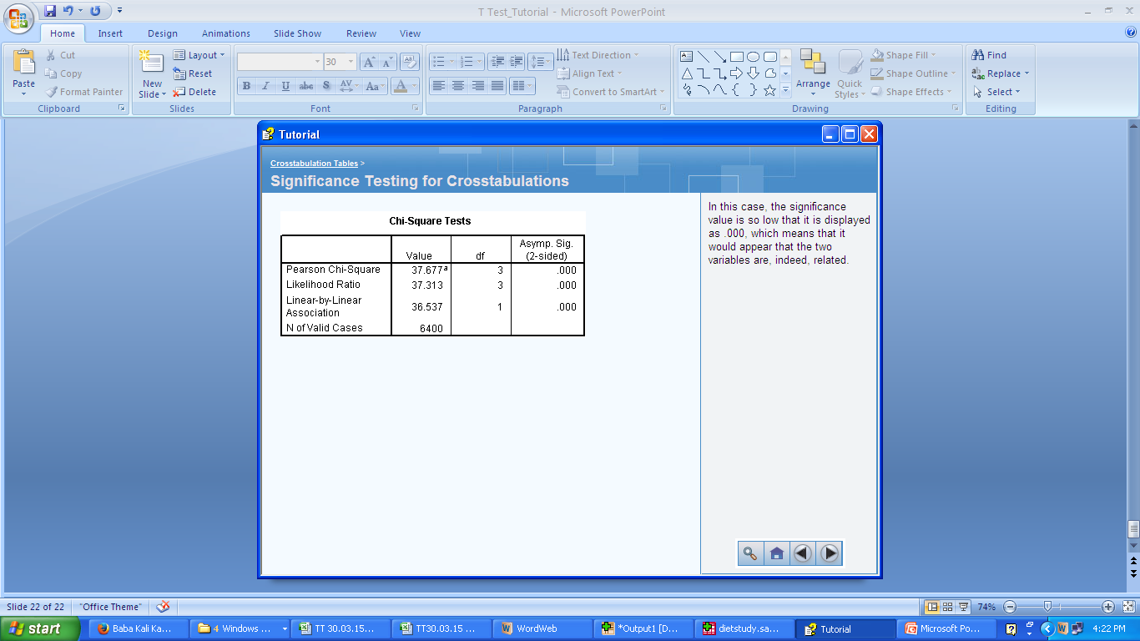

Slide 26
Adding a Layer Variable
You can add a layer variable to create a three-way table in which categories of the row and column variables are further subdivided by categories of the layer variable.
This variable is sometimes referred to as the control variable because it may reveal how the relationship between the row and column variables changes when you "control" for the effects of the third variable.

Slide 27
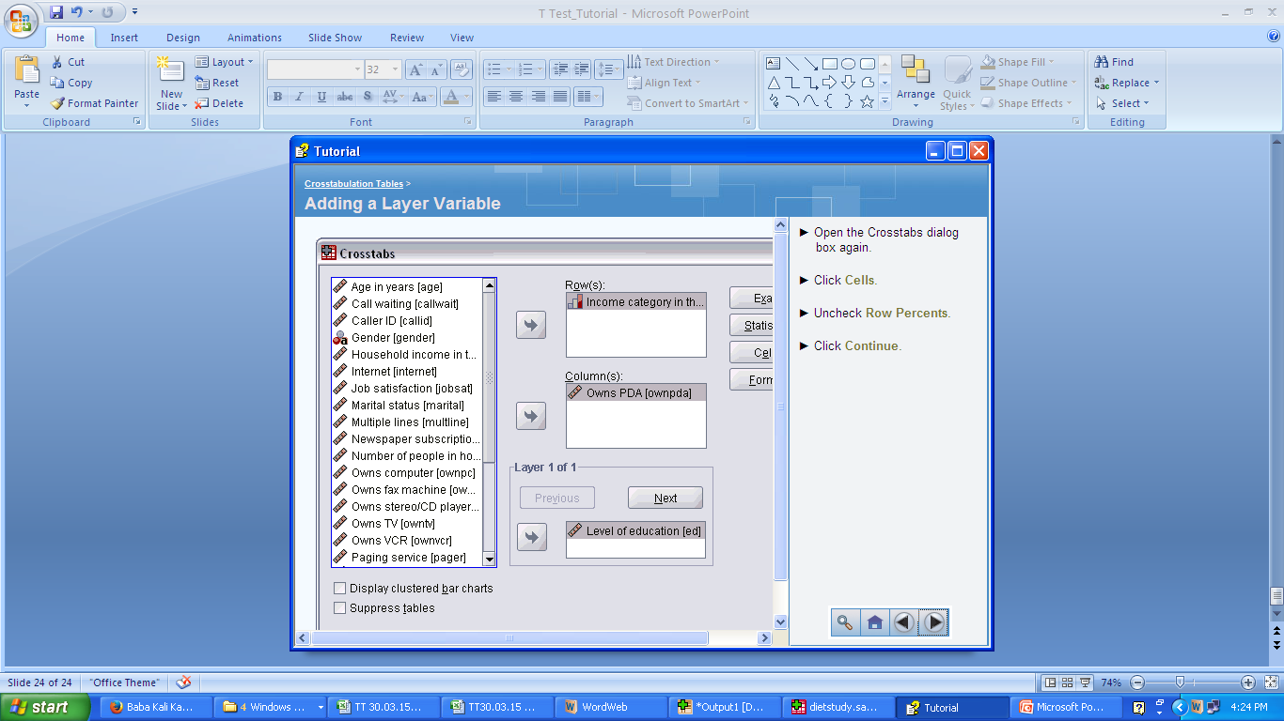

Slide 28
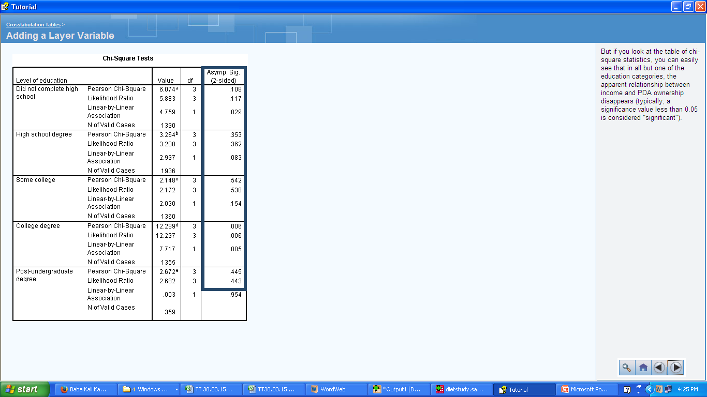

Slide 29
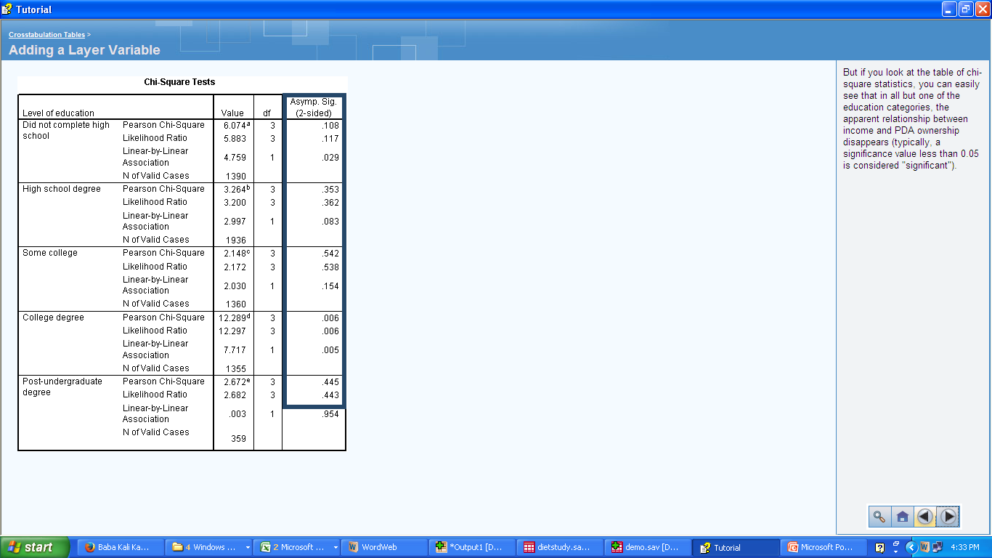

Slide 30
Conclusion
This suggests that the apparent relationship between income and PDA ownership is merely an artifact of the underlying relationship between education level and PDA ownership.
Since income tends to rise as education rises, apparent relationships between income and other variables may actually be the result of differences in education.

