Slide 1

120-Minute Leadership Workshop: Creating Alignment of Vision and Objectives
"A team without shared vision moves quickly, but rarely in the same direction—today we change that."

Slide 2
Introduction
Welcome and Session Overview
Welcome participants to this transformative session designed to create clarity, alignment, and shared ownership of the leadership team's collective vision and objectives. We'll establish ground rules centered on curiosity, openness, and equal contributions from all participants.
01
02
Co-create a shared vision
Align on strategic objectives
Develop a unified articulation of the team's collective vision
Identify 3–5 key objectives that support the vision
03
04
Define alignment behaviors
Commit to next steps
Clarify what alignment looks like in decisions and actions
Establish concrete commitments as a leadership team

Slide 3

Workshop Foundation
Draft Slides
Hybrid Tips
Title slide
Invite remote participants to unmute and greet the room
Workshop purpose
Display shared screen for equal visibility
Session objectives
Use digital whiteboard accessible to all locations
Agenda
Accessibility Considerations
Inclusion and participation expectations
Ask in advance about accessibility requirements. Provide slides in high-contrast format with readable fonts. Describe all visuals aloud.
Facilitator Script Notes
Use a warm, encouraging tone: "You all bring experience and perspectives that matter, and today is about bringing them into focus." Reinforce psychological safety throughout.
Contingency Plan: If slides fail, use flipchart or verbal outline. If platform issues occur, redirect to phone-in line or simplified shared document.

Slide 4






Topics We Will Cover
Importance of aligned vision
Defining shared vision
Strategic objectives
Alignment behaviors
Commitments and next steps
"These topics build progressively, starting with meaning-making and ending with concrete action."
Hybrid Tips: Check audio before transitions. Invite chat reactions from remote participants at each topic shift.

Slide 5
Topic 1: Why Alignment Matters
Context
19%
Misalignment slows decision-making and creates inconsistent messaging. Aligned teams amplify impact through strategic coherence—consistent decisions aligned with a shared direction.
Performance Improvement
Teams with shared goals and clarity improve performance by up to 19%
Example
A leadership team with a clear shared vision reduces duplicated effort and increases speed of execution across the organization.
Source: W. Chan Kim & Renée Mauborgne, Blue Ocean Strategy, Harvard Business Review Press, 2005

Slide 6

Interactive Activity: Identifying Misalignment
Activity Prompt
"In pairs, identify one recent moment where lack of alignment caused friction or confusion."
Online groups: use breakout rooms
Hybrid: pair in-room participants with remote participants deliberately
Reflection Prompt
"What consequences show up when our leadership group is not aligned?"

Slide 7
Worksheet A: Misalignment Signals Checklist
Communication inconsistency
Different messages to different stakeholders
Conflicting priorities
Teams working toward competing goals
Different interpretations of strategy
Varied understanding of organizational direction
Siloed decision-making
Choices made without cross-functional input
Behavioral contradictions
Actions that don't match stated values

Slide 8

Activity Implementation
Hybrid Tips
Use shared document for note capture
Ask remote participants to speak first to balance voices
Ensure equal airtime across locations
Accessibility Considerations
Offer text version of the worksheet
Pair participants to read questions aloud if needed
Allow multiple modes of contribution
Contingency Plan
If breakout rooms fail, run discussion in the main room using chat functionality to capture responses.

Slide 9

Topic 2: Co-Creating the Vision
A vision must be jointly owned to drive alignment. We'll use a simple framework to build our shared vision together.
Purpose
Future State
Why we exist as a leadership team and organization
What success looks like when we achieve our vision
Impact
The difference we want to make in our organization and beyond
Example Vision: "By 2027, we will be recognised for delivering integrated, customer-centred services that set the industry standard."

Slide 10


Interactive Activity: Vision Co-Creation
Whole Group (10 minutes)
Small Groups (8 minutes)
Share draft visions and refine into a single unified statement that represents the entire leadership team.
Individual Reflection (2 minutes)
Combine individual ideas into a draft vision statement that captures the essence of your group's thinking.
Write your response to three prompts:
What future are we striving to create?
What impact should we have?
What will our organisation look and feel like when we get there?

Slide 11

Vision Reflection
"What feels most essential to include in our shared vision?"
This reflection prompt helps participants identify the non-negotiable elements that must be present in the final vision statement. Take time to consider what truly matters most.

Slide 12

Worksheet B: Vision Builder Template
1
Purpose
Define why the organization exists and what drives us
2
Desired Future State
Describe what success looks like in concrete terms
3
Impact
Articulate the difference we want to make
4
Draft Statement
Combine elements into a compelling vision statement
5
Evidence of Success
Identify how we'll know when we've achieved the vision
Hybrid Tips: Use a central shared document for drafting. Assign a digital scribe for each breakout group.

Slide 13
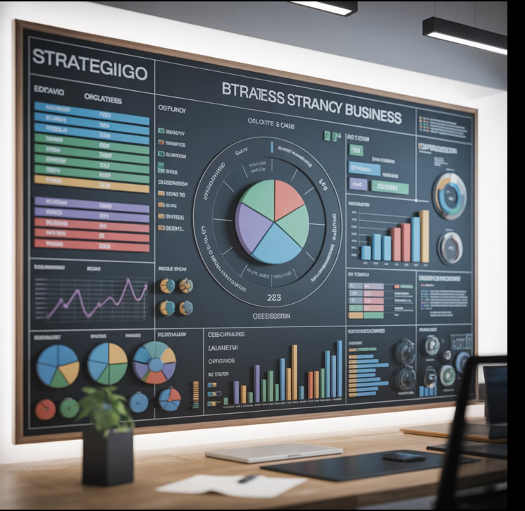
Topic 3: Turning Vision into Strategic Objectives
Context
Vision is inspirational; objectives make it actionable. We'll use the SMARTER criteria to ensure our objectives are effective and achievable.
SMARTER Criteria
Specific
Measurable
Achievable
Relevant
Time-bound
Evaluated
Reviewed

Slide 14



Example Strategic Objectives
Strengthen Cross-Functional Collaboration
Improve Customer Satisfaction Scores
Accelerate Digital Transformation
Modernize systems and processes to increase efficiency and innovation
Break down silos and create seamless teamwork across departments and functions
Enhance customer experience and increase satisfaction ratings by measurable targets
In groups, generate 3–5 strategic objectives that support the agreed vision. Each team writes each objective on a separate sticky note or digital card.
Reflection Prompt
"What objectives will have the greatest impact on realising our vision?"

Slide 15
Worksheet C: Objectives Alignment Canvas
Vision
Connect objective back to the shared vision
Objective
State the specific objective clearly
Why It Matters
Explain the importance and rationale
Key Activities
List the main actions required
Measures of Success
Define how success will be measured
Dependencies
Identify what else must happen for success
Hybrid Tips: Use an online whiteboard with shared editing. Rotate speaking responsibilities to ensure equal contribution.

Slide 16




Topic 4: Alignment Behaviors and Decision-Making
Alignment is demonstrated through consistent actions. We must define the specific behaviors that will show our commitment to the shared vision and objectives.
Consistent Messaging
Transparent Decision-Making
Communicate the same priorities and direction across all channels and stakeholders
Make decisions openly with clear rationale that connects to our objectives
Aligned Prioritization
Mutual Accountability
Ensure priorities reflect and support our shared strategic objectives
Hold ourselves and each other accountable to our commitments

Slide 17

Interactive Activity: Defining Alignment Behaviors
Activity Prompt
"What behaviors will we commit to as a leadership team to maintain alignment?"
Generate a shared list of specific, observable behaviors that demonstrate alignment in action. Focus on what we will do, not just what we believe.

Slide 18

Critical Reflection
"What behaviors will matter most in moments of pressure?"
This question helps identify the behaviors that will be most challenging to maintain but most critical for sustaining alignment when stakes are high and stress is elevated.

Slide 19
Worksheet D: Alignment Behaviors Agreement
Communication Behaviors
Decision-Making Behaviors
Prioritization Behaviors
How we will communicate to maintain alignment
How we will make decisions that reflect our shared vision
How we will prioritize work and resources
Accountability Behaviors
Conflict Resolution Behaviors
How we will hold ourselves and others accountable
How we will address misalignment when it occurs
Hybrid Tips: Use shared chat or digital note-catcher. Nominate one in-room and one remote observer to ensure balanced participation.

Slide 20

Topic 5: Commitments and Next Steps
Summary Action Planning
Each participant chooses one personal commitment and one team commitment that will strengthen alignment and move the vision forward.
Personal Commitment
Team Commitment
What will I do differently to support alignment?
What will we do together to maintain alignment?

Slide 21

Action Reflection
"What will I do in the next two weeks to strengthen alignment?"
This reflection prompt encourages immediate, concrete action. The two-week timeframe creates urgency while remaining achievable.

Slide 22
Worksheet E: Commitment Card
My Personal Commitment
Our Team Commitment
I commit to:
We commit to:
By when:
By when:
How I'll measure success:
How we'll measure success:
Hybrid Tips: Ask remote participants to share commitments verbally or in chat to ensure visibility and accountability.

Slide 23
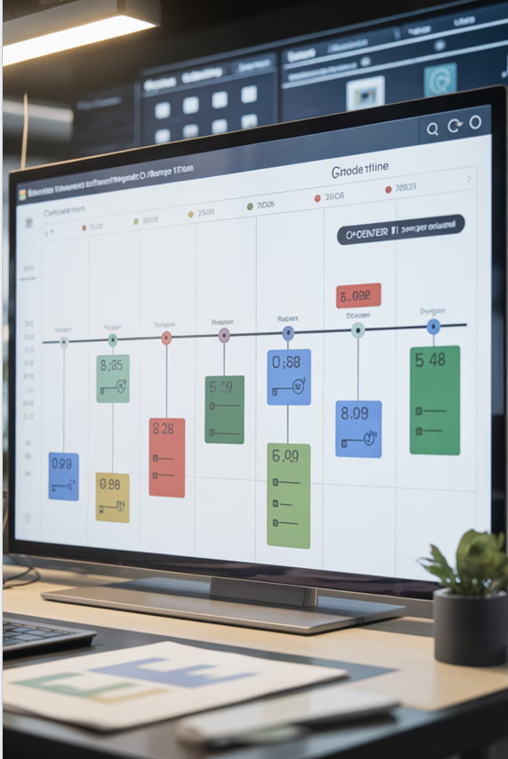
Implementation Support
1
Week 1
Begin personal commitments
2
Week 2
Check progress on actions
3
Week 4
Team commitment review
4
30 Days
Alignment review meeting
Establish clear milestones and checkpoints to maintain momentum and accountability after the workshop concludes.

Slide 24
Closing
Summary
Today we've revisited the shared vision, strategic objectives, and behavioral commitments that will guide our leadership team forward. This work represents a powerful foundation for aligned action.
What happens next?
How will we measure progress?
How often will we revisit alignment?
Follow-up actions and accountability structures
Metrics and milestones for tracking alignment
Regular review cadence and adjustment process
Further Resources
Peter M. Senge, The Fifth Discipline (Doubleday, 1990)
Harvard Business Review: "How Leaders Create Alignment"

Slide 25


Your Call to Action
Take one aligned action this week
"You've created something powerful today. Alignment isn't a one-off event; it is a discipline we strengthen together."
Bring the vision to life through your choices, conversations, and commitments in the days ahead.
Hybrid Tips: Conduct a shared digital poll to close. Ensure remote participants join the final round.

Slide 26

Time Adaptations
Condensed Version (60 minutes)
01
Introduction
5 minutes
02
Why Alignment Matters
5 minutes
03
Co-Creating the Vision
20 minutes
04
Strategic Objectives
20 minutes
05
Commitments & Close
10 minutes
Extended Version (180 minutes)
Add the following elements:
Deeper discussion rounds
More facilitated conflict resolution
Scenario-based decision-making exercises
Expanded objective-setting with detailed planning

Slide 27
Facilitator Notes
Maintain steady pace
Allow pauses for thinking but keep momentum
Address dominant voices
Invite quieter participants first to balance contributions
Encourage curiosity
Avoid judgement and create psychological safety
Transition smoothly
Summarize each activity before moving on
Use inclusive language
Apply equal airtime techniques throughout

Slide 28
Optional Pre-Work
1
2
3
Reflection Question
Video Introduction
Success Example
"What future do you want this organisation to create?" Send this prompt for individual reflection before the session.
Send a 2-minute video explaining the purpose of alignment and what to expect from the workshop.
Ask participants to bring one example of alignment working well in their experience.
Pre-work helps participants arrive prepared and engaged, maximizing the value of workshop time together.

Slide 29

Post-Workshop Follow-Up
1
Within 48 Hours
Send the refined vision and objectives summary to all participants
2
Within 1 Week
Schedule a 30-day alignment review meeting
3
Within 2 Weeks
Create accountability partners for commitments
4
Ongoing
Provide optional reading resources and continued support

Slide 30
Facilitator Checklists
Before
During
After
Test tech and hybrid links
Monitor pacing
Collect feedback
Prepare worksheets (digital and print)
Encourage balanced contributions
Share summary document
Accessibility accommodations confirmed
Reiterate ground rules
Follow up on commitments
Flipcharts and markers ready
Check inclusivity
Reflect on what to improve
Backup internet source
Capture outputs

Slide 31
Example Evaluation Forms
Likert Scale Items (1–5)
80%
85%
90%
Vision Clarity
Participation
Alignment
"The workshop helped us clarify our shared vision"
"The activities encouraged participation"
"I feel more aligned with the leadership team"

Slide 32


Open-Ended Evaluation Questions
What was most useful?
What would you change?
What follow-up support would help?
Identify the highest-value elements of the workshop
Gather suggestions for improvement
Understand ongoing needs for maintaining alignment

Slide 33
Evaluation Format Options
Printable A4
Digital Form
Hybrid QR Code
Traditional paper format for in-person completion
Microsoft Forms or Google Forms for easy data collection
Scannable code for seamless access across locations

Slide 34




Strengthen Your Leadership Team
Strengthen your leadership team's clarity, focus, and collective direction with a highly interactive 120-minute workshop designed to create true alignment of vision and objectives.
Ideal for teams navigating change, growth, or new strategic priorities, this workshop transforms abstract vision into concrete action through collaborative exercises and meaningful dialogue.
Create Clarity
Build Focus
Develop a shared vision everyone understands
Align on strategic objectives that matter
Drive Collective Action
Commit to behaviors that sustain alignment

