Slide 1

B0LD
DIGITAL POSITIONING PORTFOLIO
2025 – 2026

Slide 2


WELCOME
Bloom boldly where
you are planted.

Slide 3
CORE AGENCY OFFER
Full-service “white-glove” digital retainers for premium brands ready to dominate their niche.
We don’t just run campaigns — we build a strategic ecosystem that elevates your brand, attracts high-value leads, and establishes authority across all digital channels.
DFY – Done For You

Slide 4
WHAT’S INCLUDED
Development of a cohesive visual and verbal identity across all channels.
Design of key materials: websites, newsletters, presentations, and social visuals.
Premium brand positioning to build authority and trust.
Premium outreach to top-tier media, niche publications, and aligned influencers.
Strategic storytelling to amplify brand authority and credibility.
Coordination of interviews, articles, and collaborations.
Industry-specific keyword strategies aligned to your audience and market.
Creation of high-value content: blogs, thought-leadership articles, pillar pages,
newsletters.
Continuous optimization to increase organic visibility and decision-maker reach.
AI strategy to reach audience and referential within search engines of AI.
BRANDING & DESIGN
PR & MEDIA PLACEMENT
SEO & GEO CONTENT GROWTH

Slide 5
WHAT’S INCLUDED
High-performing campaigns across Google, LinkedIn, Meta, and more.
Story-driven lead generation and strategic remarketing.
Cohesive integration of design, copy, and brand positioning.
Full audit and optimization of your digital presence.
Multichannel approach: SEO, PR, Paid Ads, Social, Email, Newsletter.
Continuous reporting and optimization to maximize ROI, reach, and authority
$2,000–$20,000 USD for monthly retainers depending on scope, channels, and scale.
PAID ADVERTISING & POSITIONING NARRATIVE
INTEGRATED DIGITAL VISIBILITY STRATEGY
PRICING

Slide 6
CASE STUDY
B2B HEALTH BRAND (MEXICO)
Generate qualified B2B healthcare leads, strengthen brand identity, and grow visibility in specialized media across Mexico.
Lead Generation + Brand Awareness + Branding Package
EXPECTED RESULTS
LEAD GROWTH
50–100 qualified B2B leads monthly.
RECOGNITION
Brand recognition in Mexico’s top healthcare publications.
ENGAGEMENT
High engagement across LinkedIn and multichannel newsletters.
OBJECTIVES
ORGANIC GROWTH
Strong organic growth through strategic keyword positioning.
CONVERSION
Remarketing campaigns increasing conversion and nurturing high-value leads.
OPTIMIZATION
Ongoing optimization ensuring continuous visibility and conversion.
PROPOSED DFY PACKAGE
$5,500 USD/month retainer

Slide 7
CASE STUDY
SUCULENTA: A RECIPE FOR SUCCESS (MX)
Suculenta, founded by Ale Morales, was expanding from a pastry shop into a full restaurant concept. As the brand grew, it needed stronger digital visibility and a strategy to match its ambitions.
Low website traffic and limited search visibility.
Weak local SEO and missed opportunities in content optimization.
Expansion goals required stronger branding and sales momentum.
Full SEO audit and on-page optimization.
Strategic keyword research and user experience redesign.
Social media calendar using a 50:30:20 content strategy.
Creation of a newsletter to re-engage loyal customers.
Visual content strategy to enhance engagement and authenticity.
DURATION 8 MONTHS
BACKGROUND
CHALLENGES
SOLUTIONS

Slide 8
CASE STUDY
SUCULENTA: A RECIPE FOR SUCCESS (MX)
First-page SEO rankings for key terms.
+15,000 new followers and major growth in engagement.
Consistent increase in sales, leading to a third restaurant and expansion into the U.S. market.
Our collaboration with Suculenta proved how authentic storytelling and consistent strategy can translate into tangible growth.
By embedding brand values and cultural identity into every piece of content, Suculenta became not only a beloved local brand — but a regional reference point in culinary innovation.
RESULTS
THE STORY

Slide 9
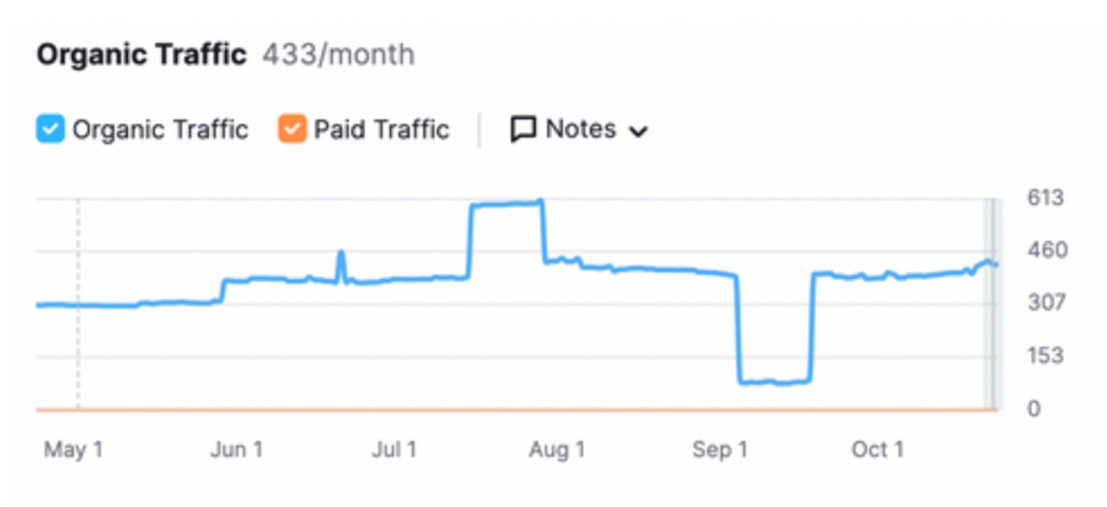
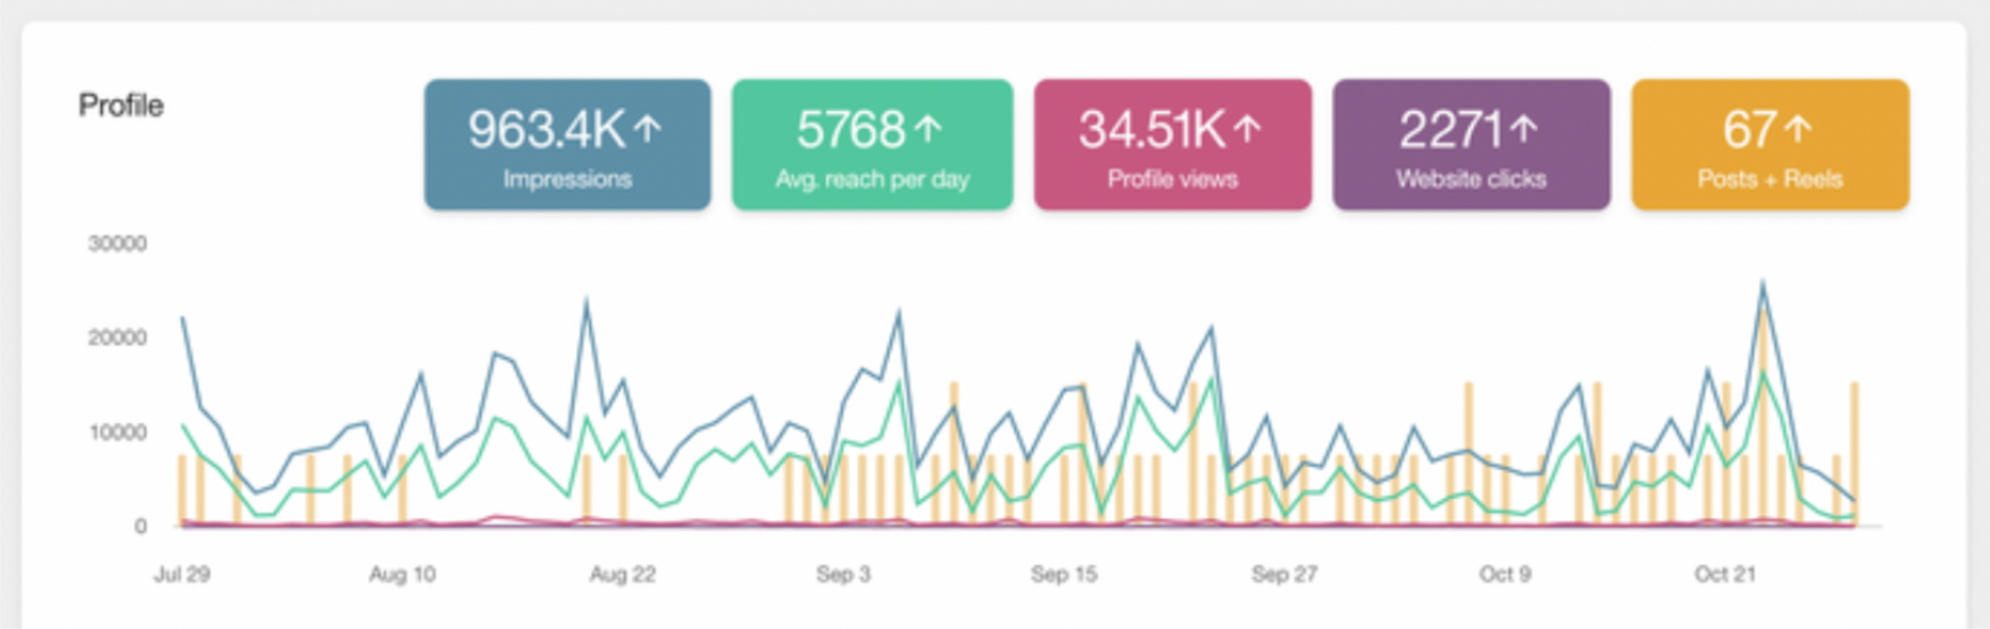
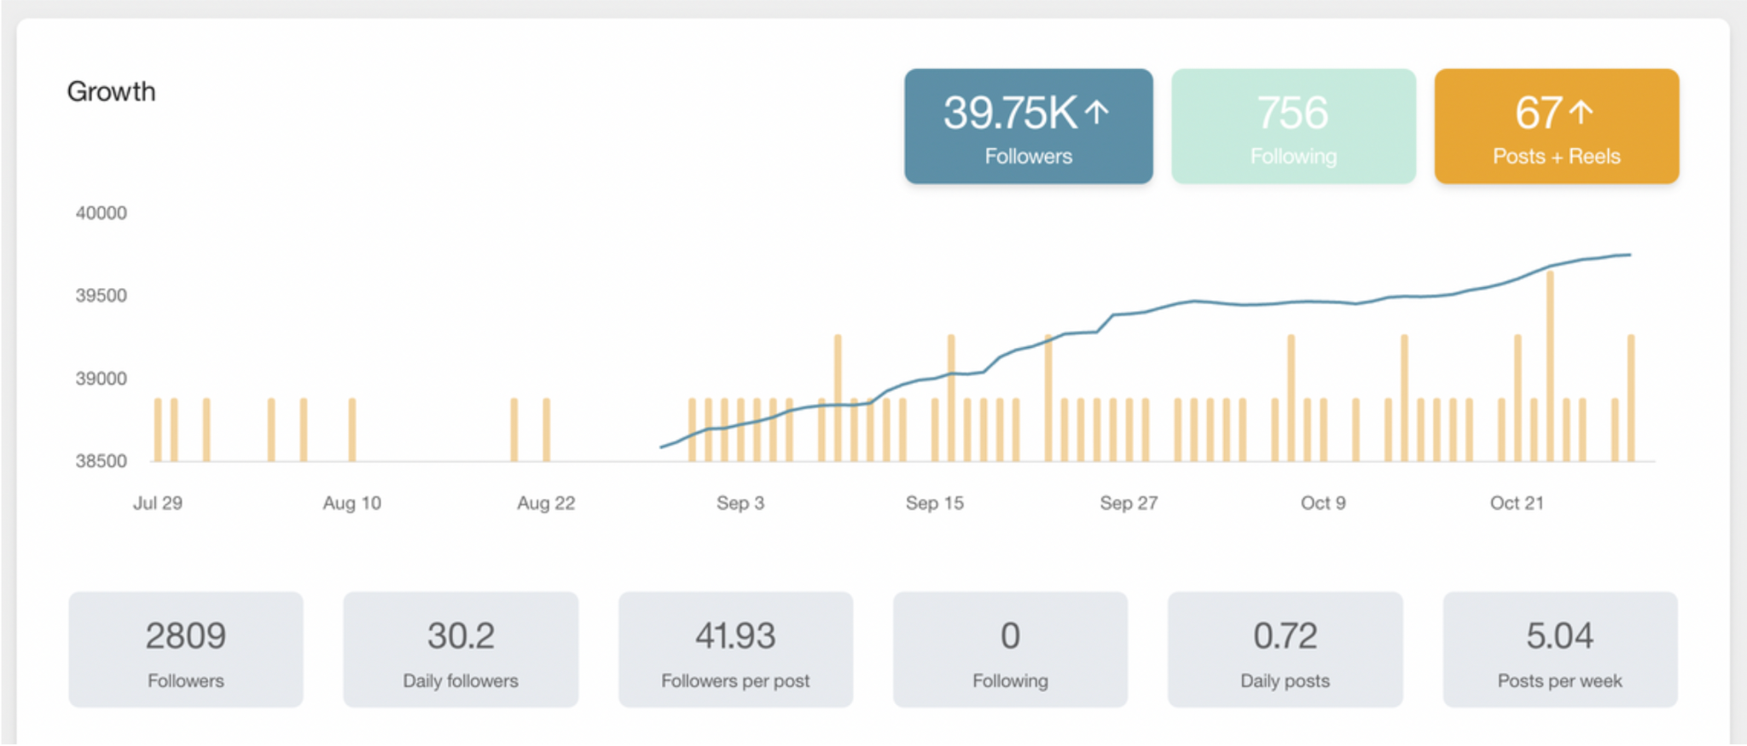
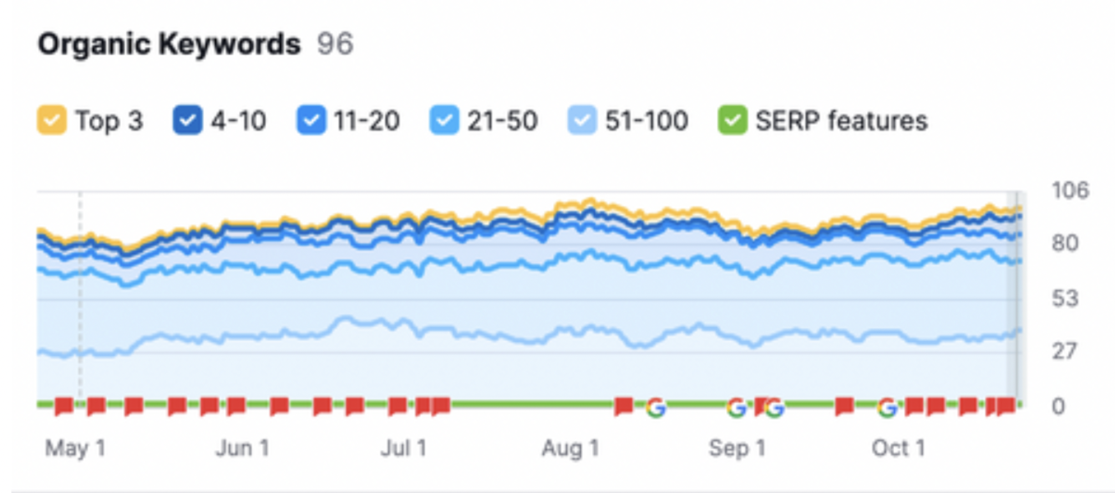
CASE STUDY
SUCULENTA: A RECIPE FOR SUCCESS (MX)
RESULTS

Slide 10
CASE STUDY
INHEDGE: TRANSFORMING DIGITAL PRESENCE
InHedge, a financial risk management firm, faced a gap between its market expertise and online image. With low visibility and minimal traffic, the brand sought a full repositioning to reflect its institutional strength.
Only 80 annual website visitors.
Minimal online credibility and low engagement.
Weak conversion from content to clients.
Full SEO and content strategy tailored for the financial sector.
Multi-country keyword positioning across South America.
Backlink campaigns to build site authority.
LinkedIn and newsletter community strategy, achieving a 77% open rate and 27.5% CTR.
DURATION 12 MONTHS
BACKGROUND
CHALLENGES
SOLUTIONS

Slide 11
CASE STUDY
INHEDGE: TRANSFORMING DIGITAL PRESENCE
Website traffic increased from 80 to 3,500+ visitors in 7 months.
Repositioned from “startup” to institutional brand.
Qualified conversations with high-value clients in multiple markets.
Working with InHedge pushed our creative and analytical limits. It demanded precision, depth, and strategic excellence — transforming both the client’s visibility and our approach to financial-sector digital growth.
RESULTS
THE STORY

Slide 12
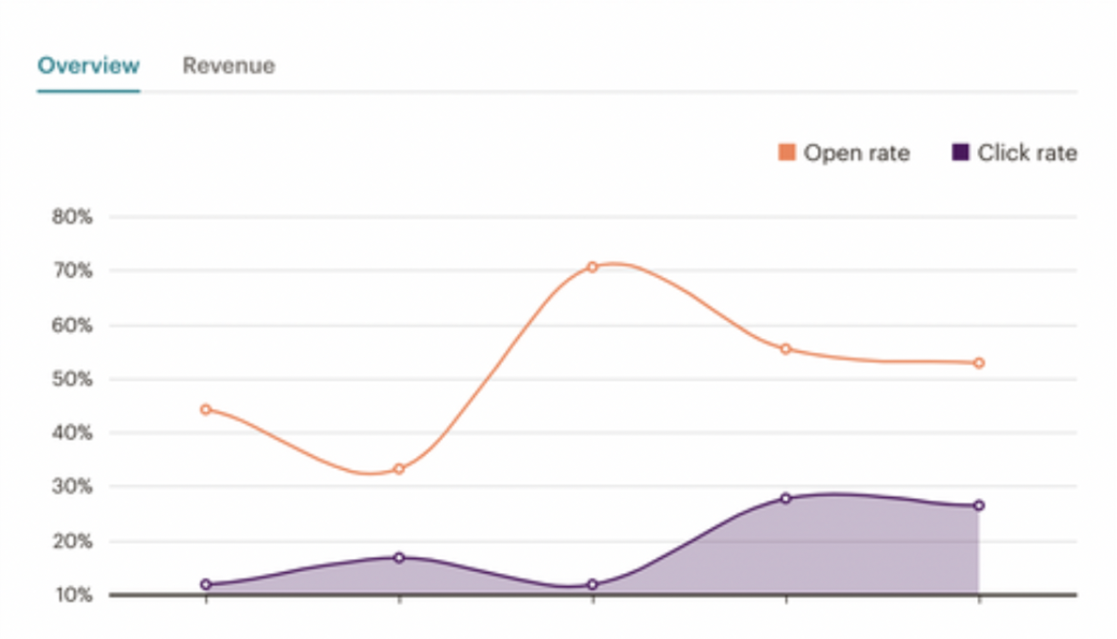
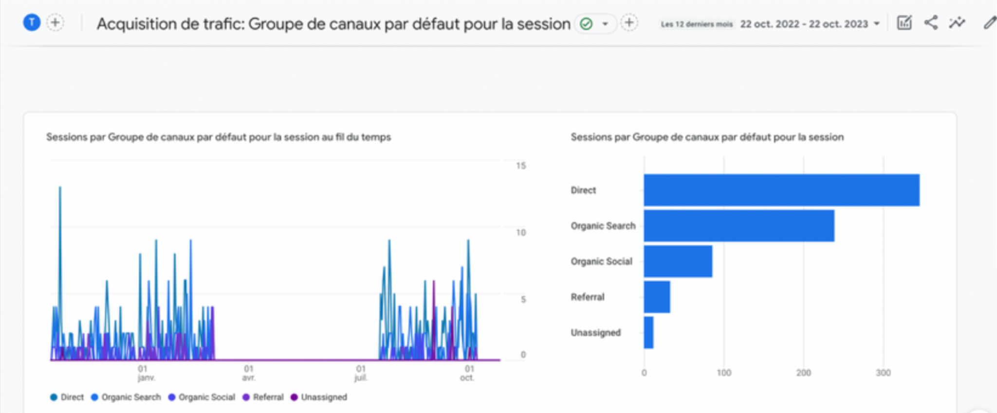
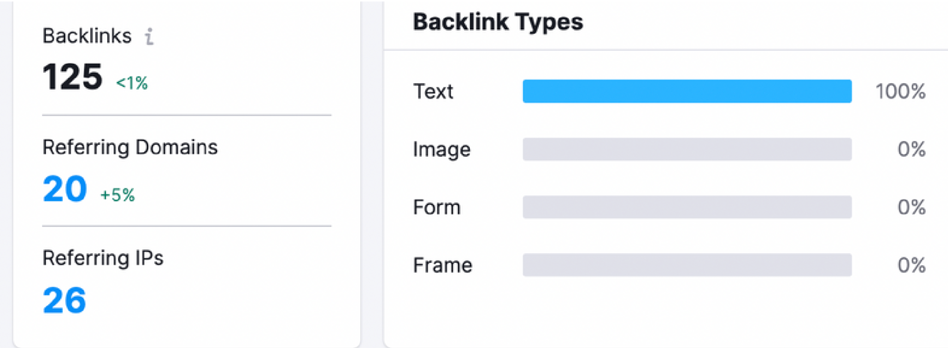
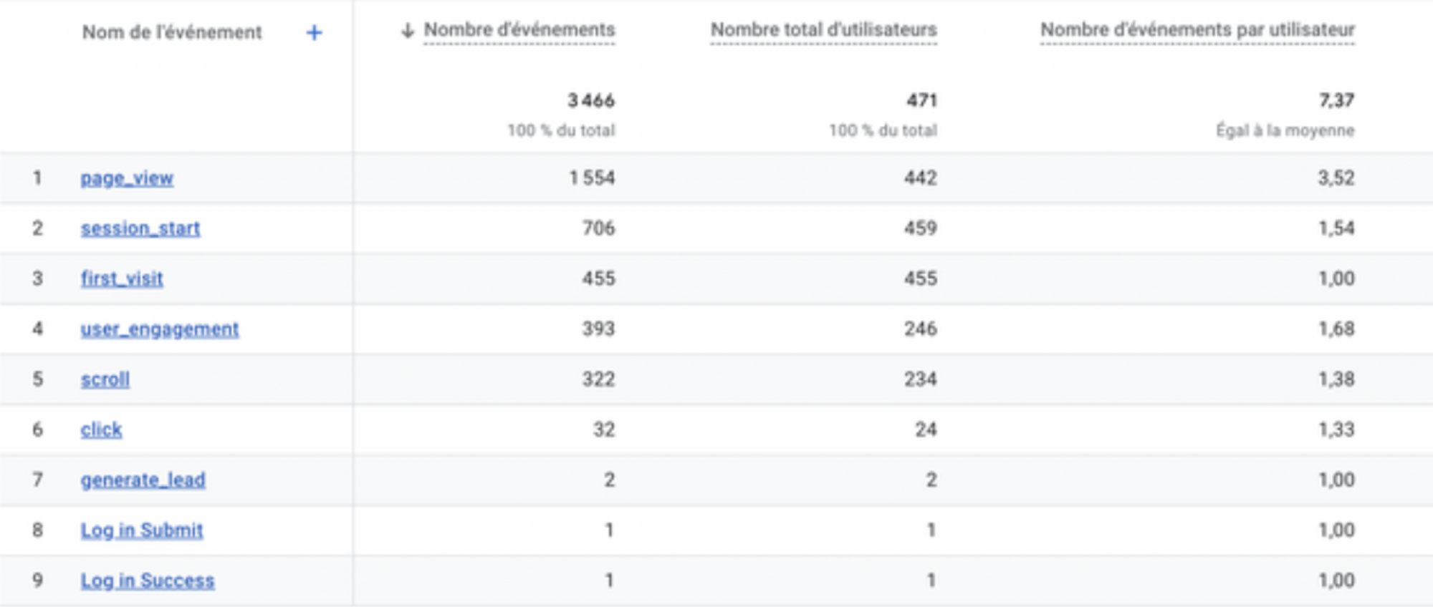
CASE STUDY
INHEDGE: TRANSFORMING DIGITAL PRESENCE
RESULTS

Slide 13
CASE STUDY
B0LD: TURNING WORDS INTO RESULTS
Originally a personal writing project, B0LD evolved into a digital platform showcasing how words, SEO, and strategy can fuel measurable growth.
Transition from personal blog to business model.
Realigning content for SEO and audience intent.
Keyword-driven optimization and technical tracking.
Newsletter creation and consistent long-form publishing.
Integration of AI tools for research and content development.
DURATION ONGOING
BACKGROUND
CHALLENGES
SOLUTIONS

Slide 14
CASE STUDY
B0LD: TURNING WORDS INTO RESULTS
+37.5K monthly visitors.
Over 200 indexed articles, 3 on Google’s first page.
Active and loyal community through email and social.
BOLD stands as living proof of how creativity and technology meet. Every article blends voice, vision, and precision — shaping not just traffic, but influence. Through platforms like Pinterest and LinkedIn, the project continues to grow as a space where inspiration, strategy, and authority intersect.
RESULTS
THE STORY

Slide 15
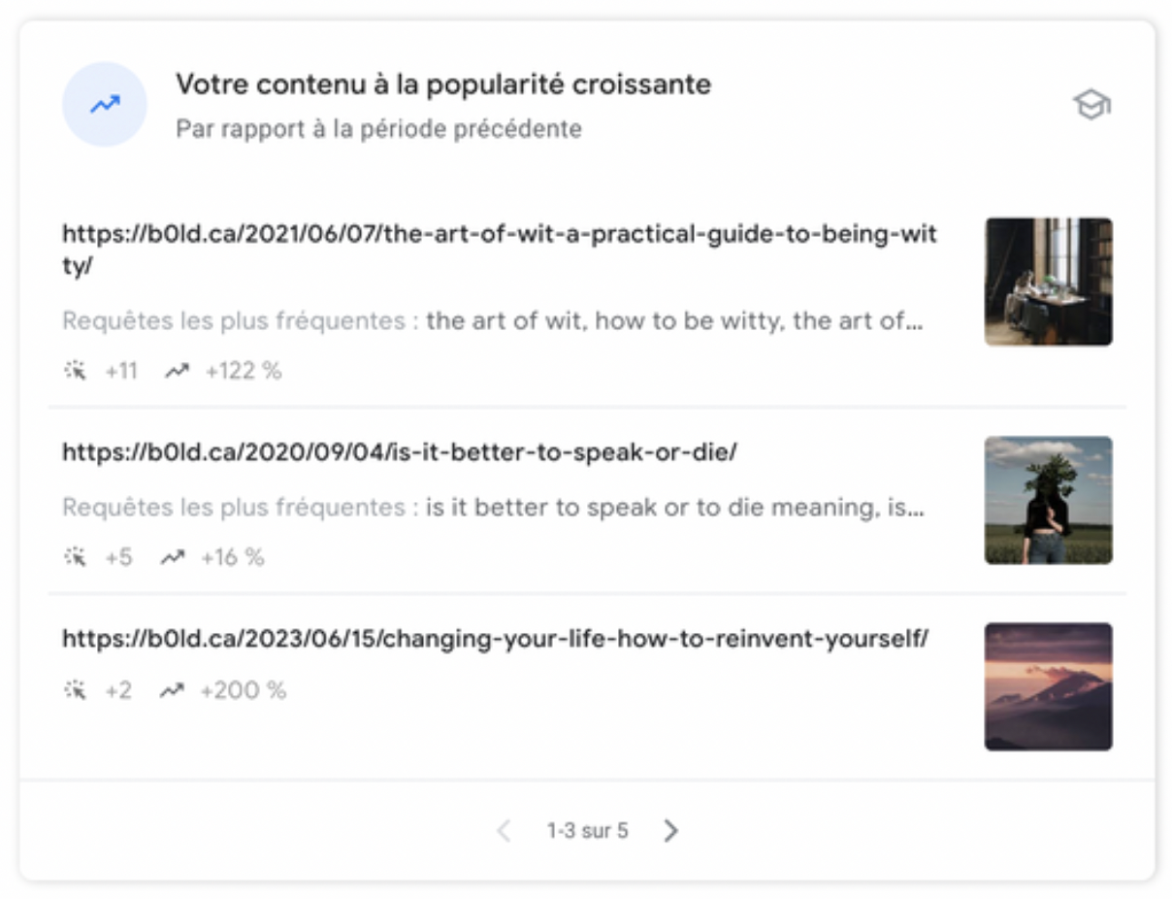
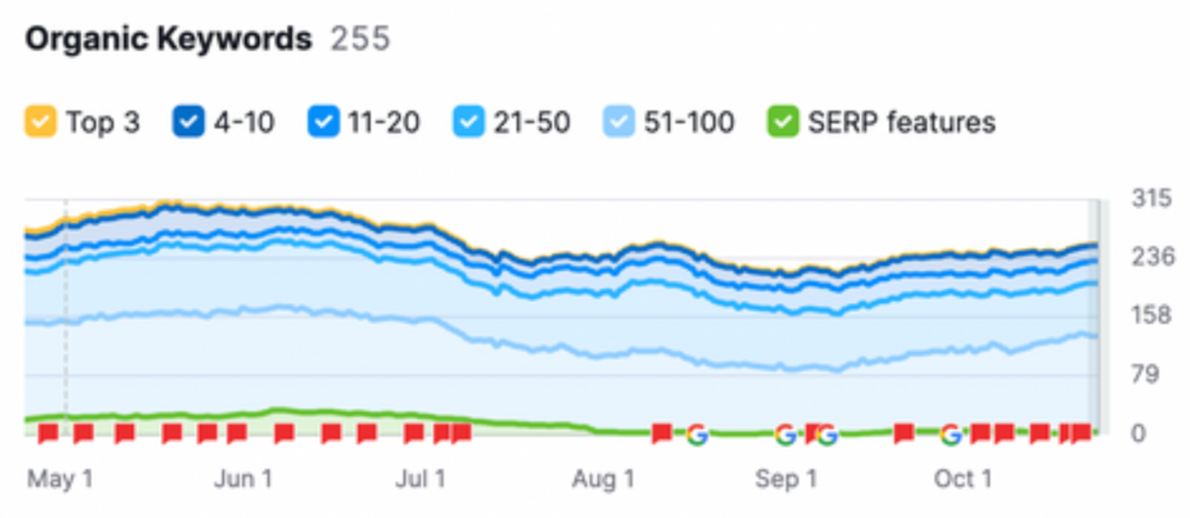
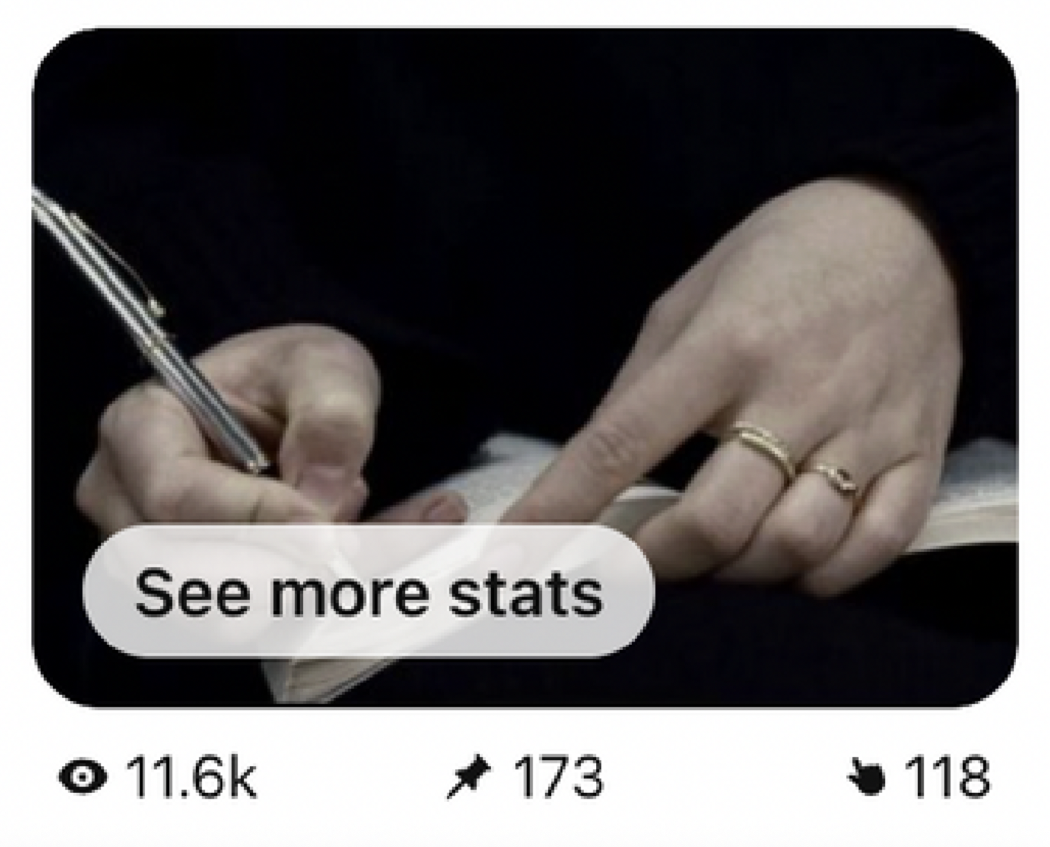
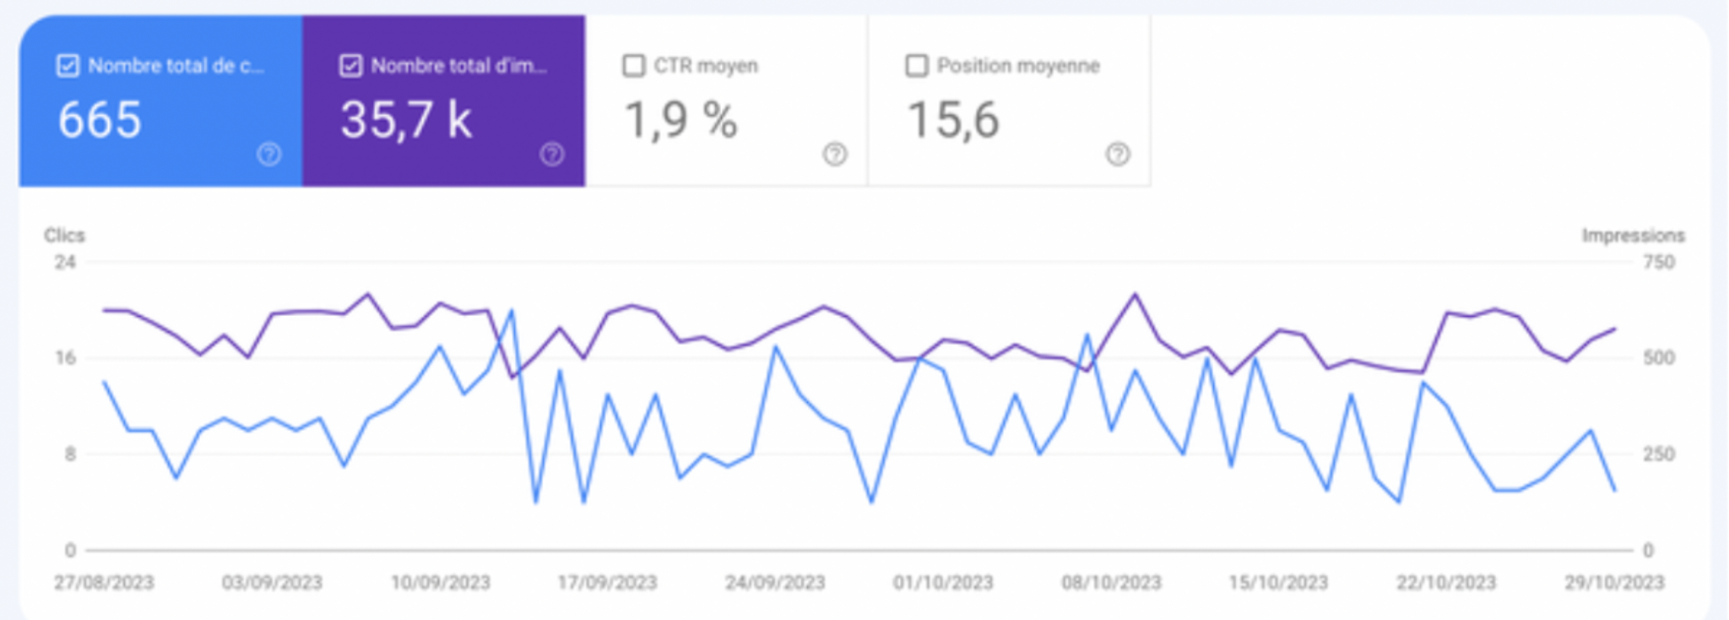
CASE STUDY
B0LD: TURNING WORDS INTO RESULTS
RESULTS

Slide 16
For inquiries or to design a custom partnership aligned with your goals, contact us anytime. Our team will guide you through every step — from strategy to measurable digital success.
– The B0LD Team

