Slide 1
Simulation for Balancing Mixed-Model Assembly Lines
Brian Harrington
MTN-SIM, LLC
www.MTN-SIM.com

Slide 2
About the Presenter
Brian Harrington is a Six Sigma Black Belt with 20 years operations research and simulation experience at Ford Motor Company. He designs and implements manufacturing process improvements which incorporate many conflicting objectives such as robust, flexible, and lean systems.
Now on his 4th year of running his own discrete event simulation specialists firm MTN-SIM LLC, he continues to deliver high quality complex models for a wide range of manufacturing, healthcare, and business process improvements. He also acts as a technical ambassador for SIMUL8 Corporation assisting in teaching, mentoring, marketing, and consulting projects. Brian holds a BS in Engineering Arts from Michigan State University, and a BS in Computer Science from University of Michigan.

Slide 3
MTN-SIM, LLC Whitefish, Montana

Slide 4
Topics
Mixed Model Assembly
Why Mixed Model?
Early Planning and Decisions
Applying Simulation Analysis
Designing in a Manufacturing Context
Discrete Event Simulation
Starting with Tasks & Takt Times
Flexibility in Machines
Flexibility in Routing
Scheduling Schemes
Conflicting Objectives
Simulation Reduces Costs & Risks

Slide 5
Mixed Model Assembly
“By 2017, Ford will increase its global flexible manufacturing to produce on average four different models at each plant around the world to allow for greater adaptability based on varying customer demand.” 1
1 http://corporate.ford.com/innovation/100-years-moving-assembly-line.html

Slide 6
Enterprise Success Equates to…
Shorter Development Time
Beating your Competition to Market
Built to Customer Order
Flexible to Customer Demands
Family of Products
Delivering Quality
Mixed Model Assembly!

Slide 7
Why Simulation?
Competition drives the following:
Leaner production environment
Shorter product development cycles
Narrower profit margins
Flexible Manufacturing (1 Design, 1 Process, Multiple Models)

Slide 8
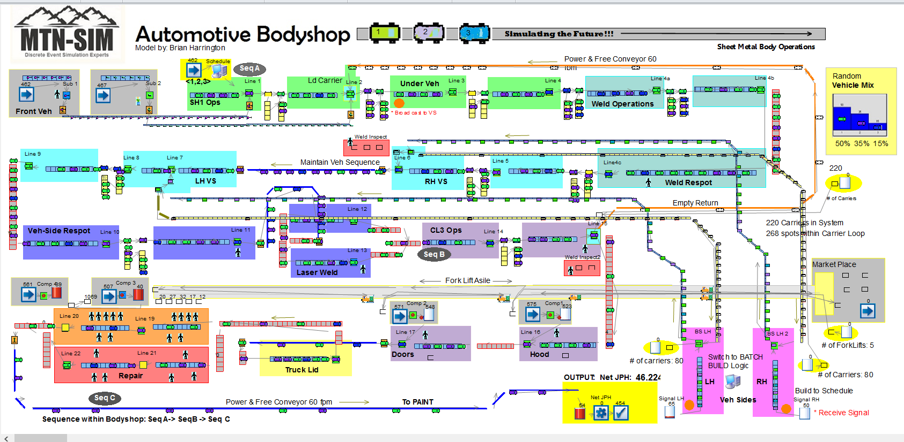
Automotive Simulation

Slide 9
Where to Build?
How do we decide where to build a particular Product?
i.e.) 20 Vehicle Types, 6 Assembly Plants
Similar product type
Built on the same platform
Built on the same Pallet (dimensional control points)
Similar build times
Within 30% of existing product builds
Existing technology works
Plants capability and capacity
Build schedule
Market demand

Slide 10
Engineering prior to DE-Simulation
Designing Products to a Factory Fit
Product Design
Design in a manufacturing context
Weld spot pattern layouts
Dimension control hard points
Bill of Process
Where in the process is this part design referenced?
Do the existing tools accommodate the new design?
Does it require Change Over or Tool Set-up?
i.e.) Siemens Teamcenter, Robcad

Slide 11
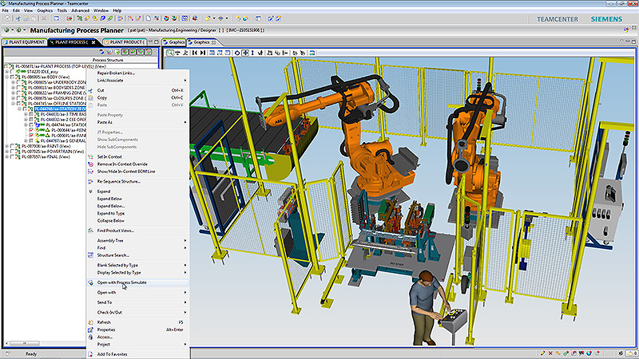
Design in Mfg Context
Referenced slide from: http://www.plm.automation.siemens.com/

Slide 12
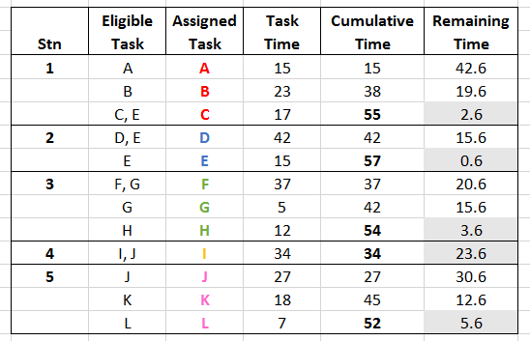
Starting with Takt Times
Takt time = Available working Time/ Customer Demand
i.e.) Producing 500 units per day within an 8 hour shift.
Takt Time = 480 minutes / 500 units = 0.96 minutes = 57.6 seconds
Line Balancing

Slide 13
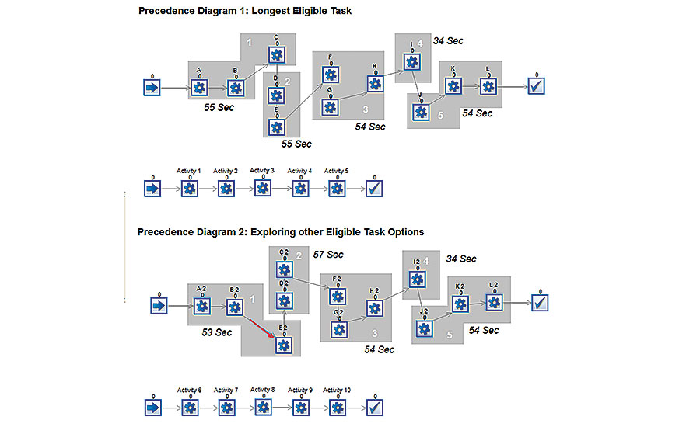
Simulating at the Cell Level

Slide 14
Adding Shared Operators
How many operators are required?
What impact does it have on throughput?
Can we meet our target of 500 units per shift with 3 operators?
What operator is causing losses?

Slide 15
Set it in Motion

Slide 16
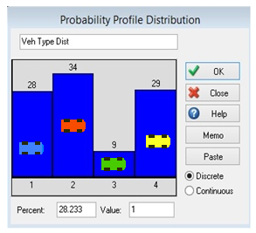
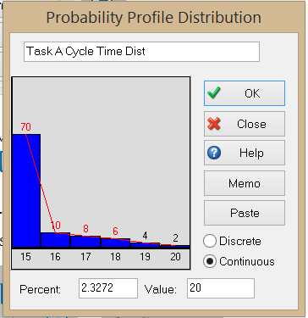
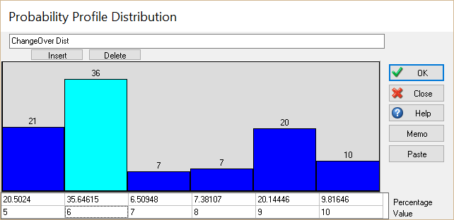
Adding Additional Stochastic Behavior
Over Cycles
Downtime (MTBF & MTTR)
Changeovers & Tool Set-ups
Product Mix
2
4
1
3

Slide 17
Flexibility in Manufacturing
Allows the manufacturing system to react to predicted or unpredicted events
Machine Flexibility
Routing Flexibility
Example:
Compare machine vs routing flexibility (Next 2 slides)

Slide 18
New Technology- Flexible Tools

Slide 19
Routing Flexibility

Slide 20
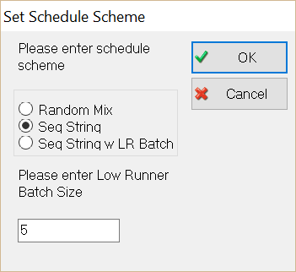
Scheduling Schemes

Slide 21
Product Mix
Product Mix %: 41.5, 22.0, 14.5, 13.5, 8.5
Schemes:
Random
String or Blend
String w Low Runner Batch
Each Vehicle Type has a Unique Capability

Slide 22
Schedule Impacts Throughput
Schedule Scheme | Throughput (JPH)
Random | 38.2
String or Blend | 38.4
String w Low Runner Batch (5) | 39.9
String w Low Runner Batch (x)
5 | 39.9
10 | 40.3
15 | 40.7
20 | 40.7
30 | 40.9
40 | 40.9 (Distorts Mix %)

Slide 23
Simulation applied throughout Kick-Off to Implementation
Setting-up Stations & Takt Times
Introducing New Technology & Flexible Tools
Optimizing Schedule & Minimizing Tool Set-ups
Running complete facility prior to Implementation

Slide 24
Conflicting Objectives
Disadvantages:
Increased Complexity
Logic & Material Flow
Extensive Early Planning
Initial Higher Costs
Additional Operator Skills
Multiple Shifts
Benefits:
Reduced Inventories
Shorter Lead Times
Improved Efficiency
Increased Productivity
Improved Resource Utilization
Reduce Time
Improve Quality
Cut Costs
Sounds good to upper management, but how is this even possible?

Slide 25
Simulation- Reduces the Risk
Most successful companies use Discrete Event Simulation to address such critical factors as:
Cost, Quality, and Time
When it comes to implementing Mixed Model Assembly Lines

Slide 26
Questions?
Please send additional Comments or Questions to:
Brian.H @MTN-SIM.com

