Slide 1
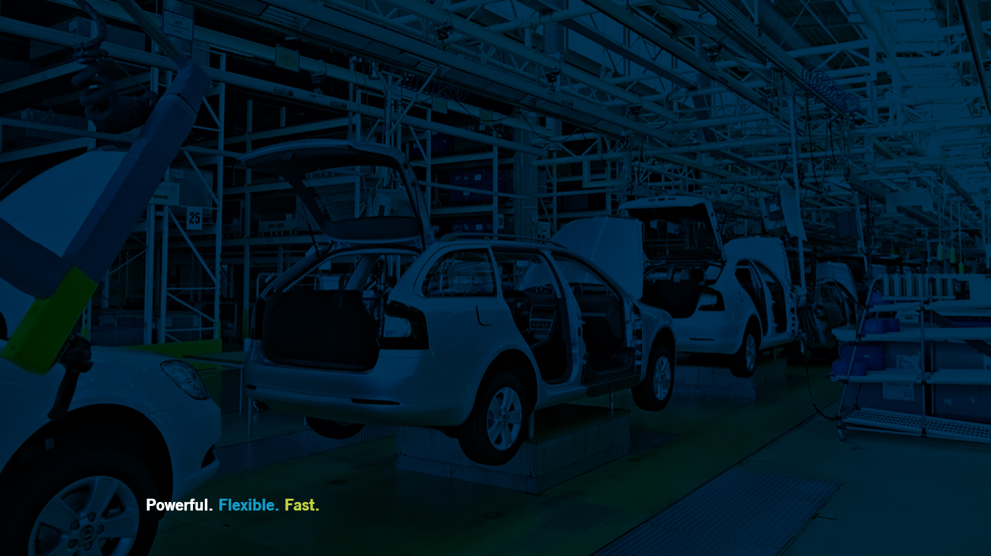
Automotive Simulation Guide: Optimizing the manufacturing life cycle
Brian Harrington
MTN-SIM, LLC
www.MTN-SIM.com

Slide 2
Presenter:
Brian Harrington is a Six Sigma Black Belt with 20 years operations research and simulation experience at Ford Motor Company. He designs and implements manufacturing process improvements which incorporate many conflicting objectives such as robust, flexible, and lean systems.
Now on his 4th year of running his own discrete event simulation specialists firm MTN-SIM LLC, he continues to deliver high quality complex models for a wide range of manufacturing, healthcare, and business process improvements. He also acts as a technical ambassador for SIMUL8 Corporation assisting in teaching, mentoring, marketing, and consulting projects. Brian holds a BS in Engineering Arts from Michigan State University, and a BS in Computer Science from University of Michigan.
Brian Harrington
Job Role Here
MTN-SIM, LLC | MTN-SIM.com | Brian.H@MTN-SIM.com
MTN-SIM, LLC | MTN-SIM.com | Brian.H@MTN-SIM.com

Slide 3
MTN-SIM, LLC Whitefish, Montana

Slide 4
Where do we get the biggest bang for the buck using simulation?
Design
Phase
Operational Changes
Continuous Improvement

Slide 5
Automotive Simulation Guide Designing efficient assembly processes
Brian Harrington
MTN-SIM, LLC
www.MTN-SIM.com

Slide 6
Greenfield or Brownfield Site
Whether it’s a new site or revamping an existing facility… a new design and new manufacturing facility is in the works!
The simulation study will become the “prototype” of the new facility.
The goal: Achieve targets and reduce the number of design changes prior to implementation.

Slide 7
Design Phase
Compare simulated design concepts, weighing in on ability to meet program targets and stay within allocated budget.
Typical design objectives:
Proving and achieving throughput
Determining bottlenecks & constraints
Setting optimal line rates
Minimizing downtime effects
Designing optimal material handling systems
Optimal placement of buffers and broadcast points in the system

Slide 8
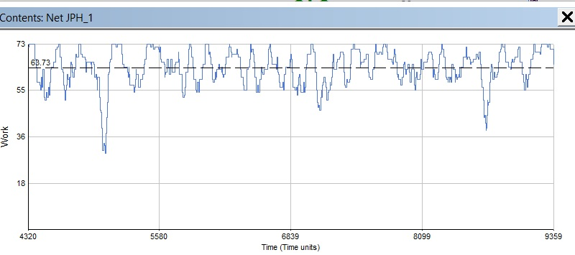
Proving and Achieving Throughput
Throughput is the key metric when it comes to designing an Automotive Facility.
Often referred to as “Vehicles per Hour” or “Jobs per Hour”
Runtime graphs shows an Average JPH of 68.7
Maximum of 73.0
Minimum below 36

Slide 9
Determining Bottlenecks & Constraints
The constraint is the limiting factor; overall JPH will be only as good as the constraint can produce.
How do we protect the constraint?
How do we prevent bottlenecks from occurring?
Can we design where the constraint should be?

Slide 10
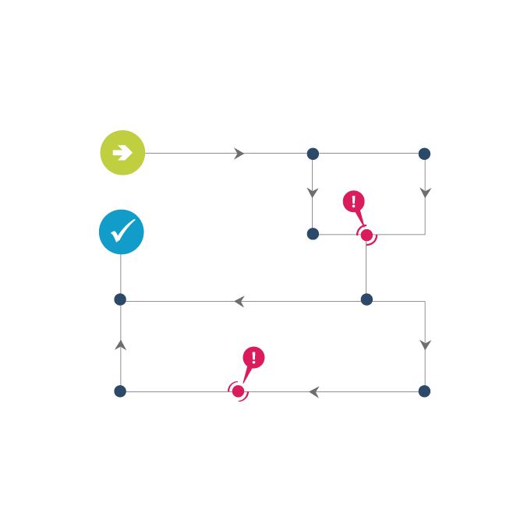
Setting Optimal Line Rates
What are the design cycle times for various stations and lines within the facility?
Will a “push system” benefit the throughput?
Do we have protection for future product or growth?
Have we considered both manual & automated cycle times?
Will we meet market demand?

Slide 11
Minimizing Downtime Effects
Unfortunately downtimes happen!
Loss of throughput
Time to repair
Number of maintenance resources
Safety & lock-out procedures
How do we design robust systems that can handle stochastic failures?
Back-up systems are costly

Slide 12
Designing Optimal Material Handling Systems
Simulation can put all of these systems into action. Each system can have its own set of unique objectives.
Palletized Loops
Power & Free Conveyance Systems
Forklift Deliveries
Tugs & Carts
AGV’s
Market Place and Line Side Racks
Etc.

Slide 13
Engines Delivered via Power & Free

Slide 14
Determining Optimal Placement of Buffers and Broadcast Points in the System
Buffers or decouplers are used to break-up synchronous stations. A lines overall “availability” is based on the multiplicity of its stations.
Broadcast points are signals to build or order a certain subcomponent.
Timing must include build and delivery time.
Assure correct part rendezvous.
Build to sequence or batch build schemes can be tested.

Slide 15
Broadcast Build Schedule

Slide 16
Automotive Simulation Guide Making effective operational decisions
Brian Harrington
MTN-SIM, LLC
www.MTN-SIM.com

Slide 17
Operational Procedures
Once an automotive plant is launched there will always be challenges to keep it running smoothly and achieving its targets.
This applies from launching a new vehicle program to refreshing an existing one.
Market Demand Fluctuates
Mixed Model Assemblies
Shift Patterns & Labor
Chasing Bottlenecks

Slide 18
Doing More with Less Facilities! - Increased Complexity
“By 2017, Ford will increase its global flexible manufacturing to produce on average four different models at each plant around the world to allow for greater adaptability based on varying customer demand.” 1
1 http://corporate.ford.com/innovation/100-years-moving-assembly-line.html

Slide 19
Simulation can improve key operational objectives, including:
Optimizing for mixed-model assembly
Batch vs Build to Order
Optimal operating shift patterns
Optimize staffing requirements and utilization

Slide 20
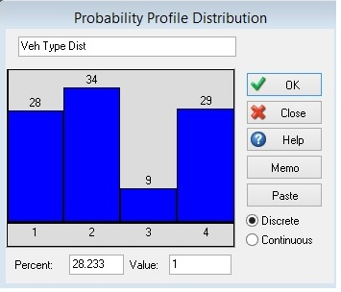
Optimizing for Mixed-Model Assembly
Building different vehicle types on the same line
Flexible Manufacturing
Increases operational complexity
Unique dimensional control equipment
Built on same or unique platforms
Different cycle times, may cause bottlenecks
Vehicle scheduling and sequence
Increased lineside racks

Slide 21
Batch vs Build to Order
Not all vehicles type are equal! A certain vehicle way require additional resources and increased cycle times.
What is the best build schedule?
Building strictly by customer order way cause significant throughput losses.
Batch building our low runners might be the answer.
Creating a blend based on orders.
Creating release rules.

Slide 22
Optimal Operating Shift Patterns
With less overall plants and still offering a wide selection of vehicles, plants are often running two to three shifts.
There are limited opportunities for running overtime to make-up for lost units.
Analyzing different resource relief patterns (Tag vs Mass)
Developing optimal work week (8 hour vs 10 hour, etc.)

Slide 23
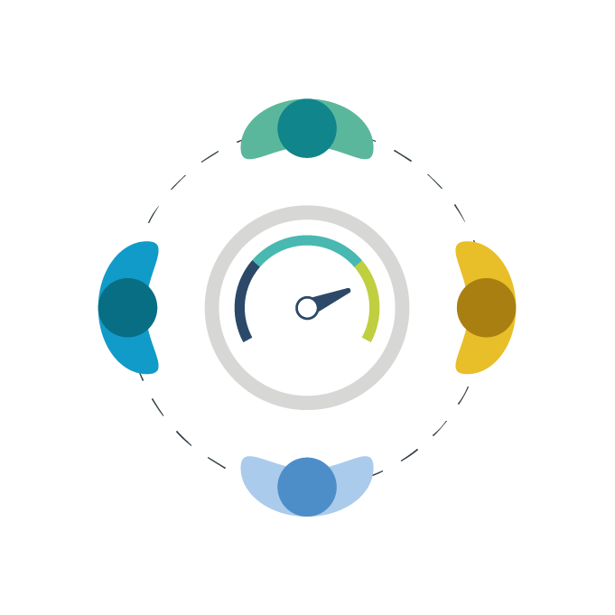
Optimize Staffing Requirements and Utilization
Operators can pace the line; do we have an effective labor force?
Where are the sensitive areas?
Are we staffed to handle unplanned downtimes?
Skilled trades & maintenance crew
Material handling operators
Forklift
Tug and rack
Docks and Market Place

Slide 24
Controlling Operational Procedures
Once operational procedures are documented and implemented, how do we assure they stay effective?
Good designs! Poka-yoke, design error proofing procedures
Continuous Improvement
Measuring performance metrics
“If you can measure it; you can manage it!”

Slide 25
Automotive Simulation Guide Continuously optimizing performance
Brian Harrington
MTN-SIM, LLC
www.MTN-SIM.com

Slide 26
Performance Metrics
Continuous Improvement starts with the ability to measure your performance!
Most plants will be collecting real-time shop floor metrics including OEE, Working, Blocked, Waiting and Downtime, etc.
Leveraging existing simulation studies can prove to advantageous throughout the entire vehicle program life cycle.

Slide 27
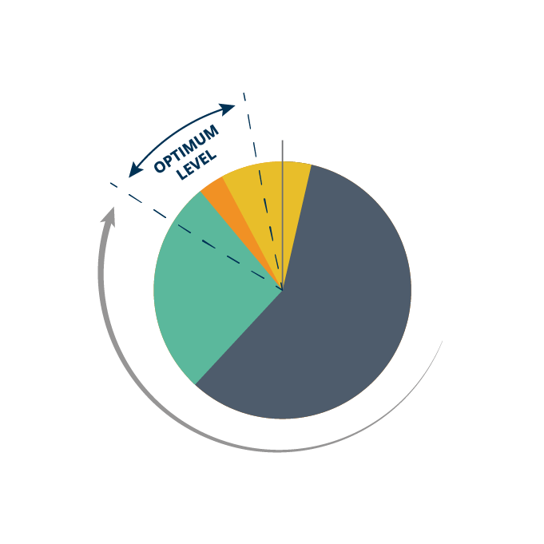
What Should we be Measuring?
Simulation can optimize key performance objectives, including:
Jobs per Hour (JPH)
Financial Costs
First Pass Yield (FPY)
Overall Equipment Effectiveness (OEE)
Schedule Adherence Percent
Time in System (Dock to Dock)
Resource Utilization

Slide 28
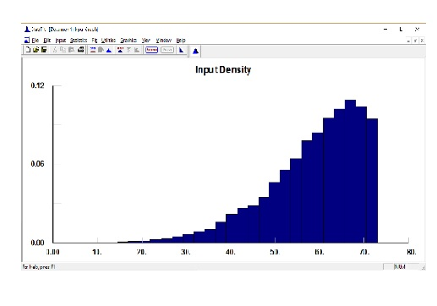
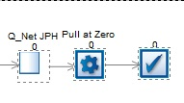
Jobs per Hour
How many vehicles do we make per hour?
At the end of your model push parts into a “Dwell Buffer” for 60 minutes.

Slide 29
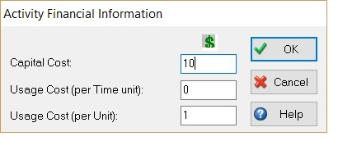
Financial Costs (ROI)
Capital Costs
Are high cost technology stations worth the return on investment?

Slide 30
First Pass Yield (FPY)
Keeping reworked and scrapped items to a minimum. Eliminating waste!
FPY =
(Good parts – Scrap – Rework) / Total Parts
Goal is to eliminate scrap and optimize or rework process.

Slide 31
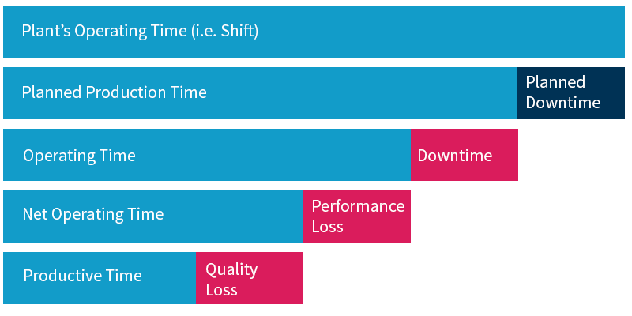
Overall Equipment Effectiveness (OEE)
OEE = Availability * Performance * Quality

Slide 32
Schedule Adherence Percent
The manufacturing metric Schedule Adherence Percent measures how well the original build schedule is maintained.
Schedule Adherence Percent = (Actual Production / Scheduled Production) * 100
Typical case for late units:
Rework loops
Parallel Lines
Quality Tests
Decouplers with short-cuts (buffers, mezzanines, and storage banks)

Slide 33
Time in System (Dock to Dock)
This metric captures the total time to complete a single product from start to finish.
Usually starts with a certain “control part” early on near the entrance docks, and ends where the vehicle leaves the facility.
Why longer build times? Bottlenecks, rework items, shift patterns, product variants, and lineside inventory.

Slide 34
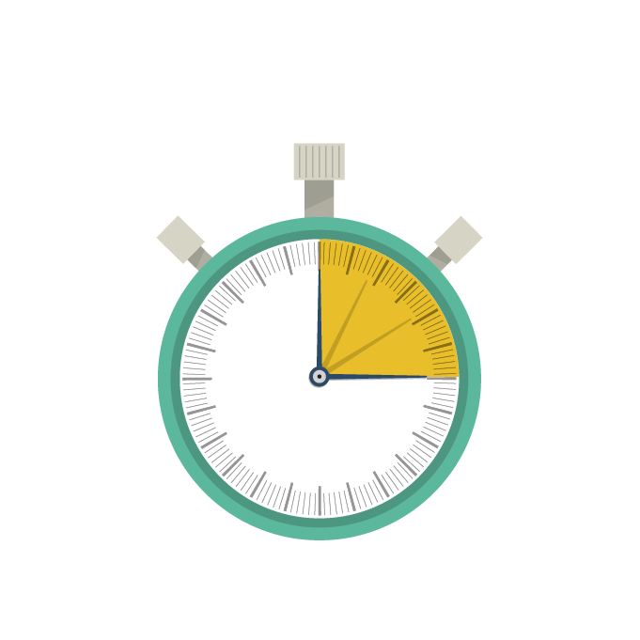
Resource Utilization
Simulation is effective for determining the best strategy for resource placement, as well as optimizing the balance of resource tasks.
Line operators
Material Handling Operator
Maintenance Crews
Shared Resources
Are we waiting on a part or waiting for an operator?

Slide 35
Close-up on the Metrics
Line 15 Performance Metrics:
Jobs per Hour (JPH)
= 48.8
Financial Costs
= $6,412,394 (Profit)
First Pass Yield (FPY)
= 8136-237/8136= 97%
Overall Equipment Effectiveness (OEE)
= 0.96 * 0.85* 0.97 = 0.79
Schedule Adherence Percent
= 1-(1325/8136) = 83.7%
Time in System (Dock to Dock)
= 299 minutes (Average)
Resource Utilization
87% Utilized & 2% Travel

Slide 36
Questions?
Please send additional comments or questions to:
Brian.H @MTN-SIM.com

