Slide 1
A Sermon By Bishop Andy C. Lewter, D. Min

Slide 2
Special
Diet
We left off last week with Daniel and the three Hebrew Boys being allowed to eat only fruit and vegetables which resulted in them having superior health and a brighter countenance than those who ate from the king’s table

Slide 3
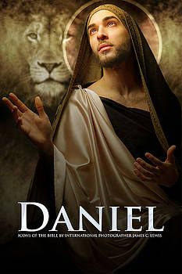
Spiritual Insight
Because they kept covenant with God Daniel also had spiritual insight that allowed him to interpret dreams

Slide 4
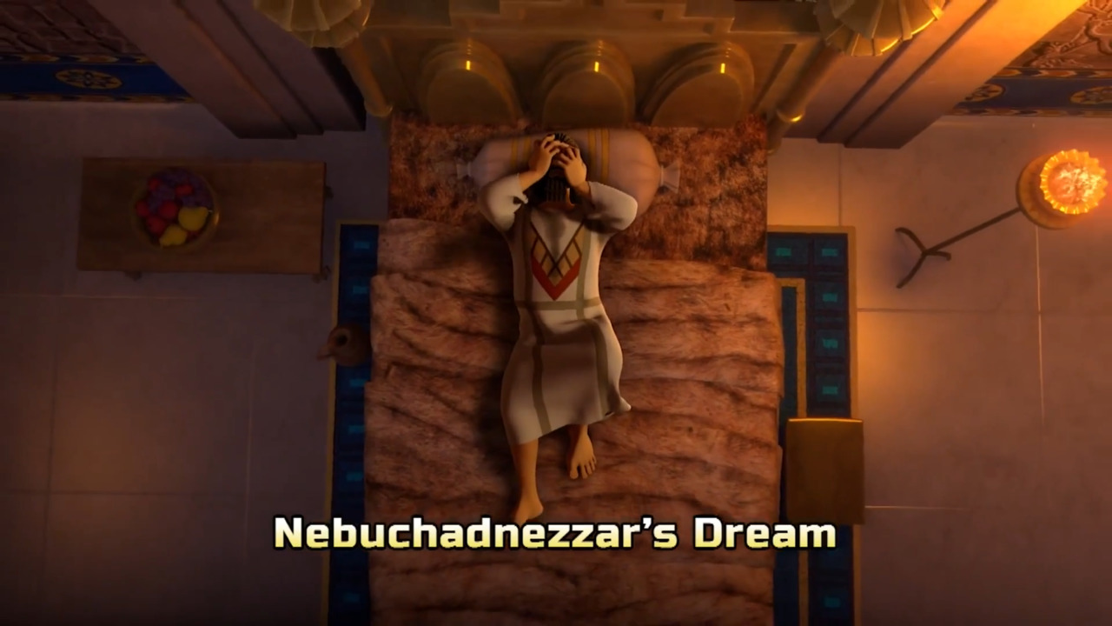
2. The Dream
Nebuchanezzar has a dream that he demands be told to him along with its interpretation, only Daniel comes through

Slide 5
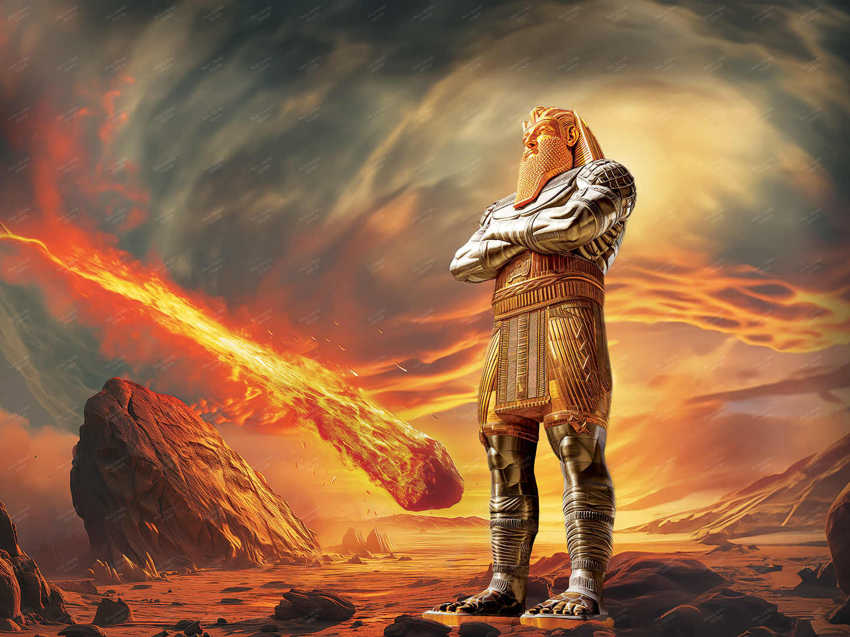
The Statue
Head of Gold” Shoulders of Silver Chest of Bronze Legs of Iron Feet of Clay

Slide 6
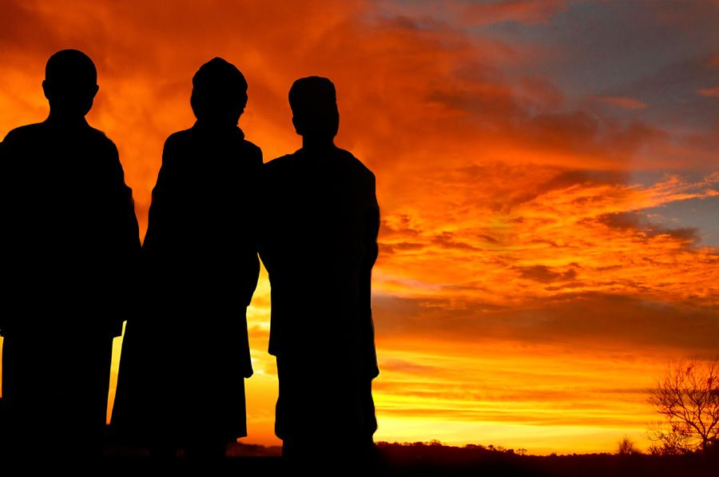
Name Change
All three had name of God in their names
Shadrach- Aku Meshach- Aku Abendego- Nabo

Slide 7
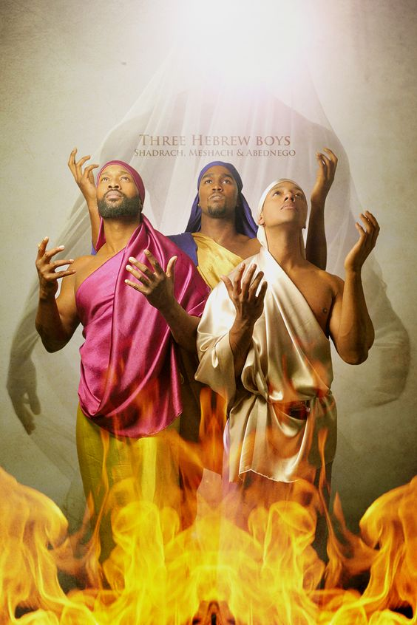
Hebrew Boys
The three Hebrew Boys refuse to bow to the statue of the king and is placed in the furnace of fire

Slide 8
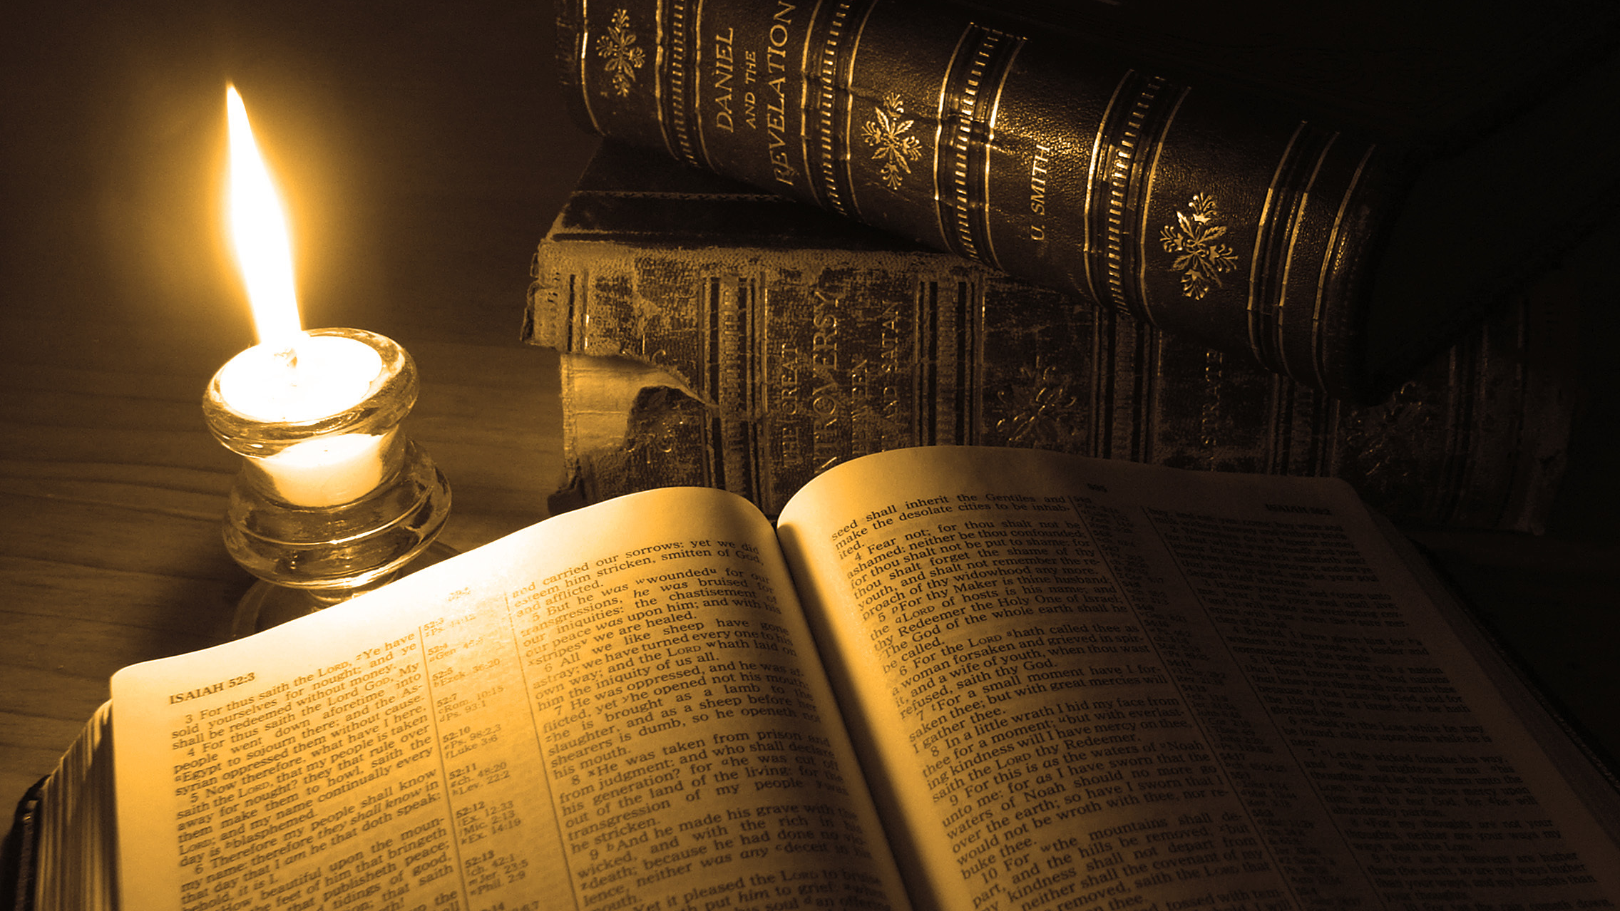
Thank You for Watching

