Slide 1

A Sermon By
Bishop Andy C. Lewter, D. Min

Slide 2
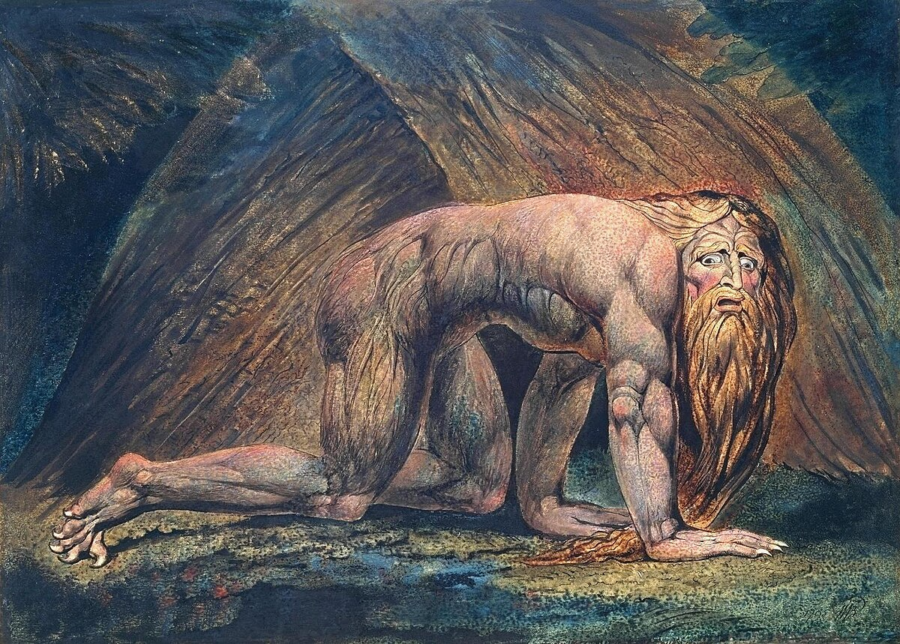

Last Week
Last week we discussed how King Nebuchanezzar was brought low until he recognized the sovereignty of God

Slide 3
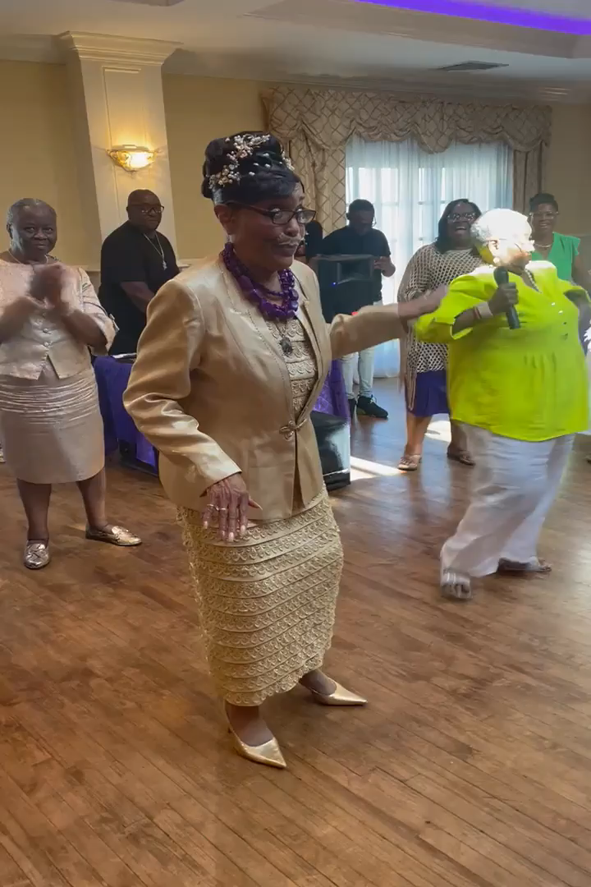
Happy Birthday
Yesterday I attended the 80th birthday celebration of my Aunt, Pastor MaryAnne McElroy of the Friendship Baptist Church in Riverhead

Slide 4
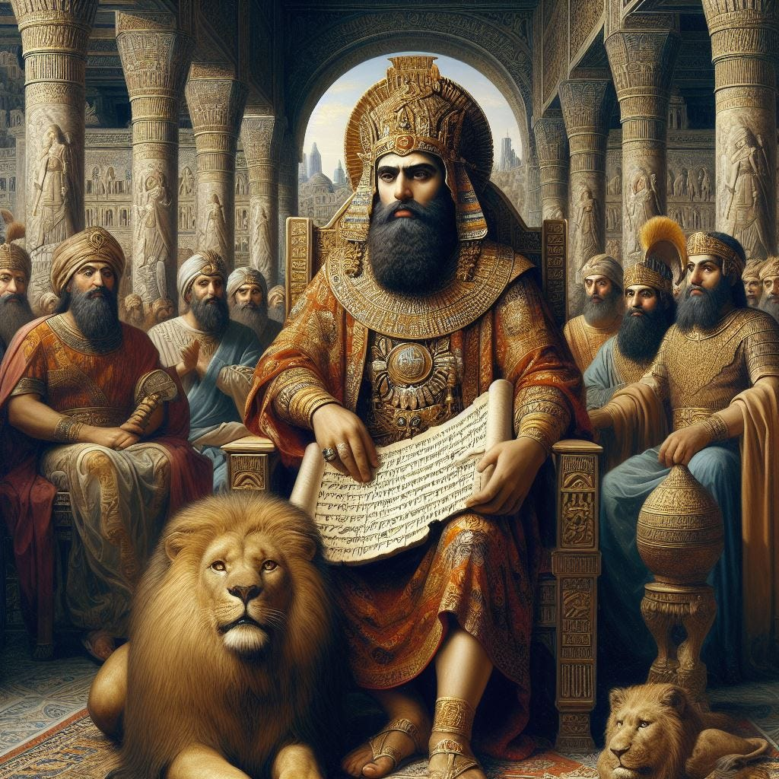
This Week
We turn our attention to another party given by Belchezzar, the son of King Nebuchanezzar

Slide 5
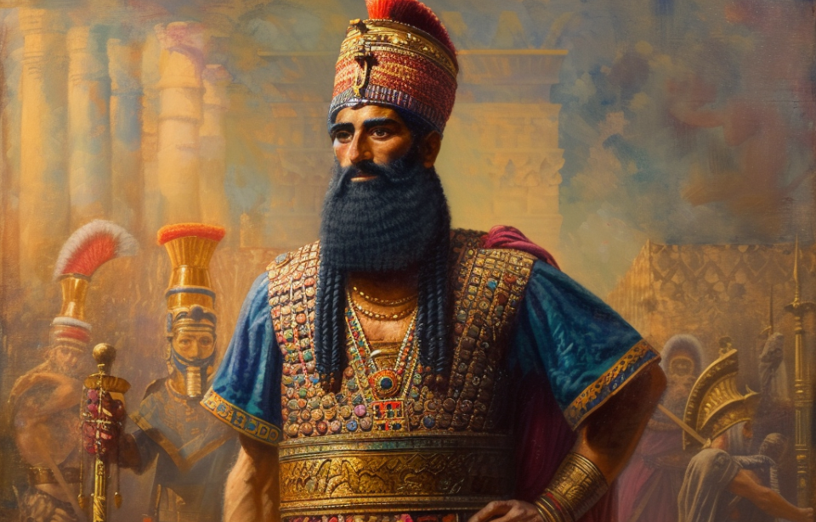
The King is Dead
Nebuchanezzar has died and is replaced by Belchezzar, perhaps this party was his coronation celebration

Slide 6
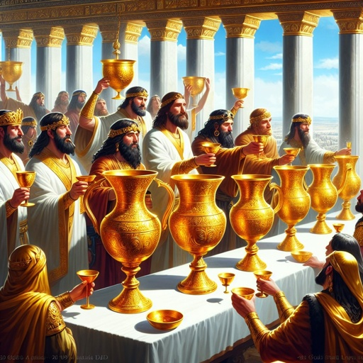
How But Not What
The issue here is not that there was a party but what Belchezzar used in the party, the holy vessels stolen from the temple in Jerusalem

Slide 7
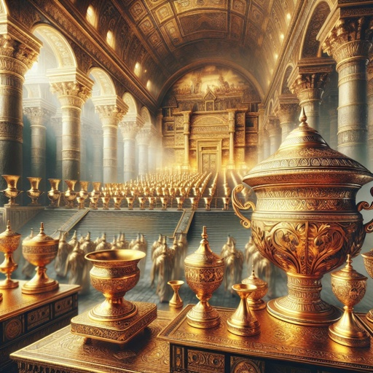
Disrespect
By doing so he was disrespecting the God of Daniel who he had to turn to in order to get an interpretation to the vision

Slide 8
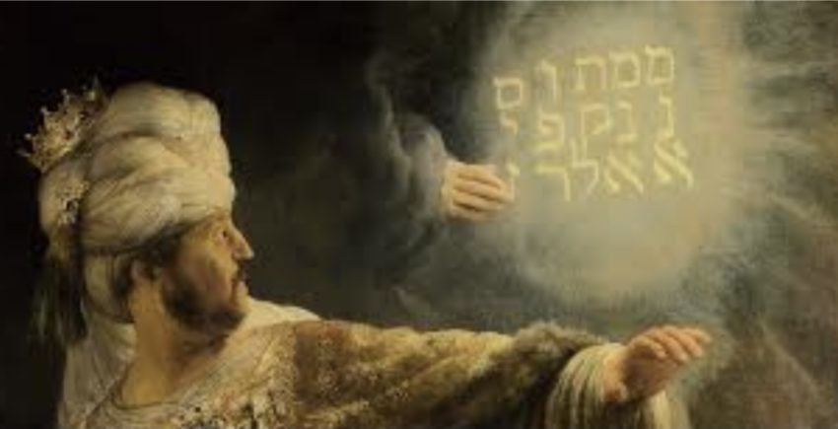
Mene Mene…
The handwriting on the wall suggested that God was going to divide his kingdom between both the Medes and the Persians

Slide 9
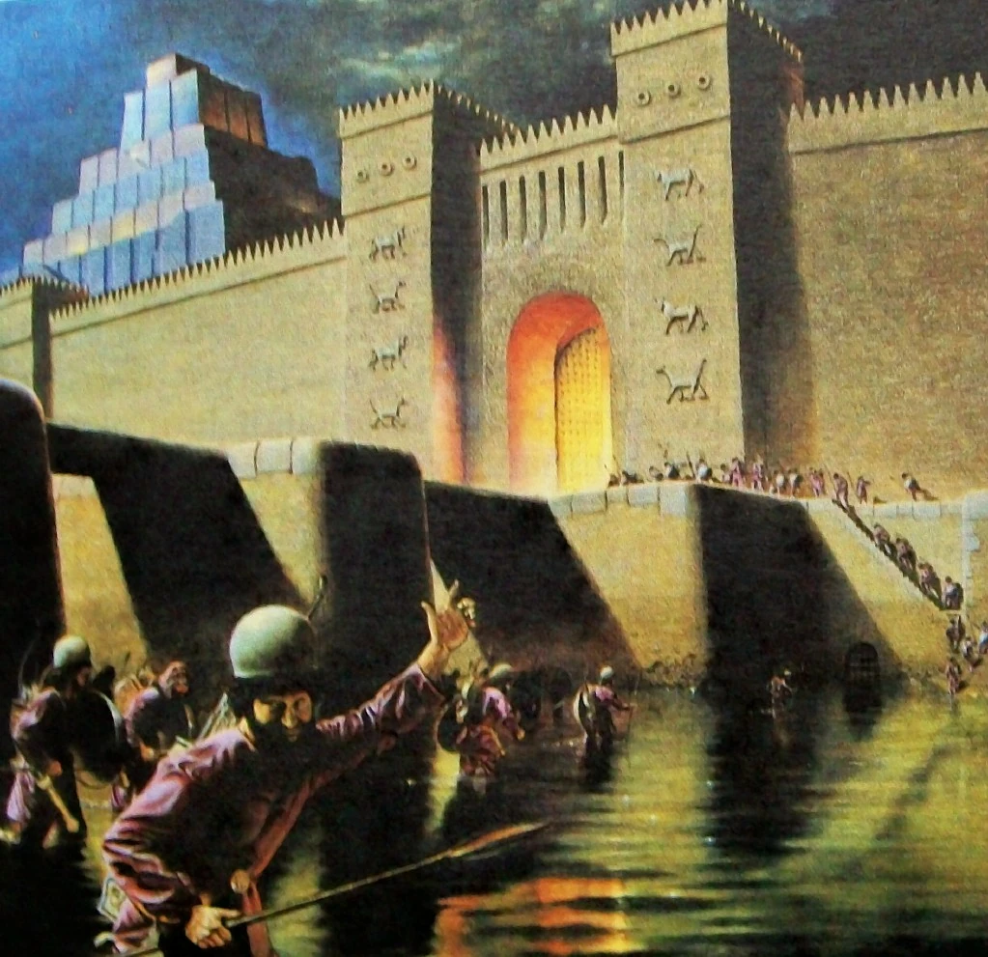
The Same God
The same God that raised you up in 605 BC is the same God that will bring you down in 539 BC

Slide 10
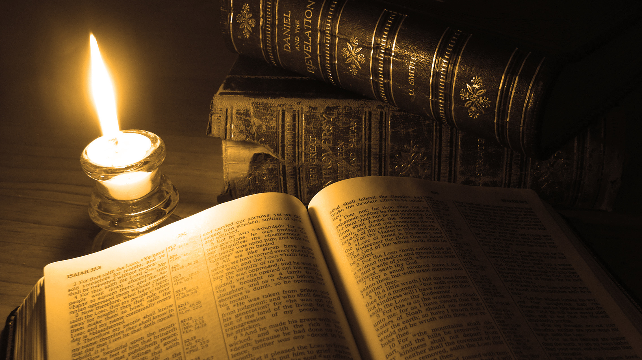
Thank You for Watching

