Slide 1
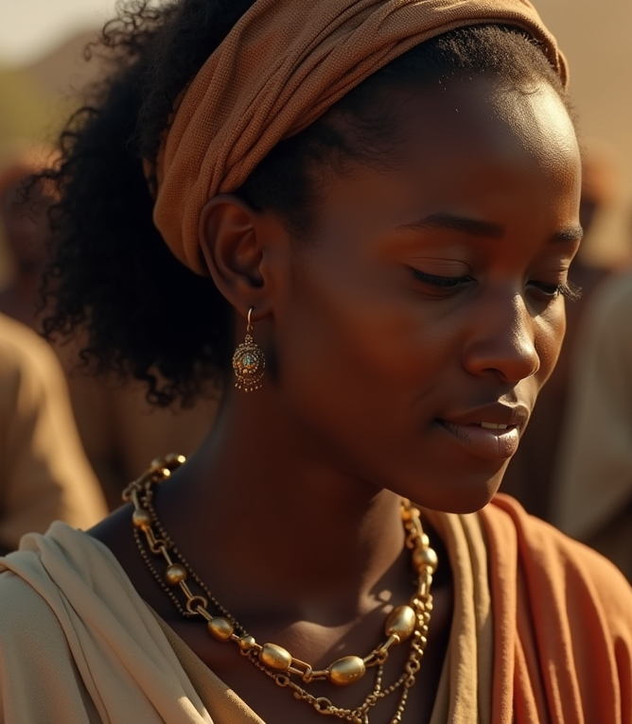
The Woman with an Issue of Blood
A Sermon By
Bishop Andy C. Lewter, D. Min

Slide 2
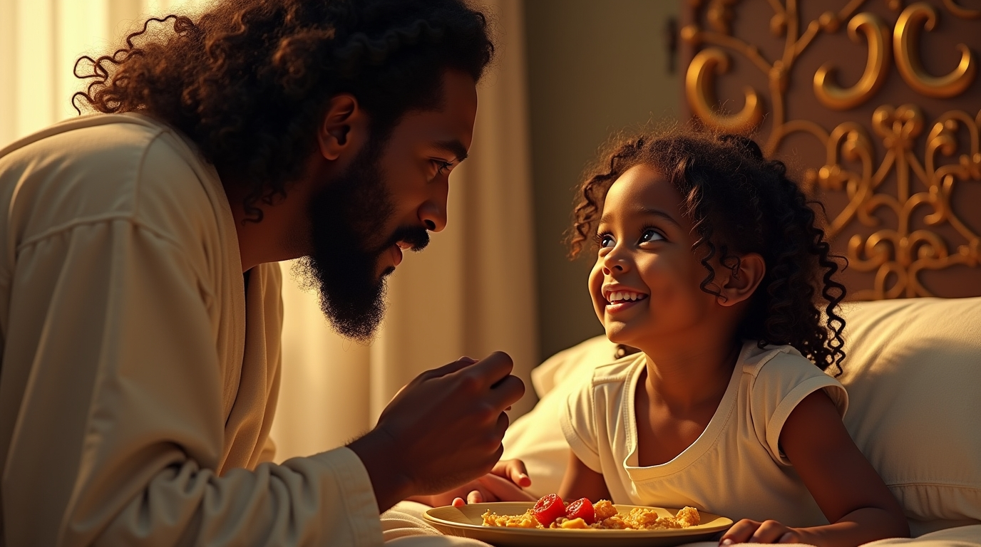

Slide 3
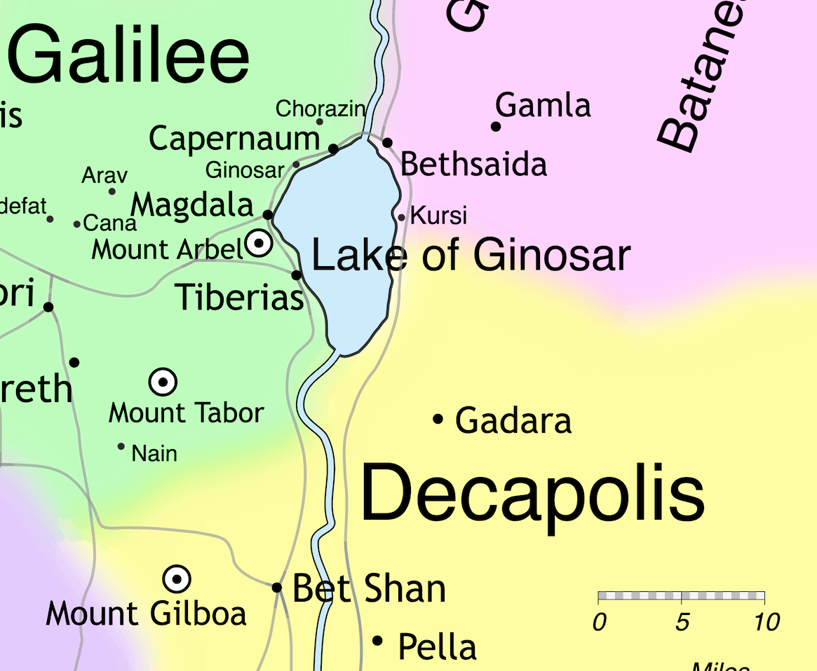

Slide 4
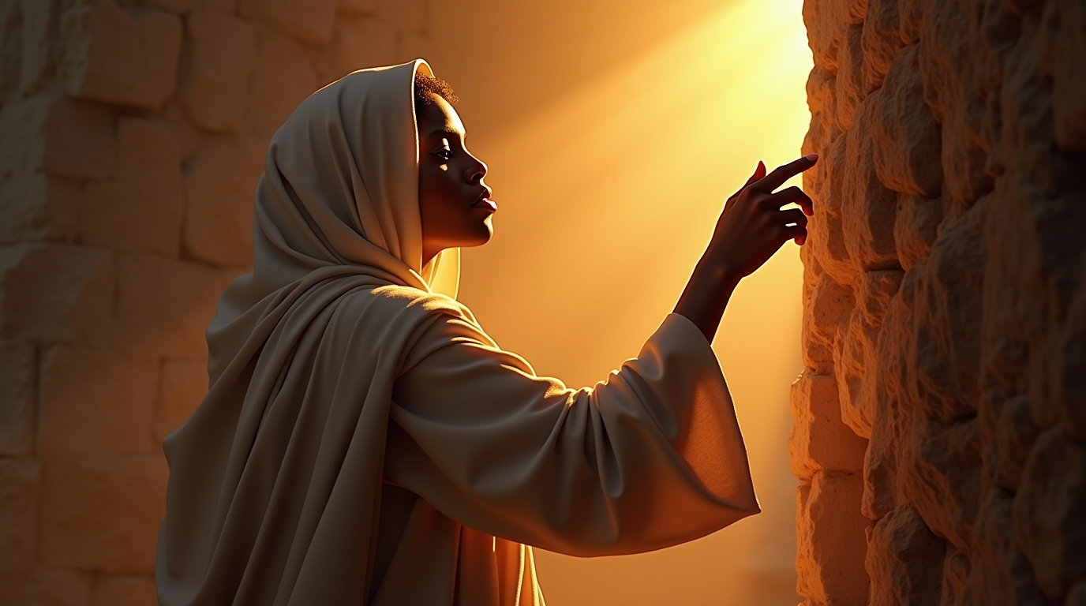

Slide 5


Slide 6
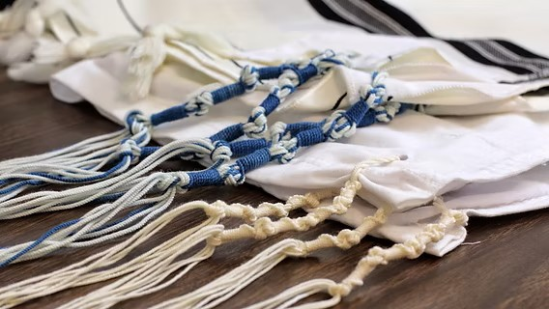

Slide 7
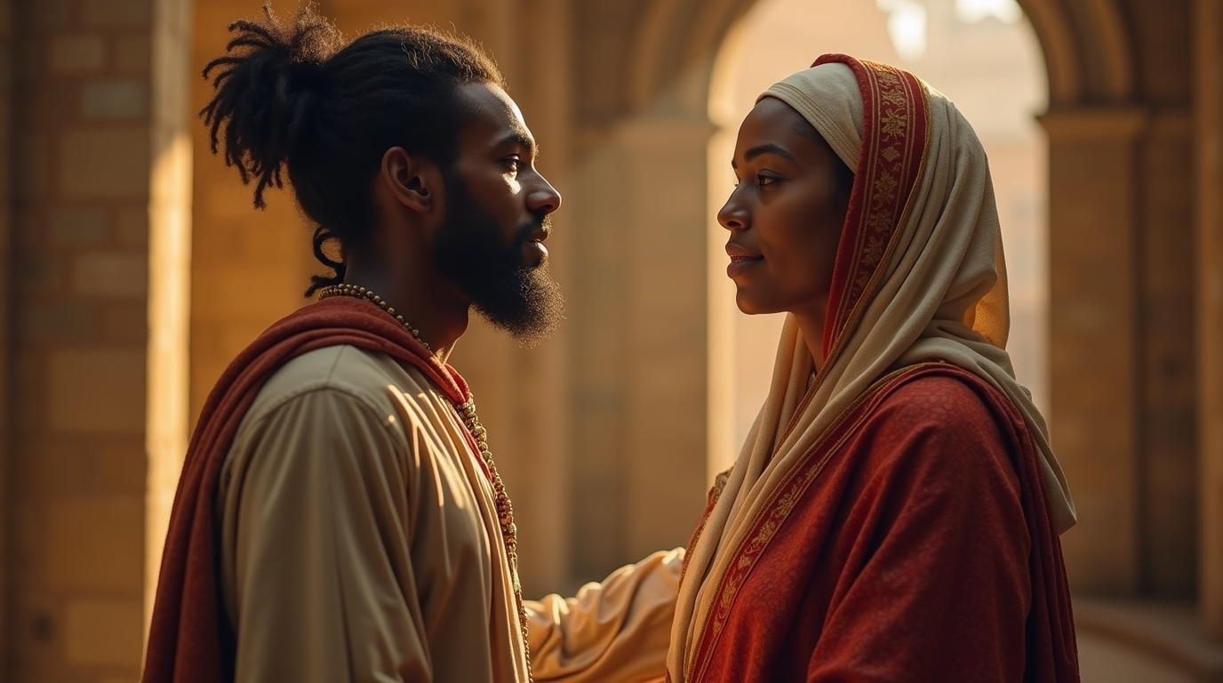

Slide 8
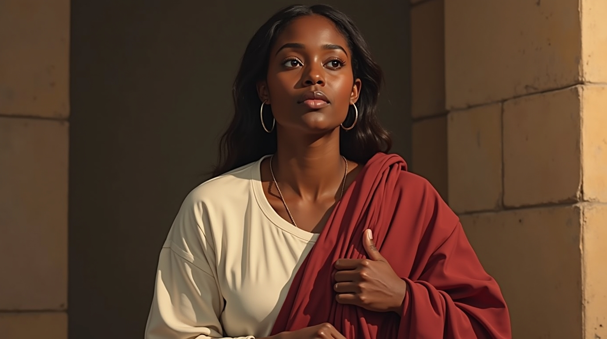

Slide 9
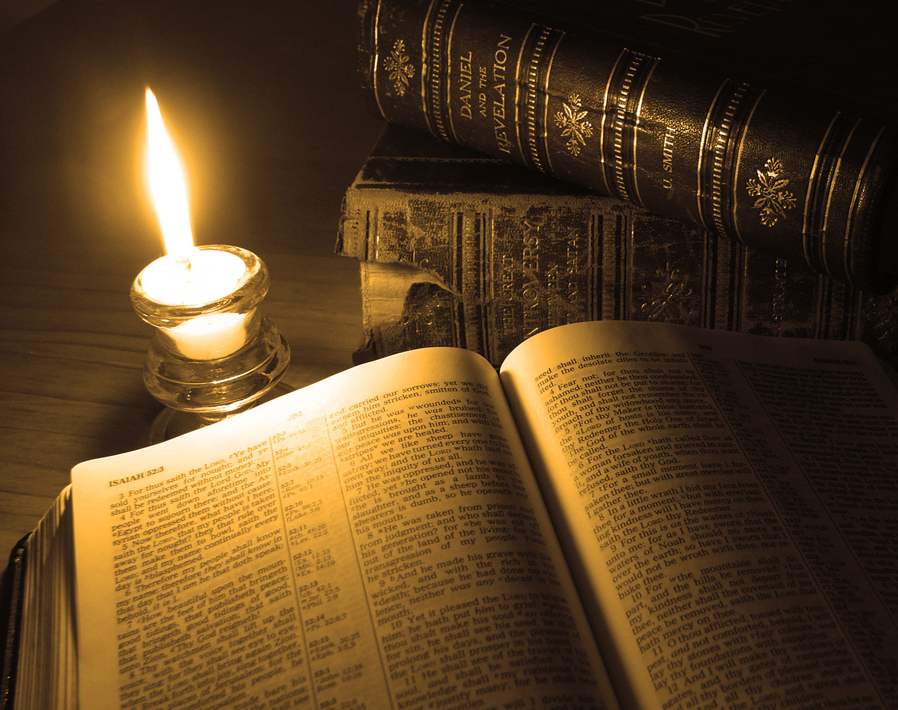
Thank You for Watching
A Sermon By
Bishop Andy C. Lewter, D. Min

