Slide 1
Inventory Management issues & Solution [Navision] Detailed Discussion and Testing on Live Scenarios/Test Cases based Queries.
CASE Study: There are some differences in Value of Inventories between Trial Balance & Inventory Valuation Report

Slide 2
Item Journal (Page)

Slide 3
CASE Study: Differences in Value of Inventories between Trial Balance & Inventory Valuation Report
Case 1: When Difference arises in Inventory / Stock Values.
Case 2: When Stock is showing with Zero Qty. but still showing its Value.
Case 3: Differences showing in Company Store / Warehouse Inventories & Navision System Inventories.

Slide 4
Item Journal (Uses & Features)
To Post Opening Stock (Item/Inventory).
Try to insert Cost Per Unit also to avoid Cost related issues in future.
Try to Post Opening Entry Location wise.
Unit Amount includes Indirect Cost also but Cost Per Unit uses only Direct Cost.
If Required, we can Reclassify Location, Bin Code, Serial Number, Lot Number, Dimensions using Item Reclass. Journal, and if we are using Warehouse Module and Post Put Away & Pick Entries then need to use Warehouse Item Journal.
If required, we can update the Item Value (Unit Amount) in future using Revaluation Journal.
Hint: Entry Type would be Direct or Indirect.

Slide 5
Item ReClass. (Re-Classification) Journal [For: item & Fixed assets]

Slide 6
Revaluation Journal

Slide 7
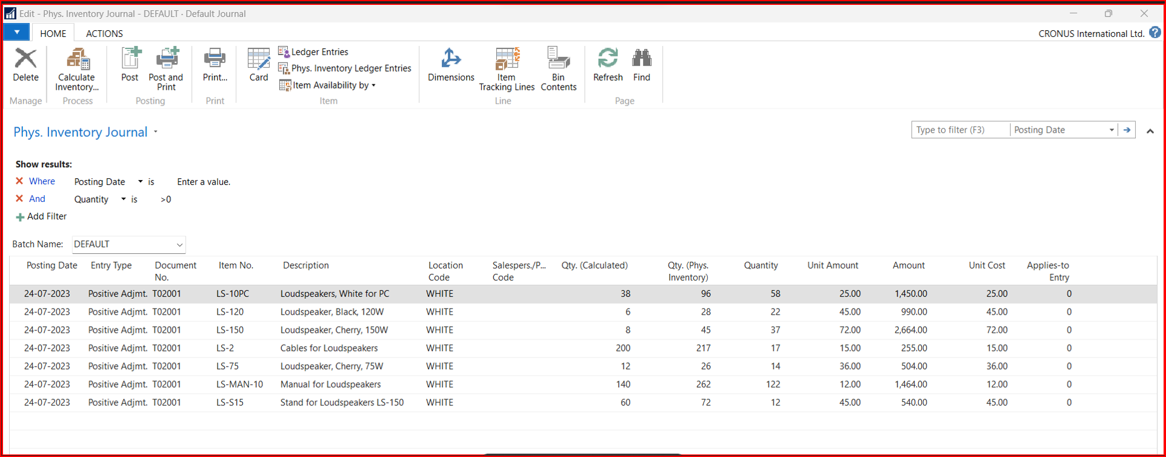
Physical Inventory Journal (Batch job)
To check discrepancies in Store Inventory and Actual Physical Inventory (available on system).

Slide 8
Report: Closing Trial Balance (inventory/Stock-in-Hand Group)

Slide 9
Inventory Valuation Report (fiscal Financial Year Started from 01/04/23..31/03/24
01/04/2023
Beginning inventory (Closing of Last Fiscal Year, 31/03/23)
2023 (After Beginning & Before End Date)
Increases/Decreases During the Period
31/03/2024
Closing Inventory [Cost Amount (Actual) & Cost Posted to G/L]

Slide 10
Report: Inventory Valuation Report

Slide 11
Batch Job / Reports: If Required Run Manually.
Adjust Item Costs/Prices.
Adjust Cost Item Entries. (use Revaluation Journal to update these)
Post Inventory Cost to G/L (you may find in the system there is a one more Report named is; Post Invt. Cost to G/L –Test).
Note: Test these Scenarios and Shared Batch Job (Reports) on a Test Company first, then on Live.
To do that make a Copy (Duplicate/Replica) of Live Company as Test Company, and Test all the shared Scenarios/Cases.

Slide 12
Data Reconciliation: Try to Match Report of “Trial Balance” & “Inventory Valuation”.
“Trial Balance” Report

Slide 13
Data Reconciliation: Try to Match Report of “Trial Balance” & “Inventory Valuation”.
“Inventory Valuation” Report

