Slide 1
Navision | Business Central
Fixed Assets Module
Notes:
Website: www.NavisionFunctionalExpert.com

Slide 2
Purchase of Fixed Assets
Create Purchase Order / Service Order
Post Purchase Receipt / GRN
Post Purchase Invoice
FA Registers, and Reports.
Notes:
YouTube Channel: Freelancer Madhavi

Slide 3
Appreciation/ Extension in Existed Fixed Assets, Like; A Machinery
Situations Are:
When we have spent/invest some money for an Add-On, Or make an Extension on an Existing Asset.
An invoice is posted for painting the existing machine. The invoice amount is 5000 /-.
Existing / Old Asset was appeared in your Fixed Assets List (As a FA Card).
We had already charged Deprecations on that Fixed Asset.
Solution: No need to Create a New FA Card, Or even No need to Purchase a New Asset. Just follow the next step.
Notes:
LinkedIn Company Page: www.LinkedIn.com/Company/navisionfunctionalexpert

Slide 4
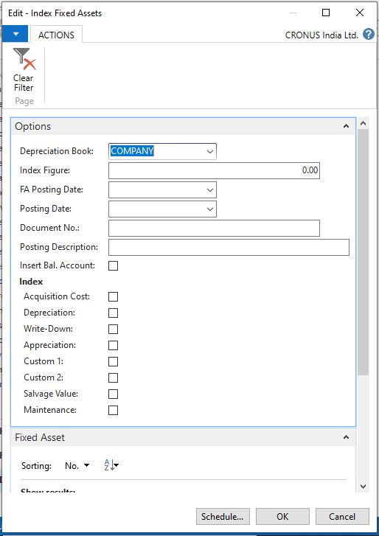
To post Additional Acquisition Costs
We can post Additional Acquisition Cost for a Fixed Asset in the same way as we post the Original Acquisition Cost, from a Purchase Invoice, OR from a Fixed Asset Journal.
If Depreciation has already been calculated for the Fixed Asset, then we will select the ”Depr. Acquisition Cost ” check box to have the Additional Acquisition Cost less the Salvage Value depreciated in proportion to the amount by which the previously acquired fixed asset has already been depreciated. This ensures that the depreciation period is not changed.
The depreciation percentage is calculated as:
P = (total depreciation x 100) / depreciable basis
Depreciation amount = (P/100) x (extra acquisition cost - salvage value)
Point to Note that, Please do remember to select the ”Depr. until FA Posting Date” check box on the Invoice page/screen, using the Fixed Asset G/L Journal, or the Fixed Asset Journal to ensure that Depreciation is calculated from the last Fixed Asset Posting Date, to the Posting Date of the Additional Acquisition Cost.
This will add posted Acquisition Cost + Additional Appreciation Cost of Fixed Assets.
Use of Index Fixed Assets Batch Job:
Indexation is used to Adjust Multiple Fixed Asset values,.
For Example: When there is a change in general price of FA. The Index Fixed Assets batch job can be used to change various amounts, such as write-down and appreciation amounts.
Note: Use Index Fixed Assets “Batch Job”, for Indexing Fixed Assets automatically.
Notes:
Consultancy Name: Freelance Consultancy

Slide 5
Contact Us for *Free Consultancy Services*
Regards,
Team FC
We are Out of the Box Thinker !
Freelance Consultancy
Website: www.NavisionFunctionalExpert.com
Email: Support@Navisionfunctionalexpert.com | mpandey065@gmail.com | navisionfunctionalexpert@gmail.com
Notes:
Email: mpandey065@gmail.com | Navisionfunctionalexpert@gmail.com

