Slide 1
Dynamics Navision (Version 2018) Case Study on Retail/Trading Business
Purchase & Sales Orders (Credit Transactions): Items & G/Ls.
Receipts (GRN/MRN/SRV) & Shipments (Sales Challan).
Invoice/Bill Generation (Order to Invoice or Direct).
Credit Memos (Purchases & Sales).
Dues/Balance/Outstanding Check (for Payables & Receivables).

Slide 2
Orders (Purchases & Sales)
Purchase Order-> GRN -> Invoice.
Sales Order-> Sales Shipment -> Invoice.
Posted Transactions/Documents/Invoices/Bills (Posted Purchase Receipts, Sales Shipments and Purchase & Sales Invoices).
Hint: Purchase Receipts Note = GRN (Goods Receipts Note)|MRN (Material Receipts Note)|SRV (Store Receipts Note).

Slide 3
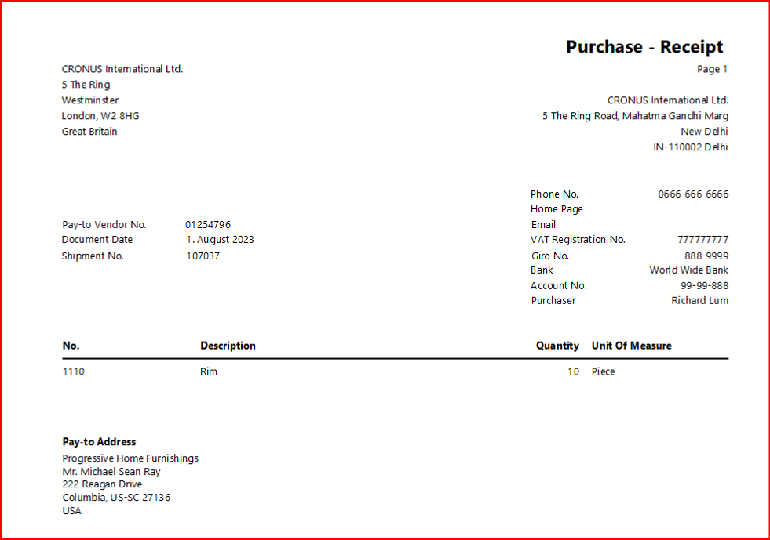
GRN/Sales Shipment
Goods Receipts Note (Purchases): Physical Quantity “Receipts” Document.
Hint: Inbuilt Print Layout of Posted Purchase Receipt (See the shared image).
Sales Shipment (Sales Challan): Physical Quantity “Dispatch” Document.

Slide 4
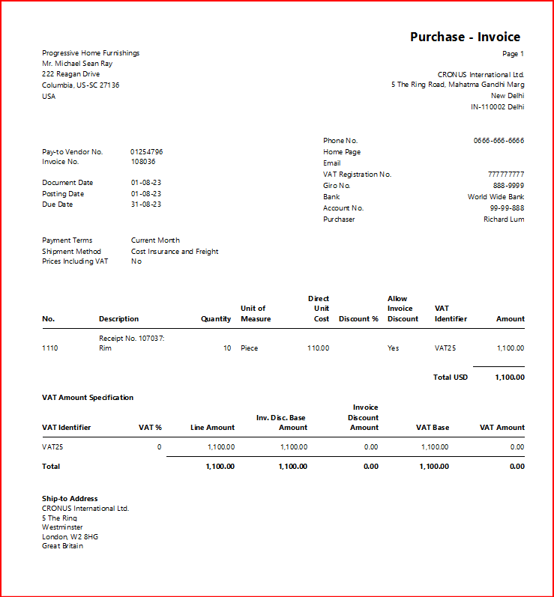
Invoice: Purchases & Sales Bill (for Payment) Use Cases: Depends on Conditions
Invoices Creation Method/Process: “From Orders” or Direct (this is known as Regular Invoice, where traders use Cash Mode Only).
Hint: Inbuilt Print Layout of Posted Purchase Invoice, excluding Tax (See the shared image).
Invoice MODE: “Credit” or Cash.
Hint: Use Balancing Account Ledger for generating Cash Invoice.

Slide 5
Credit Memos (Purchase & sales)
Purchase Credit Memo (Cancellation/Reversal of Purchase Invoice).
Sales Credit Memo (Cancellation/Reversal of Sales Invoice).
Others.

Slide 6
Dues Check & Payments Settlement to Payables (Suppliers)/Receivables (Customers).
Vendor Card
Customer Card
Hint: You may also check Bank Accounts Card, and “Items by Location” (this is to check the current Inventory Status).

