Slide 1

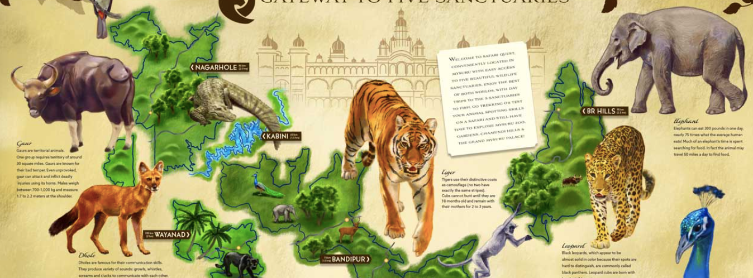
SAFARI QUEST
GATEWAY TO THE 5 SANCTUARIES
ANSWER THE CALL OF THE WILD
MYSORE,KARNATAKA

Slide 2
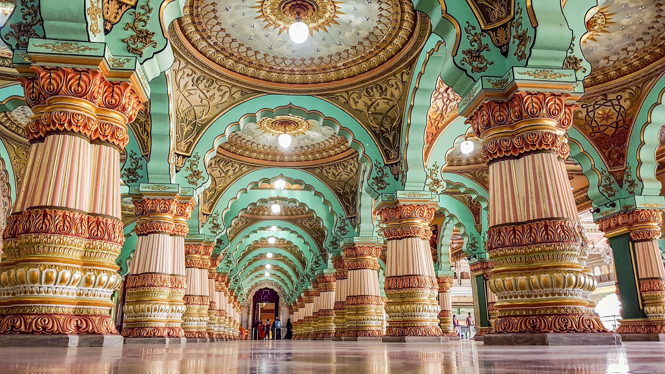
CONCEPT
CULTURE,HISTORY,WILDLIFE

Slide 3
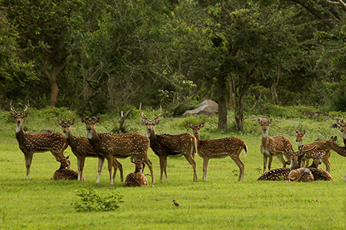
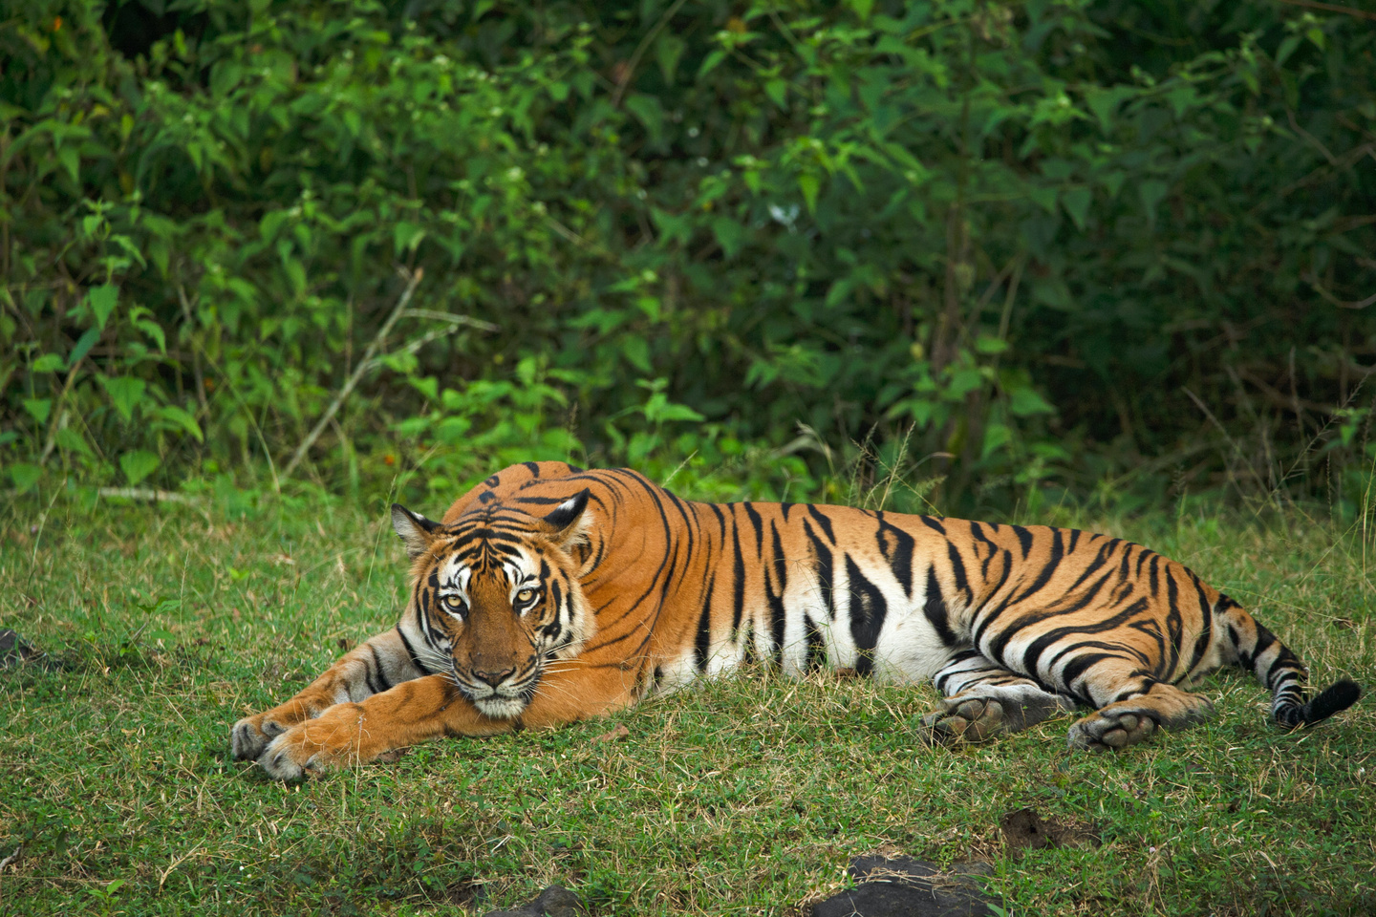
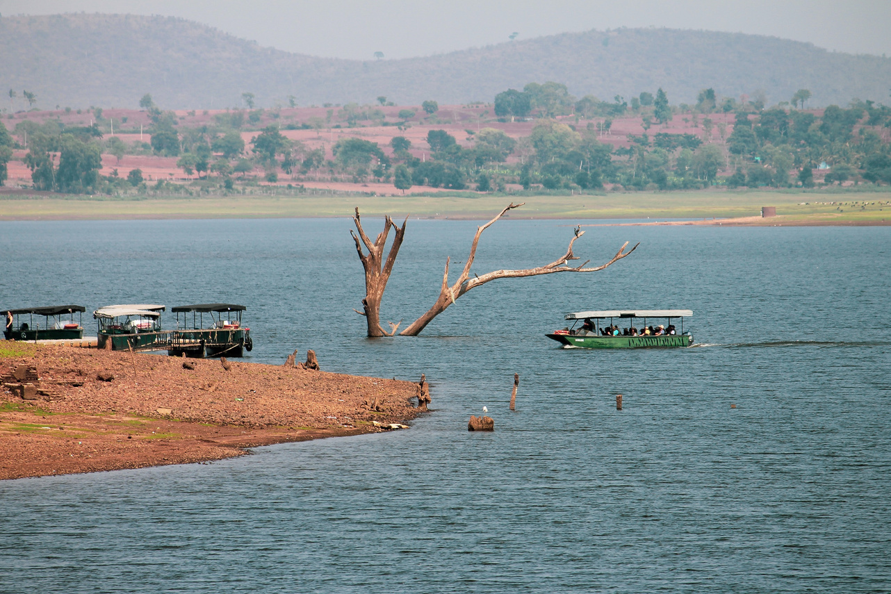
WILDLIFE EXPERIENCES
BANDIPUR NATIONAL PARK
NAGARHOLE NATIONAL PARK
KABINI NATIONAL PARK

Slide 4
WILDLIFE AND BOAT SAFARIS
BIRDWATCHING AND FISHING
CURATED TOURS
Visit unique, lesser known spots of Mysore, curated just for you. Enjoy your day at an organic Farm. Get transported in the magical Bonsai Garden or make your up your Insta game in the 3D Selfie Gallery.
Pick from a boat or jungle safari. Spot the elusive, majestic wildlife like the Bengal Tiger, Leopard and Guar, or aquatic reptiles and mammals! Explore the ‘hidden’ jungle with our expert naturalists.
Discover over 350 species of birds or spend a serene morning fishing. Both are equally enticing and offer a myriad perspectives of nature.
ADVENTURE SPORTS
NATURE HIKES/ WALKS
CITY AND CULTURE
Mysore is the right destination for adventure junkies. Trigger an adrenaline rush with water skiing, lake rafting, water trampoline, banana boat ride, kayaking, bumper ride, speed boat, canoeing, and more.
Discover a variety of native and indigenous flora. Explore the diverse habitats of the Mysore landscape, Click great pictures of the surroundings and wildlife that make Mysore a must-see destination.
The city is home to a plethora of magnificent ancient palaces, museums, hills and architecture and natural attractions that dot the city’s landscape. Don't miss out on these places in the cultural capital of Karnataka.

Slide 5

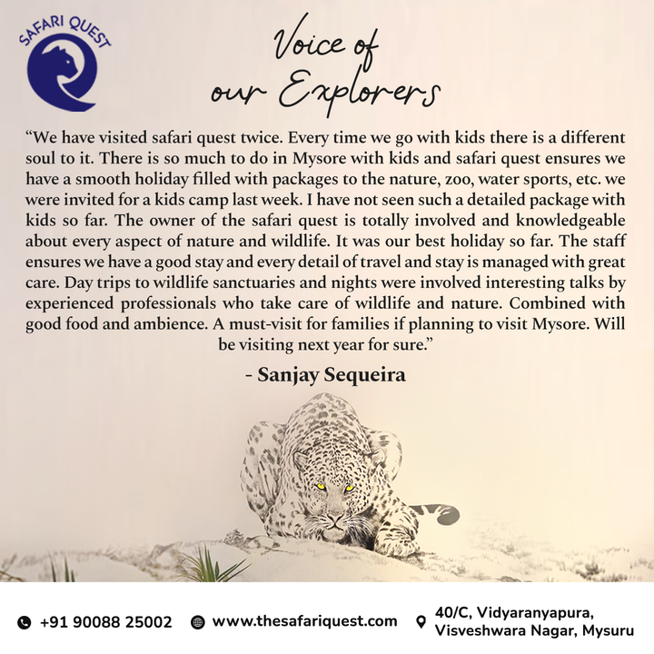
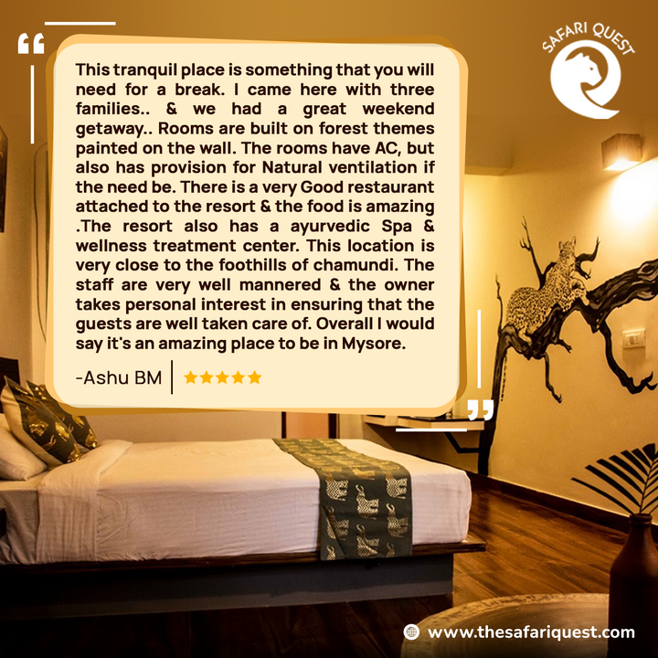
REVIEWS
WHAT PEOPLE ARE SAYING ABOUT US

Slide 6
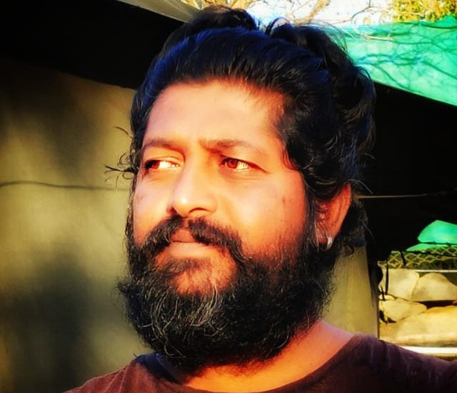
Meet our resident Naturalist and wildlife expert:Pradeep
20 + years as one

Slide 7

8.6/10
FABULOUS
5.0/5
EXCELLENT
BOOKING.COM
TRIPADVISOR
4.8/5
4.6/5
GOOGLE
GOIBIBO

Slide 8
SAFARI QUEST
HIGHLIGHTS
NATURE-THEMED SUITES
SPA
SHOP FOR CURIOS
CAFE AND DINE-IN
ACTIVITIES AND GAMES
Every spacious room is surrounded by greenery and is safari-themed with a jungle lodge vibe,
Relax at our spa with the aroma, Thai, deep tissue massages, among others.
Make this a trip to remember, pick up wildlife souvenirs, trinkets and more at our in-house kiosks.
Chill out at Drongo, our coffee shop or eat a delicious meal at Best Kept Secret—our restaurant.
Spend sometime in the library, maybe enjoy a live music session or play a game with your kids!

Slide 9
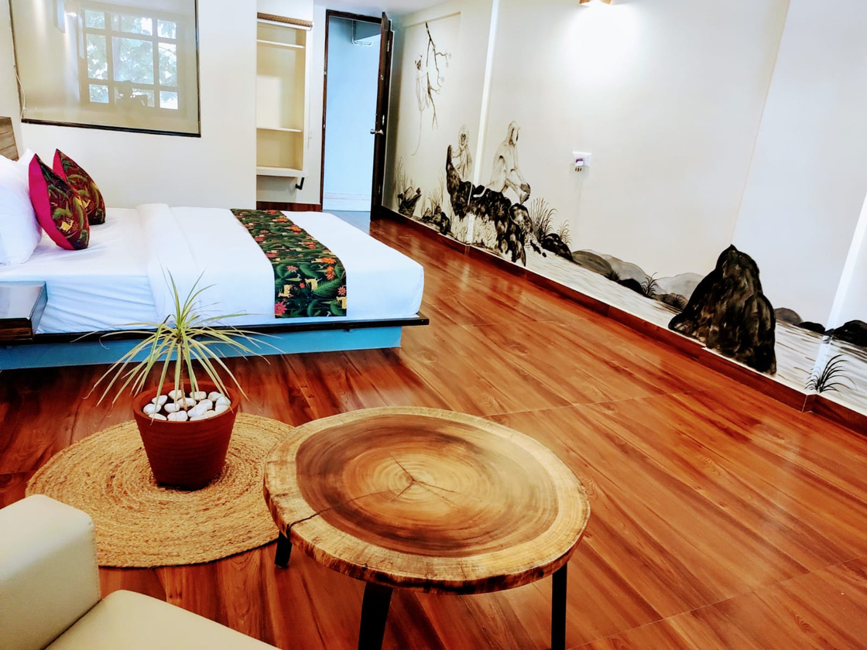
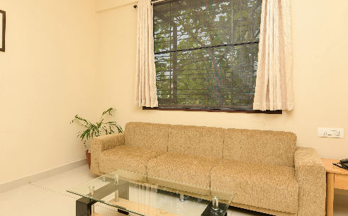
16 ONE BEDROOM SUITES
10 APARTMENTS

Slide 10
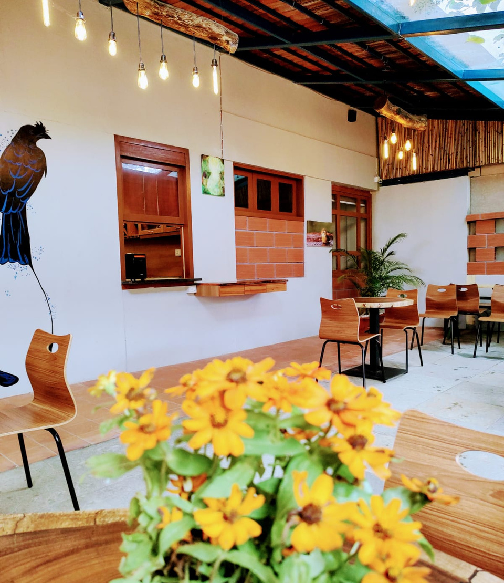
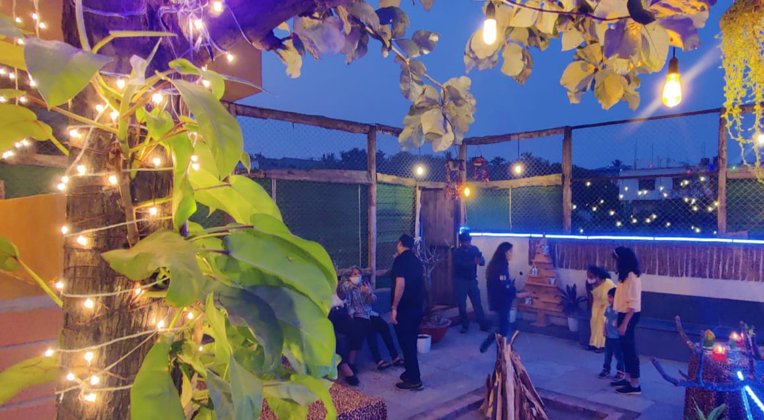
BEST KEPT SECRET
DRONGO CAFE

Slide 11
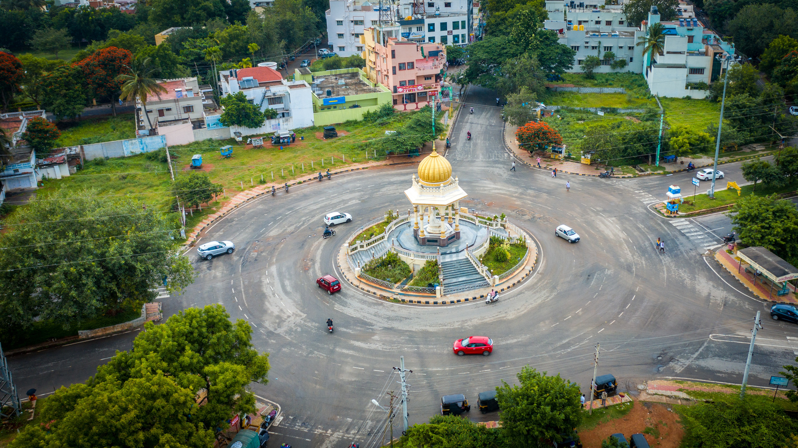
LOCATION
AT THE HEART OF EVERYTHING!
FIND US
CURATED TRIPS
GATEWAY TO 5 SANCTUARIES
  JP Nagar is in the southern part of Mysore. Nestled between HD Kote Road and Nanjangud Road, it provides fast and easy access to Bandipur, Kabini & Nagarhole.
  Depending on the guest profile, we will plan a trip that is best suited to your needs. Be it wildlife, wellness, city or adventure packages.
  Safari Quest is base to explore Coorg, Nilgiri biosphere, Chikmagalur. Just tell us where you want to go let us do the planning!

Slide 12



WHY STAY WITH US
A TRAVEL EXPERIENCE LIKE NO OTHER
Truly sustainable
Pocket-friendly
Boutique wildlife stay

Slide 13



INQUIRE
Call or email us!
Best of Both Worlds
TALK TO OUR
TRAVEL EXPERTS
Get curated itineraries
CONFIRM BOOKING
Book a holiday customised to your needs

Slide 14
ADDRESS
40/C, behind Kanti Conventional Hall, Industrial Suburb, Vidyaranyapura, Visveshwara Nagar, Karnataka 570008
PLAN YOUR HOLIDAY TODAY
EMAIL
info@thesafariquest.com
PHONE NUMBER
+91 8884566000 / +91 9591922559

Slide 15


Connect with us!
FACEBOOK
INSTAGRAM
@thesafariquest
@thesafariquest

Slide 16
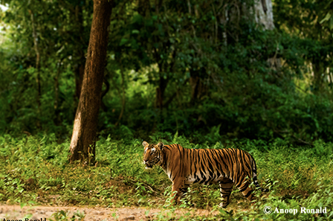
THANK YOU!
VISIT SOON!

