Slide 1

ShareSync
Patterson Consulting, LLC’s ShareSync service delivers easy-to-use, business-grade backup and file sharing

Slide 2

Agenda
Backup and file sharing in your business
Introducing ShareSync – a better way to backup and share your files
Why choose ShareSync?
Pricing and packaging
Notes:
Curt

Slide 3
Have you ever experienced this scenario?
Your computer hard drive crashed, and all your files are gone.
You’re at an off-site meeting, but left an important document back at the office.
It takes you hours to consolidate reports and updates from your team.
You edited an entire document, only to realize you didn’t see the email with the newer version.
Your new client cannot receive emails with large file attachments.
That your users are putting company data on services you cannot see and cannot manage.
Wouldn’t you rather be managing your business?
ShareSync can significantly reduce the amount of time you
and your employees spend on managing files and folders.

Slide 4
Presenting ShareSync:
Business-grade
Backup and File Sharing
Notes:
Viktor

Slide 5
ShareSync: Improve backup, mobility and collaboration
File backup. Real-time (not scheduled) backup for user files, with simple recovery
File sharing and collaboration. Sync and share files internally and externally using virtually any device, while maintaining control over file access permissions
Admin control and security. Keep your data safe and protected while consolidating two separate services for simpler management.
Business continuity and disaster recovery. SecuriSync keeps operations up and running across a number of scenarios, from stolen devices to ransomware outbreaks.

Slide 6
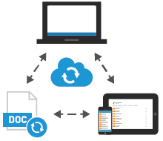
Backup & Sync Files with SecuriSync
File saved to ShareSync across your machine are backed up and synced in real time
Files stay up to date whenever an update is made
Backed up files are secured and instantly recoverable for those worst-case scenarios
Simple and familiar with support for Windows, Mac and virtually all browsers

Slide 7
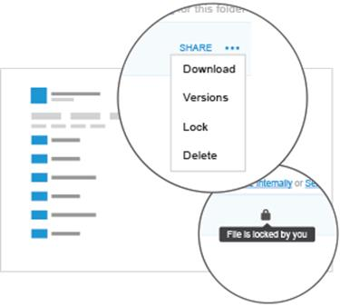
Share Folders
Easily share folders for collaboration
Share folders with co-workers or external users with one click
Share directly from the corporate address book
Control access with “Co-Owner,” “Modify”, and “View” permissions
Modify permissions at any time
Set different permissions for sub-folders
Change to files in shared folders are automatically synced
Easily share content with groups using Exchange Distribution Lists

Slide 8
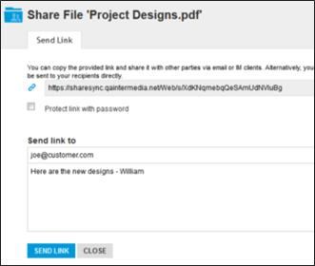
Share Files
Share files with anyone via web link
Any ShareSync file can be shared with anyone
Files can be viewed even if the recipient doesn’t use ShareSync
Can be shared using the Send Link function from the ShareSync web portal, or by copy/pasting the link into email
Links are secure, but can be further protected with a password

Slide 9

Business-grade Security Features
Share files with anyone via web link
Data is encrypted at-rest and in-transit
Each account’s data is encrypted with a unique security key
Only authorized users can access ShareSync
Strong-password policies are enforced
Mobile devices can be further secured with a ShareSync passcode
ShareSync data can be remotely wiped from virtually any device – including desktops and laptops
Audit Log tracks all ShareSync events on an account

Slide 10
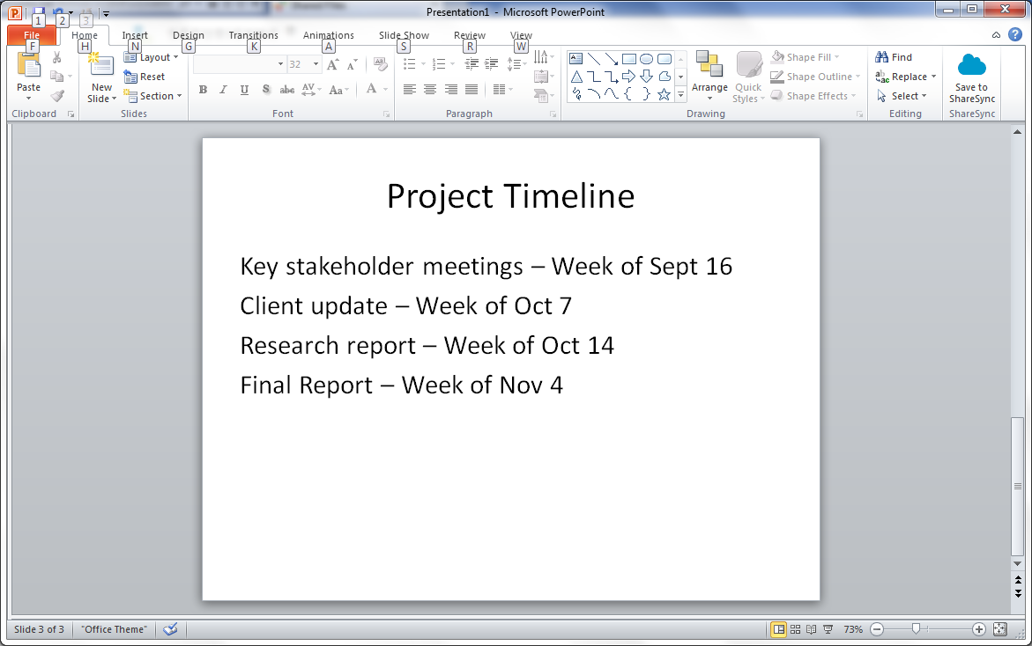
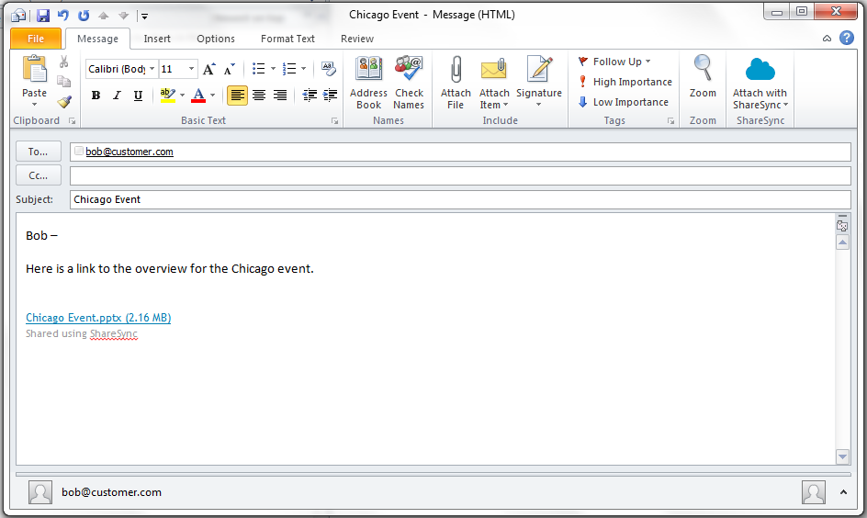
Integrates with Outlook and Office
Sync files right from Office programs
Save files to ShareSync directly from the ribbon on Word, Excel, and PowerPoint
Lock shared files to prevent conflicts
Restore previous versions
Share files without leaving Outlook
Send attachments as ShareSync links
Set up for on-demand or automatic link replacement

Slide 11
Live Demo
Demonstration Component
Use Case(s)
William backs up his files on his desktop – it’s instantly available on his Web browser, iPad and iPhone
Back up files online
Offline access to files while on the plane
Instant access to files updated by collaborators
William shares a folder with Nancy, a colleague – uses permission levels, collaboration, versioning, lock, and Office plug-in to share
Secure sharing
Collaborate with co-workers
Co-author files
File version management / Locking
Sharing with external collaborators
William uses the Outlook plug-in to share all files / a large file
Share files with any recipient
Joe loses his mobile phone and ShareSync data is immediately wiped
Device management

Slide 12
Why choose ShareSync?
Notes:
Viktor

Slide 13

ShareSync is the right choice for backup & file sharing
Immediately boost your company’s productivity
Intuitive functionality helps shorten the learning curve
Files are always backed up and available across every device
File sharing is intuitive for recipients – a simple click of a link in email
Business-grade security and control
Offers full control and protection of company data
Sharing permissions are easy to set and manage at any time
Integrates with Exchange, Outlook, Office, and Active Directory
99.999% service level agreement uptime
YOUR LOGO HERE

Slide 14
Compared to other backup and file sharing methods
vs. backup solutions
vs. traditional ways
of collaborating
vs. other provides of
suites of cloud services
vs. other sync/share
services
Carbonite
CrashPlan
Mozy
Dropbox
Box
Egnyte
Hightail (formally YouSendIt)
Email & attachments
File Servers
SharePoint
FTP Servers
Thumb Drives
Couriers/Bike Messengers
Microsoft (Office 365/OneDrive)
Google (Apps and Drive)
ShareSync:
ShareSync gives backed up files added benefits of file sharing and collaboration.
ShareSync also offers real-time backup which eliminates versioning gaps as file change multiple times during a day.
ShareSync:
Provides a high level of integration helping to minimize the adoption curve
Offers greater security and management, particularly for remote wipe
ShareSync:
More efficient way of working
Easy and intuitive for your employees to adopt
Easier to do business with external business partners and clients
Provides business owners with greater management and control
ShareSync:
Protect files with complete backup & restore solution built in
Is as easy to use, but offers higher degree of security and administrative controls (particularly compared to free versions)
Integrates with email and a complete suite of cloud services
Offers business-grade security and 99.999% uptime

Slide 15
Compared to Other Backup Solutions
 | ShareSync | Mozy Pro | Carbonite Pro | CrashPlan for Business
Retail price | Your Price /10GB/user Your Price /100GB/user Your Price/Unlim | $9.99/10GB/Act $19.99/50GB/Act $39.99/100GB/Act $94.99/250GB/Act $189.99/500GB/Act $379.99/1TB/Act | $133/Act for 1.5 TB | $10/user for Unlim
Month-to-month term | Yes | Yes | No | No
Real-time multi-folder backup for PC/Mac/File Server | Yes | Yes | Scheduled backup only | Yes
Secure file access from desktop, mobile, web | Yes | No | No | No
Audit Log | Yes | No | No | No
Microsoft Office integration | Yes | No | No | No
99.999% uptime SLA | Yes | No | No | No
How ShareSync wins |  | Higher value 2-in-1 offer Higher security & Admin control | Higher value 2-in-1 offer Higher security & Admin control | Higher value 2-in-1 offer Flexible pricing

Slide 16
Compared to Other Sync and Share Services
 | ShareSync | Box for Enterprise | Box for Business | Dropbox for Business
Monthly Price | Your Price | $35/user | $15/user | $15/user
Included storage | 10 GB | Unlimited | 1 TB/ Acct | Unlimited
Max file size | Unlimited | 2 GB | 2 GB | Unlimited
Support for all PC/Mobile platforms | Yes | Yes | Yes | Yes
Granular sharing permissions | Yes | Yes | Yes | No
Sub-folder sharing | Yes | No | No | No
Group Sharing | Yes | Yes | No | No
Free Secure External Sharing and Collaboration | Yes | $35/user | $15/user | Insecure
In-transit/At-rest encryption | Yes | Yes | Yes | Partial
Account-level encryption key | Yes | Yes | No | No
Lock files for editing | Yes | Yes | Yes | No
Active Directory integration | Yes | Yes | Yes | Yes
Office/Outlook integration (Windows) | Yes | Yes | Yes | No
Full-text Search (web/mobile) | Yes | Yes | Yes | No
Remote wipe of data | Yes | Yes | No | Yes
Audit Log of all events | Yes | Yes | Yes | Yes
One-stop shop for Cloud Services | Yes | No | No | No
99.999% uptime SLA | Yes | No | No | None
Gray-label branding for partners | Yes | No | No | No

Slide 17
Packaging and pricing
Notes:
Curt

Slide 18
ShareSync Pricing
Start using ShareSync today $19.95 Per user Includes 100 Gb of storage per user Storage is pooled across all users on the account Overage is charged at $3.00 per GB

Slide 19
ShareSync Pricing

