Slide 1
How to Use Zoom
David Ross
djross95@gmail.com

Slide 2
Background
First, create personal Zoom account at “zoom.us” web site
Zoom can be used on a PC/Mac, tablet, or cell phone (iPhone or Android)
  Need Zoom app from Zoom web site (PC or Mac), iOS or Android app stores
  App will download automatically when joining a Zoom meeting for the first time
Most people can get by with the free version, but there is a paid version as well ($150/yr.)

Slide 3
Two primary ways to use Zoom
Attend a Zoom call set up by someone else (most common scenario):
  Click on link in calendar invite or email
  Click “yes” to download and/or launch Zoom app (one time only for download)
  Select “computer audio” for sound source and “yes or no” for video
  Pay attention to audio & video “mute” buttons, “messaging”, and “share screen” options
  40-minute limit for free account calls
  Click “leave meeting” (bottom right of screen) to leave
Set up your own Zoom call and send out invites (not covered further here)

Slide 4
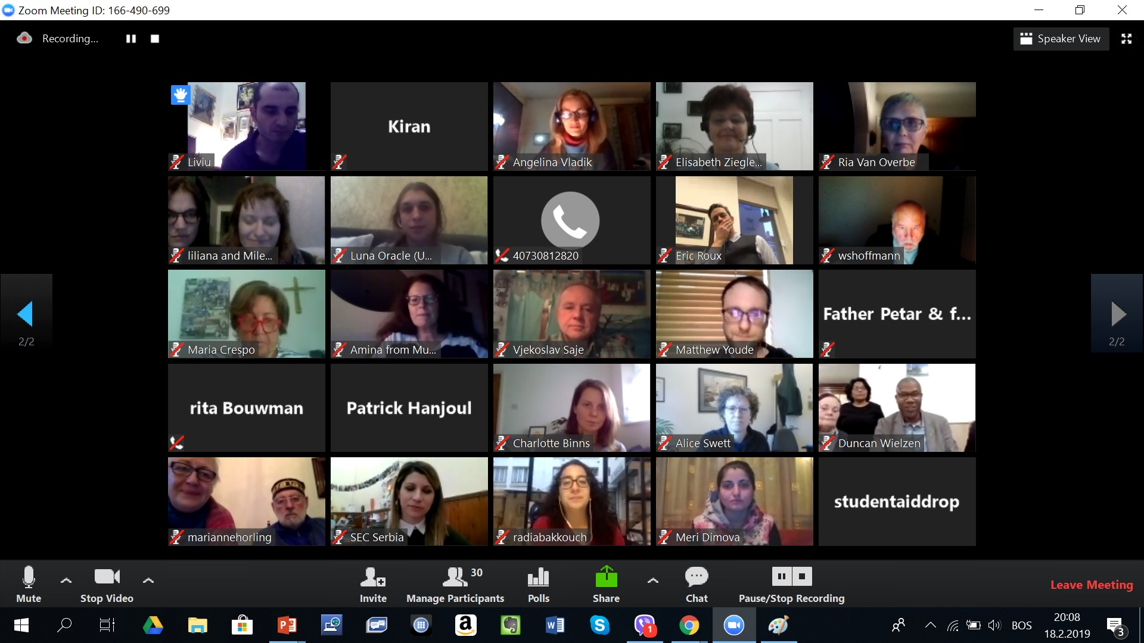
Zoom Main Window

Slide 5
Video Tutorials
https://www.youtube.com/watch?v=iagJnvy6lLY
https://www.youtube.com/watch?v=fMUxzrgZvZQ
Many more tutorials available on YouTube (www.youtube.com) – search for (what else?) “Zoom tutorials” !

Slide 6
Questions?
David Ross
djross95@gmail.com

