Slide 1
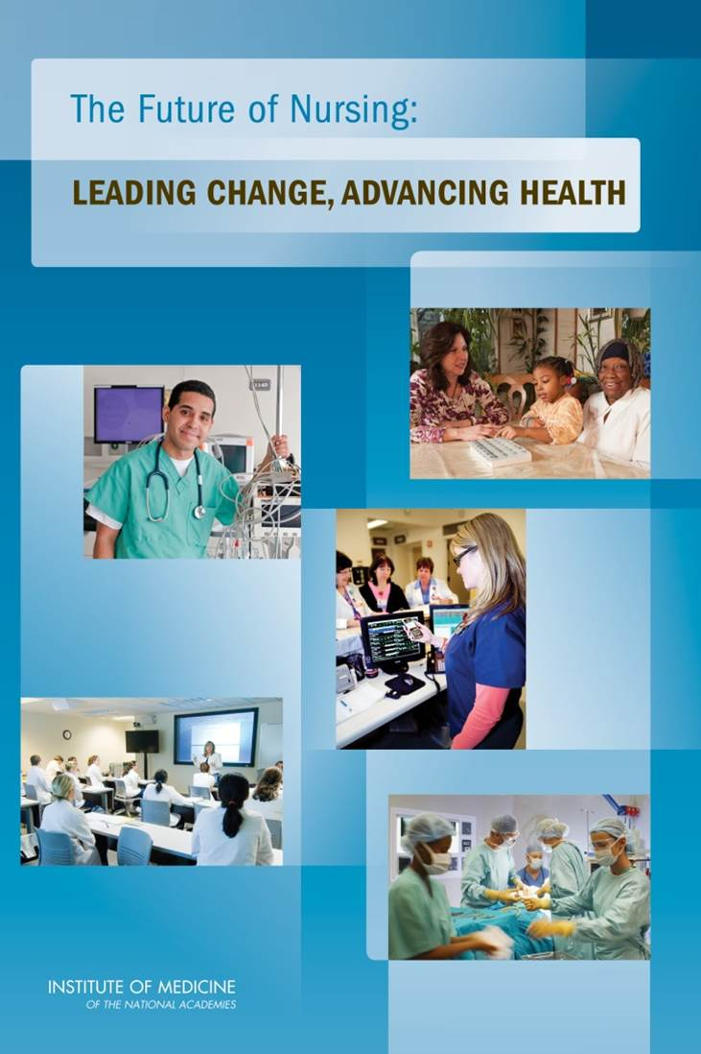
2010 Future of Nursing Report
Education
Scope of practice
Workforce data
Leadership
Notes:
In 2008, The Robert Wood Johnson Foundation and the Institute of Medicine, now called the National Academy of Medicine, launched a two-year initiative to assess and transform the nursing profession.
In 2010, a report called, The Future of Nursing: Leading Change, Advancing Health, was released that made recommendations for an action-oriented blueprint for the future of nursing.
Goals were identified in four key areas in the report:
•Education: Nurses should achieve higher levels of education and training through an improved education system that promotes seamless academic progression
•Scope of practice: Nurses should practice to the full extent of their education and training
•Workforce data: Effective workforce planning and policy making require better data collection and an improved information infrastructure
•Leadership: Nurses should be full partners, with physicians and other health care professionals, in redesigning health care in the United States
Some of the key “wins”:
Education
The number of RN-to-BSN graduates increased 180% from 2010 to 2017.
Since 2010, the number of employed nurses with a doctoral degree has more than doubled.
The number of people receiving nursing doctoral degrees annually has risen 375% from 2010 to 2017 for DNPs; and nearly 50% from 2010 to 2017 for PhDs
While many states will not reach 80% by 2020, Action Coalitions and their partnering organizations around the country have built a solid infrastructure that will continue to scale academic progression partnerships and reduce barriers nurses have historically faced in advancing their education.
Scope of practice
Currently, 22 states, the District of Columbia and Guam grant full practice authority to one or more APRN roles upon licensure and/or certification. 16 states, Puerto Rico and the Virgin Islands grant reduced practice. 12 states operate under restricted APRN practice.
In 2016, a MAJOR win: Nurses broke records in response to the VA proposed rule on APRNs– flooded the system with more than 177k comments. As a result 3 of the 4 advanced practice roles (NOT CRNAs) were granted full practice authority in the VA.
The number of nurse-led clinics in the United States, affiliated with the National Nursing Centers Consortium, rose from 16% from 2011 to 2016.
Workforce data
In general, we are seeing people pay more attention to nurses and we are getting better data on the nursing workforce, in particular from the U.S. Bureau of Labor Statistics, the Centers for Medicare and Medicaid Services and the Health Resources and Services Administration.
Between 2010 and 2015, many states increased the number of data items they collect on the nurse workforce in response to the IOM report.
The National Forum of State Nursing Workforce Centers reports that more than 70% of State Nursing Workforce Centers are partners with Action Coalitions in their states—a step toward creating a comprehensive collection of workforce data that integrates the diverse sources of statistics.
The number of state nursing boards that participate in Nursys Quick Confirm data system increased nearly 12% from 2011 to 2017. And the number of state nursing boards that participate in Nursys Licensure Verification data system increased 15% in the same 5 year window. (Nursys is the only national database for verification of nurse licensure, discipline, and practice privileges for registered nurses and licensed practical nurses/licensed vocational nurses licensed in participating boards of nursing, including all states in the Nurse Licensure Compact.)

Slide 2
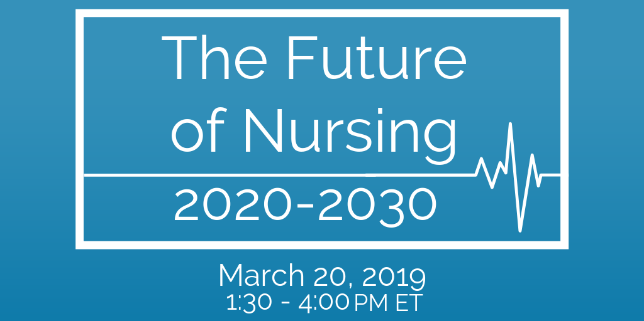
Learn More: nam.edu/FutureofNursing2030
Notes:
The Robert Wood Johnson Foundation has tasked the committee with extending the vision for the nursing profession into 2030 and to chart a path for the nursing profession to help create a culture of health, reduce health disparities, and improve the health and well-being of the U.S. population in the 21st century.
In examining current and future challenges, the committee will consider:
The role of nurses in improving the health of individuals, families, and communities by addressing social determinants of health and providing effective, efficient, equitable, and accessible care for all across the care continuum, as well as identifying the system facilitators and barriers to achieving this goal.
The current and future deployment of all levels of nurses across the care continuum, including in collaborative practice models, to address the challenges of building a culture of health.
System facilitators and barriers to achieving a workforce that is diverse, including gender, race, and ethnicity, across all levels of nursing education.
The role of the nursing profession in assuring that the voice of individuals, families and communities are incorporated into design and operations of clinical and community health systems.
The training and competency-development needed to prepare nurses, including advance practice nurses, to work outside of acute care settings and to lead efforts to build a culture of health and health equity, and the extent to which current curriculum meets these needs.
The ability of nurses to serve as change agents in creating systems that bridge the delivery of health care and social needs care in the community.
The research needed to identify or develop effective nursing practices for eliminating gaps and disparities in health care.
The importance of nurse well-being and resilience in ensuring the delivery of high quality care and improving community health.
The Committee on the Future of Nursing 2020-2030 held its first public session on March 20 at the National Academy of Sciences building in Washington, D.C., and online.
This public session is one of many processes that the committee will use to gather information and assemble evidence that members will examine

Slide 3
Join the conversation using #FutureofNursing2030 on Twitter!

