Slide 1



Autumn Leaves are Falling Down
MATERIALS AND DIRECTIONS:
Print out the leaves.
Glue the leaves sheet on another piece of paper or cardstock.
Cut out the leaves in a circle form.
Print out the target words.
Cut out and glue the target words on the back of the leaves.
Laminate the leaves
Cut out the laminated leaves.
Add adhesive Velcro to the back of the leaves under the target word picture.
Print out the tree trunk
Glue the tree trunk sheet on cardstock.
Laminate the tree trunk sheet.
12. Add Velcro to the branches and 2 Velcro pieces to the base of the tree/ground area.
13. Add and layer the leaves on the branches and base of the tree.
14. Print out the “I spy” card. Glue on cardstock and cut out the card/cards.
15. Laminate the “I spy” card/cards.
16. Purchase and use mini magnifying glasses from Amazon.
www.jabberjawkids.com
https://www.instagram.com/jabberjawkids/
https://www.facebook.com/JabberJawKidsLLC/
Visit my Jabber Jaw Kids store at https://wow.boomlearning.com/store/authorId/MWnJMe3dXhiBCyEHn/?collection=Decks&sort=publishDate&order=-1

Slide 2



Clipart acknowledgments: SillyODesign, FlapJack Educational Resources, Chirp Graphics, and Speech Doodles

Slide 4
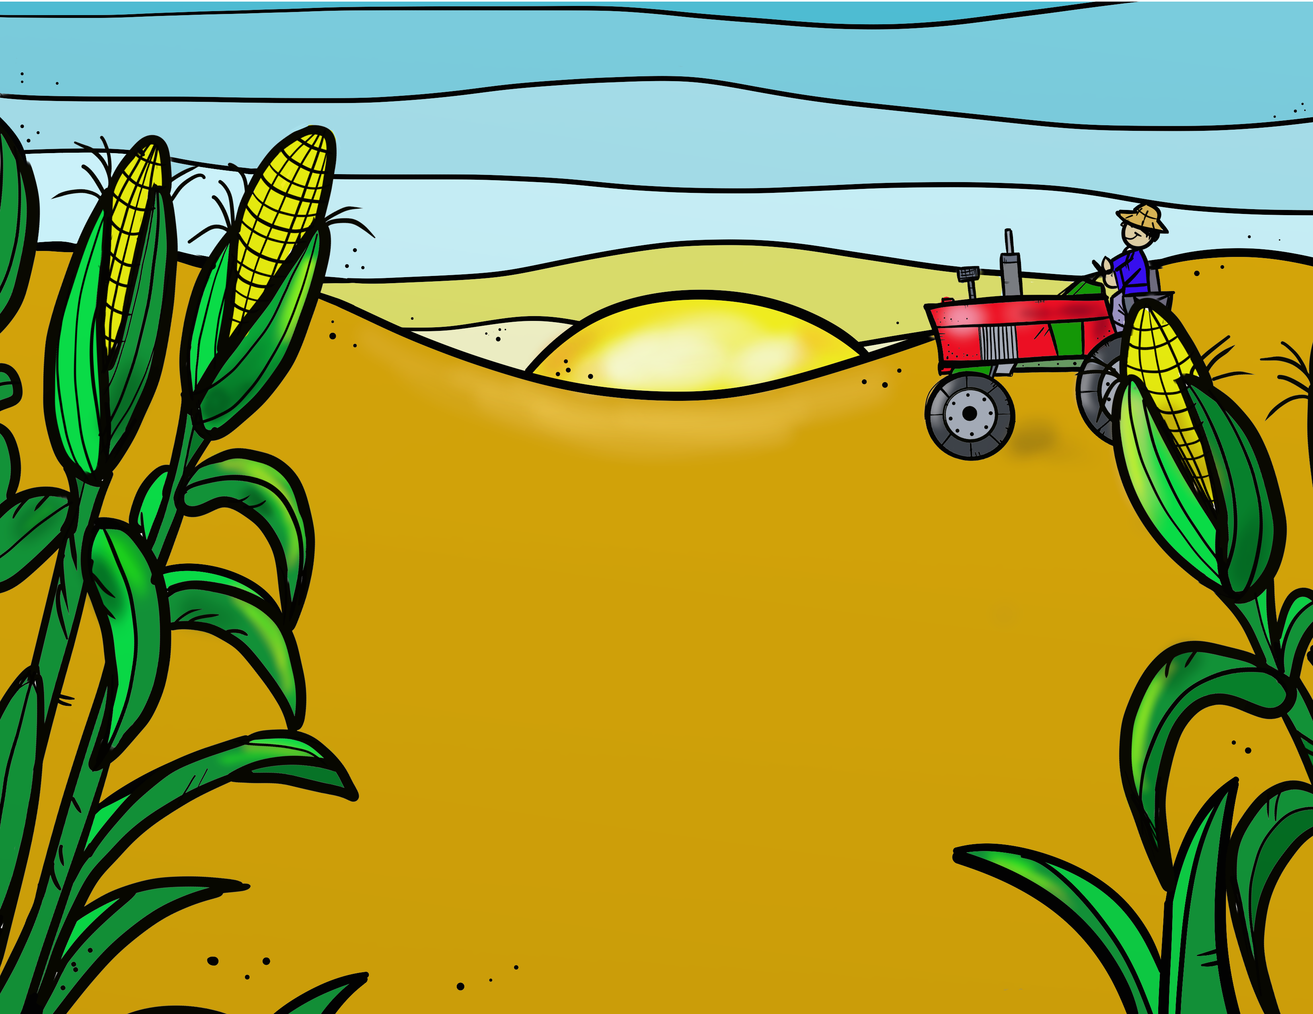


Slide 5


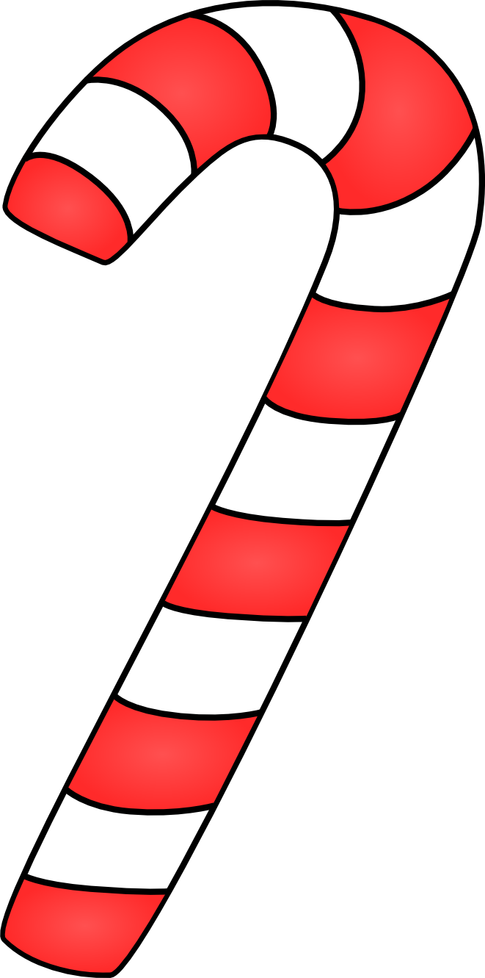
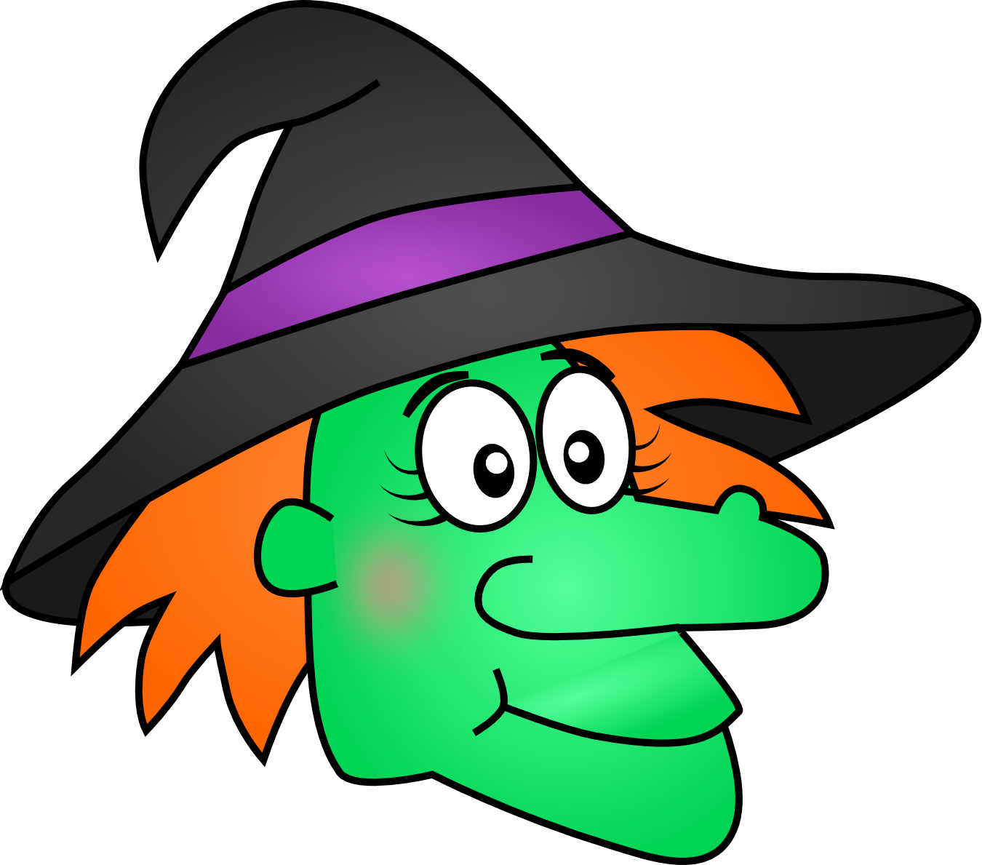

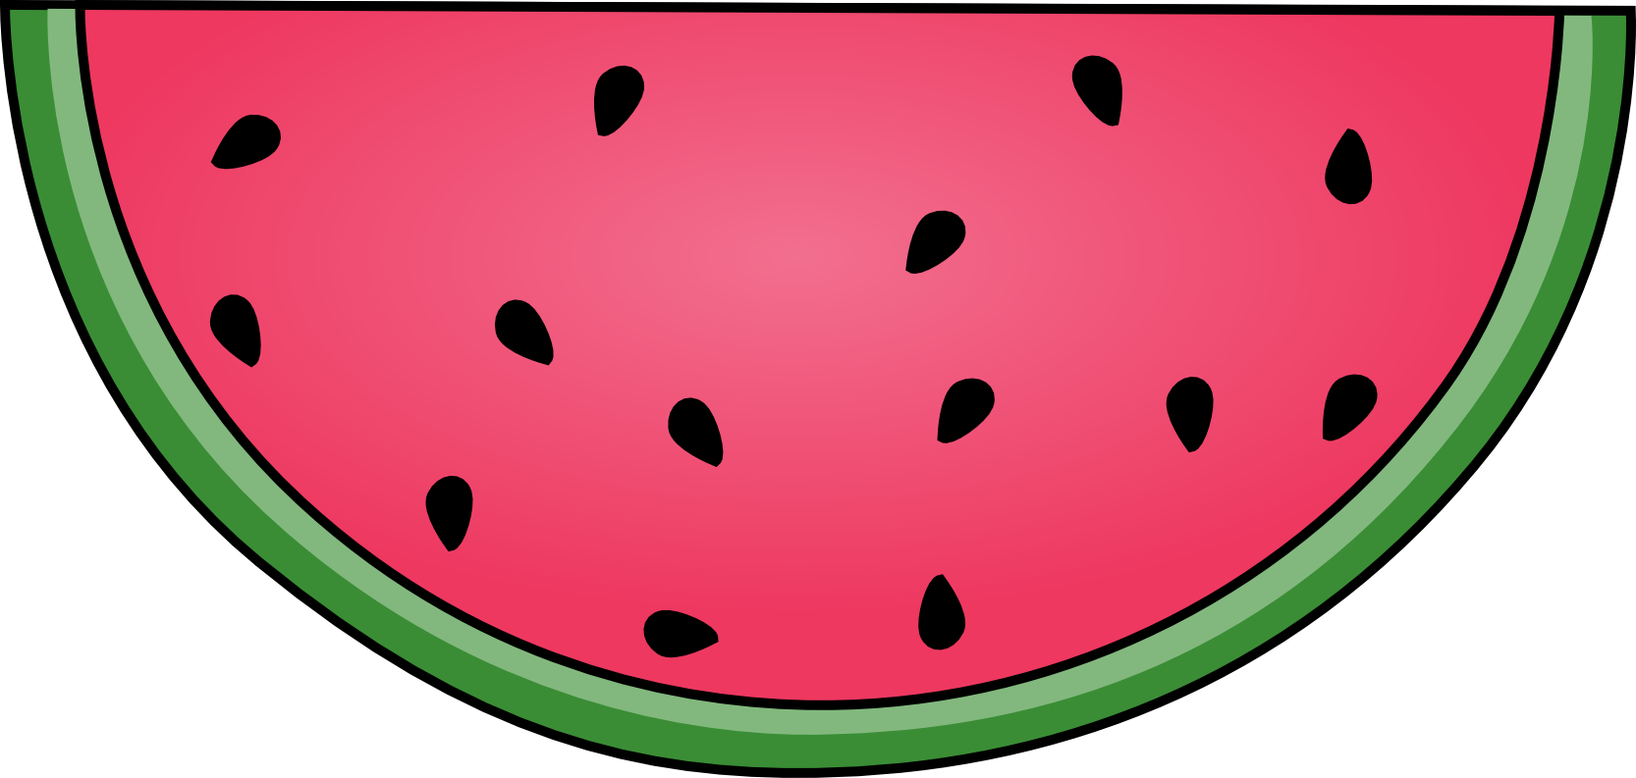
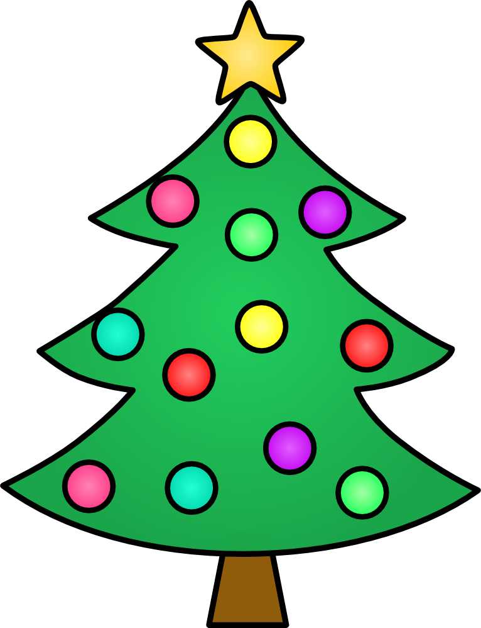
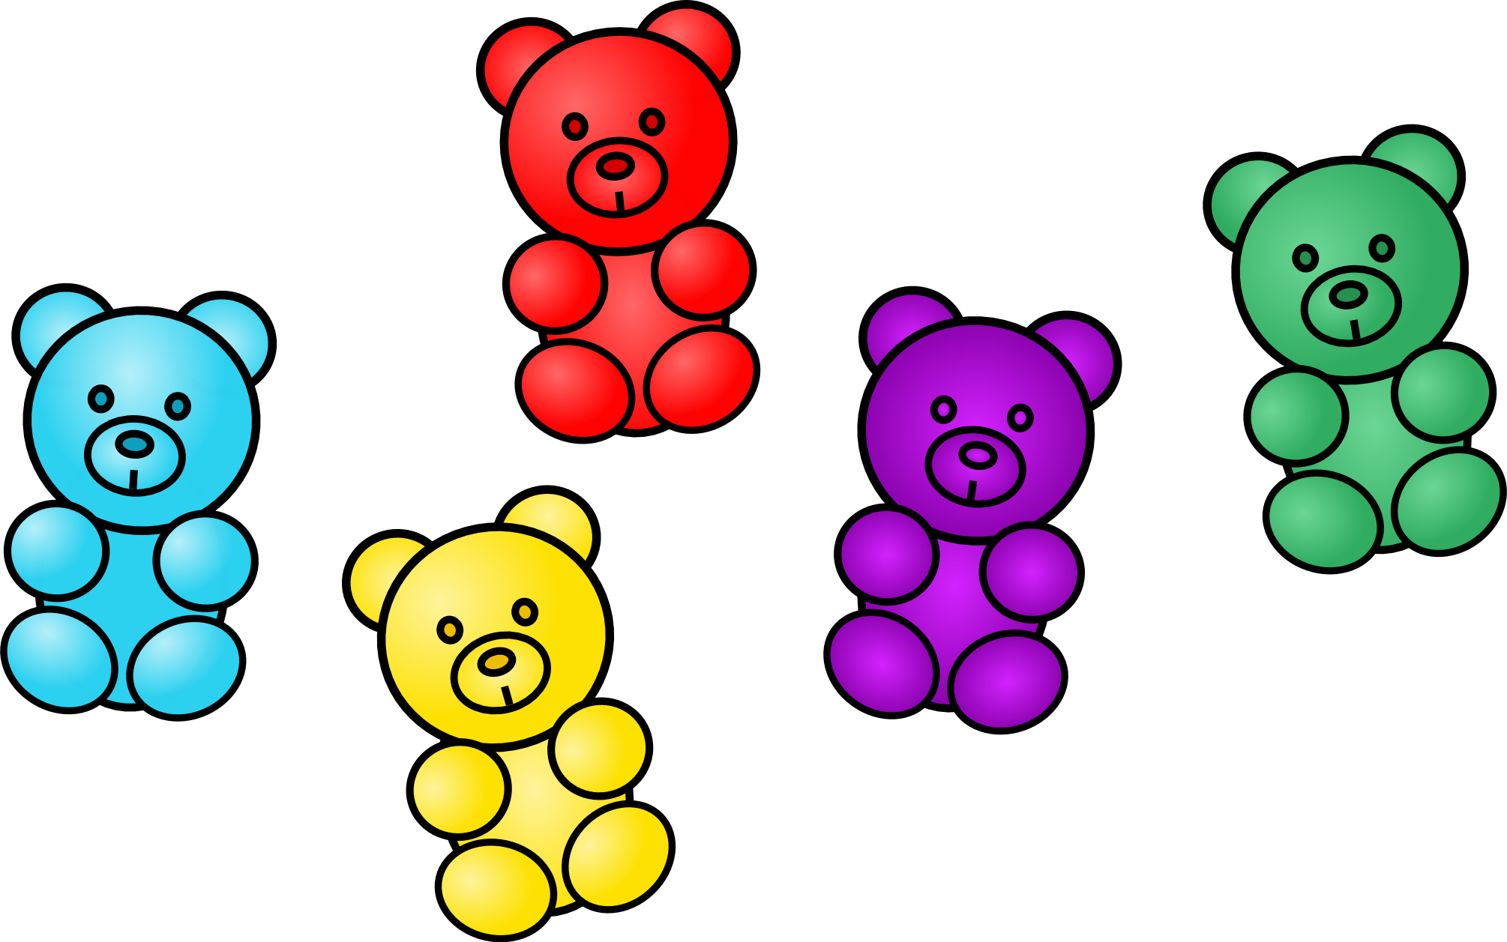
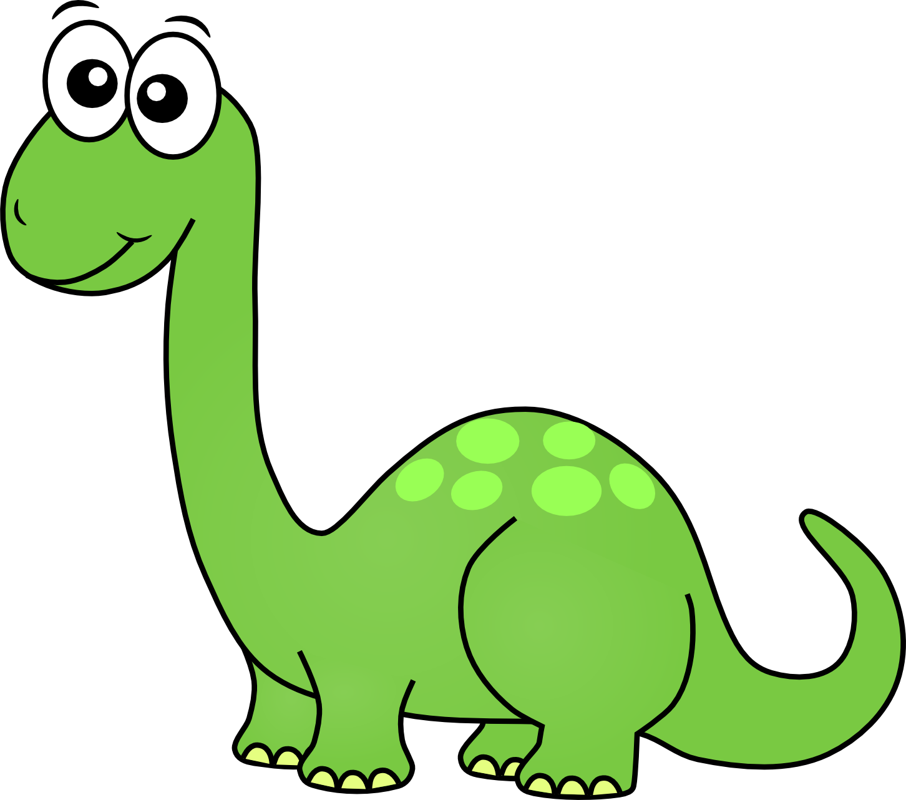
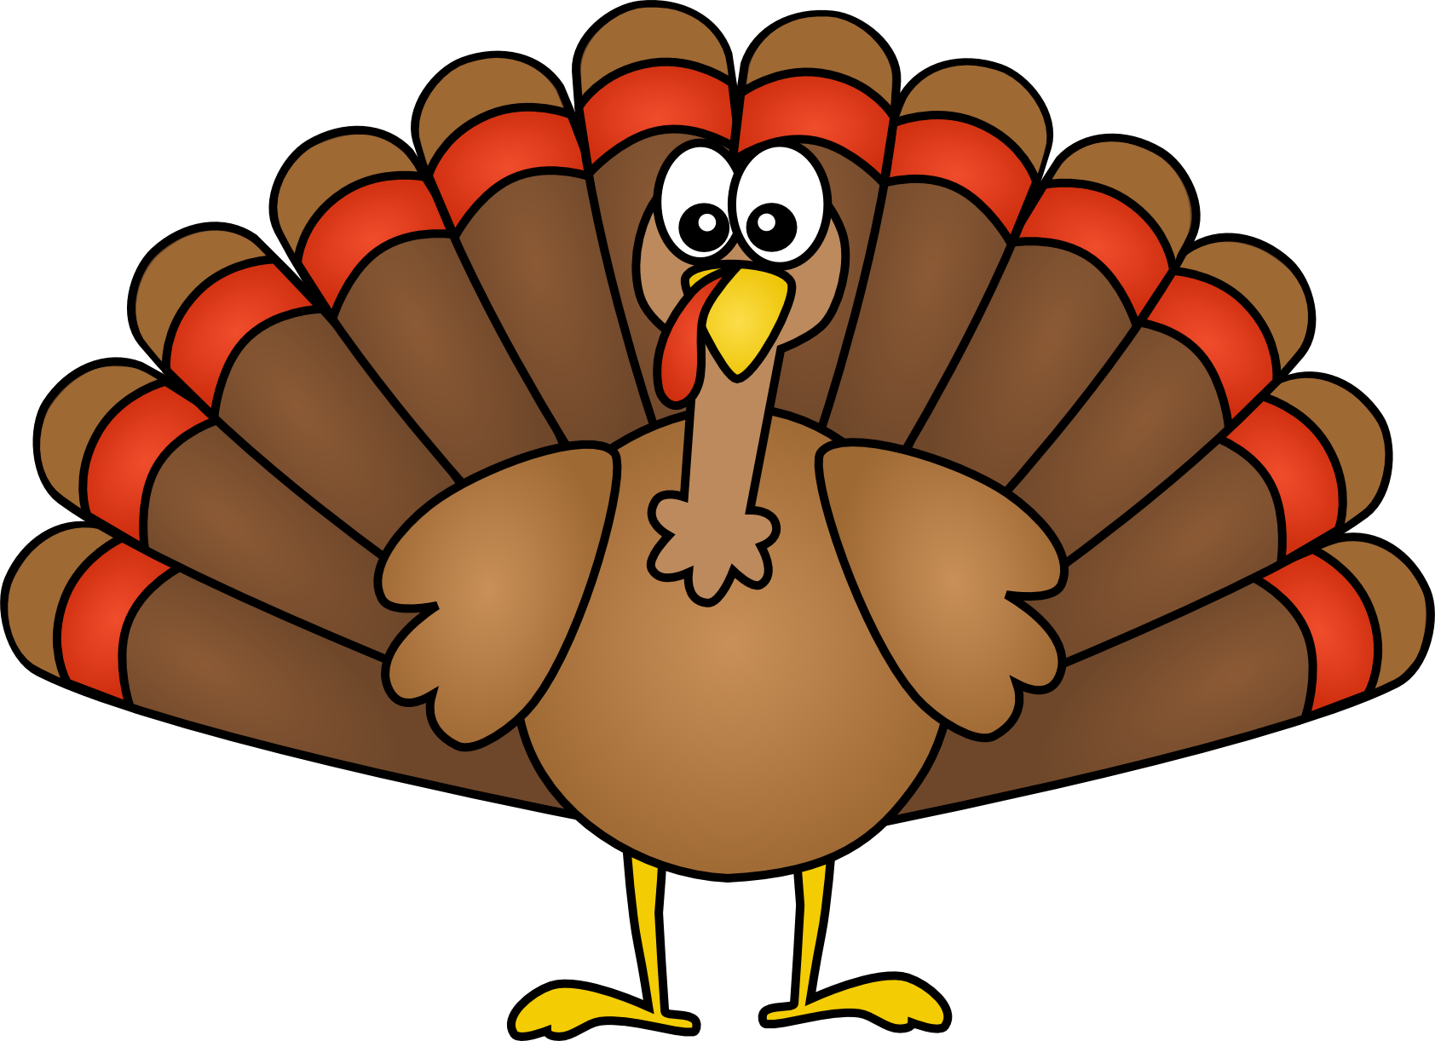
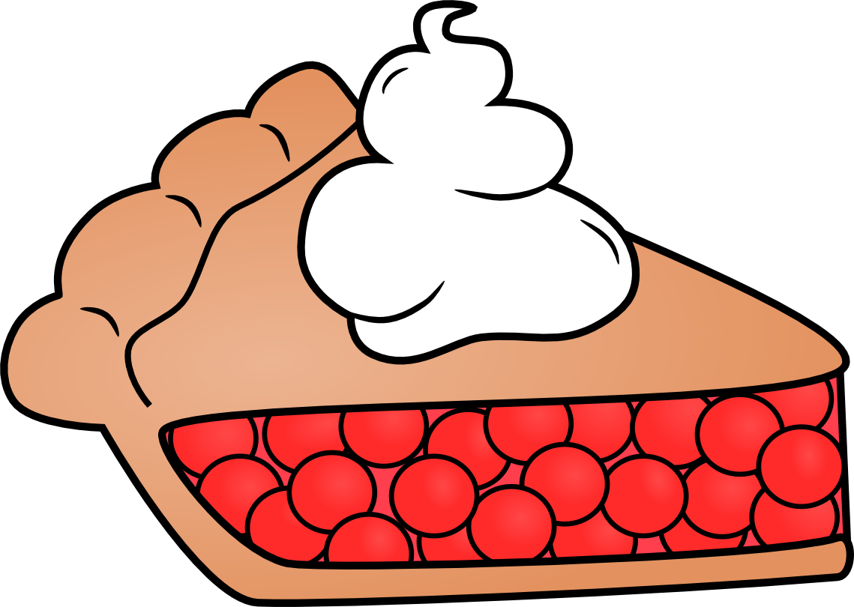
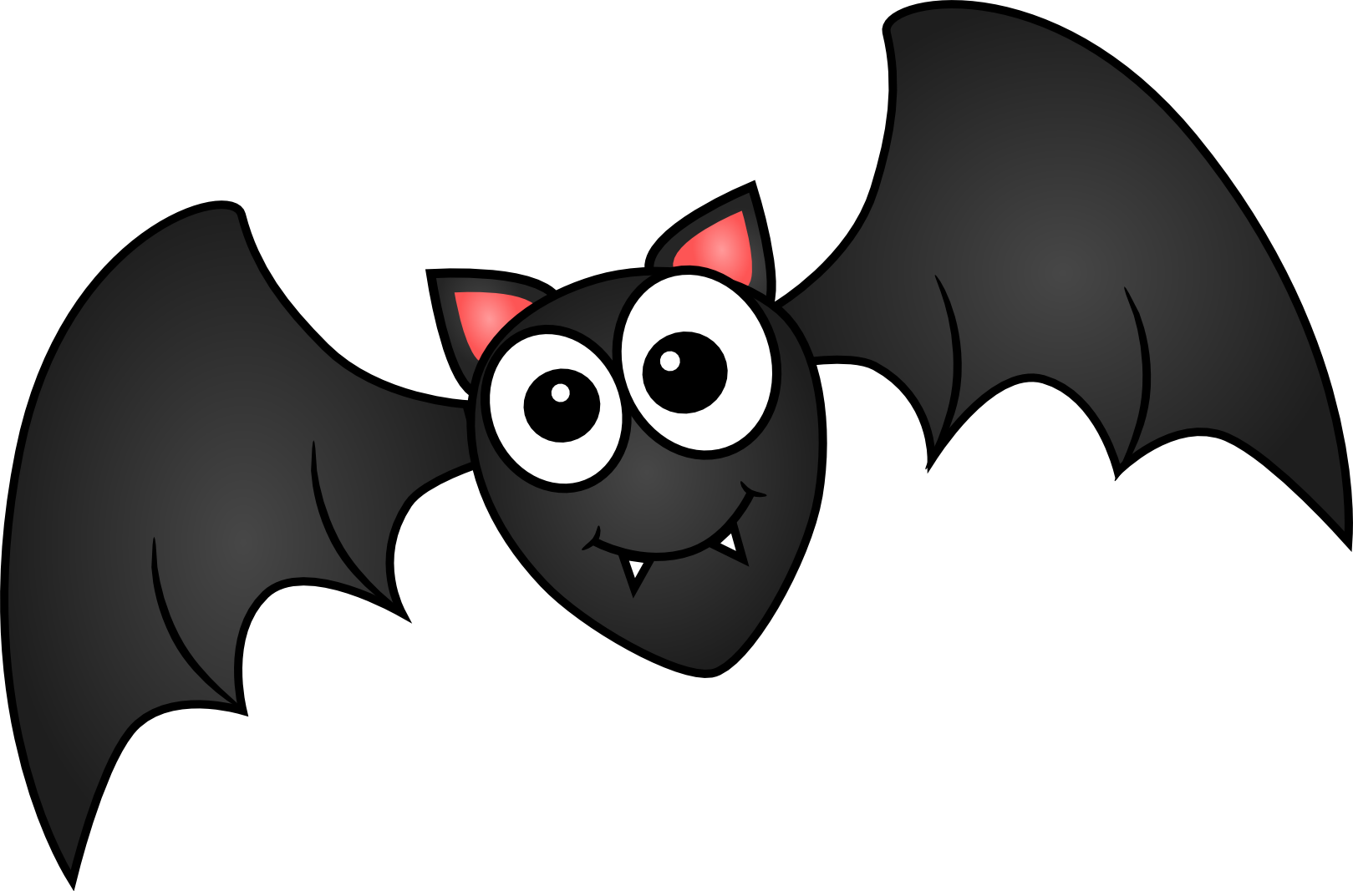

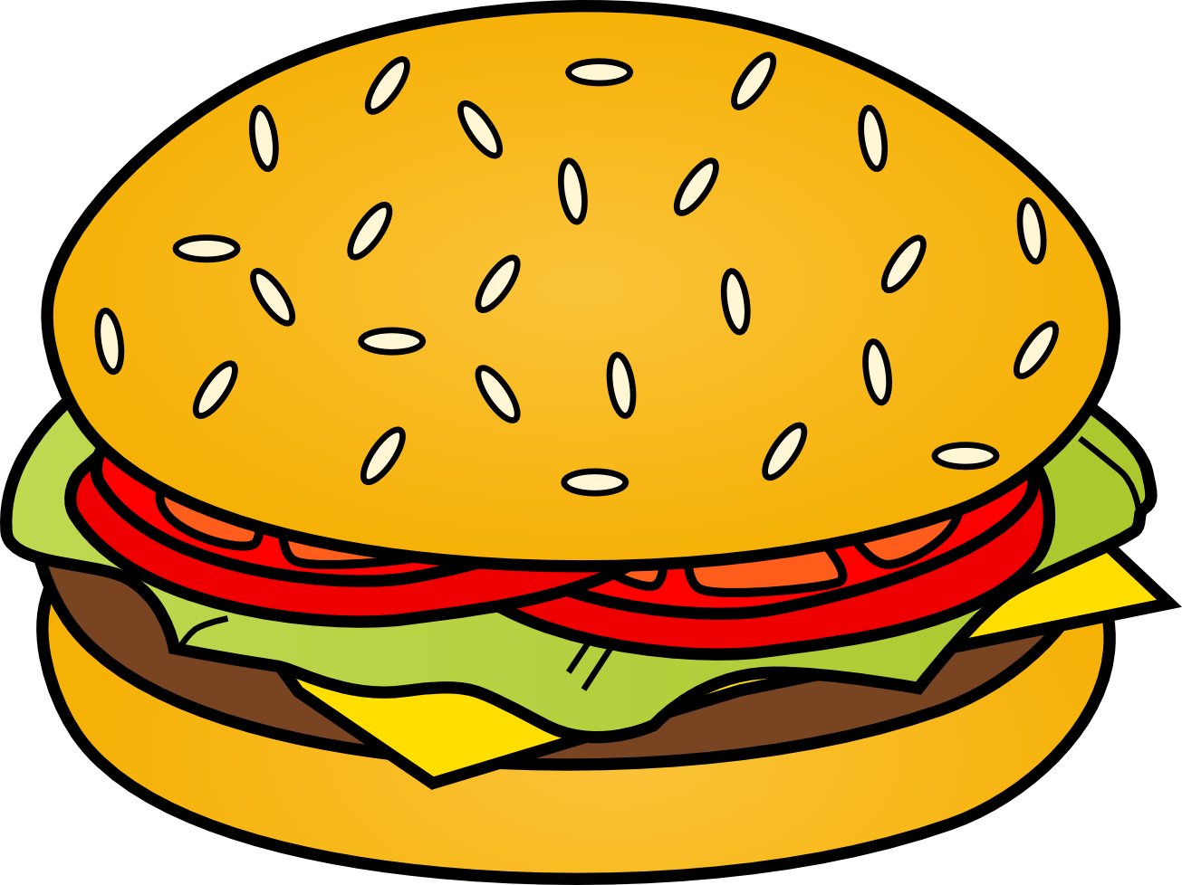

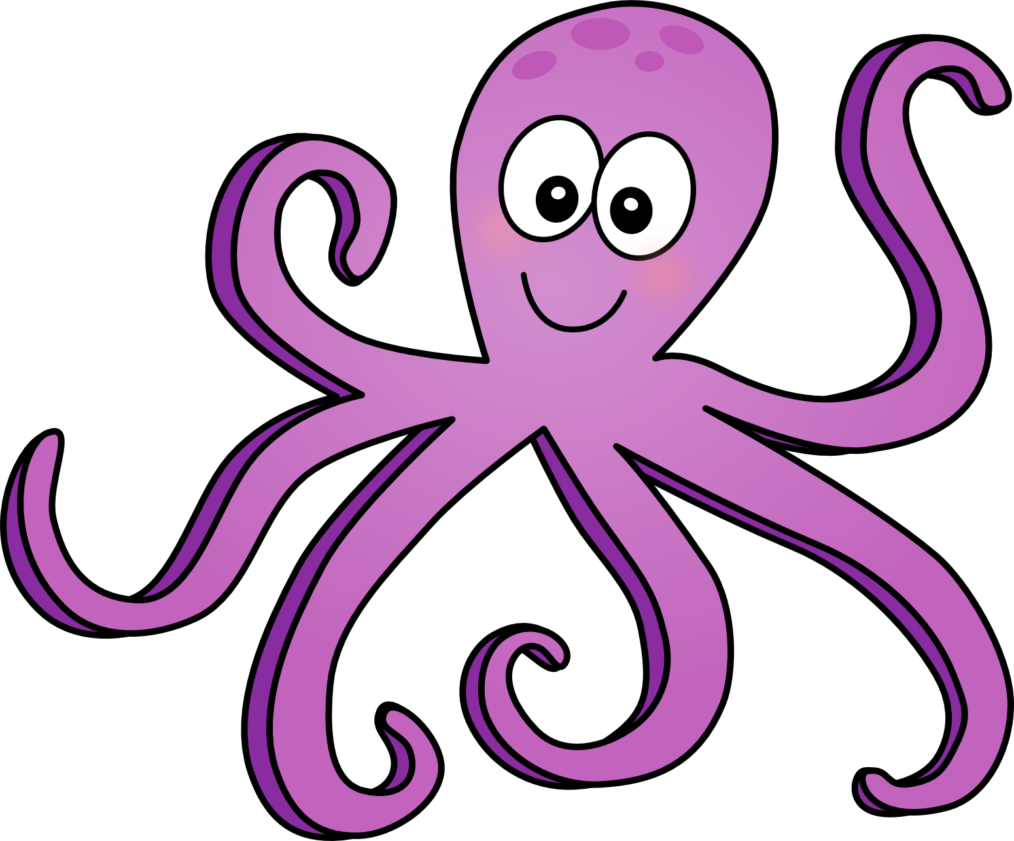

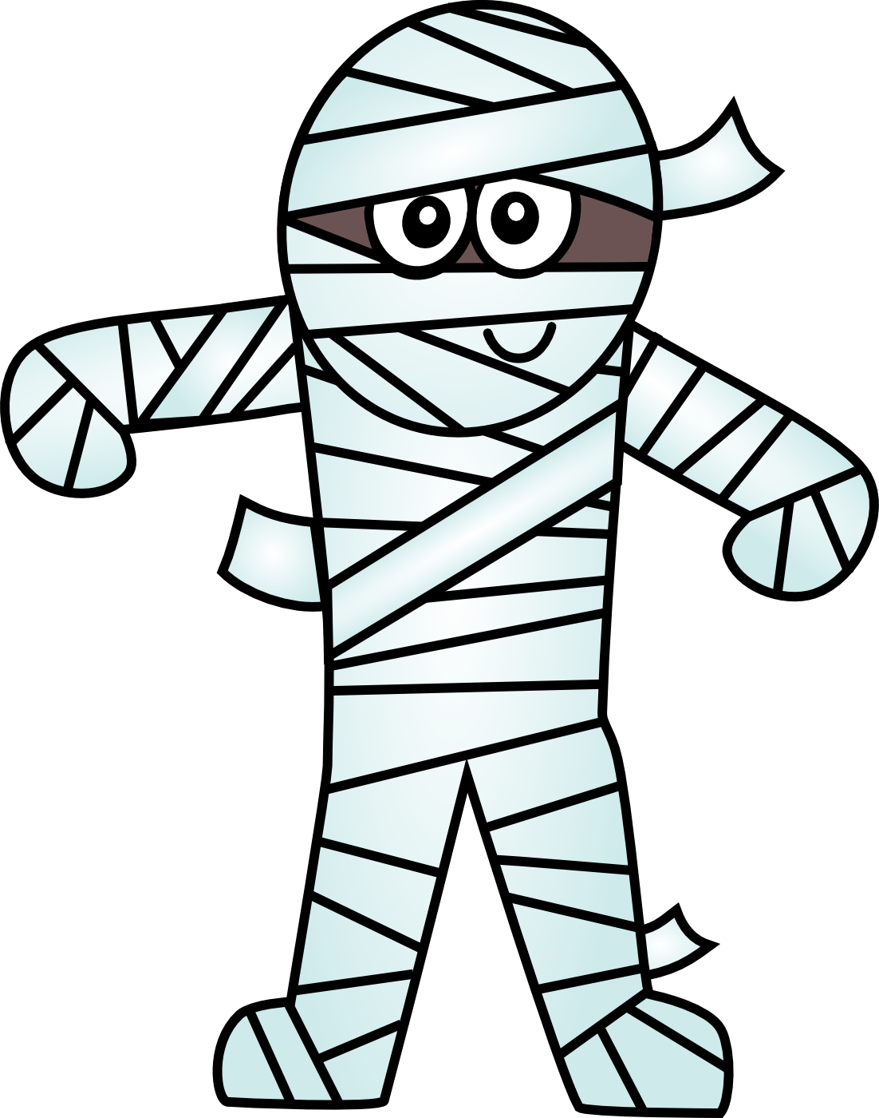
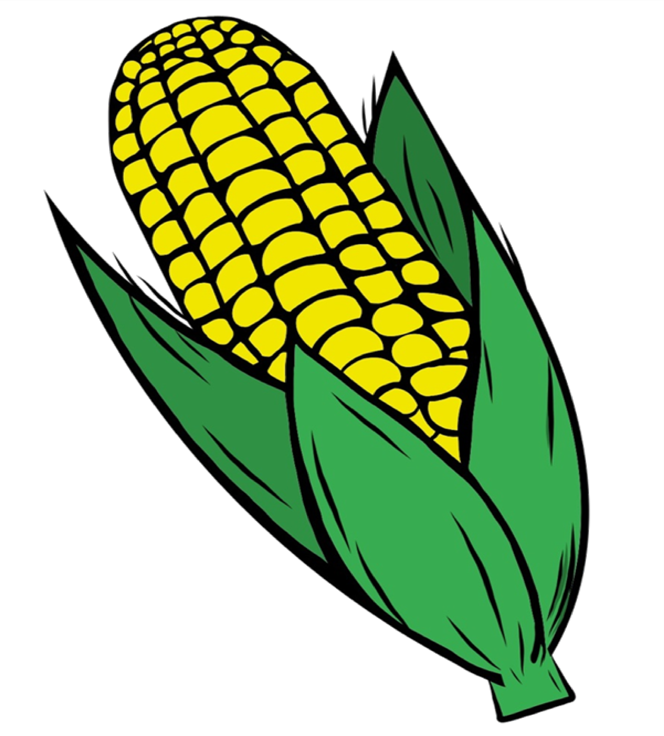
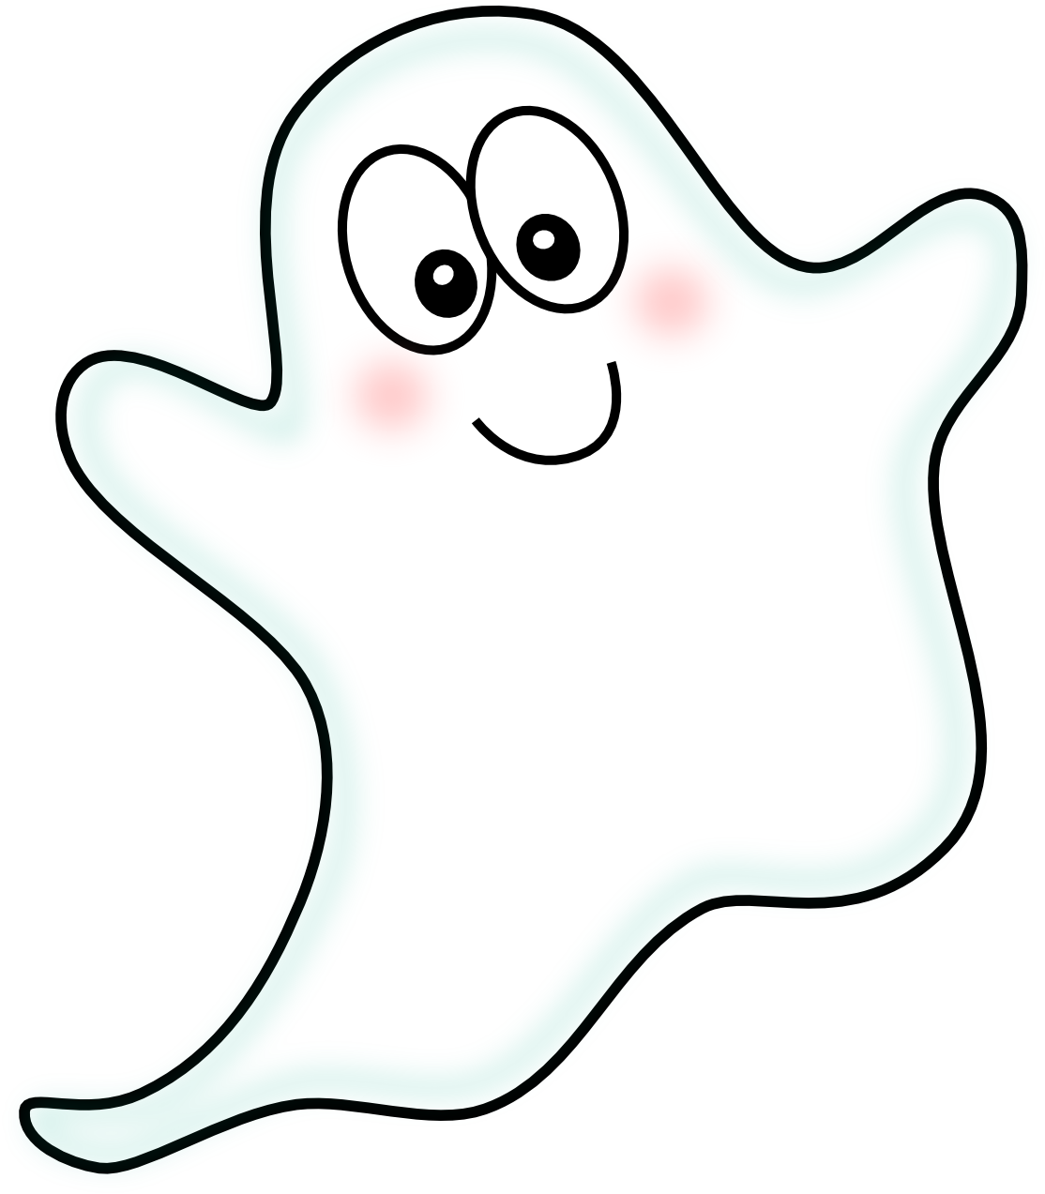
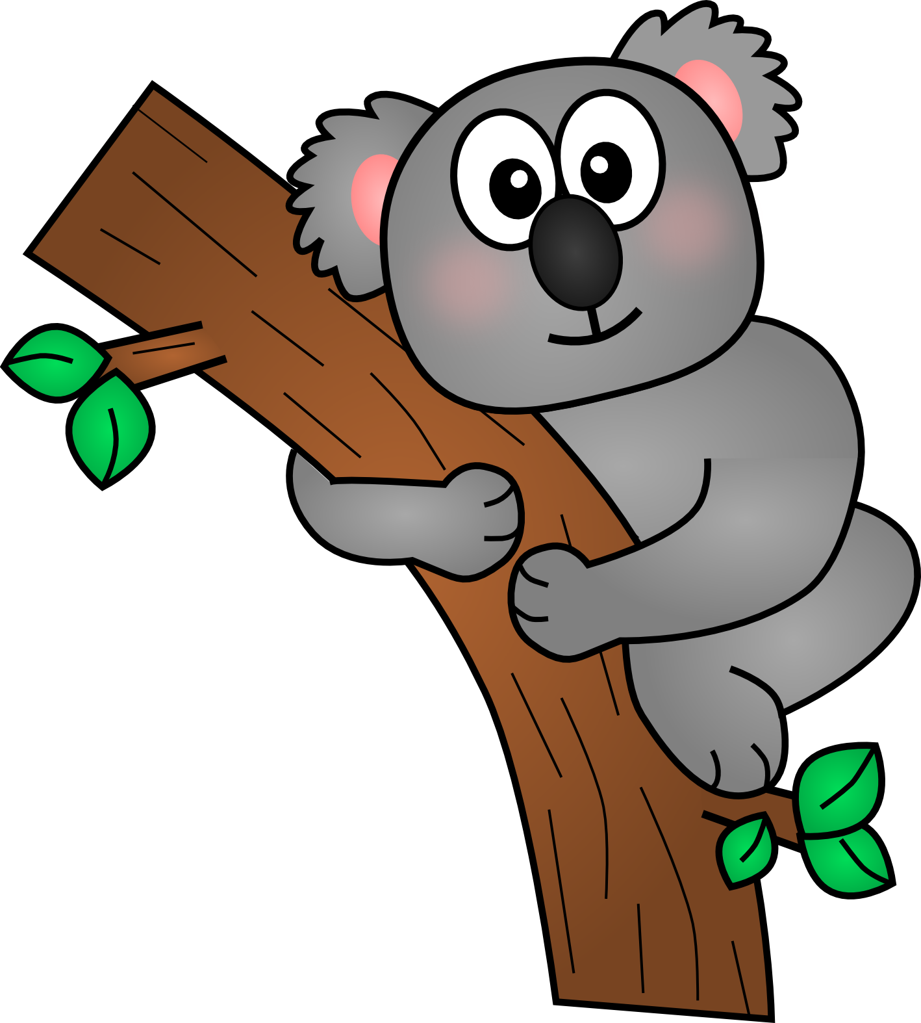
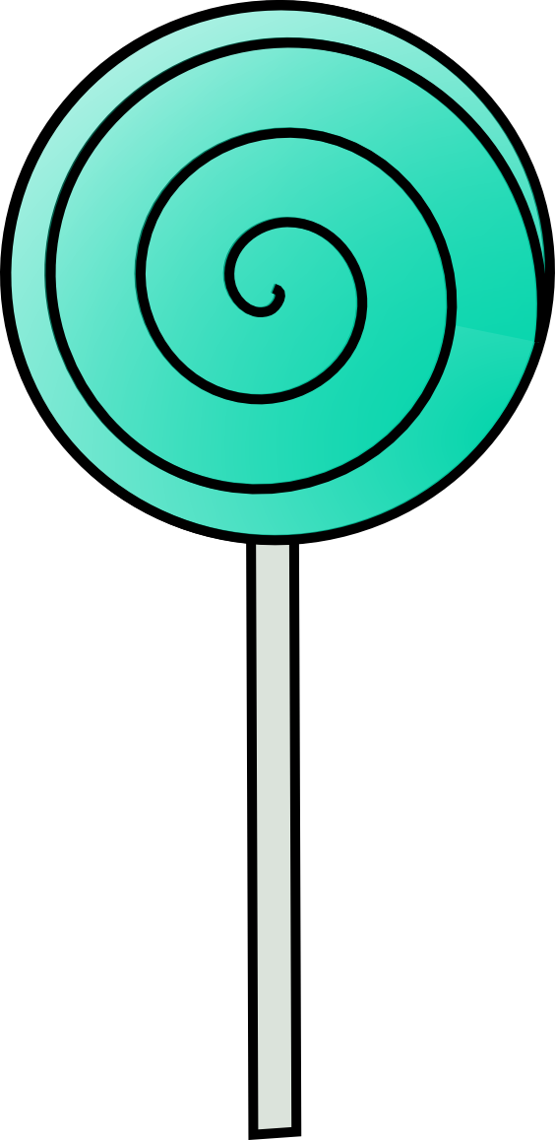
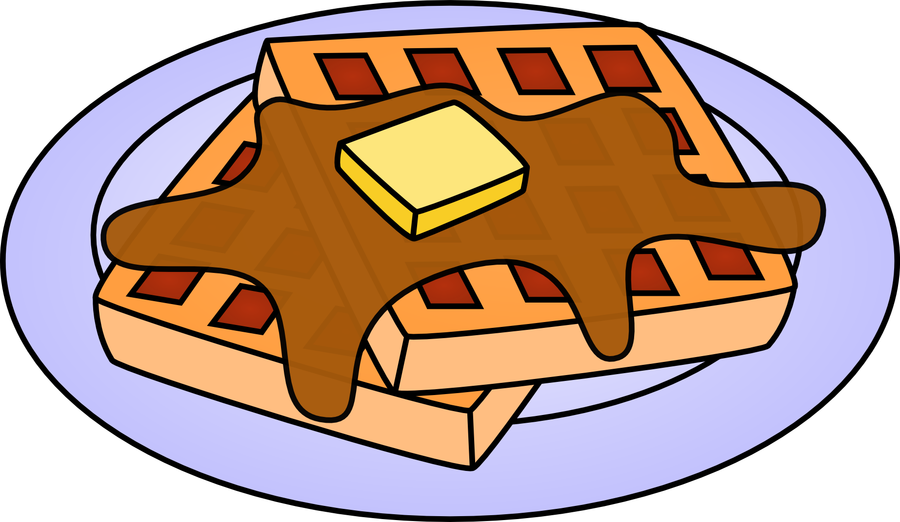
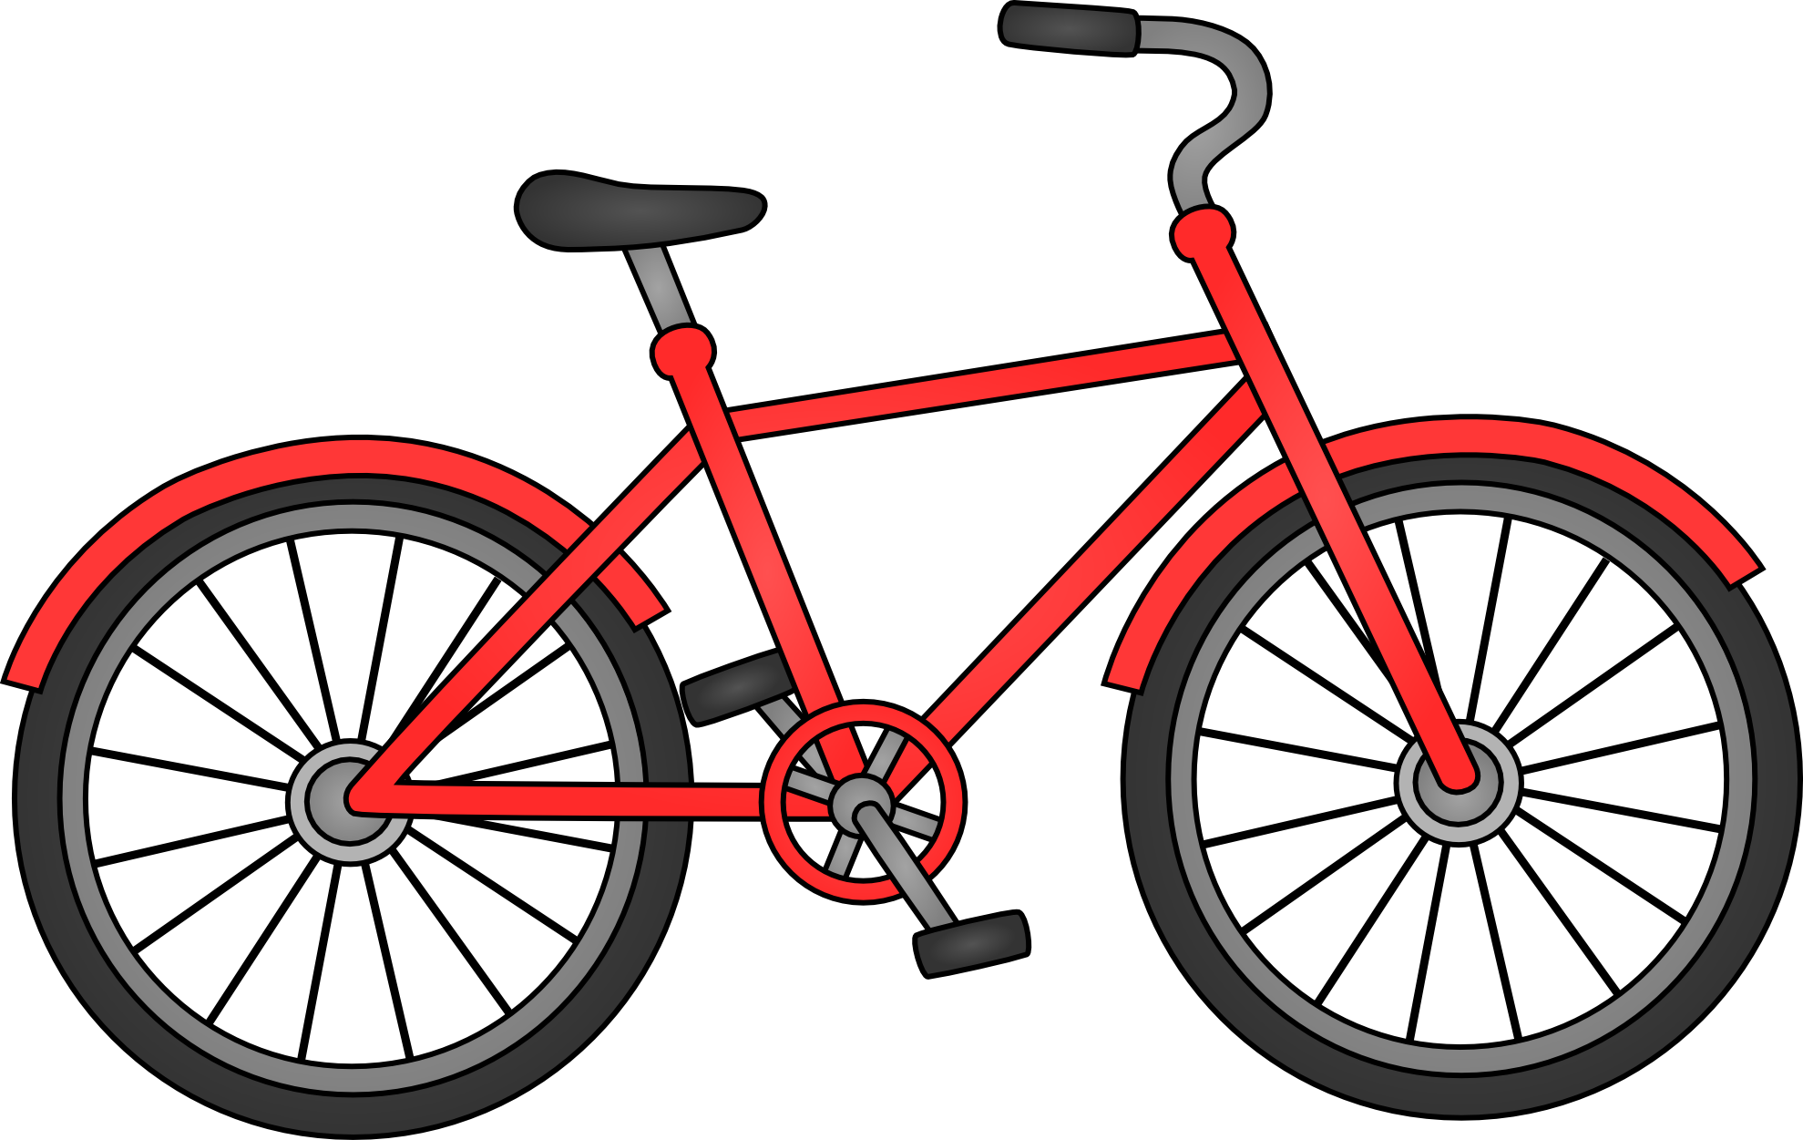
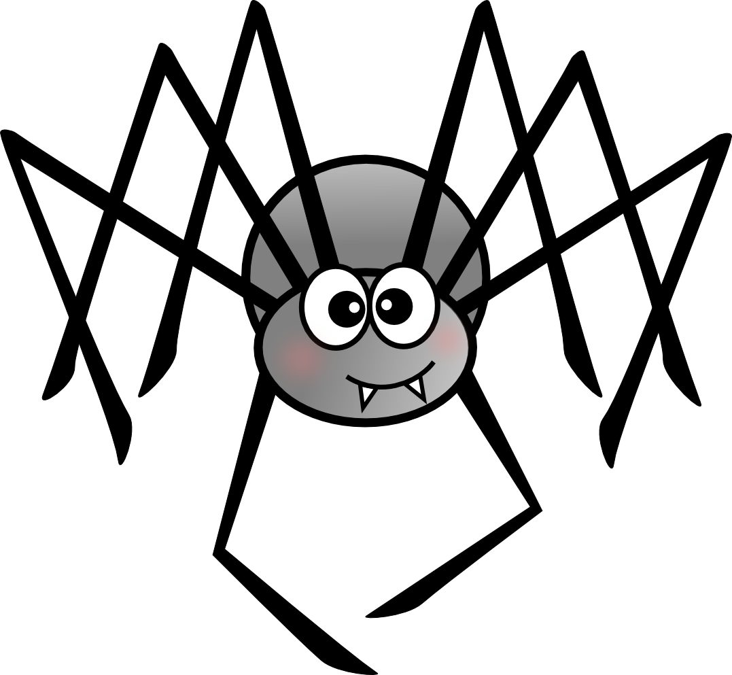
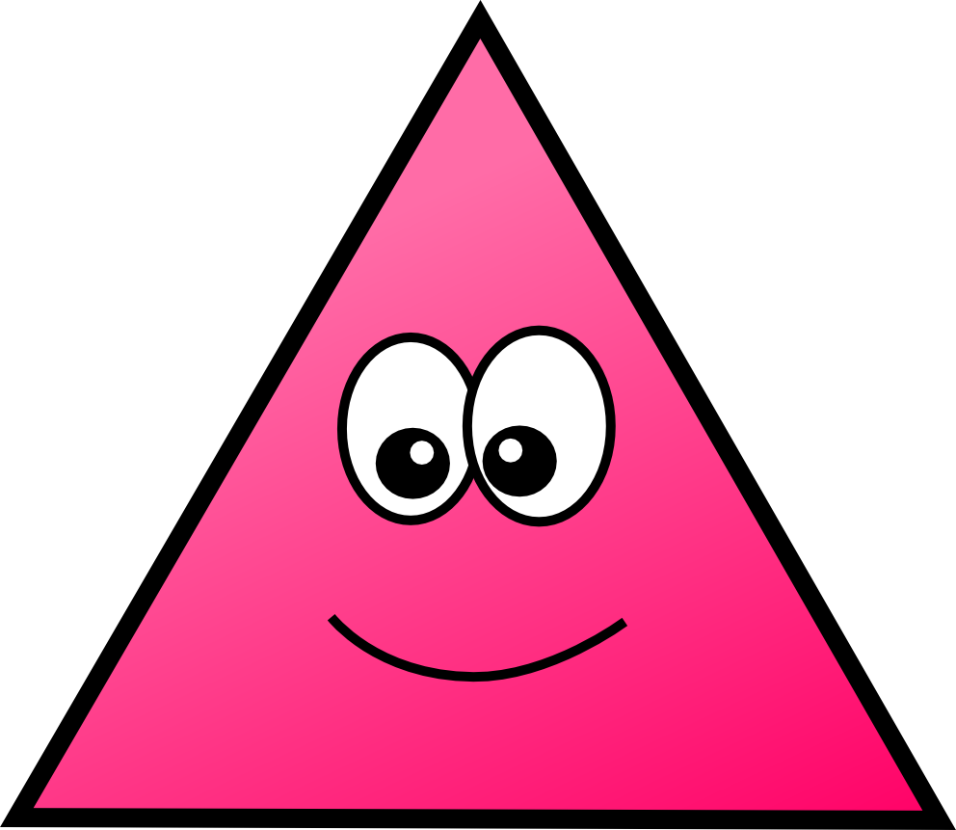

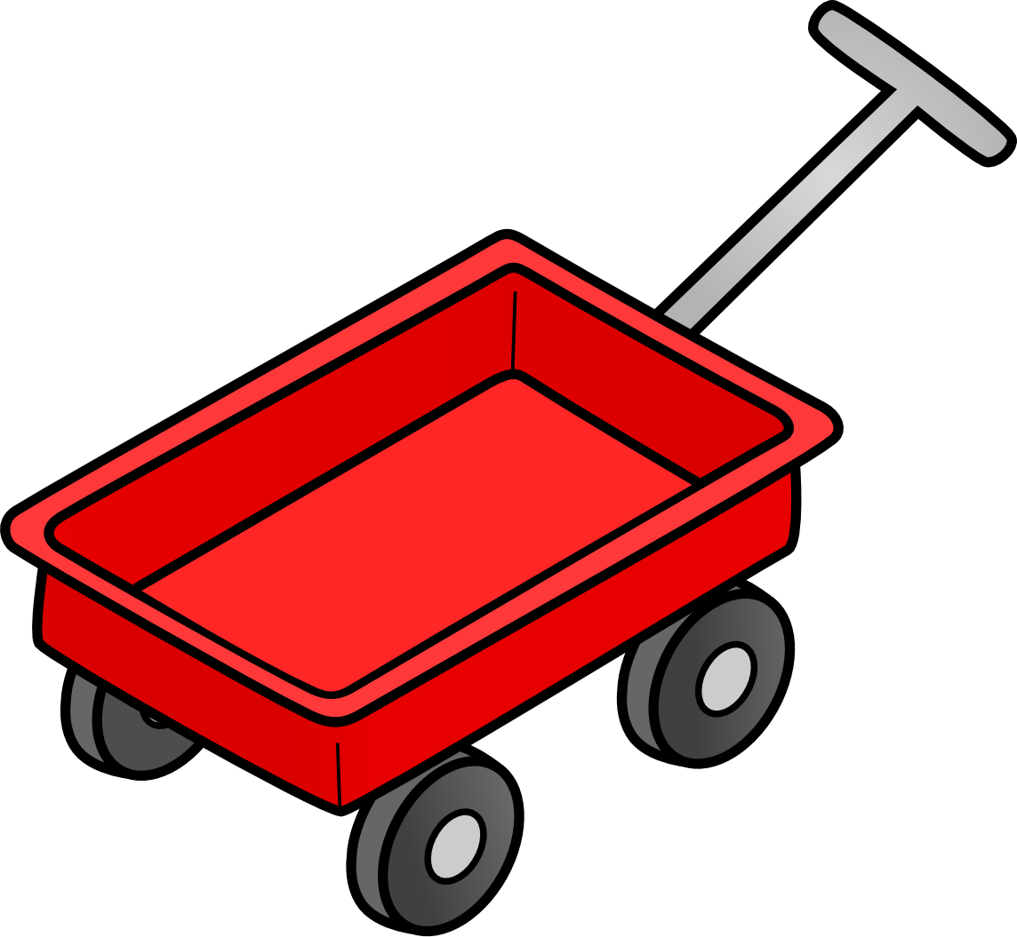
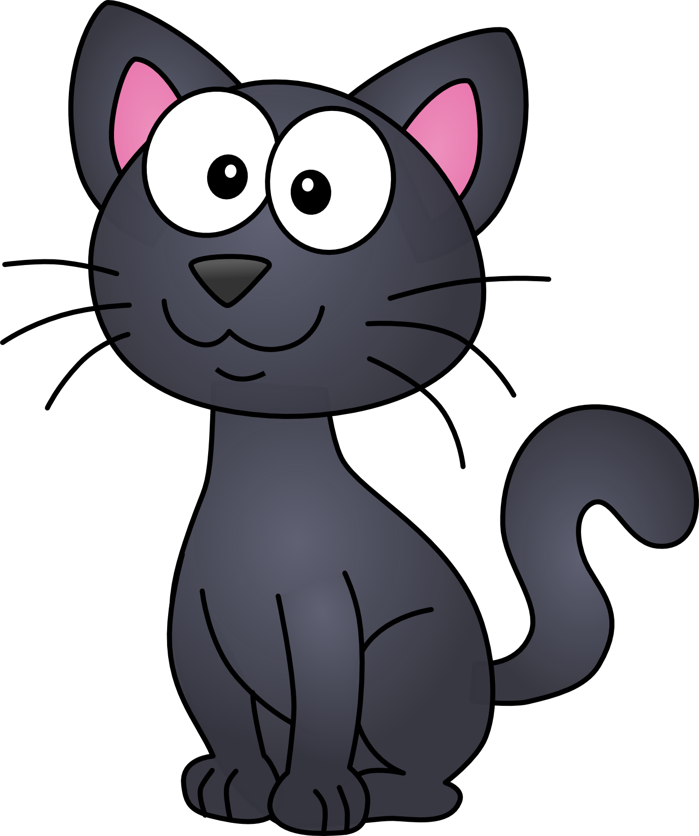
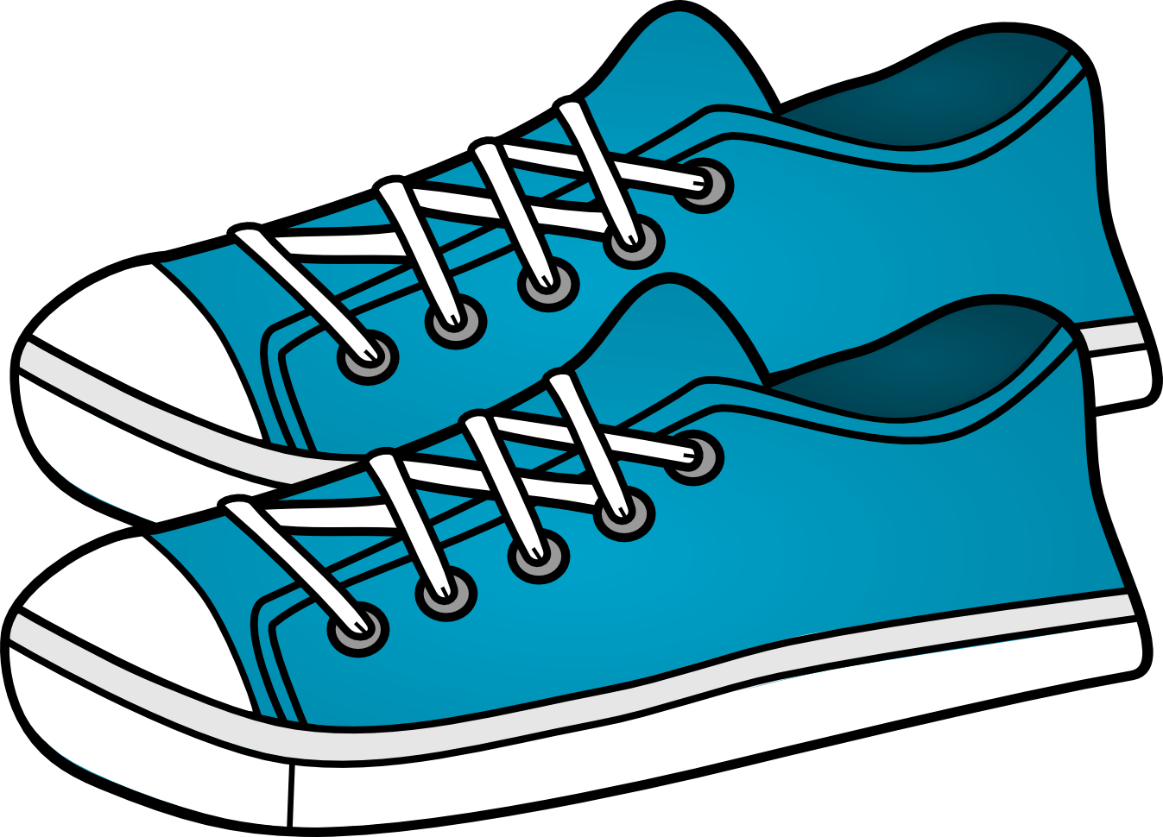


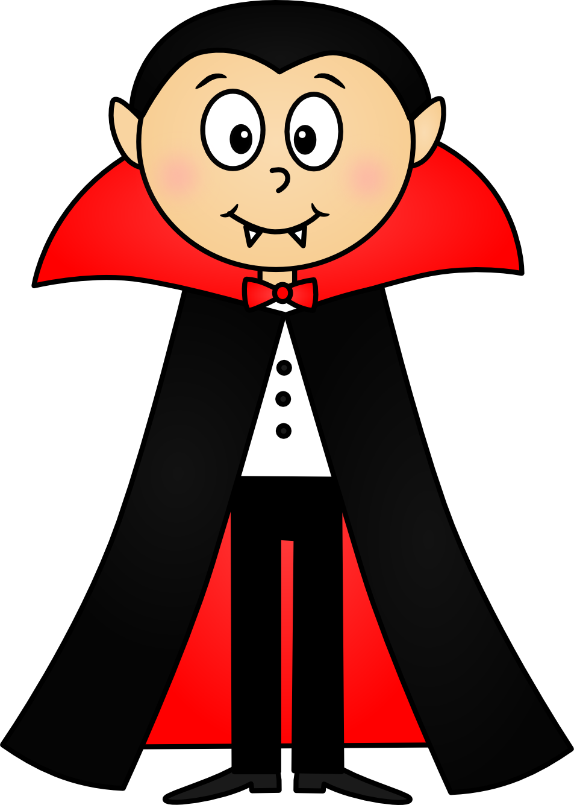

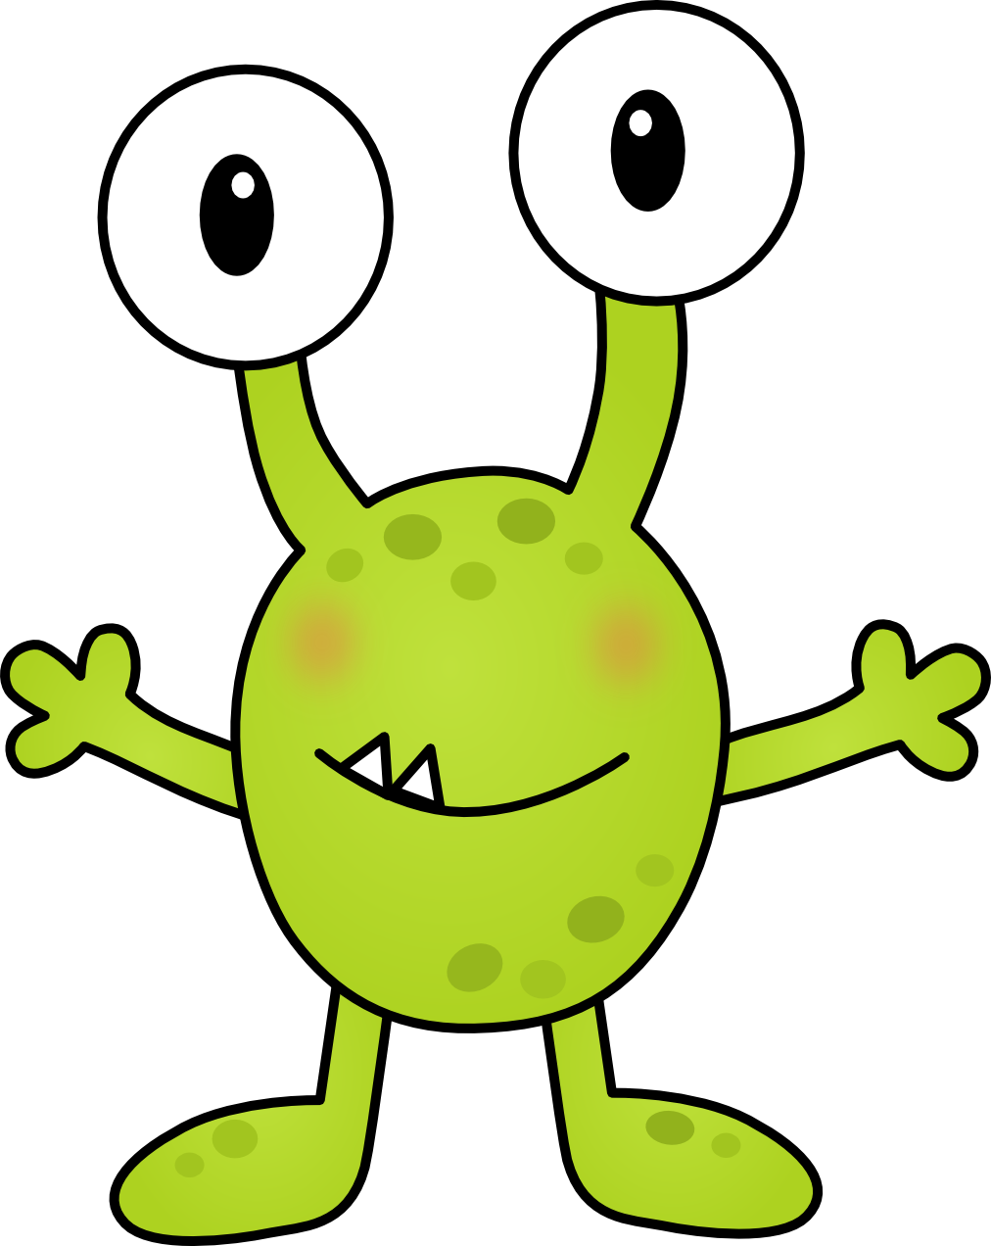



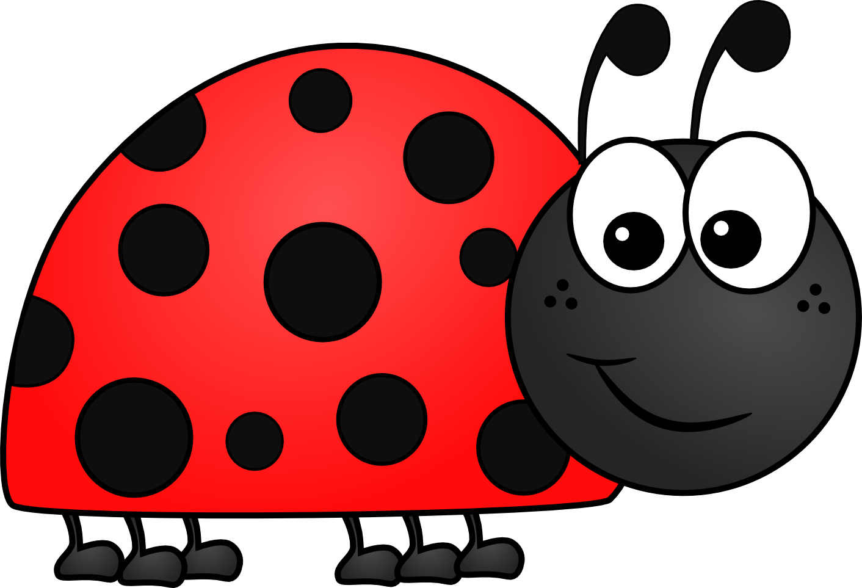
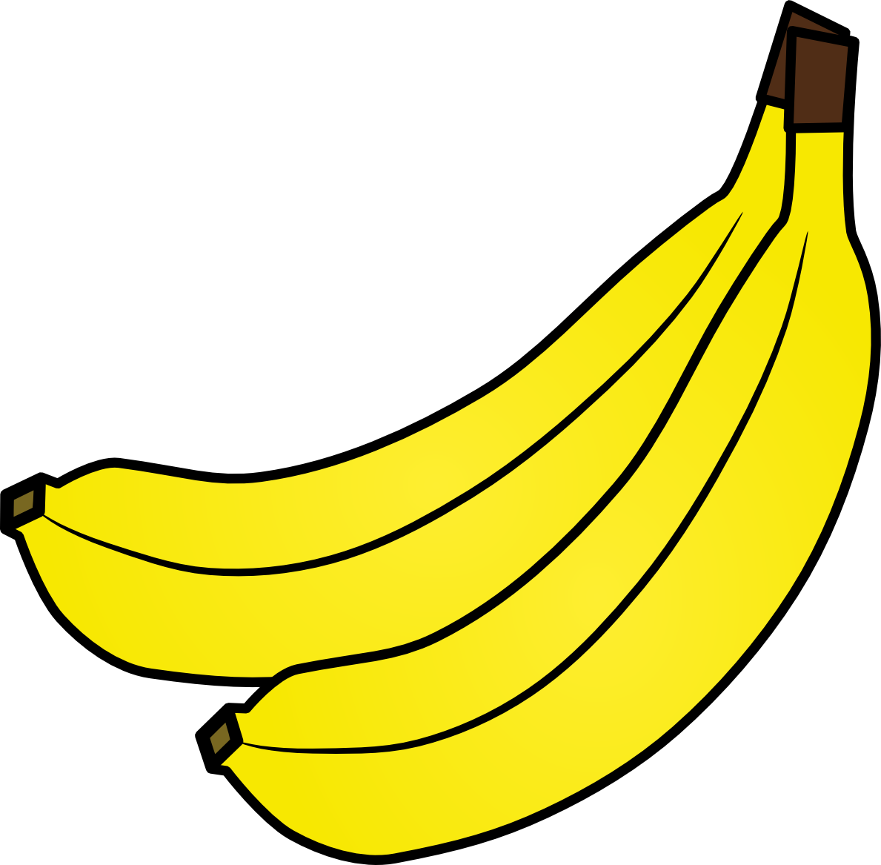
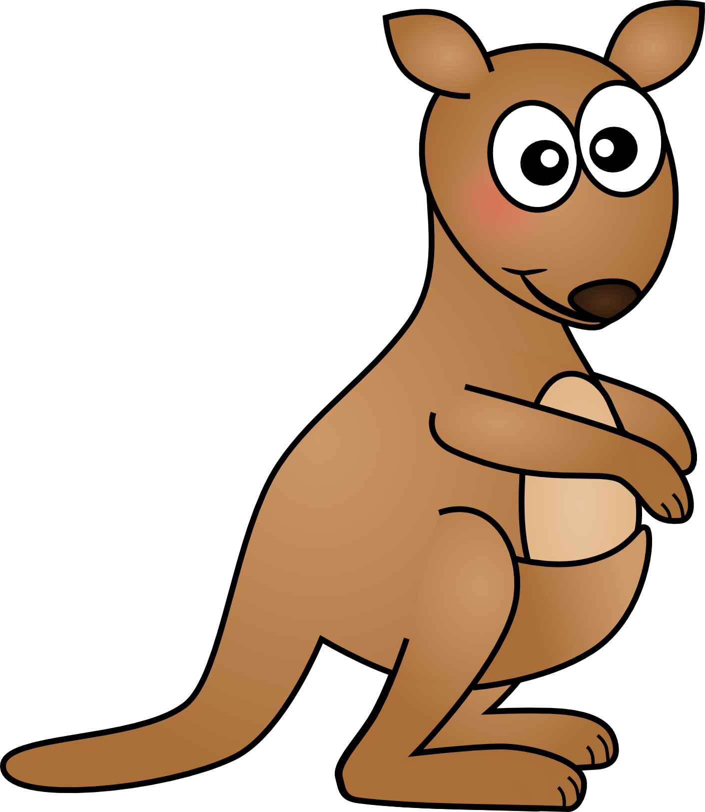
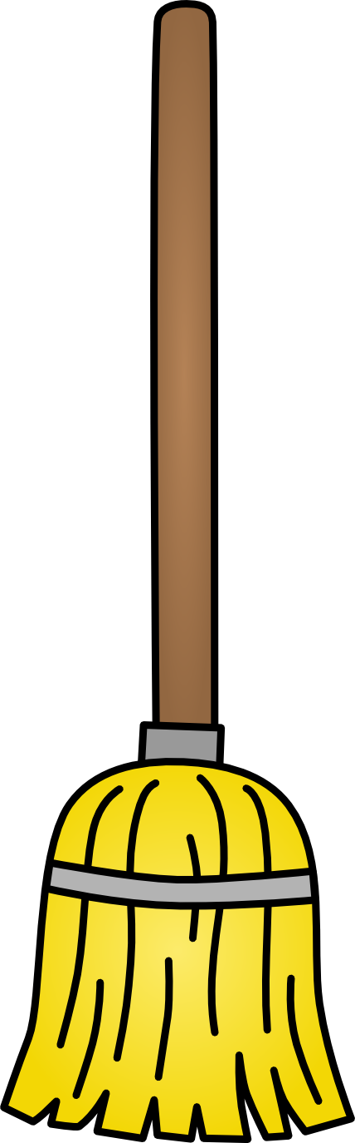
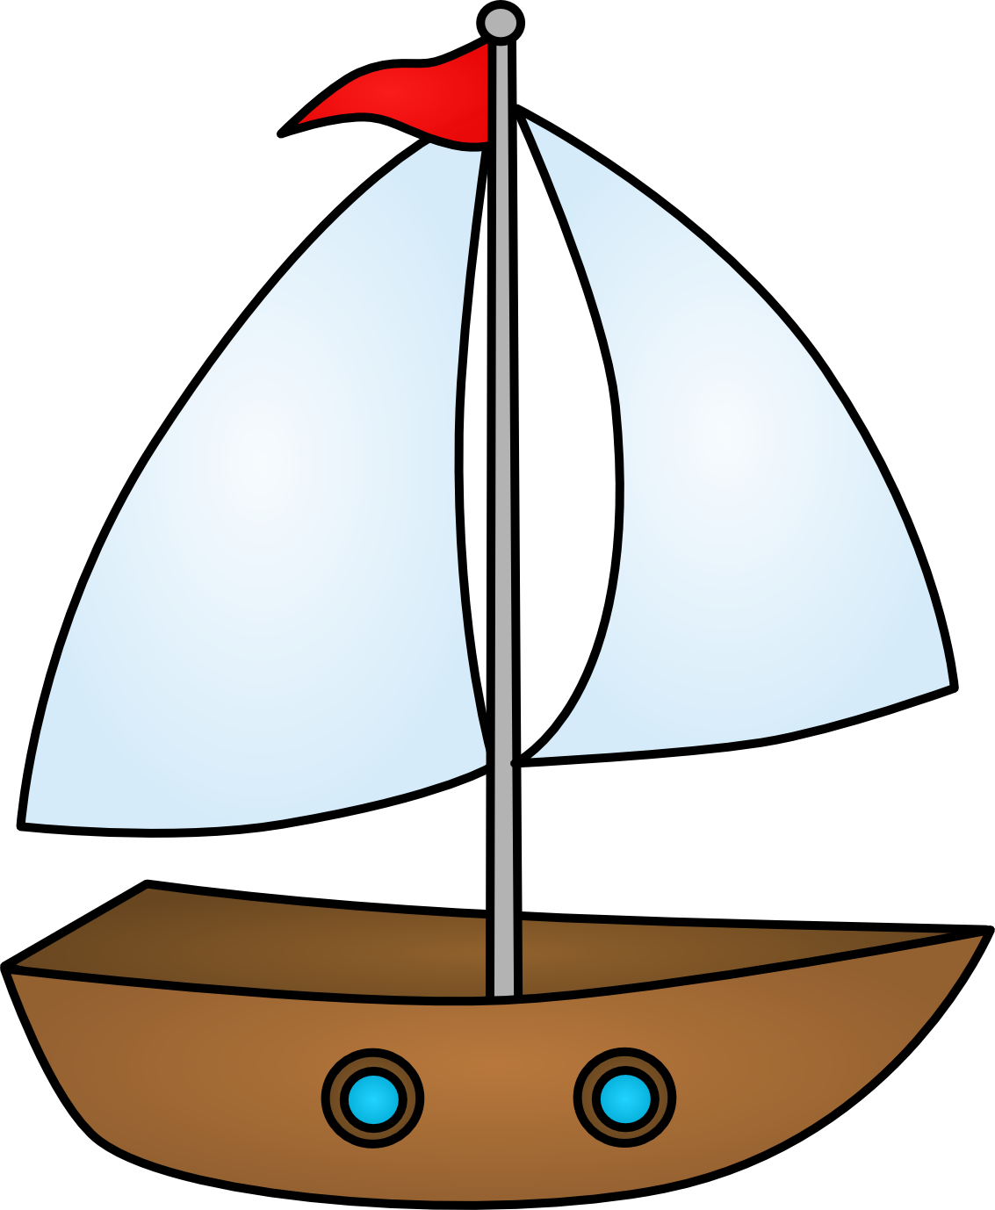




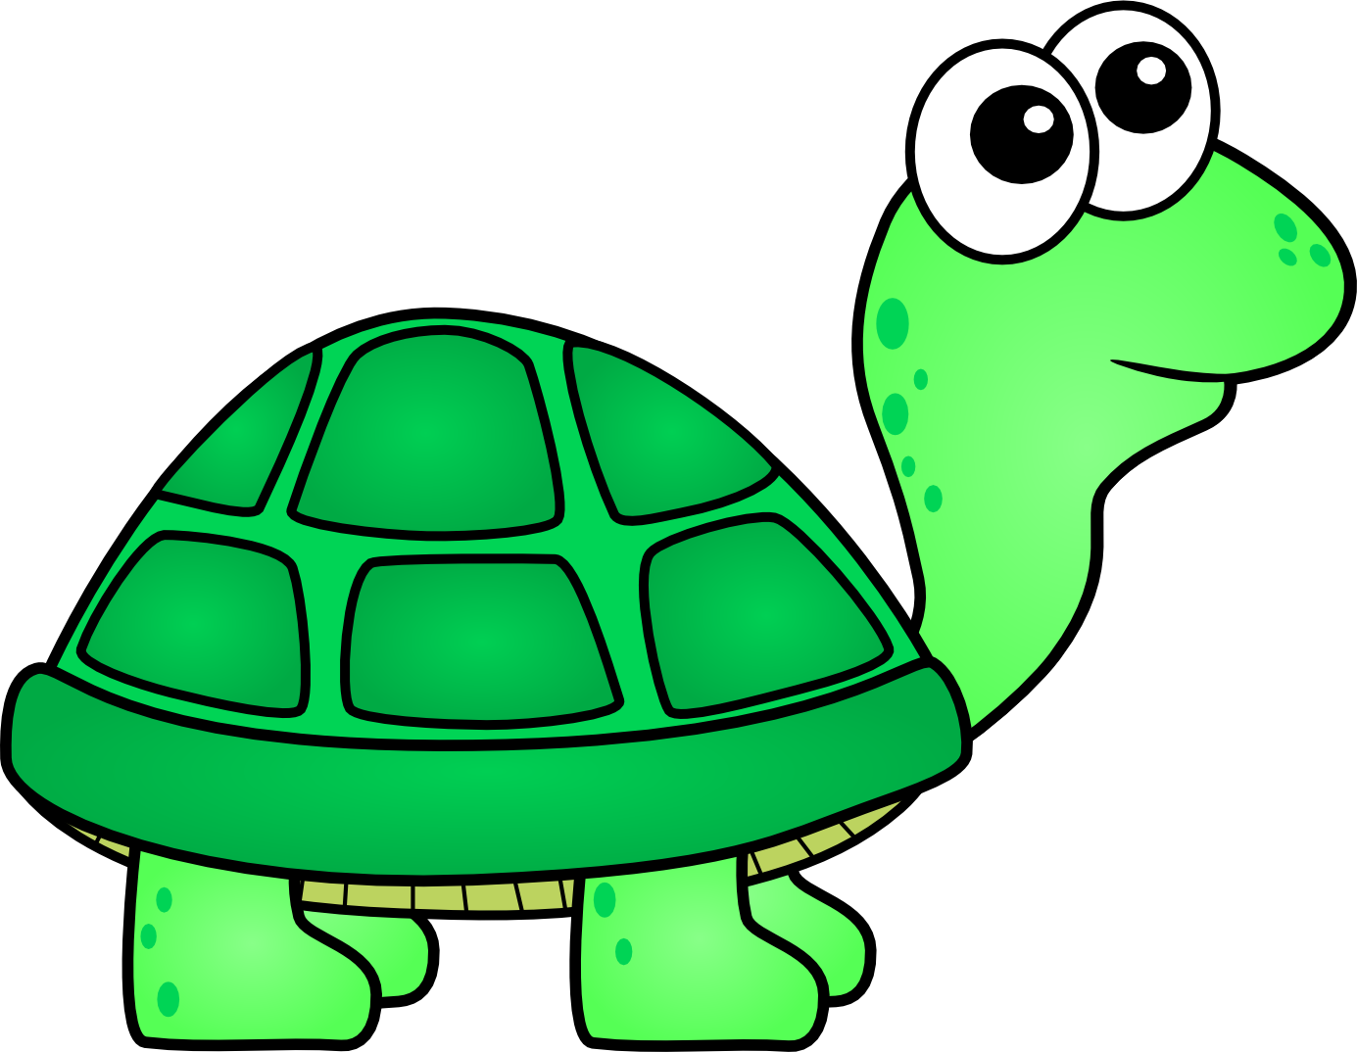
I Spy – 3 Syllable Words

Slide 6
Target words
Target word list: banana, bumble bee, bicycle, gummy bears, hamburger,
ladybug, dinosaur, kangaroo, triangle, octopus, happy face, candy cane

