Slide 1


WITCH’S BREW
INITIAL “TH” WORDS
Glue the witch’s broom on cardstock and cut out the broom. Laminate and cut out the broom.
Use Velcro or glue to attach a wooden coffee stirrer to the back of the broom handle for extra strength and stability.
Cut out the witch’s brew ingredients and the “th” target word pictures.
Glue the target words on the back of each witch’s brew ingredient. Laminate and cut out the ingredients.
Add a paper clip to each of the ingredients.
Add sticky back round magnets (found at www.lakeshorelearning.com ) or magnetic tape to the back of the straw portion of the broom.
Make sure you have a black cauldron or bowl to add the ingredients to the brew (found at Target or Dollar Tree).
To Play:
Lay all of the ingredients (target word face down) on a table or floor.
Have your client/student use the back side of the broom to pick up an ingredient.
Have your client/student say the target “th” word on the back of the ingredient.
Then put the ingredient in the cauldron.
Continue this same process with all of the ingredients/target words.
Suggestions: single word production and carrier phrase/sentence (“I put the -------- in the witch’s brew”, “--------- in the pot”, “-------- in the cauldron”)

Slide 2


Slide 3





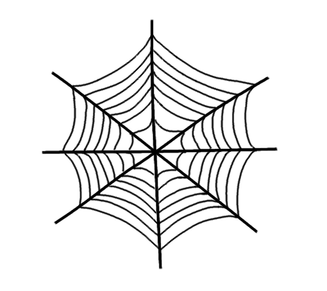




Witch’s Brew Ingredients

Slide 4






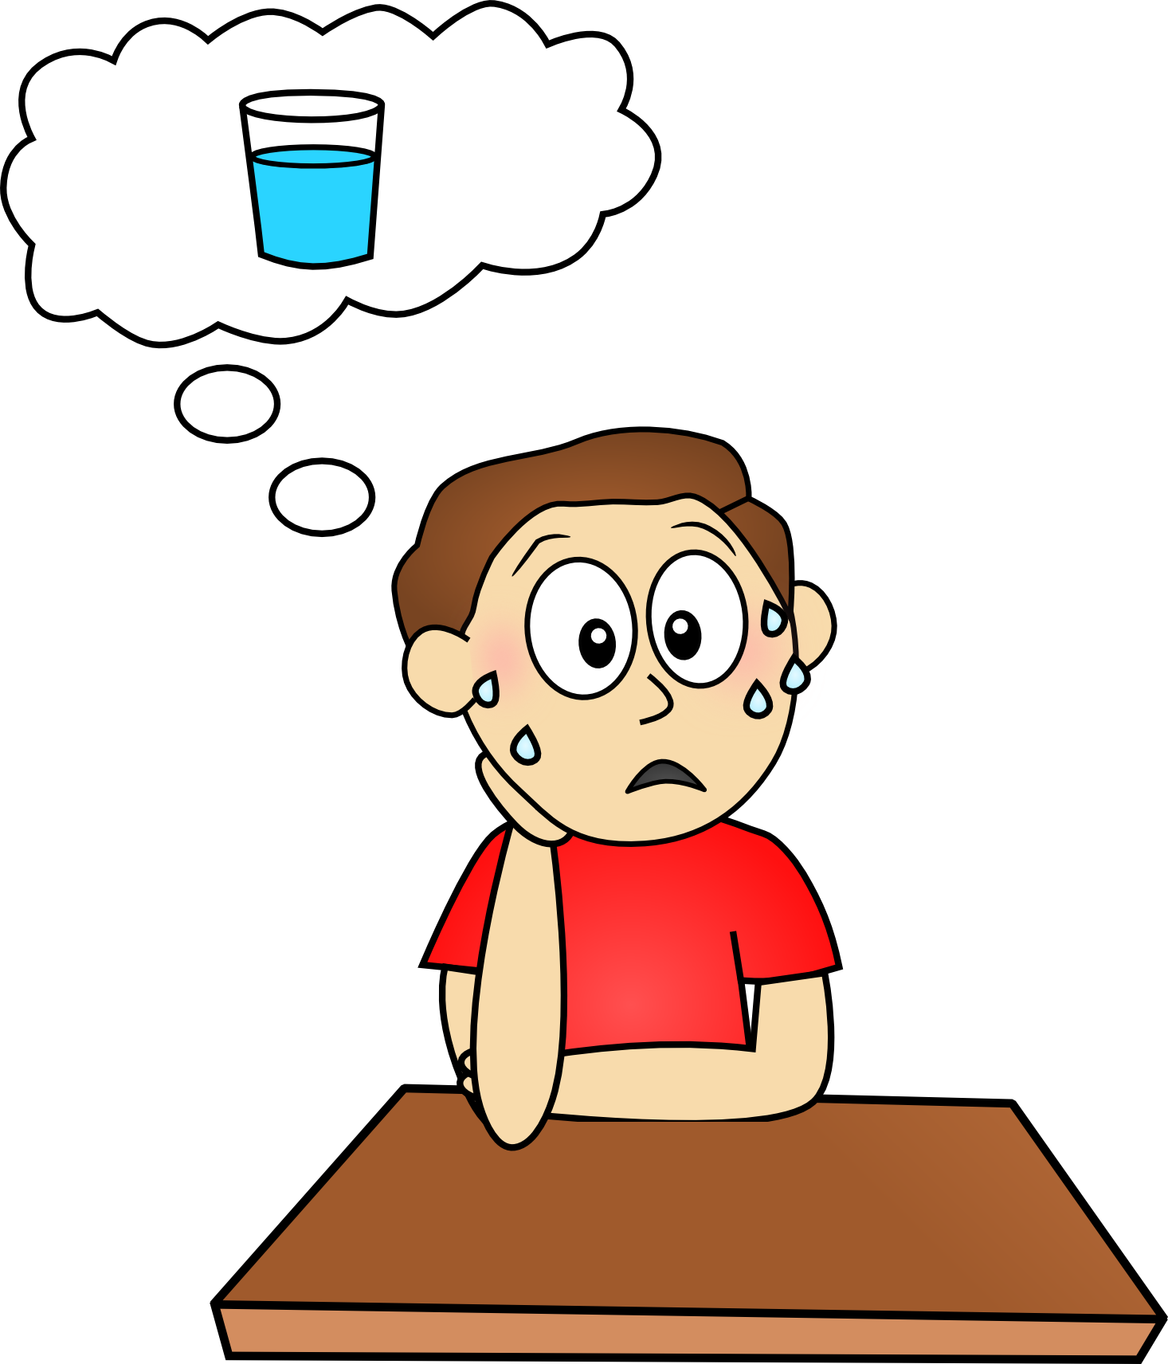



Target words: thank you, thermos, thigh, thimble, thinking, thorn, thirsty, three, thunder, thumb.

