Slide 1
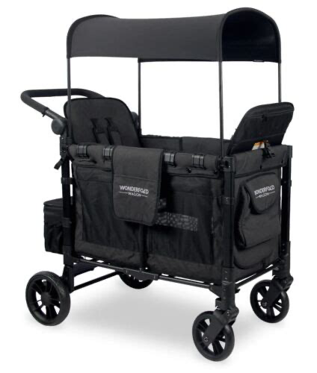
Jacy’s Wagons
June 2024
Turning a Test into a Testimony One Wagon at a Time
Note from Jacy:
Executive Board Members:
Jennifer Raburn, President, (662)664-2547
Jacy Raburn, Vice President (731) 610-9406
Tasha Barnett, Secretary (662) 664-3305
Kelly Broadway, Treasurer (731) 267-1470
June has been an amazing month! We are very proud of how far we have come this month! By the end of this month we will have shipped 100 wagons for the year. We are way past meeting our 150 goal for the entire year.
At the first of the month I started back to school at UTM working toward gaining my K-5 education degree.
Our Community Yard sale and concessions was hot but went well. We raised enough for 2 wagons.
God is Good and each day is a blessing! Keep fighting and keep praying!
Love Jacy
100
Requested
94
Shipped
2024 YTD
Mail donations to:
Jacy’s Wagons
PO Box 355
Michie, TN 38357
July 1st - August 1st
Little Caesars Pizza Kit
Fundraising Event
Stock up for Back to School -
All orders can be placed online and will ship directly to your door.
Contact:
Jacyswagons@gmail.com
we will send you a personal link to share with your friends and family all over the U.S.
Sign up today!!!!!
Calling ALL Warrior teams, Wagon families, church youth groups, etc…
Are you ready for an exciting challenge?
August 1st is Jacy’s 21st Birthday!
We are having a Birthday Bash Fundraiser!!
Join our team with Online sales and win amazing prizes!
All proceeds go to Jacy's Wagons.
🎉 $100 - 1st Place 🎉 $75 - 2nd Place 🎉 $50 - 3rd Place
Have Fun and Win Big! Let's get started!

Slide 2
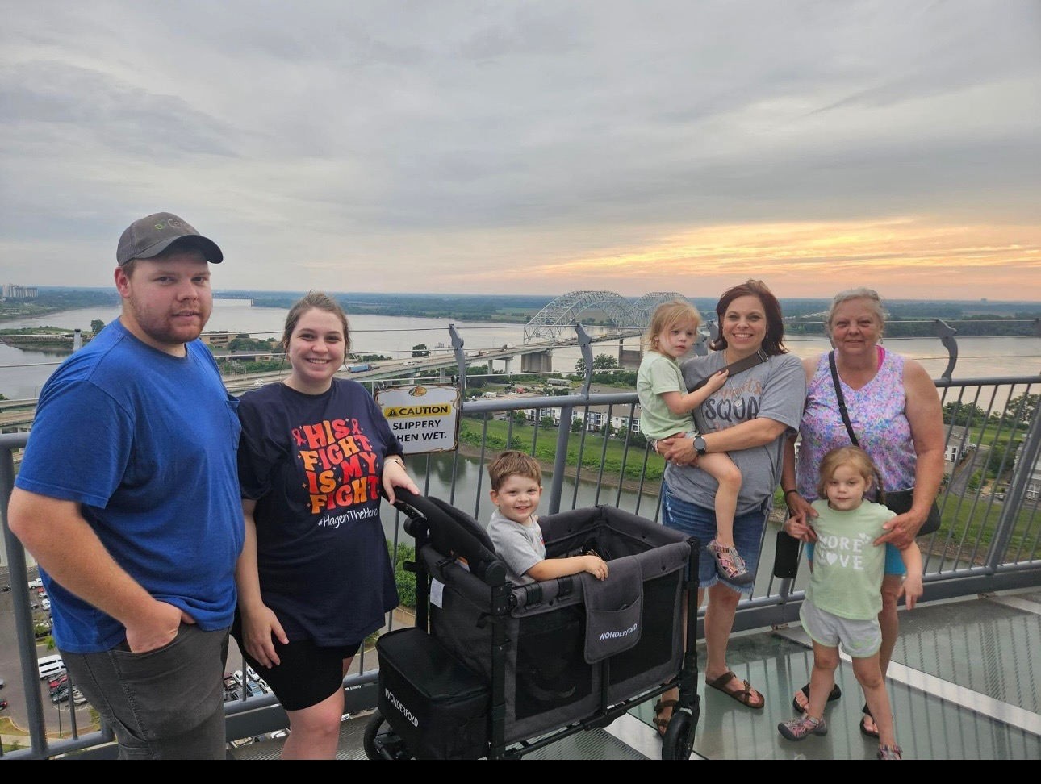
Hagen Lane
My name is Hagen Lane, I’m 2 years old from a small town called Nickelsville, Virginia. My mom is Laura and my dad is Sidney. I’m also going to be a big brother soon in October. I love being outside, watching Bluey and Paw Patrol, and eating chips with salsa and chicken nuggets.
On May 23rd, I started running a fever and had difficulty walking. After a visit to my pediatrician and ER, I was sent for more testing at a St. Jude affiliate hospital in Johnson City, TN. I was then diagnosed with Leukemia. On May 27th, I was brought to St. Jude in Memphis to continue with this battle. I have ALL B-cell. I know my journey will be long but I am strong.
Everyone unite for Hagen the Hero! I know that God is with me all the way.
Respectfully,
Hagen, Laura, and Sidney Lane

