Slide 1

100 Year Centenary Event
30 September - 1 October 2023
Sponsorship Opportunities

Slide 2
About the organisation
The Proston & District Heritage Association Inc. is a registered charity staffed wholly by volunteers.
The objectives of the Association are to:
To establish the Proston & District Heritage Museum to maintain an authentic historical record of Proston and District.
To celebrate Proston’s heritage and culture through hosting a centenary event.
To protect our heritage for future generations.

Slide 3
During the past 5 years the Association has:
Incorporated the Association (2018) and registered as a charity (2023).
Compiled the Proston & District Heritage Collection of photographs, books, posters, maps and other artefacts (over 1,000 followers on Facebook).
Collaborated with Council to upgrade the Proston Railway Park precinct.
Obtained grant funds to construct The Platform – a stage located in the Proston Railway Park precinct.
Revamped, updated and promoted the Proston Heritage Trail.
Advocacy with Council to establish a Proston & District Lookout & Picnic Area on the ridge overlooking Proston.
Procured and held multiple public screenings of a cultural heritage film of life in and around Proston from the 1950s to the 1970s.
Publishing a book recording stories of local heritage as a legacy of the centenary of our community in 2023.
Planning and preparation for the Proston & District centenary event on 30 September – 1 October 2023.

Slide 4
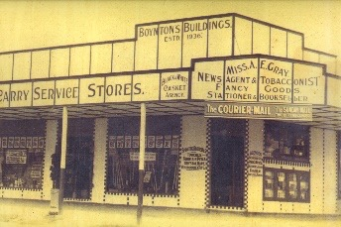
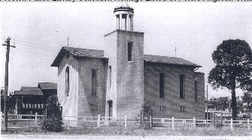
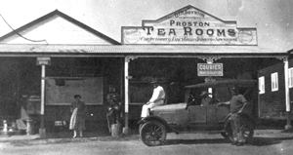
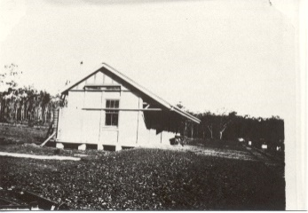
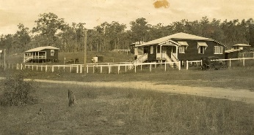
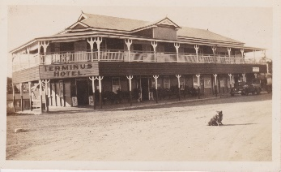
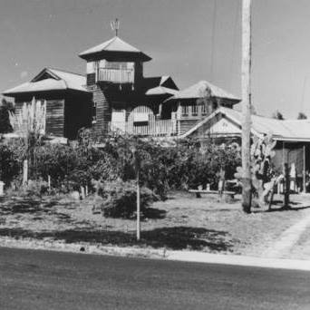
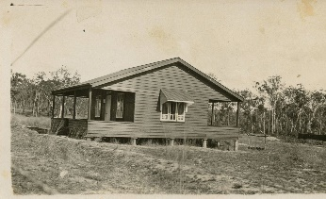

Slide 5


Slide 6
Centenary event theme
Proston & District – 100 years down the track
It is 100 years since the railway came to Proston, a development that transformed the town and the district.
The centenary event will be held in the Proston Railway Park precinct, with accompanying displays at the Proston Showgrounds.
The centenary is shared with the Proston State School and both centenaries are being celebrated together on the same long weekend.

Slide 7
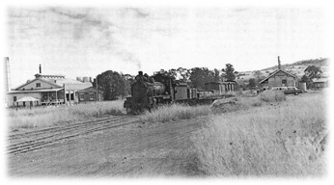

Slide 8
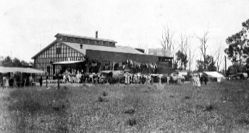
Proston & District – 100 years down the track Preliminary Program – Saturday 30 September
Daytime
Parkrun and markets
Street parade and official opening
Book launch – 100 years down the track
Railway Tours with Colin Thomson
District Dressmakers Exhibition
Vintage machinery demonstration
Bus Tours of District Schools
Cutting of the Centenary cake
Raffles and souvenir stalls
Damper and billy tea
Class year photos at Proston State School
Food vendors / amusements / rides
Evening
Centenary Ball – Proston Town Hall
Outdoor screening of Proston cultural heritage film with introduction by editor Peter Keys
Food vendors at Railway Park and menu options at the bowls club, golf club and pub.

Slide 9
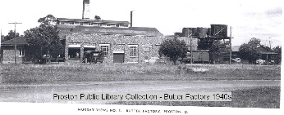
Proston & District – 100 years down the track Preliminary Program – Sunday 1 October
Daytime
Breakfast at showgrounds or railway park
Brunch at Proston Golf Club
Thanksgiving service – SB Ministries
Bus tours of District schools
District Dressmakers Exhibition
Official opening of Proston Village shops & Proston Men’s Shed
Proston & District inter-school sports re-enacted!
The Platform – Centenary book story recitals, music, and poetry (open-mic)
Food vendors
Evening
Food vendors at Railway Park and menu options at the bowls club, golf club and pub
Centenary Fireworks!!
Entertainment in Railway Park

Slide 10
Centenary Sponsorship Invitation
Proston & District – 100 years down the track
We are anticipating over 1,000 people in Proston for the Centenary.
By sponsoring this event you will:
Promote and enhance the visibility of your business brand.
Associate your business with the community of Proston & District.
Acknowledge the loyalty of Proston & District people to your business.
Contribute to preserving and making accessible the cultural history of Proston & District.
Contribute to strengthening the sense of community and shared values based in cultural heritage.

Slide 11
Sponsorship Opportunities & Recognition
Platinum sponsor $3,000+
Permanent signage in the Proston Heritage Museum for an agreed duration
Invited to have lead float in the Centenary parade
Nominated speaker in the Centenary opening program
Acknowledgement on Centenary website/promos/social media
Acknowledgement/logo on sponsors sign at Centenary event 30 Sept-1 Oct
Logo on sponsor reel at intervals during evening events
Use of the Centenary logo on Sponsor’s website/materials for an agreed duration
¼-page ad in the online Centenary program
Complimentary stall site at event
Four complimentary tickets to the Centenary Ball
Certificate of appreciation
Gold sponsor $1,000+
Invited to have a float in the Centenary parade
Acknowledged during the Centenary opening program
Acknowledgement on Centenary webpage/promos/social media
Acknowledgement/logo on sponsors sign at Centenary event 30 Sept-1 Oct
Use of the Centenary logo on Sponsor’s website/materials for an agreed duration
Logo on sponsor reel at intervals during evening events
¼-page ad in the online Centenary program
Complimentary stall site at event
Two complimentary tickets to the Centenary Ball
Certificate of appreciation

Slide 12
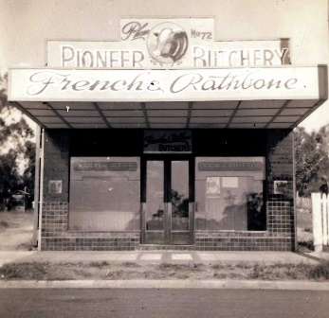
Sponsorship Opportunities & Recognition
Silver sponsor $300+
Logo on sponsor reel at event
Logo on Centenary webpage
Logo/Name on sponsor sign at event
Acknowledgement on Centenary webpage/promos/social media
1/8-page ad in the online Centenary program
Complimentary stall site at event
Certificate of appreciation
Bronze sponsor $50+
Logo on Centenary webpage
Logo/Name on sponsor sign at event
Complimentary stall site at event
Certificate of appreciation
Discuss your sponsorship policy and requirements with us. We can tailor sponsorship and provide naming rights to specific elements of the event.
Donations of prizes or gift vouchers of equivalent value to the above tiers will go into the Centenary multi-draw raffle and will attract the same sponsorship tier recognition.
All sponsors will be asked to complete a sponsorship agreement detailing terms and conditions.

Slide 13
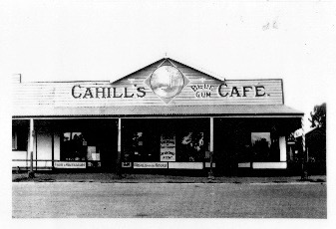
What sponsor funds will be used for
Centenary book: Proston & District – 100 years down the track
Centenary cake
Centenary fireworks
Official centenary souvenirs
Event publicity, event insurance, sound system, generator hire, marquees hire, port-a-loos hire, bus hires, road closure permit, catering, first aid attendance, photographer, amusements.

Slide 14
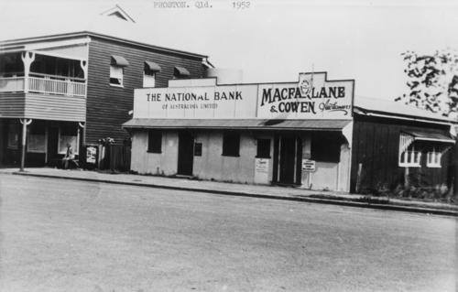
Fundraising delegates
Nick Volk
Email: volkfamily@hotmail.com Mobile: 0407 628 508.
Janee Crane
Email: janee.crane@serenityridge.com.au
Mobile: 0419 029 949.

