Slide 1

Introduction (Company Name)
< Company’s Logo
Company’s Statement

Slide 2

Defining the Unresolved Problem
State the problem(s) that your business solves (unmet needs or wants, etc.).

Slide 3
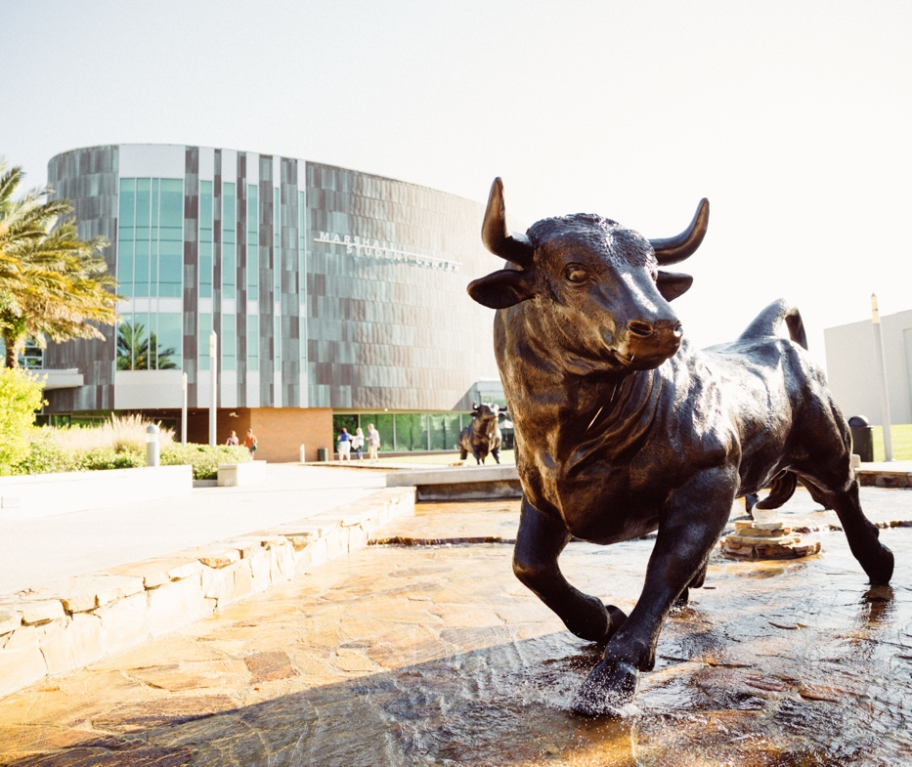
Our Solution
Explain how you solve the problem

Slide 4
Our Product or Service
Go into more detail about what your product/service is.

Slide 5
Target Market and Opportunity
What types of potential customers do you intend to focus on? Which group represents your primary market? Which others are worth pursuing?

Slide 6
Business Model
Primary Revenue Streams

Slide 7
Business Model
Pricing Strategy

Slide 8
Business Model
Competitive Positioning

Slide 9
Marketing and Sales Plan
Overview of the key tactics you'll employ to reach potential customers
Sales channels

Slide 10
Your Team
Full Name
Role
Full Name
Role
Full Name
Role
Full Name
Role
Full Name
Role

Slide 11
Financial Projections

Slide 12
Funding needed
Seeking:
$10,000.00
Describe how you intend to use that money to reach your goals.

Slide 13
Thank you for your time! Questions?

