Slide 1
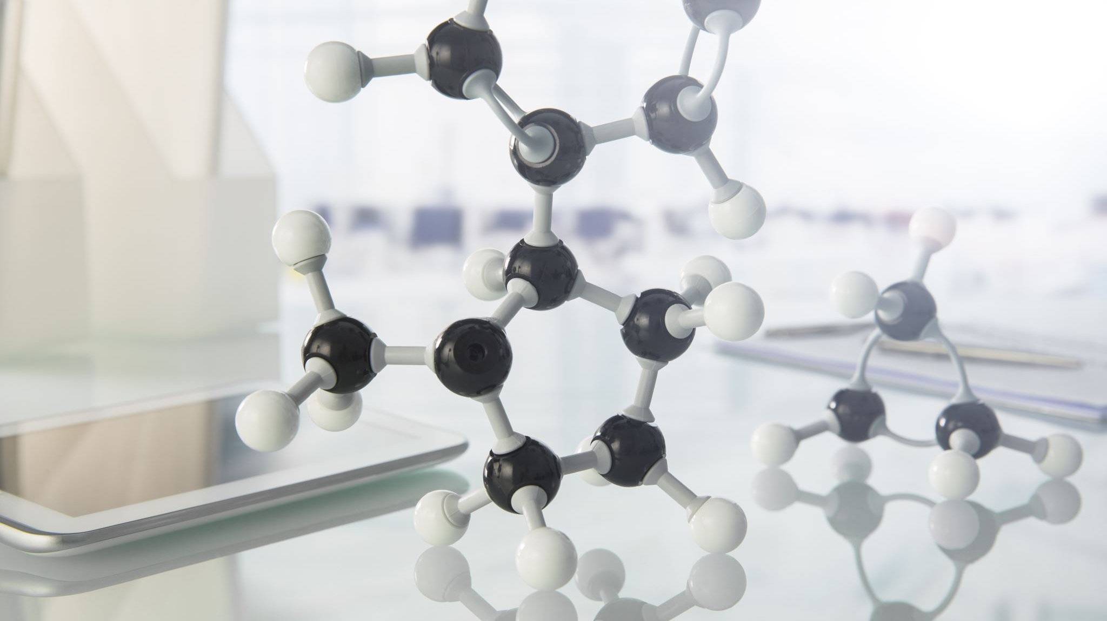

The power of digital transformation
Working while digitally distancing

Slide 2

Your host
The Delaware Sustainable Chemistry Alliance (DESCA) was founded in 2010 to support the growth of new and existing startup companies in the area of sustainable chemistry. As the global chemical landscape evolves, and given our region’s core competencies in chemistry, advanced materials, biochemistry, agriscience and industrial biology, DESCA’s mission has evolved.
Today, DESCA focuses on:
Continuing to foster innovation and collaborative partnerships between major strategics, startups and universities as well as building a M&A pipeline;
Driving the conversation around the adoption of digital technologies which will be a key driver in sustainability for the future;
Harmonizing the development of talent with the validated needs of the industry.
Dora Cheatham
doracheatham@desustainablechem.org
Erica Crell
erica.crell@desustainablechem.org

Slide 3

Your presenter
Iiro Esko is a Chemical Industry Manager for Siemens Digital Industries.
He has a background in chemical engineering with 10 years of experience in Digital Twinning and the application of these digital twins in the process industries.
Iiro has worked for Siemens in several different areas and countries, focusing on the application, business development and commercial aspects of digitalization and Industry 4.0 technologies.
His current role is based in Houston, TX, aiming to promote the use of new technologies in the chemical industry.
Iiro earned a Bachelor of Science in Chemical Engineering in Tampere, Finland.
Iiro Esko
Iiro.esko@siemens.com

Slide 4

Unprecedented change
Pre-COVID, businesses across the country were working slowly towards digital transformation. The COVID-19 crisis has changed the trajectory of that progress with an unprecedented adoption of digital technologies at multiple levels.
The next big wave of disruption is headed our way as companies seek new models and methods to face ongoing economic uncertainty.

Slide 5

THE POWER OF DIGITAL TRANSFORMATION
“We have incredible manufacturing flexibility where we can produce specialty paint batches in 1/50th of the size.“
Kevin Worrell,
Project Director at Dulux Australia
>50% less time from testing to paint production
8x faster production process

Slide 6
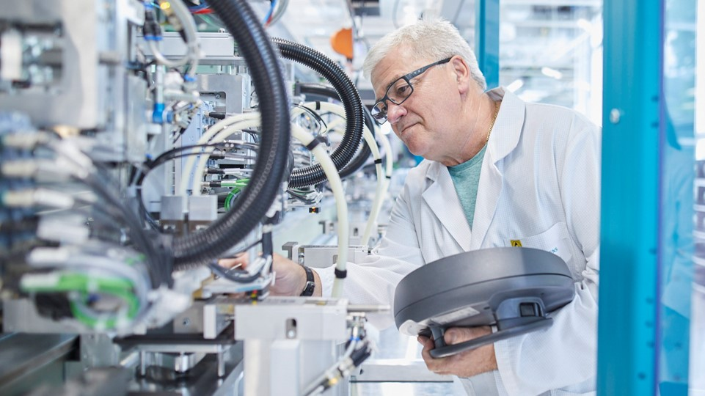
Manufacturing Karlsruhe –
People using digitalization
to simplify complexity!
~40%
increase in machine utilization
>24,000
living products
>160
product ramp-ups per year
<0.2%
field return index

Slide 7
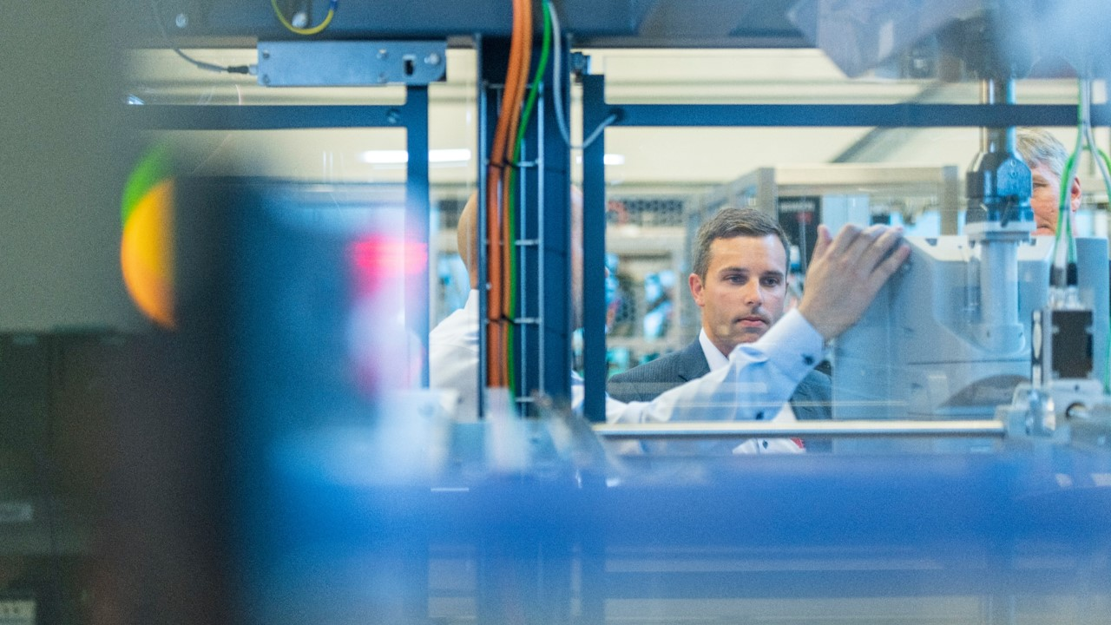

“The most important is the competence of the people. We can ask technical questions and they are helping us to solve our challenges, and that makes their systems far more powerful.”
Olav Tronrud, CEO at Tronrud Engineering
Shortened commissioning phase by 20-25%
Reduced design phase by 10% through parallel working of electronic, mechanical and automation departments

Slide 8
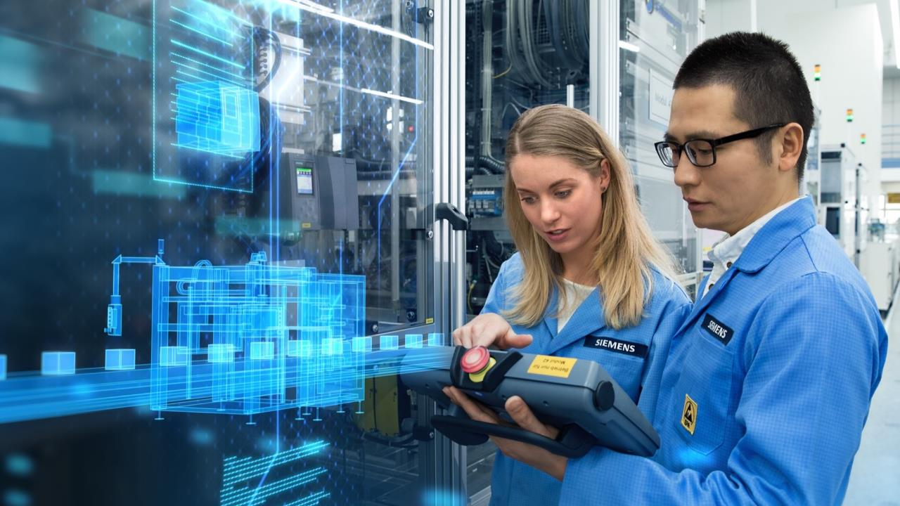

14x
productivity increase since the start of production in 1990
99.9999%
perfect quality – every day
>120
variations are built per day | ~1 product per second
Siemens Electronics Manufacturing
Plant Amberg, Germany
~350
changeovers per day to handle 1,200 different products
Industry 4.0
Award

Slide 9
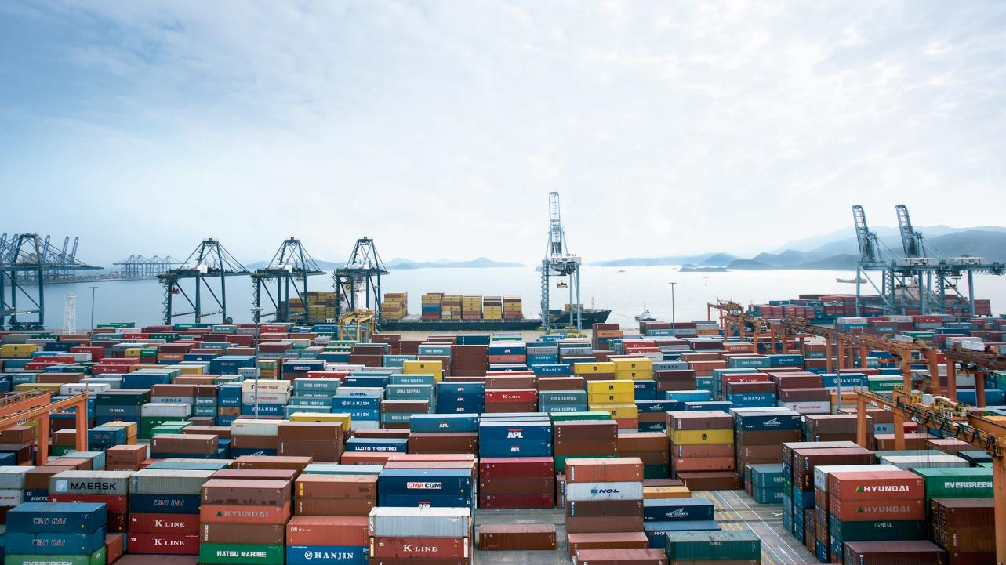

Contract logistics app from Mendix processes orders from e-commerce systems to custom warehouse management system:
Preventing 7-figure customer churn
Securing 4 Fortune100 accounts worth millions per year

Slide 10
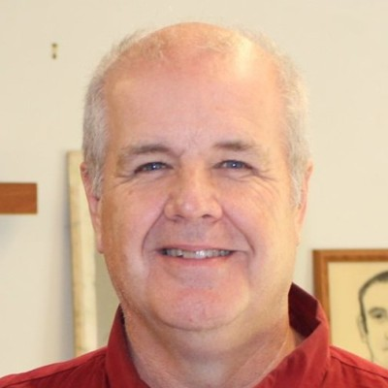
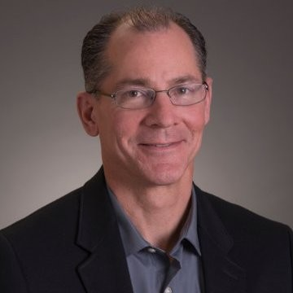
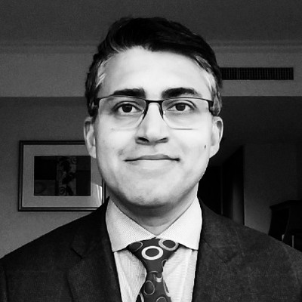
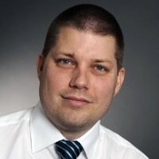

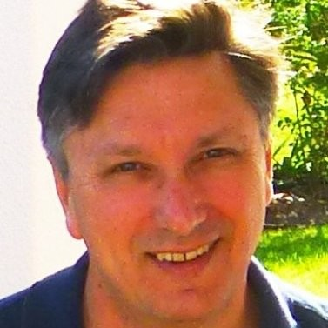
Desca webinar series: the power of digital transformation
Working while digitally distancing
Tuesday, July 28
Digital Readings
Wednesday, July 29
Digital Controls
Thursday, July 30
Digital Modeling
Jack Roushey
Remote Instruments
Don Mack
Prescriptive Analytics
Ravi Aglave
Simulation from Home
Allan Petersen
Digital Service
Glasses
Ethan Cook
Connected Control System
Mark Matzopoulos
Modeling Your Process While Far Away

