Slide 1
Implicit learning in an artificial language: A replication and extension of Batterink et al. (2014)
David Abugaber, Laura Batterink, & Kara Morgan-Short
Second Language Research Forum
September 20st, 2018

Slide 2
Introduction
Is it possible to learn second language grammar without any awareness of learning?
Replication and extension of Batterink et al. (2014):
Behavioral reaction-time experiment using an artificial language paradigm
[ Preliminary piloting for a full EEG study for my dissertation ]

Slide 3
Background

Slide 4
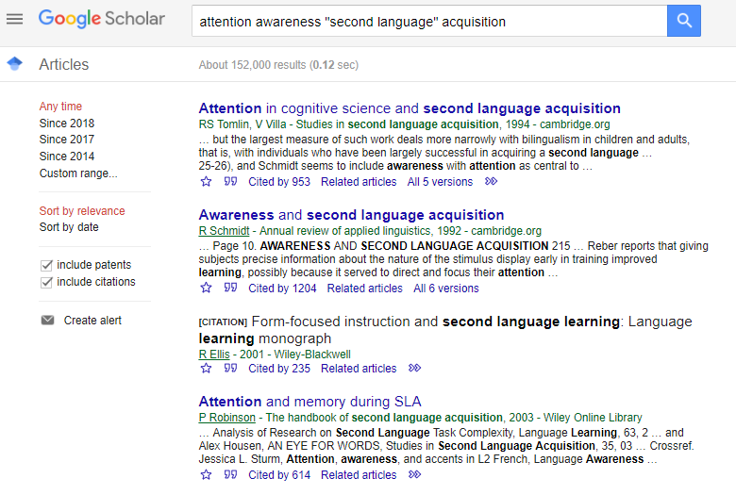
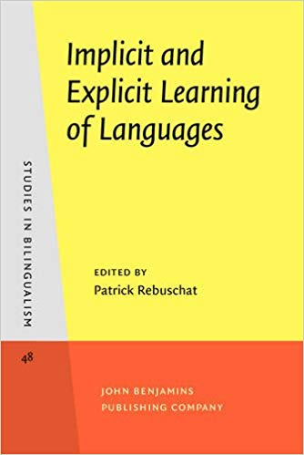
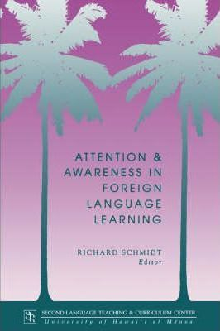
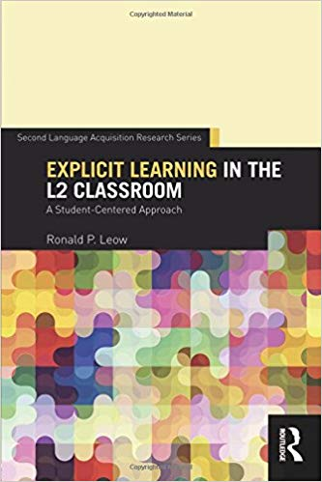
Importance of attention/awareness in Second Language Acquisition

Slide 5
Can you learn without awareness?
Is it possible to learn second language grammar without awareness?
Schmidt (1990) and Robinson (1995): No!
Tomlin and Villa (1994) and Leow (2015): Yes!
Many studies on implicit/explicit L2 learning speak to external training conditions, not to processing at the level of individual learners (Sanz & Leow, 2011)

Slide 6
L2 learning without awareness: artificial language paradigms
Assess awareness of rules at level of individual learners, instead of manipulating training conditions
Paradigm originally developed by Williams (2004, 2005)
Participants are exposed to an artificial language with hidden regularities
Learning of hidden regularity is measured covertly
Awareness of the hidden regularity is assessed at the end of the experiment
Reaction time results have found evidence for rule-unaware learning
Slowdowns to rule-violating trials (Leung & Williams, 2011; replicated by Leung & Williams, 2012, 2014; Paciorek & Williams, 2015)

Slide 7
Conflicting findings on rule-unaware learning
Williams (2004, 2005): yes
evidence for rule-unaware learning, using a two-alternative forced choice task
Hama & Leow (2010): no
no evidence of rule-unaware learning when concurrent “think-aloud” task is performed
Faretta-Stutenberg & Morgan-Short (2011): no
no evidence for rule-unaware learning, using a two-alternative forced choice task
Leung & Williams (2011): yes
evidence of rule-unaware learning when using reaction-time-based measures (slowdowns to rule-violating trials)
Reaction-time results replicated in Leung & Williams (2012, 2014); Paciorek & Williams (2015)
Rebuschat, Hamrick, Sachs, Riestenberg, & Ziegler (2013): yes
Above-chance accuracy for trials whose judgment source attributions were attributed to guess or intuition as opposed to rules or memories

Slide 8
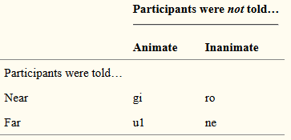
Batterink et al. (2014)
1 of every 7 trials violated the hidden rule
Slower responses to rule-violating trials indicate learning
Interview at end to determine participants’ awareness of hidden rule
Will rule-unaware learners show learning?

Slide 9
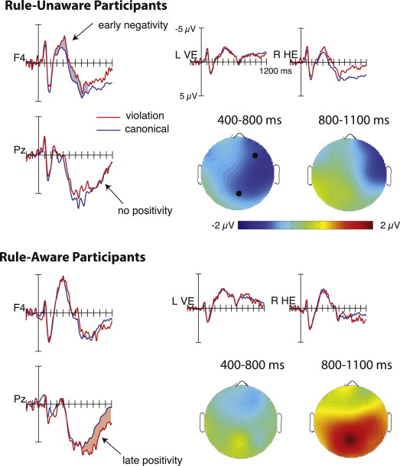
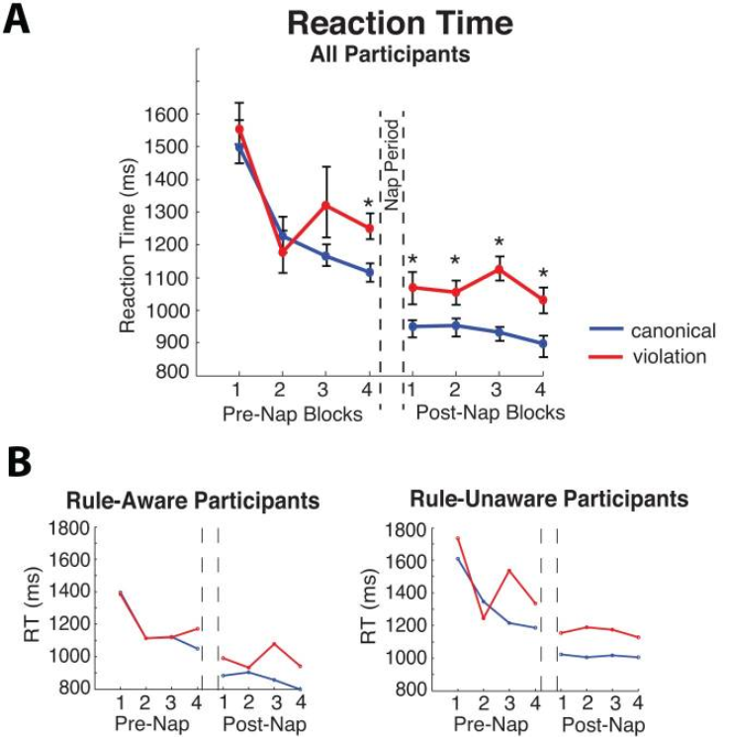
L2 learning without awareness: Batterink et al. (2014) results
Behavioral results suggest possibility of rule-unaware learning
ERP results show differences between aware vs. unaware learners

Slide 10
Can you learn without awareness?
Is it possible to learn second language grammar without awareness?
Schmidt (1990) and Robinson (1995): No!
Tomlin and Villa (1994) and Leow (2015): Yes!
Batterink et al. (2014): ____________________________

Slide 11
Can you learn without awareness?
Is it possible to learn second language grammar without awareness?
Schmidt (1990) and Robinson (1995): No!
Tomlin and Villa (1994) and Leow (2015): Yes!
Batterink et al. (2014): __suggests YES________________

Slide 12
Motivation
Growing movement for more replication studies in psychology (Lamal, 1990; Francis, 2012) and second language acquisition (Marsden, Morgan-Short, Thompson, & Abugaber, 2018).
Research Question:
Can L2 morphosyntax learning occur in the absence of rule awareness, as indexed by reaction time and accuracy measures in an artificial language learning experiment?
NOTE:
[ Preliminary piloting for a full EEG study for my dissertation ]

Slide 13
Methods

Slide 14
Participants
Follow inclusion criteria in Batterink et al. (2014)
26 participants (18 female, mean age = 19.76, S.D. = 1.88)
Native speakers of English
(Additional language experience OK)
Undergraduate students at a large university recruited through introductory psychology courses.

Slide 15
Procedure
Follows Batterink et al. (2014) except for two changes:
Artificial language articles are presented separately, before the nouns
... to allow for analysis of linguistic prediction (feel free to ask in Q&A!)
No nap between Blocks 1 and 2
... replaced by five-minute break ☹

Slide 16
Vocabulary pre-training details
Follow procedure in Batterink et al. (2014)
Flashcard study
Gi, ro, ul ne printed on one side, near or far printed on the other side; as much time as desired
Forward translation
Read near or far, press buttons corresponding to gi, ro, ul, ne
Backward translation
Hear gi, ro, ul, ne, press button corresponding to near or far

Slide 17
Main experimental task
Trial structure
Fixation cross (1000ms)
Artificial language article (1000ms)
Noun (500ms, replaced by blank screen until living/nonliving response)
Near/Far? prompt (shown until response)
Two blocks of 308 experimental trials each
1 of every 7 experimental trials violates animacy rule
(assigned randomly)
Canonical/violation nouns matched for word length and frequency
Assignment to Block 1 or Block 2 counterbalanced
Assignment to canonical/violation counterbalanced

Slide 18
+

Slide 19
ne

Slide 20
table

Slide 22
Near/Far?

Slide 23
+

Slide 24
gi

Slide 25
octopus

Slide 27
Near/Far?

Slide 28
Rule-awareness debriefing questionnaire
Did you notice any specific patterns in the use of the new words you learned (other than the near/far rule that we taught you)? If so, what?
(If participant correctly identifies pattern):
When did you become aware that this pattern was relevant (i.e., during the first block, during the second block, or during this interview)?
(If participant does not identify pattern):
At any point, did you look for rules to figure out when to use any of these words?
There is actually a rule that determines the correct word choice—i.e., when to say "gi" instead of "ro" or when to say "ul" instead of "ne." If you had to guess, what do you think that rule is?
(If correct rule is not stated):
Could you tell me which of the new words are used more often to describe living things? And which words are used more often to describe objects?
Following Batterink et al. (2014):
Coded as AWARE if participant produces the correct pattern and reports having noticed it during either the first or second experimental block
Otherwise, coded as UNAWARE

Slide 29
Analysis
Follows same analysis procedure as in Batterink et al. (2014)
Only analyzed trials with correct animacy judgments
Experiment data divided into eight epochs of equal length
Analysis of participants’ median epoch response times
Greenhouse-Geisser-corrected mixed 2x2x8 ANOVA, with
Awareness (rule-aware vs. rule-unaware) as between-participant factor and
Condition (canonical vs. violation trial) as within-participant factor
Epoch (for each of eight experimental epochs) as within-participant factor
Same analysis also performed for participants’ mean epoch accuracies

Slide 30
Results

Slide 31
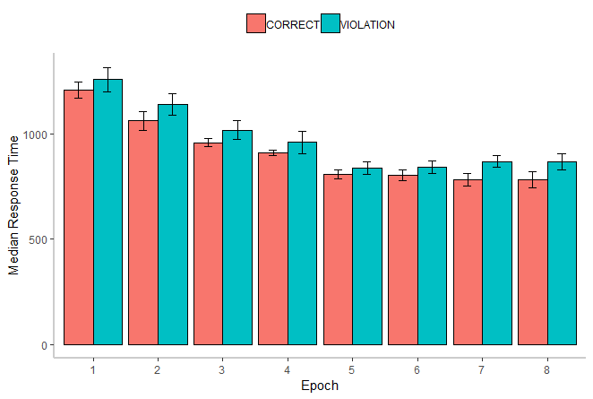
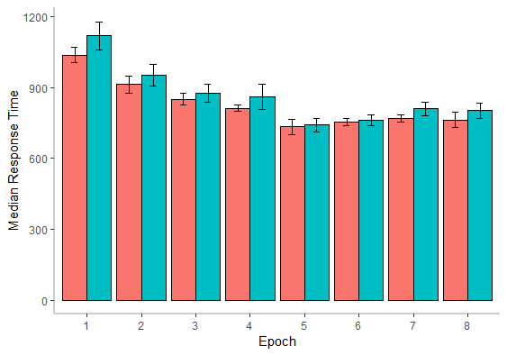
Response time results
All participants
Significant effect of condition:
violation trials were slower than rule-following trials
Significant effect of time point in experiment:
participants get faster over the course of the experiment
No significant effect or interactions from Rule Awareness
Rule-aware
Rule-unaware

Slide 32
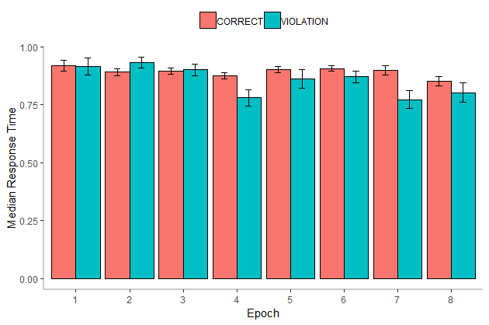
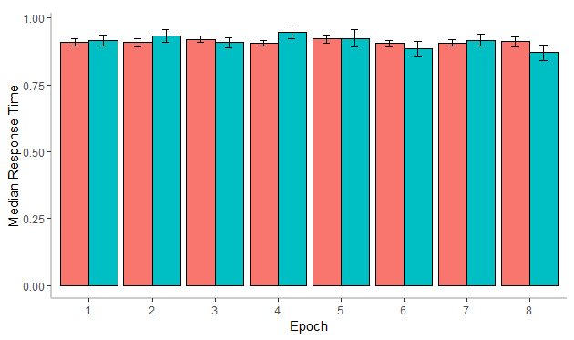
Accuracy results
All participants
Significant effect of condition:
Accuracy was lower for violation trials than canonical trials
Significant effect of time point in experiment:
Participants become less accurate over course of experiment
Interaction of Rule Awareness x Condition:
Aware participants: higher accuracies for canonical vs. violation
Unaware participants: no accuracy differences between canonical vs. violation trials
Rule-aware
Rule-unaware

Slide 33
Comparison with Batterink et al. (2014) results
Effect | Measure | Batterink et al. (2014) | Pilot study
Main effect of condition? | Response times | Yes | Yes
 | Accuracy | Yes | Yes
Interaction of Condition x Awareness? | Response times | No | No
 | Accuracy | Stronger effect for aware vs. unaware -> significant in each f group separately | Stronger effect for aware vs. unaware -> only significant f for aware group
Interaction of Condition x Epoch? | Response times | Yes-ish (at p = .07) | No
 | Accuracy | Yes | No
Interaction of Condition x Awareness x Epoch? | Response times | No | No
 | Accuracy | No | No

Slide 34
Discussion
Replicated findings of rule-unaware learning from Batterink et al. (2014)
But...
Disparity #1: change in learning effect over time
Batterink et al. (2014): learning effect strengthened over time
Our results: no Epoch x Condition interaction
Due to fatigue? (no nap in this experiment!)
Disparity #2: accuracy effects within rule-unaware group
Batterink et al. (2014): significant
Our results: not significant
Accuracy is less sensitive? Slightly smaller sample size? (12 vs. 15) More “careful” participants?
Main effect of Rule Awareness in ANOVA suggests some effect

Slide 35
How to “milk” behavioral measures some more?
Idea #1: Tune in to speed/accuracy trade-off
Feedback asking for faster RTs/higher accuracy as necessary?
Incentivize speed vs. accuracy?
“Titrate” rate of word presentation so all participants have comparable accuracy?
Idea #2: Consecutive trials with same ul/gi/ro/ne article = “affordances for learning”
Did rule-aware participants get more consecutive-trial affordances?
Idea #3: Dynamical-appearing rule awareness probes
Present rule-awareness probe as soon as signs of rule learning emerge?
May allow us to identify behavioral signs of rule awareness (as in Rose, Heider, & Büchel, 2010)
Idea #4: What is “explicit processing,” anyway?
Rule awareness =/= always applying the rule
Do rule-aware participants vary in how they “understand”/respond to violation trials?
Idea #5: The role of attitudes? Personality? Learning styles?
Collect personality measures & link to rule use? Speed/accuracy trade-off? (Förster, Higgins, & Bianco, 2003; Gray, Williams, & Rebuschat, 2015)

Slide 36
Conclusion
Ultimately, Batterink’s (2014) findings of rule-unaware learning could be replicated in our modified design.
Suggests that this experiment paradigm could be successfully implemented to examine implicit learning in the full EEG study.
Behavioral measures might be exploited even further to triangulate the onset and time course of rule learning and rule awareness.
Any and all ideas welcome!

Slide 37
Thank you! Questions/comments?
Other dissertation committee members:
Dr. Jennifer Cabrelli-Amaro
Dr. Philip Hamrick
Dr. David Miller
Dr. Kim Potowski
Krishna Bhatia
Will Camacho
Dr. Kara Morgan-Short
Dr. Laura Batterink

Slide 38
References (1)
Batterink, L. J., Oudiette, D., Reber, P. J., & Paller, K. A. (2014). Sleep facilitates learning a new linguistic rule. Neuropsychologia, 65, 169-179.
DeKeyser, R. (2009). Cognitive-psychological processes in second language learning. In M. H. Long & C. J. Doughty (Eds.), The handbook of language teaching (pp. 119-138). Oxford, UK: Blackwell.
Doughty, C. J. (2003). Instructed SLA: Constraints, compensation, and enhancement. In C. Doughty & M. H. Long (Eds.), The handbook of second language acquisition (p256-310). Malden, MA: Blackwell.
Ellis, N. (2006) Selective attention and transfer phenomena in L2 acquisition: Contingency, cue competition, salience, interference, overshadowing, blocking, and perceptual learning. Applied Linguistics, 27(2), 164-194.
Ellis, N., & Sagarra, N. (2010). The bounds of adult language acquisition: Blocking and learned attention. Studies in Second Language Acquisition, 32(4), 553-580.
Fahrenfort, J. J., Grubert, A., Olivers, C. N., & Eimer, M. (2017). Multivariate EEG analyses support high-resolution tracking of feature-based attentional selection. Scientific Reports, 7(1), 1886.
Förster, J., Higgins, E. T., & Bianco, A. T. (2003). Speed/accuracy decisions in task performance: Built-in trade-off or separate strategic concerns?. Organizational behavior and human decision processes, 90(1), 148-164.
Goo, J., Granena, G., Yilmaz, Y., & Novella, M. (2015). Implicit and explicit instruction in L2 learning. In Rebuschat (Ed.), Implicit and explicit learning of languages (p443-482). John Benjamins.
Grey, S., Williams, J. N., & Rebuschat, P. (2015). Individual differences in incidental language learning: Phonological working memory, learning styles, and personality. Learning and Individual Differences, 38, 44-53.
Grootswagers, T., Wardle, S. G., & Carlson, T. A. (2017). Decoding dynamic brain patterns from evoked responses: A tutorial on multivariate pattern analysis applied to time series neuroimaging data. Journal of Cognitive Neuroscience, 29(4), 677-697.

Slide 39
References (2)
King, J. R., & Dehaene, S. (2014). Characterizing the dynamics of mental representations: the temporal generalization method. Trends in cognitive sciences, 18(4), 203-210.
Leow, R. P. (2015). Toward a model of the L2 learning process in instructed SLA. In R. P. Leow (Ed.), Explicit learning in the L2 classroom: A student-centered approach (pp. 236–250). New York, NY: Routledge.
Leung, J. H., & Williams, J. N. (2011). The implicit learning of mappings between forms and contextually derived meanings. Studies in Second Language Acquisition, 33(1), 33-55.
Leung, J. H., & Williams, J. N. (2012). Constraints on implicit learning of grammatical form‐meaning connections. Language Learning, 62(2), 634-662.
Leung, J. H., & Williams, J. N. (2014). Crosslinguistic differences in implicit language learning. Studies in Second Language Acquisition, 36(4), 733-755.
Marian, V., Blumenfeld, H. K., & Kaushanskaya, M. (2007). The language experience and proficiency questionnaire (LEAP-Q): Assessing language profiles in bilinguals and multilinguals. Journal of Speech, Language, and Hearing Research, 50(4), 940-967.
Marsden, E., Morgan‐Short, K., Thompson, S., & Abugaber, D. (2018). Replication in second language research: Narrative and systematic reviews and recommendations for the field. Language Learning, 68(2), 321-391.
Norris, J. M., & Ortega, L. (2000). Effectiveness of L2 instruction: A research synthesis and quantitative meta‐analysis. Language Learning, 50(3), 417-528.
Paciorek, A., & Williams, J. N. (2015). Implicit learning of semantic preferences of verbs. Studies in Second Language Acquisition, 37(2), 359-382.
Paradis, M. (2009). Declarative and procedural determinants of second languages. Amsterdam, John Benjamins.

Slide 40
References (3)
Rebuschat, P., Hamrick, P., Sachs, R., Riestenberg, K., & Ziegler, N. (2013). Implicit and explicit knowledge of form-meaning connections: Evidence from subjective measures of awareness. In J. M. Bergsleithner, S. N. Frota, & J. K. Yoshioka, (Eds.), Noticing and second language acquisition: Studies in honor of Richard Schmidt (pp. 255–275). Honolulu: University of Hawaii, National Foreign Language Resource Center.
Robinson, P. (1995). Attention, memory and the “noticing” hypothesis. Language Learning, 45, 283–331.
Rose, M., Haider, H., & Büchel, C. (2010). The emergence of explicit memory during learning. Cerebral Cortex, 20(12), 2787-2797.
Sanz, C., & Leow, R. (Eds.) (2011). Implicit and explicit language learning: Conditions, processes, and knowledge in SLA and bilingualism. Washington: Georgetown University Press.
Schmidt, R. (1990). The role of consciousness in second language learning. Applied Linguistics, 11(2), 129-158.
Simard, D., & Wong, W. (2001). Alertness, orientation, and detection: The conceptualization of attentional functions in SLA. Studies in Second Language Acquisition, 23(1), 103-124.
Spada, N., & Tomita, Y. (2010). Interactions between type of instruction and type of language feature: A meta‐analysis. Language Learning, 60(2), 263-308.
Tomlin, R. S., & Villa, V. (1994). Attention in cognitive science and second language acquisition. Studies in second language acquisition, 16(2), 183-203.
Williams, J. (2004). Implicit learning of form-meaning connections. In B. VanPatten, J. Williams, S. Rott & M. Overstreet (Eds.), Form Meaning Connections in Second Language Acquisition (pp. 203-218). New York: Routledge.
Williams, J. (2005). Learning without awareness. Studies in Second Language Acquisition, 27, 269-304.

Slide 41
What is “rule-aware processing,” anyway?
Which of these cognitive sub-routines constitutes “rule-aware processing”?
1. Pre-program the relevant finger movement based on the artificial language article
2. Perceive the fact that experiment didn’t advance after response
3. Consciously realize that the experiment didn’t advance after response
4. Inhibit urge to re-press the same buttons
5. Stop and decide to read the noun
6. Actually read the noun and think about its animacy status
7. Recall the button assignment and provide the living/nonliving response
8. Perceive and process the “Near/far?” prompt
9. Try to recall which of ul/gi/ro/ne had been previously seen
10. Inhibit any residual weirdness from competition from the canonical article
11. Recall the button assignment and provide the near/far response
12. Consciously recognize the fact that there was an exception to the rule
13. Update any personal understanding of the rule
13. Willfully attempt to recover from bad performance and re-orient to the upcoming trial
Alternative:
Rule-aware processing slows you down and taxes working memory more. Let’s leave it at that.
Slower feedback + distracting conscious thoughts -> lessens opportunity for implicit learning to occur (see Maddox & Ashby, 2004; )

Slide 42
Additional debriefing questions?
Did you have a particular "fondness" for one of the ul gi ro ne words over the others?
Did you think about what combinations of finger movements you'd have to do during the experiment?
Did you think of the colors of the words after the vocab pretraining was over?
Did you care about accuracy / reaction times at all?
Did you care more about accuracy at some points of the experiments versus others? How did this change?
Did you care MORE about how fast you were at some points of the experiments versus others? How did this change?
Did it help to establish a "beat" to the rhythm that the words came in?
Did you try to envision the colors from the pre-training part throughout the experiment?
Did you get frustrated during the experiment? What was most frustrating? (words were too slow; forget which of ul/gi/ro/ne I saw; etc.)
Did you consciously notice when the rule was *violated*? What did you think about this? Did the violations make you angry?

Slide 43
26 participants; 1 excluded for low accuracy, 1 excluded for not completing task in allotted time
Gender | 18 female, 8 male
Age | 19.76 (SD = 1.88)
Self-reported English reading proficiency (max 5) | 4.81 (SD = 0.39)
Self-reported English writing proficiency (max 5) | 4.73 (SD = 0.52)
Self-reported English speaking proficiency (max 5) | 4.96 (SD = 0.19)
Percent reporting additional language | 88.46%
Additional language reading proficiency (max 5) | 2.77 (SD = 1.41)
Additional language writing proficiency (max 5) | 2.59 (SD = 1.46)
Additional language speaking proficiency (max 5) | 3.63 (SD = 1.07)
Additional reported languages | Spanish (9), Arabic (3), Vietnamese, Romanian, French (all 2), Assyrian, Ewe, Chinese, Urdu, Italian, Tagalog, Japanese (all 1)

Slide 44
Background questionnaire
Based on standardized LEAP-Q (Language Experience And Proficiency Questionnaire; Marian, Blumenfeld, & Kaushanskaya, 2007)
Covers information regarding:
Age
Gender
Highest level of education
Undergraduate major
Listing of languages known to the participant as well as
environment of exposure (i.e., home, school, and/or other)
five-point Likert scale ratings of writing, speaking, and reading abilities for each language

Slide 45
Vocabulary pre-training details
Follow procedure in Batterink et al. (2014)
Flashcard study
Gi, ro, ul ne printed on one side
Near or far printed on the other side
in different colors to distinguish assignment between the two near and the two far words
As much time as desired
Forward translation
Read “near” or “far” (in different colors), press buttons corresponding to gi, ro, ul, ne
... while saying the answer choice out loud
Backward translation
Hear gi, ro, ul, ne
Press button corresponding to near or far (in different colors)
48 trials

Slide 46
Response time analysis (all participants)
 | Df | MSE | F | η2G | p
Awareness | 1, 22 | 1036332.19 | 1.41 | .04 | .250
Condition | 1, 22 | 27396.79 | 12.55 | .01 | .002*
Awareness x Condition | 1, 22 | 27396.79 | 0.57 | <.001 | .460
Epoch | 3.36, 73.99 | 101841.81 | 23.62 | .190 | <.001*
Awareness x Epoch | 3.36, 73.99 | 101841.81 | 2.27 | .02 | .080
Condition x Epoch | 3.93, 6.49 | 30649.63 | 0.32 | .001 | .860
Awareness x Condition x Epoch | 3.93, 86.49 | 30649.63 | 0.74 | .003 | .570
Main effect of Condition (Canonical vs. Violation):
response times to violation trials (M = 976.00ms, S.D. = 363.69) were significantly slower than to correct trials (M = 916.14ms, S.D. = 313.68), t(22) = -3.54, p = .002, d = 0.32.
Main effect of Epoch (time point in experiment):
significant linear trend, t(154) = 11.73, p < .001, such that later epochs had significantly faster reaction times than earlier epochs, averaged over Condition or Awareness.

Slide 47
Response time analysis (rule-aware only)
 | df | MSE | F | η2G | p
Condition | 1, 11 | 47005.99 | 5.39 | .010 | .040*
Epoch | 2.71, 29.83 | 180965.27 | 13.66 | .240 | <.001*
Condition x Epoch | 3.26, 35.89 | 60119.66 | 0.44 | .004 | .740
CONDITION: epoch median response times to violation trials (M = 1044.02ms, S.D. = 406.24) were significantly slower than to correct trials (M = 971.40ms, S.D. = 358.31), t(11) = 2.32, p = .041, d = 0.30.
EPOCH: significant linear trend, t(77) = 9.17, p < .001, such that later epochs had significantly faster reaction times than earlier epochs, averaged over Condition or Awareness.
Response time analysis (rule-aware only)
 | df | MSE | F | η2G | p
Condition | 1, 11 | 7787.59 | 13.66 | .008 | .004*
Epoch | 3.45, 37.90 | 56374.00 | 11.14 | .150 | <.001*
Condition x Epoch | 4.13, 45.43 | 10854.59 | 0.92 | .003 | .470
CONDITION: epoch median response times to violation trials (M = 907.97ms, S.D. = 302.57) were significantly slower than to correct trials (M = 860.89ms, S.D. = 251.53), t(11) = 3.70, p = .004, d = 0.41.
EPOCH: significant linear trend, t(77) = 7.46, p < .001, such that later epochs had significantly faster reaction times than earlier epochs, averaged over Condition or Awareness.

Slide 48
Accuracy analysis (all participants)
 | df | MSE | F | η2G | p
Awareness | 1, 22 | 0.07 | 1.99 | .04 | .170
Condition | 1, 22 | 0.01 | 4.49 | .008 | .050*
Awareness * Condition | 1, 22 | 0.01 | 5.39 | .010 | .030*
Epoch | 4.30, 94.54 | 0.01 | 2.59 | .040 | .040*
Awareness * Epoch | 4.30, 94.54 | 0.01 | 2.12 | .030 | .080
Condition * Epoch | 4.82, 106.10 | 0.01 | 1.78 | .020 | .130
Awareness * Condition * Epoch | 4.82, 106.10 | 0.01 | 2.14 | .020 | .070
Condition: epoch mean accuracies to violation trials (M = 88.40%, S.D. = 13.00% ) were significantly lower than to correct trials (M = 90.21%, S.D. = 7.68%), t(22) = 2.12, p = .046, d = 0.40
Interaction of Awareness and Condition: Aware participants had significantly higher accuracies for their correct trials (M = 89.32%, S.D. = 8.08%) than for their violation trials (M = 85.51%, S.D. = 14.84%), t(22) = 3.14, p = .005, d = 0.641.
Meanwhile, the same effect did not hold for Unaware participants' correct trials (M = 91.11%, S.D. = 7.19%) vs. violation trials (M = 91.29%, S.D. = 10.12%), t = 0.14, p = .888, d = 0.029.
Epoch: significant linear trend, t(154) = 3.68, p < .001, such that later epochs had significantly lower accuracies than earlier epochs, averaged over Condition or Awareness.

Slide 49
Extension component: Disentangling neural indices of implicit vs. explicit processing
Do rule-aware participants show implicit processing of the rule?
(King & Dehaene, 2014)

Slide 50
MVPA can be used to infer whether neural activity from one time point can also be detected at another time point.
(King & Dehaene, 2014)

Slide 51
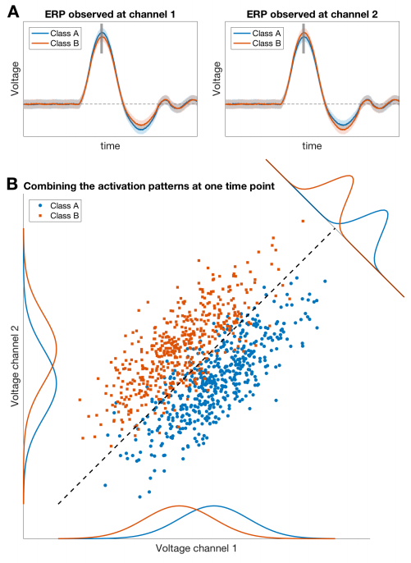
(Grootswagers, Wardle, & Carlson, 2017)
Traditional ERP analysis may be unable to detect effects due to overlap between data points within any single electrode.
MVPA uses correlations across electrodes to detect effects that can’t be found within any given electrode.

Slide 52
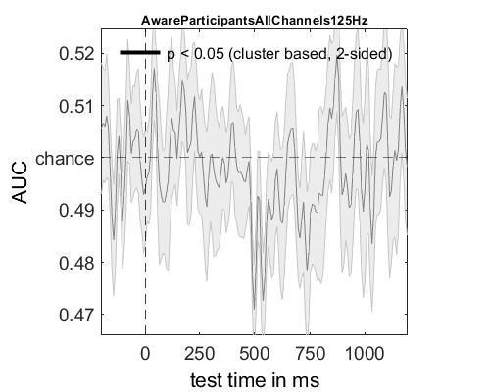
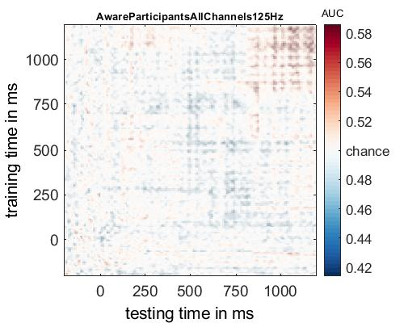
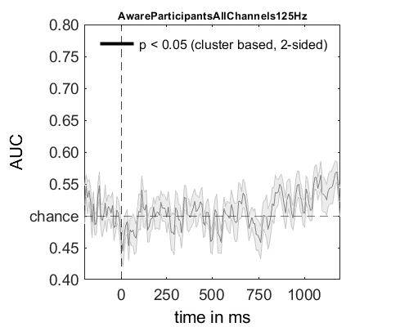
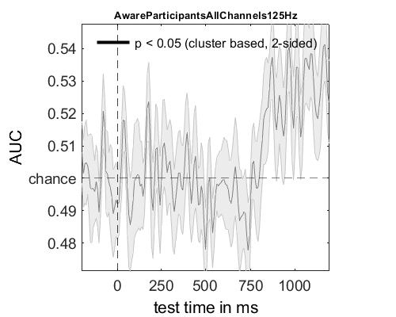
Within-participant decoding: Rule-aware participants
400-800ms generalization
“Diagonal” decoding
800-1100ms generalization
(non-significantly) above-chance performance only in late time window
No sign of rule processing in the early time window

Slide 53
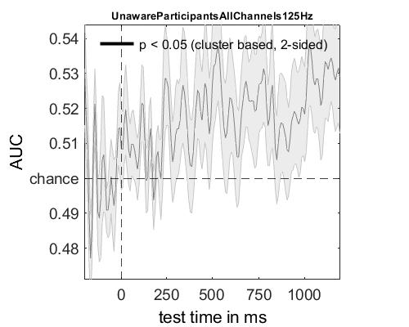
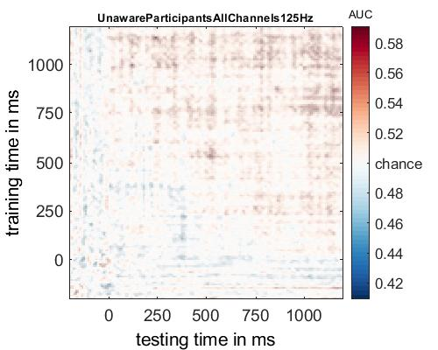
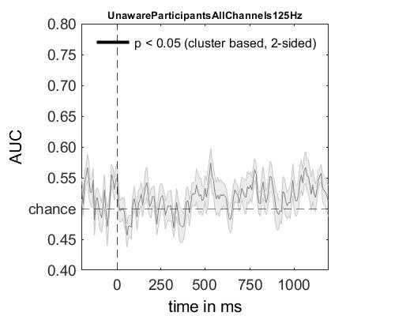
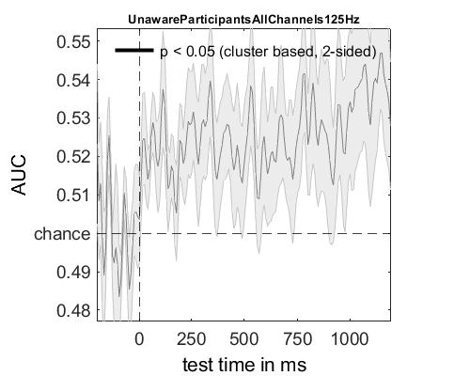
Within-participant decoding: Rule-unaware participants
400-800ms generalization
“Diagonal” decoding
800-1100ms generalization
Above-chance performance in early time window -- artifact of decoding filtered data?

Slide 54
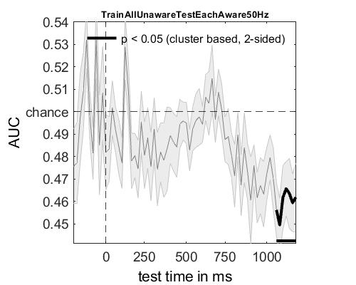
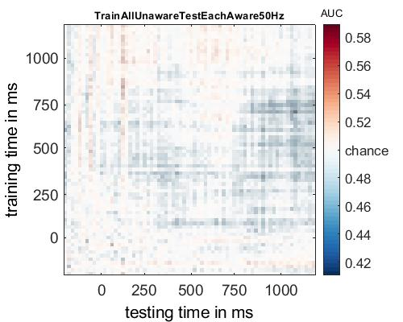
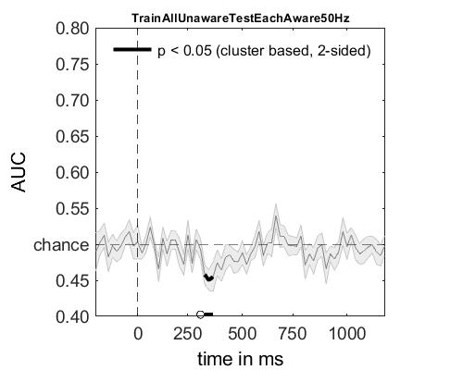
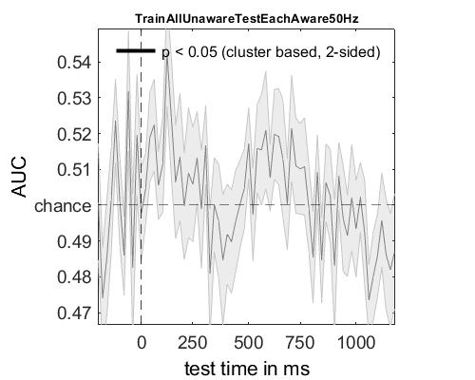
Cross-participant decoding
400-800ms generalization
Null results
… but various possible ways to refine future analyses
“Diagonal” decoding
800-1100ms generalization

Slide 55
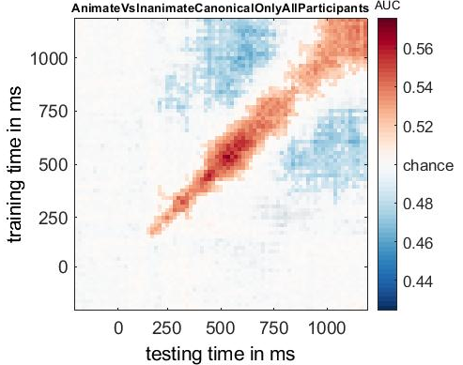
Also: train decoder to detect neural indices of animacy processing
Critical first step for measuring linguistic prediction induced by L2 morphosyntax

Slide 56
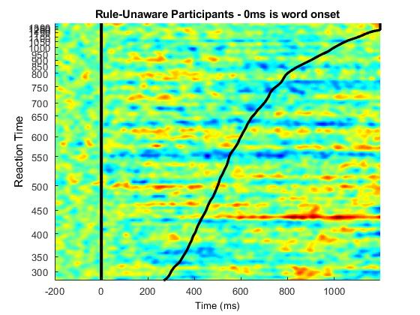
Shown for Pz electrode (locus of “explicit” P600 effect)
Also: response time-sorted “ERP images” suggest relationship between reaction times and P600 index of explicit processing

Slide 57
All explicit First trials are implicit before participant becomes rule-aware Participant occasionally zones out and processes some trials implicitly Implicit and explicit processing co-occur Explicitness takes some time to “kick in” Automatization of explicit processes
My analysis can’t distinguish between these possibilities…
By-epoch analyses?
“Inherently underpowered”
Making the experiment longer would not help, because I only get a few trials before learning kicks in?
Take a closer look at per-trial classification accuracy over the course of the experiment?

