Slide 1
Differences between conscious vs. subconscious grammar learning as revealed by drift diffusion modeling
David Abugaber
University of Illinois at Chicago
10/9/2020

Slide 2
Overview
My definitions of conscious and subconscious
Conscious vs. subconscious language processing
Different brain patterns in native language processing (Batterink & Neville, 2013)
… and in second language processing (Batterink et al., 2014)
Open question
But what does “different brain patterns” actually mean?
Methods
Drift diffusion modeling
Results
“Cautiousness” as the relevant difference between conscious vs. subconscious learners
Discussion
Take-aways for language educators

Slide 3
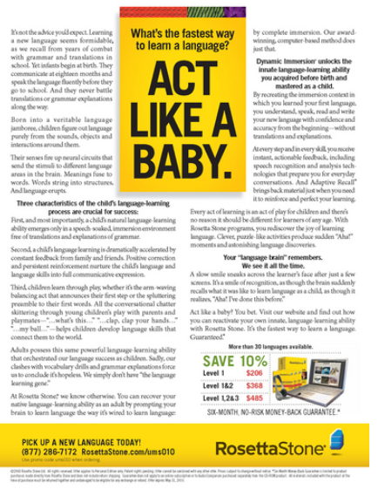
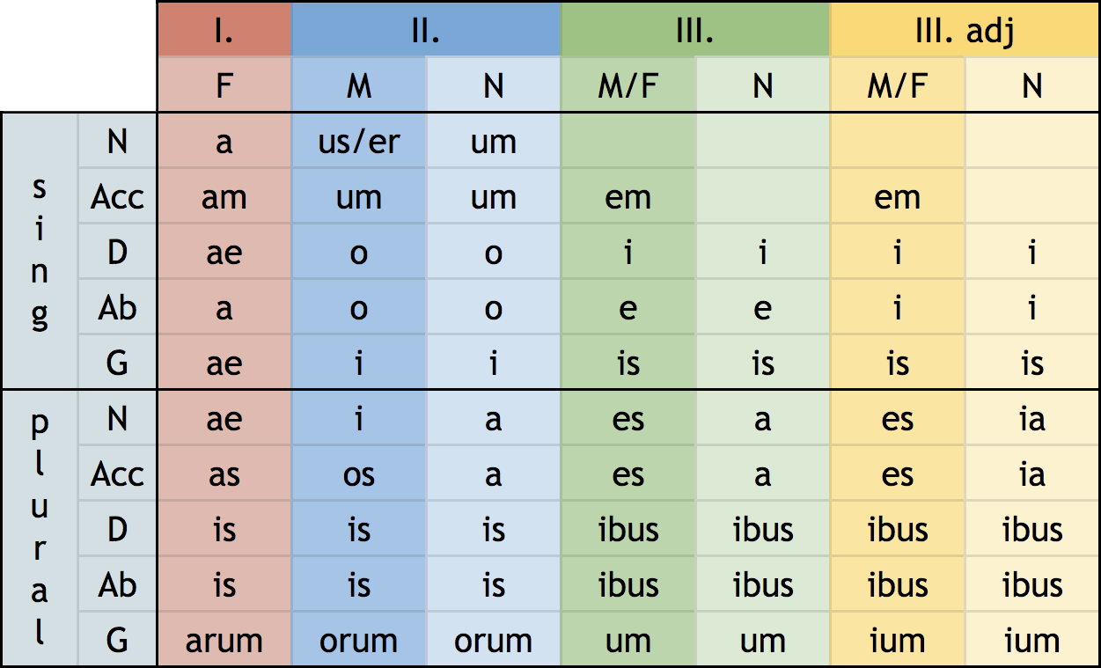
Conscious vs. subconscious language learning
“Learning without knowing you’re learning”

Slide 4
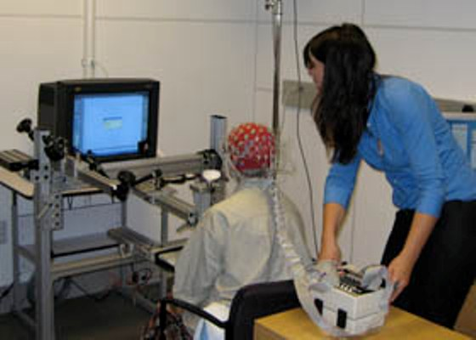
Electroencephalography (EEG)
Directly measures neural mechanisms underlying cognition
… vs. “indirect” measures like button presses or eye movements
Can detect subconscious activity with millisecond-level precision
Non-invasive

Slide 5
+

Slide 6
The

Slide 7
graduate

Slide 8
student

Slide 9
present

Slide 10
at

Slide 11
the

Slide 12
Ford

Slide 13
conference.

Slide 14
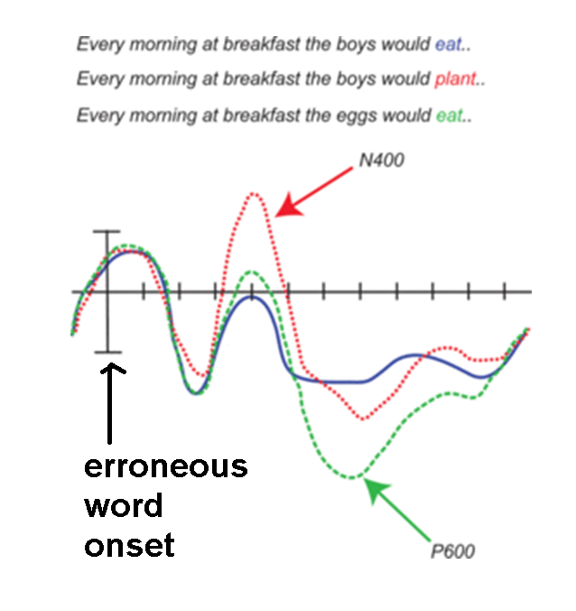

Slide 15
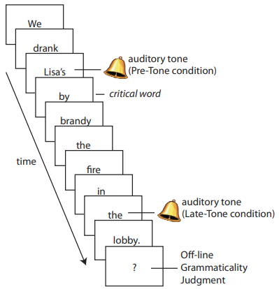
Consciousness in native language processing (Batterink & Neville, 2013)
“Cross-modal distraction task”
Bell distracts conscious attention from noticing a grammar error in a sentence
Reading when not distracted
Reading when distracted, but still notice grammar error
Reading when distracted & don’t notice grammar error

Slide 16
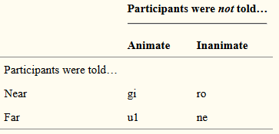
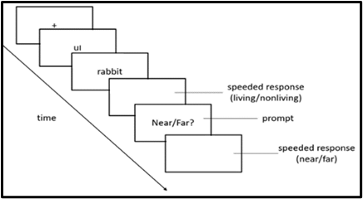
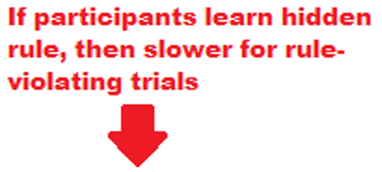
Consciousness in second language processing (Batterink et al., 2014)
1 of every 7 trials violates the hidden rule
Learning indicated by slower responses to rule-violating trials
Debriefing interview to determine participants’ awareness of hidden rule

Slide 17
+

Slide 18
ul

Slide 19
typewriter

Slide 20
Living / nonliving?

Slide 21
Near/Far?

Slide 22
+

Slide 23
ro

Slide 24
politician

Slide 25
Living / nonliving?

Slide 26
Near/Far?

Slide 27
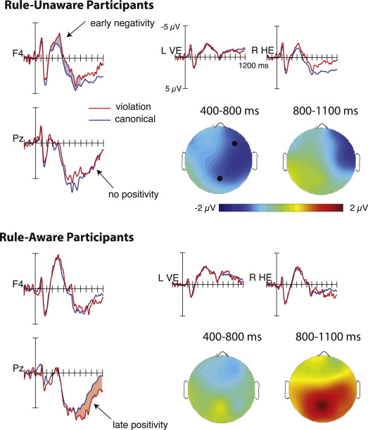
Effects of rule awareness (Batterink et al., 2014)
Reaction time data show that subconscious learning is posible
Different brain patterns for conscious vs. subconscious learners

Slide 28
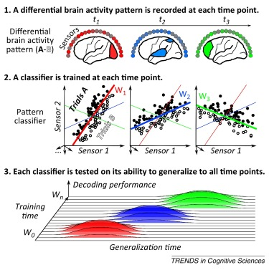
Dissertation (delayed due to coronavirus…)
Do brain patterns for conscious & subconscious language processing co-occur?
(King & Dehaene, 2014)

Slide 29
Conscious/subconscious language processing are qualitatively different in native language processing (Batterink & Neville, 2013)
Different brain patterns for second language learners with/without conscious rule knowledge (Batterink et al., 2014)
But what does “different brain patterns” actually mean?

Slide 30
Two possibilities for grammar learning
Possibility #1:
Rule-search & hypothesis-testing for verbalizable rule
The learners who consciously detect the rule are the ones who are most cautious and deliberate in their responses
Possibility #2:
Rule awareness comes from being surprised at your own unconscious learning
The participants who consciously detect the rule are the ones who are faster at pressing buttons and so are better at learning subconsciously
Are conscious learners more CAREFUL or more RAPID?
(when compared to subconscious learners)

Slide 31
Participants: native English speakers with varying levels of additional language experience, recruited from psych classes at U. of Illinois at Chicago (N = 40, 2 removed for low task accuracy)
Participant Attributes | Mean (Standard Deviation)
Gender | 30 female, 10 male
Age | 18.60 (0.80)
Self-reported English reading proficiency | 4.89 / 5.00 (0.31)
Self-reported English writing proficiency | 4.87 / 5.00 (0.41)
Self-reported English speaking proficiency | 4.89 / 5.00 (0.38)
Percent reporting additional language | 90%
Additional language reading proficiency | 3.36 / 5.00 (1.36)
Additional language writing proficiency | 3.03 / 5.00 (1.44)
Additional language speaking proficiency | 3.72 / 5.00 (1.15)

Slide 32
1 of every 7 trials violates the hidden rule
Learning indicated by slower responses to rule-violating trials
Debriefing interview to determine participants’ awareness of hidden rule

Slide 33
+

Slide 34
ne

Slide 35
laptop

Slide 36
Living / nonliving?

Slide 37
Near/Far?

Slide 38
+

Slide 39
gi

Slide 40
professor

Slide 41
Living / nonliving?

Slide 42
Near/Far?

Slide 43
Post-experiment debriefing
https://youtu.be/0jPoL5XQ1Po

Slide 44
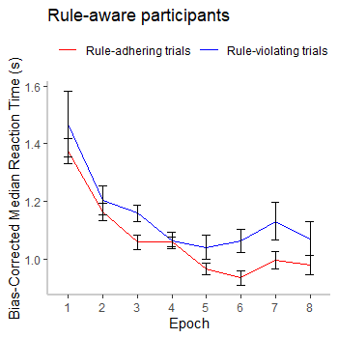
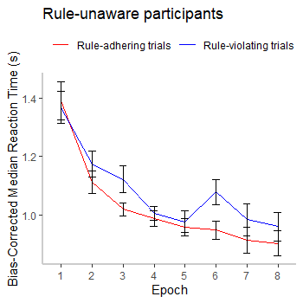
Subconscious learning shown in reaction times
Significant main effect of Trial Condition F(1, 36) = 14.15, p < .001, such that response times to rule-nonconforming trials were significantly slower than to rule-conforming trials.
No main effects or interactions from Awareness (all p < .05), suggesting that the learning effect was not significantly dissimilar across rule-aware (n = 14) and rule-unaware (n = 24) participants.

Slide 45
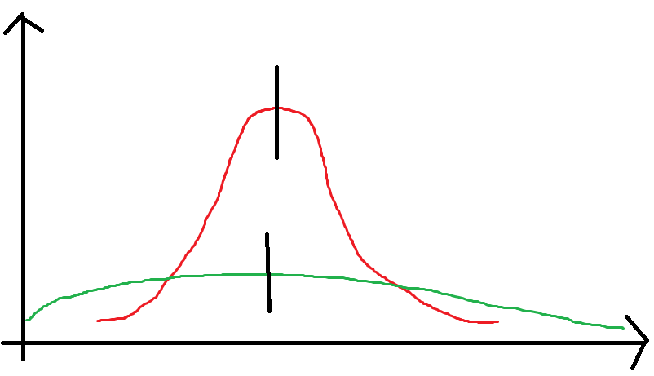
Qualitative differences?
Conscious/subconscious learners show no diff. in avg. reaction times
… but what about the SHAPE of the reaction time distribution?
QUALITATIVE differences b/w conscious & subconscious processing?

Slide 46
Drift diffusion modeling
Experiment task with binary decision task
“Response A or Response B”
1. “motor speed”
Speed of non-decision-related processes
2. “thinking speed”
How quickly participant ‘accumulates evidence’ for/against Response A or B
3. “cautiousness”
Height of evidence threshold for choosing Response A/B

Slide 47
thinking speed
cautiousness
motor speed
(Mulder et al., 2012)

Slide 48
Analysis details
Removed responses slower than 3 seconds
Drift diffusion models fit per participant using rtdists package (Singmann et al., 2020) in R (R Core Team, 2020)
Two-sample t-tests to compare rule-aware vs. rule-unaware participants, for each of:
Rate of evidence accumulation (v): “thinking speed”
Distance between decision thresholds (a): “cautiousness”
Duration of non-decision processes (t₀): “motor speed”

Slide 49
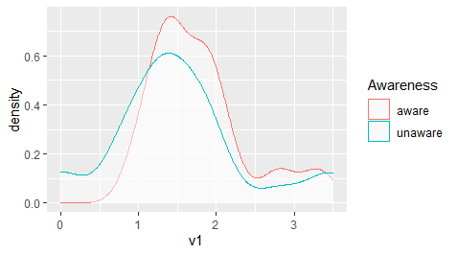
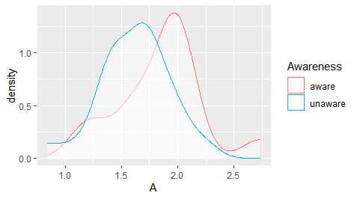
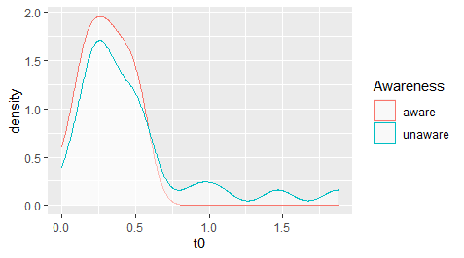
“Thinking speed”
“Cautiousness”
No significant difference: t(36) = 1.04, p = .302, d = 0.35
Significant difference: t(36) = 2.03, p = .049, d = 0.68
“Motor speed”
No significant difference: t(36) = 1.55, p = .131, d = 0.52

Slide 50
Two possibilities for grammar learning
Possibility #1:
Rule-search & hypothesis-testing for verbalizable rule
The learners who consciously detect the rule are the ones who are most cautious and deliberate in their responses
Possibility #2:
Rule awareness comes from being surprised at your own unconscious learning
The participants who consciously detect the rule are the ones who are faster at pressing buttons and so are better at learning subconsciously
Are conscious learners more CAREFUL or more RAPID?
(when compared to subconscious learners)

Slide 51
Summary of results
Replicated findings of subconscious learning from Batterink et al. (2014)
Slower reaction times to rule-violating trials, even in participants who didn’t have conscious awareness of the rule
Drift-diffusion model shows qualitative differences between conscious/subconscious learners
No significant differences in “thinking speed” and “motor speed”…
… but conscious learners showed more “cautiousness”
Higher threshold of evidence before making a decision

Slide 52
Limitations
Artificial language in a lab =/= natural language learning “in the wild”
Small, unbalanced sample sizes
(14 rule-aware participants vs. 24 rule-unaware participants)
“Consciously aware of a rule” =/= “always used the rule consciously”

Slide 53
Future directions
Capture changes over the course of learning?
See how speed/cautiousness parameters change during experiment
More elaborate models, with…
Parameters to capture bias against/towards a decision
Hierarchical Bayesian estimation (adjust estimates for individuals based on group results)
How do conscious vs. subconscious processing differ when a grammar rule is violated?
Can participants intentionally control their processing style?

Slide 54
Take-aways for language learning
Grammar learning can happen without conscious awareness
Metalinguistic rule explanations aren’t strictly necessary!
Difference between conscious/subconscious learning might not be due to inherent differences in how “quick” someone is
Instead, related to something like “risk-taking” or “conscientiousness” from personality research
Classic trade-off between fluency, accuracy, and complexity in second language research (Housen & Kuiken, 2009)

Slide 55
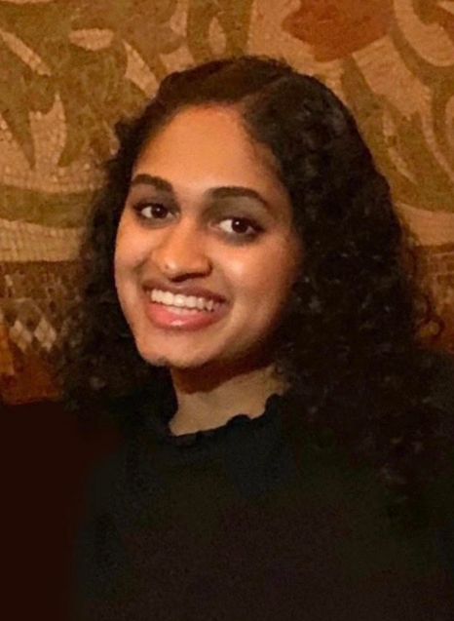
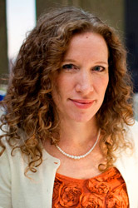
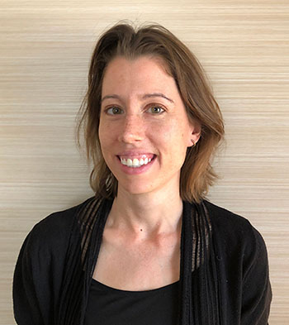
Thank you! Questions/comments?
Will Camacho
Gayatri Chavan
Sarah Hassan
Victoria Ogunniyi
Other dissertation committee members:
Dr. Jennifer Cabrelli
Dr. David Miller
Dr. Kim Potowski
Dr. Philip Hamrick
Dr. Kara Morgan-Short
Dr. Laura Batterink

Slide 56
References
Batterink, L., & Neville, H. J. (2013). The human brain processes syntax in the absence of conscious awareness. Journal of Neuroscience, 33(19), 8528-8533.
Batterink, L. J., Oudiette, D., Reber, P. J., & Paller, K. A. (2014). Sleep facilitates learning a new linguistic rule. Neuropsychologia, 65, 169-179.
Housen, A., & Kuiken, F. (2009). Complexity, accuracy, and fluency in second language acquisition. Applied linguistics, 30(4), 461-473.
Morgan-Short, K., Steinhauer, K., Sanz, C., & Ullman, M. T. (2012). Explicit and implicit second language training differentially affect the achievement of native-like brain activation patterns. Journal of cognitive neuroscience, 24(4), 933-947.
Mulder, M. J., Wagenmakers, E. J., Ratcliff, R., Boekel, W., & Forstmann, B. U. (2012). Bias in the brain: a diffusion model analysis of prior probability and potential payoff. Journal of Neuroscience, 32(7), 2335-2343.
R Core Team (2020). R: A language and environment for statistical computing. R Foundation for Statistical Computing, Vienna, Austria. https://www.R-project.org/
Singmann, H.; Brown, S.; Gretton, M.; & Heathcote, A. (2020). rtdists: Response Time Distributions. R package version 0.11-2. https://CRAN.R-project.org/package=rtdists
Voss, A., Nagler, M., & Lerche, V. (2013). Diffusion models in experimental psychology: A practical introduction. Experimental psychology, 60(6), 385.

Slide 57
Participants
Follow criteria in Batterink et al. (2014)
Native speakers of English
(Additional language experience OK)
Undergraduate students at a large university recruited through introductory psychology courses.
Right-handed
Neurologically typically developing
Normal or corrected-to-normal vision
No reported hearing problems, language disabilities, learning disabilities, or history of head trauma.
Provide consent as per institutional review board standards; receive research participation credit for their psychology course

Slide 58
Procedure
Follows Batterink et al. (2014) except for two changes
Artificial language articles are presented separately, before the nouns
... to allow for analysis of linguistic prediction (Research Question 3)
No nap
... replaced by five-minute break between experimental blocks

Slide 59
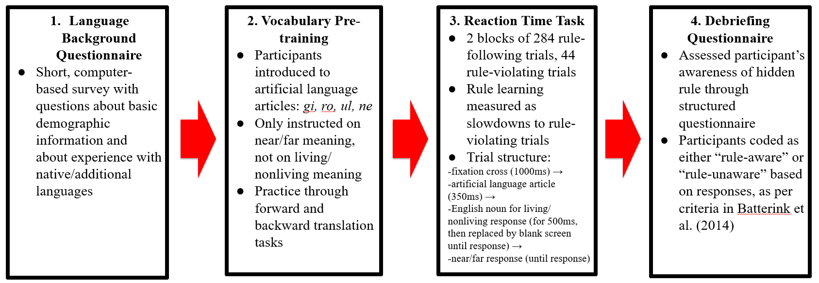

Slide 60
Part 1: Background questionnaire
Based on standardized LEAP-Q (Language Experience And Proficiency Questionnaire; Marian, Blumenfeld, & Kaushanskaya, 2007)
Covers information regarding:
Age
Gender
highest level of education
undergraduate major
listing of languages known to the participant as well as
environment of exposure (i.e., home, school, and/or other)
five-point Likert scale ratings of writing, speaking, and reading abilities for each language

Slide 61
Part 2: Vocabulary pre-training
Follow procedure in Batterink et al. (2014)
Flashcard study
Gi, ro, ul ne printed on one side
Near or far printed on the other side
in different colors to distinguish assignment between the two near and the two far words
As much time as desired
Forward translation
Read “near” or “far” (in different colors)
Press buttons corresponding to gi, ro, ul, ne
... while saying the answer choice out loud
24 trials; must get 11/12 correct on last 12 trials (if not, repeat 12 more trials until criterion)
Backward translation
Hear gi, ro, ul, ne
Press button corresponding to near or far (in different colors)
48 trials

Slide 62
Part 3: Main experimental task
Trial structure
Fixation cross (1000ms)
Artificial language article (1000ms)
Noun (500ms, replaced by blank screen until living/nonliving response
Near/far? prompt (shown until response)
Practice block of 6 canonical trials;
Two learning blocks (4 buffer trials, 308 experimental trials)
1 of every 7 experimental trials violates animacy rule
(assigned randomly)
Correct/violation nouns matched for word length and frequency
Assignment to Block 1 or Block 2 counterbalanced
Assignment to correct/violation counterbalanced

Slide 63
Part 4. Debriefing questionnaire
Did you notice any specific patterns in the use of the new words you learned (other than the near/far rule that we taught you)? If so, what?
(If participant correctly identifies pattern):
When did you become aware that this pattern was relevant (i.e., during the first block, during the second block, or during this interview)?
(If participant does not identify pattern):
At any point, did you look for rules to figure out when to use any of these words?
There is actually a rule that determines the correct word choice—i.e., when to say "gi" instead of "ro" or when to say "ul" instead of "ne." If you had to guess, what do you think that rule is?
(If correct rule is not stated):
Could you tell me which of the new words are used more often to describe living things? And which words are used more often to describe objects?
Following Batterink et al. (2014):
coded as AWARE if participant produces the correct pattern and reports having noticed it during either the first or second experimental block
otherwise, coded as UNAWARE

Slide 64
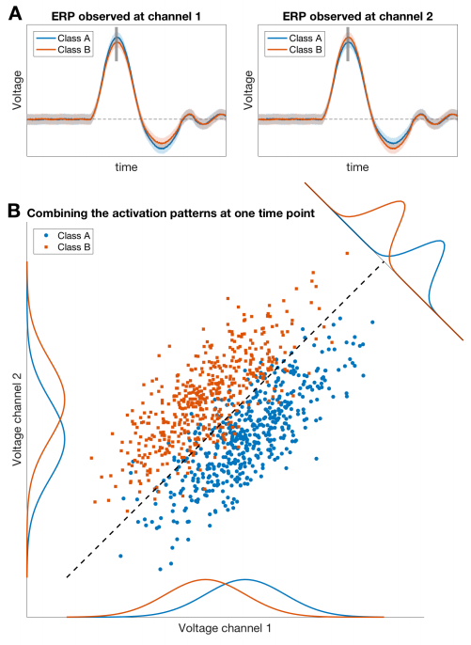
(Grootswagers, Wardle, & Carlson, 2017)
Traditional ERP analysis may be unable to detect effects due to overlap between data points within any single electrode.
MVPA uses correlations across electrodes to detect effects that can’t be found within any given electrode.

Slide 65
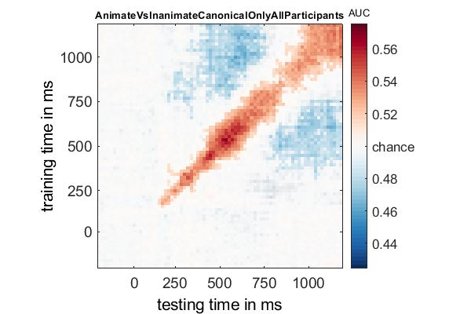

Slide 66
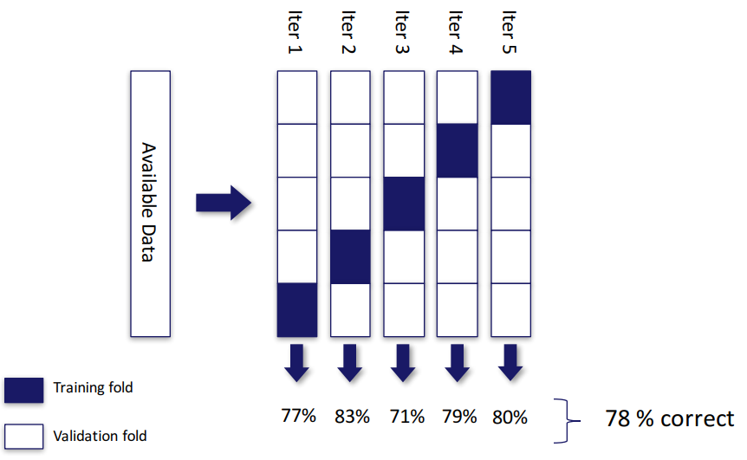

Slide 67
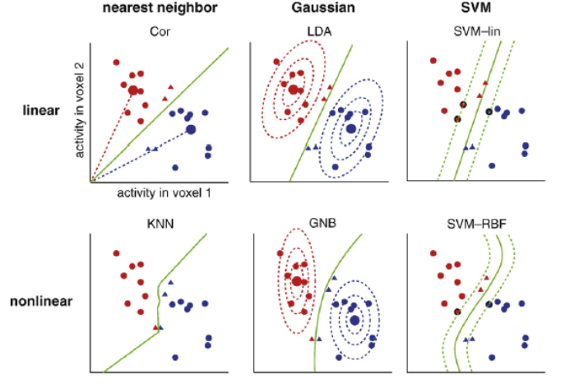

Slide 68
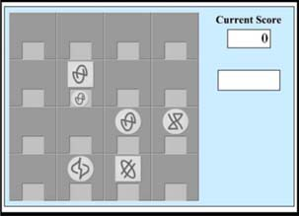
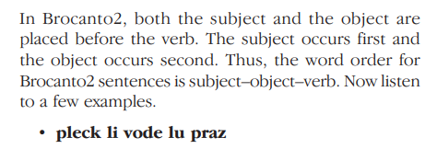
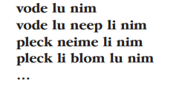
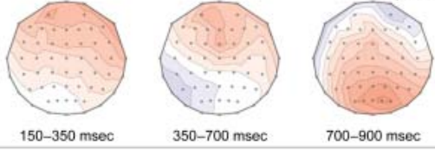
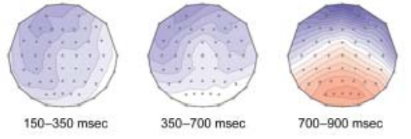
Effects of training condition (Morgan-Short et al., 2012)
Artificial language (Brocanto2) for playing a novel board game
Taught using either…
Explicit training (rule explanations)
Implicit training (input flood)
Results:
Explicit learners -> positive EEG deflections
Implicit learners -> negative EEG deflections
More nativelike brain response?
BUT is this “conscious” vs. “subconscious”?

