Slide 1
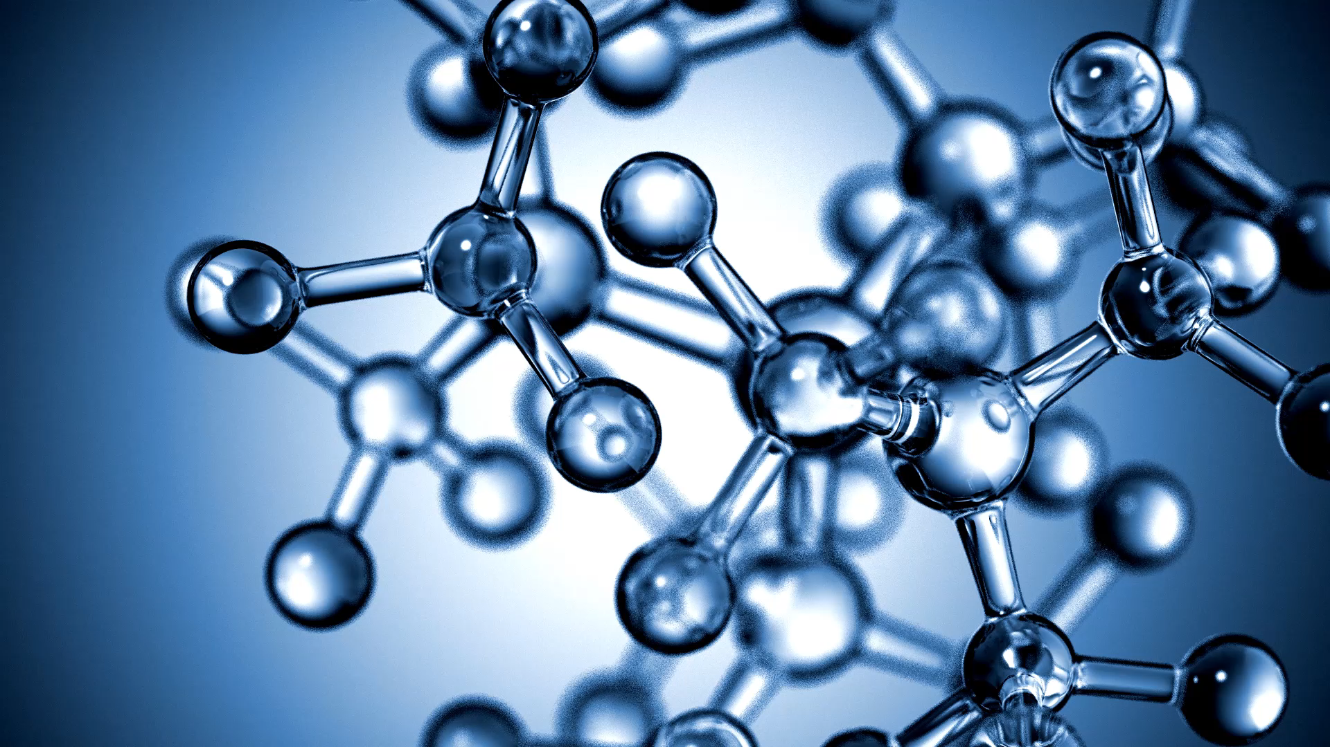
Molecular Qubits
Cu Qubit Candidate
D. F. Hakala, Ph.D.

Slide 2
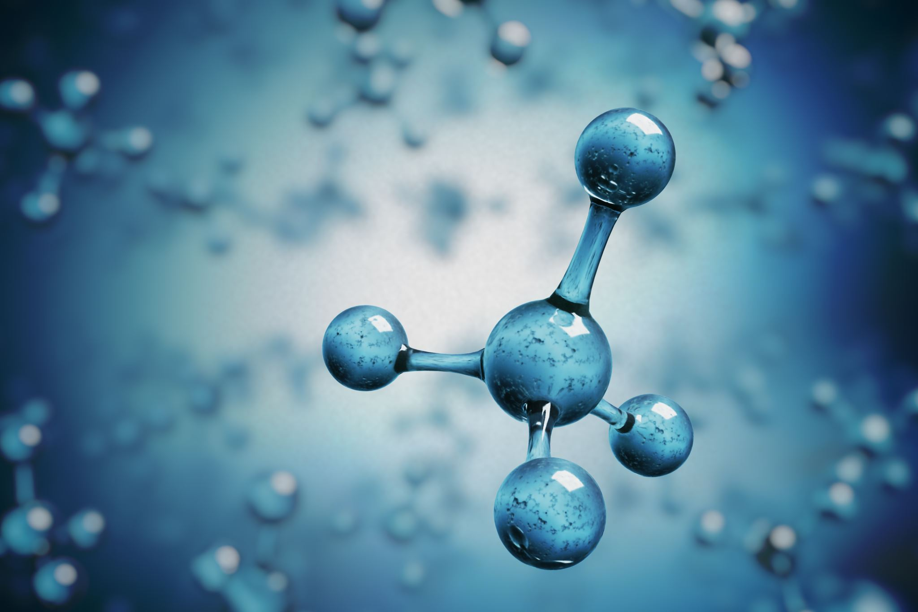
Introduction-Molecular Qubits
A good relatively recent review related to molecular qubits is
Recent Innovations in Solid-State and Molecular Qubits for Quantum Information Applications
J. Phys. Chem. Lett. 2021, 12, 10742-10745
There are over 40 references in this article, many of them with respect to molecular qubits.
This is an overview for a Virtual Issue of J. Phys .Chem.Lett. on this subject.

Slide 3
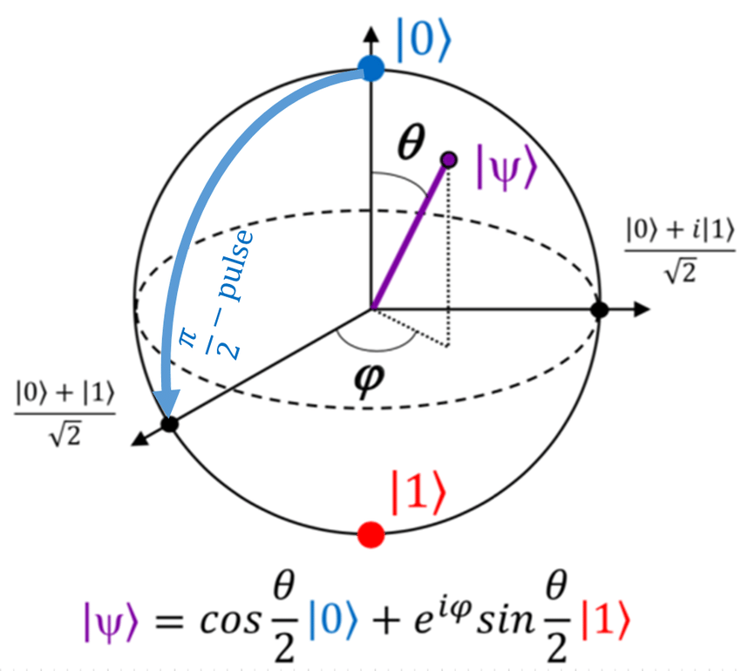
Bloch Sphere Representation of the Qubit
Applying (typically) microwave pulses of the correct time and frequency(it will need to be at the resonance of the energy difference between the |0> and |1> states at the applied magnetic field strength) will rotate the qubit from its initial orientation to a final one.
Assume the qubit is initially in the |0> state (theta =0). A resonant frequency pulse of theta=Pi/2 will rotate the qubit 90 degrees on the block sphere and result in a superposition (equal weights) of the |0> and |1> states or a normalized state of (|0>+|1>)/2^{1/2}. A pulse of length theta=Pi would change the qubit from the |0> state to the |1> state, effectively a NOT gate.

Slide 4
Molecular Qubits
A qubit is an object that has two states (generally referred to as |0> and |1>) and all their superpositions. There are many possible physical implementations of the qubit. One of these that is attractive is the molecular qubit.
The attractiveness is for several reasons.
  They are small which will help in scaling up to higher device densities
  They can be engineered or designed with respect to a number of different properties.
  They are capable of being encoded, addressed, manipulated, and read by means such as optical or microwave radiation.
A typical molecular qubit is one that is spin based using the spin of unpaired electron(s). This energy of the molecule will both change and split in response to an applied magnetic field.

Slide 5
Molecular Qubits
So, one of the characteristics we want in a molecular spin qubit is that it is easy to achieve a spin state. Coordination compounds of transition metals such as Cr, Cu, Ni, V etc. can be selected to have unpaired spins.
Another characteristic is that we want to maximize the time it can spend in the targeted coherent superpositions of qubits. Since there can be an I* S interaction between nuclear spins (I) and the electron spin (S) of the transition metal , this interaction can result in a decoherence of the qubit state. By designing molecular qubits such that atoms with net or strong nuclear spins are further from the transition metal atom we should improve the coherence time of the qubit.
The stiffness of the lattice can also be a factor. A stiffer lattice generally means higher phonon energies. The higher energies are less likely to interact and cause decoherence of the qubit.
Qubits that have better coherence times at high temperatures are of interest because this could result in a less costly quantum computer. So good room temperature coherence is a desired objective. However, even good coherence at liquid N2 temperature (77K) would be huge improvement over liquid helium temperatures.

Slide 6
Molecular Qubits
One type of molecule proposed as a qubit with better room temperature coherence are copper(II) complexes.
  Room Temperature Quantum Coherence in a Potential Molecular Qubit.
  NATURE COMMUNICATIONS , 5:5304 , DOI: 10.1038/ncomms6304 , www.nature.com/naturecommunications
An analog for one of these molecules has been studied to better understand the electronic states of the molecule, focusing on the lower lying states which are of most interest in the dynamics of the qubit behavior .
  Characterizing Excited States of a Copper Based Molecular Qubit Candidate with Correlated Electronic Structure Methods.
  J. Phys. Chem. A 2023, 127, 6764-6770
The following does initial calculations on the copper qubit analog studied in the last paper.

Slide 7
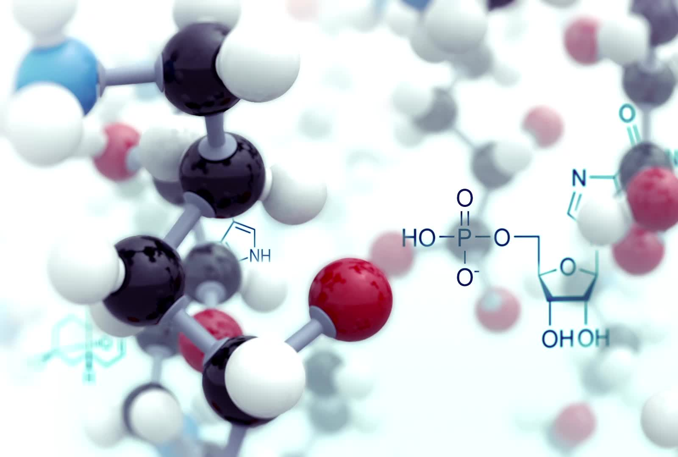
Calculations
The molecule examined is an analog for a proposed room temperature molecular qubit. [Cu(II)S₄C₄H₄]⁻² , or [Cu(II)(edt)₂]⁻² where edt is short for ethylene dithiolate a doubly negatively charged ligand.
The Cu qubit analog molecule was geometry optimized using a DFT method with the PBEO functional, a basis set of def2/TZVPPD and the auxillary basis set def2/J.
The molecule was drawn and initially optimized using Spartan 20.
The resulting data was used to generate an XYZ file that was edited to be suitable for ORCA.
The DFT calculation was done using ORCA 5.04.

Slide 8
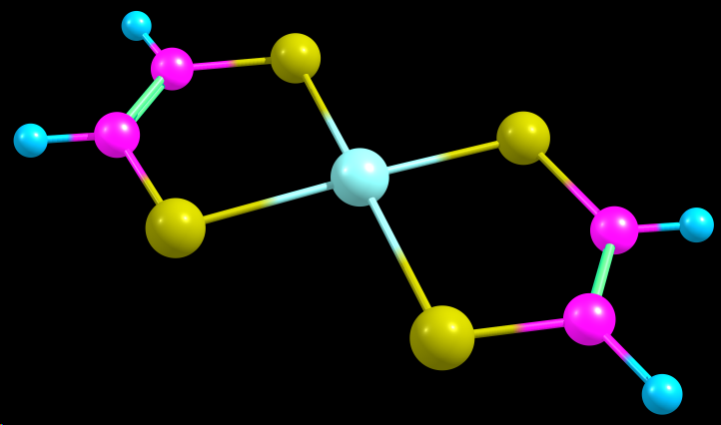
Cu Qubit Analog
This molecule is an analog for a proposed room temperature molecular qubit. [Cu(II)S₄C₄H₄]⁻²
A proposed molecule to which this is an analog has four cyano groups instead of the four hydrogens. The carbon 12 atoms have no net nuclear spin (as opposed to the hydrogens). The nitrogen has a very weak spin interaction. They therefore will have less interaction with the Cu(II) spin, reducing environmental interaction of the qubit.
However, the addition of additional electrons from the four cyano groups significantly adds computational complexity to quantum calculations, So this molecule is easier to study.

Slide 9
ORCA Input File
! PBE0 def2-TZVPPD def2/J OPT
! PAL8 Printbasis PrintMOs
* xyz -2 2
Cu 0.79423 0.71870 0.00000
S -1.02180 2.16851 -0.00000
S 2.14846 2.60707 -0.00000
S 2.61024 -0.73113 -0.00000
S -0.55997 -1.16969 -0.00000
C -2.35657 0.98041 -0.00000
C -2.16717 -0.38861 -0.00000
C 3.75565 1.82598 -0.00000
C 3.94504 0.45693 -0.00000
H 4.95690 0.07356 0.00000
H 4.62545 2.46965 0.00000
H -3.36845 1.36378 0.00000
H -3.03696 -1.03230 0.00000
This file shows that the ORCA computational chemistry calculation was done using
- A Density Functional Theory (DFT) functional of PBE0
- A basis set of def2-TZVPPD (triple zeta level)
- An auxillary basis set of def2/J
The calculation itself was a geometry optimization (keyword = OPT)
The calculation was done using 8 threads of parallel processing (keyword = PAL8)
The other comments refer to the data printed in the output file to be consistent with what ChemCraft software requires for input to that program for visualization of the Molecular Orbitals.
The atomic position are given by the XYZ file in angstroms
The net charge on the molecule is -2
The multiplicity of 2S+1 is 2, since the spin S is ½.

Slide 10
MO Energy Diagrams from ORCA Output
Overall View
Closeup View of HOMO-LUMO Region
Rendered with ChemCraft

Slide 11
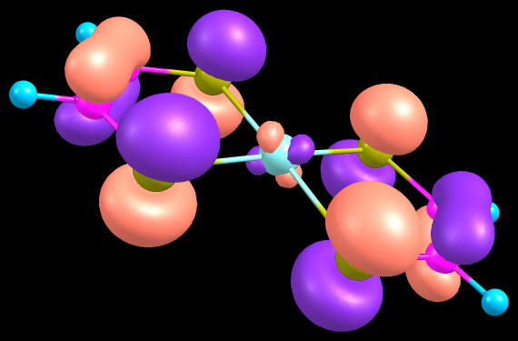
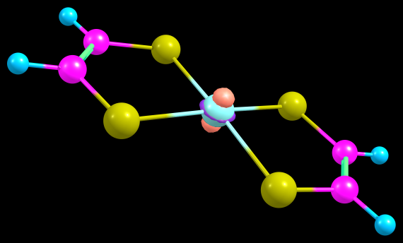
Graphical Representations of Molecular Orbitals
This is the Highest Occupied Molecular Orbital (HOMO) for the Cu(II) molecule as calculated.
Note the d_{xz} character around the Cu atom
This is the Lowest Unoccupied Molecular Orbital (LUMO) for the Cu(II) molecule as calculated.
Note the d_{z2} character around the Cu atom

Slide 12
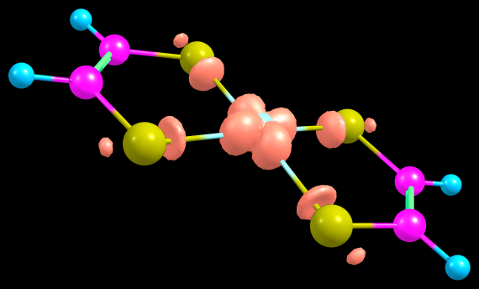
Spin Density 3D Isosurface
This is the Chemcraft rendering of the spin density of the Cu qubit candidate with hydrogen substitutions.

Slide 13
ABSORPTION SPECTRUM
Cu Qubit Candidate (H Version)
VIA TRANSITION ELECTRIC DIPOLE MOMENTS*
State Energy Wavelength fosc T2 TX TY TZ
(cm-1) (nm) (au**2) (au) (au) (au)
-------------------------------------------------------------------------------------------------------
1 8143.4 1228.0 0.000007381 0.00030 0.00193 -0.01717 -0.00000
2 14961.1 668.4 0.000000041 0.00000 -0.00000 -0.00000 0.00096
3 17862.9 559.8 0.000608257 0.01121 -0.10487 -0.01458 0.00000
4 18711.4 534.4 0.000000007 0.00000 0.00001 0.00000 0.00035
5 21058.8 474.9 0.000000000 0.00000 0.00004 0.00002 0.00004
6 22698.8 440.6 0.000333950 0.00484 -0.01340 0.06829 -0.00000
7 25371.2 394.1 0.000000000 0.00000 -0.00000 -0.00002 0.00001
8 25810.8 387.4 0.000279522 0.00357 -0.00808 -0.05916 0.00000
9 26013.1 384.4 0.256247058 3.24297 1.78145 0.26348 -0.00002
10 26124.3 382.8 0.000003534 0.00004 0.00271 0.00040 0.00608
Strongest transition is highlighted
* From ORCA 6.0 TDDFT/TDA Calculation

Slide 14
UV-VIS Calculated Absorption Spectrum
Cu Qubit Candidate (H Version)

Slide 17
ABSORPTION SPECTRUM VIA TRANSITION ELECTRIC DIPOLE MOMENTS
------------------------------------------------------------------------------------------------------
State Energy Wavelength fosc T2 TX TY TZ
(cm-1) (nm) (au**2) (au) (au) (au)
-------------------------------------------------------------------------------------------------------
1 9449.1 1058.3 0.000000001 0.00000 0.00013 -0.00000 0.00000
2 15786.0 633.5 0.000000000 0.00000 -0.00000 -0.00000 0.00000
3 16599.1 602.4 0.000064184 0.00127 0.03568 -0.00000 0.00000
4 17367.2 575.8 0.000000000 0.00000 -0.00000 -0.00000 -0.00000
5 18926.6 528.4 0.000000000 0.00000 -0.00000 0.00000 -0.00000
6 19776.9 505.6 0.000000000 0.00000 0.00000 0.00000 -0.00001
7 20551.2 486.6 0.000000028 0.00000 0.00000 -0.00068 -0.00000
8 22107.1 452.3 0.000000575 0.00001 0.00000 0.00000 -0.00293
9 22860.5 437.4 0.000000005 0.00000 -0.00014 -0.00010 0.00022
10 23715.9 421.7 0.000000000 0.00000 -0.00001 -0.00000 0.00001
Strongest transition highlighted (i.e. largest fosc)

Slide 18
UV-VIS Calculated Absorption Spectrum
Cu Qubit Candidate (Cyano Version)

Slide 19
MO Energy Levels and Strongest Transition

Slide 20
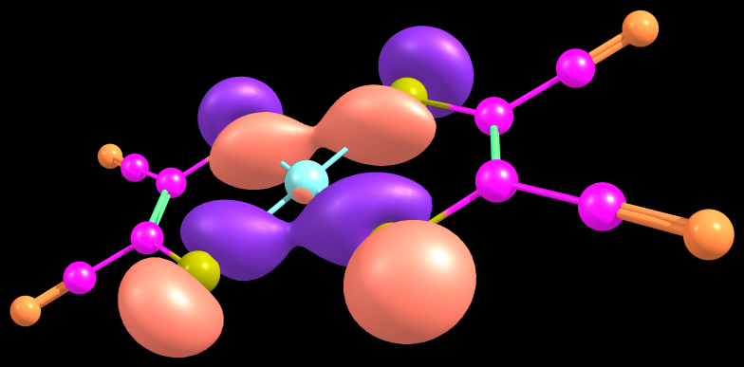
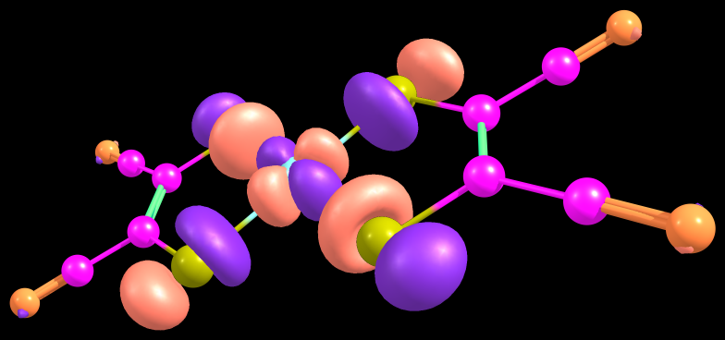
MO’s involved in GS -> State 13 Transition

Slide 21
Cu(II) cyano qubit candidate-EPR Spectrum*
“Pepper”-rigid limit
“Garlic”-isotropic limit
* Simulated using Easy Spin on an ORCA 6.0 output file

Slide 22
Cu(II) H qubit candidate-EPR Spectrum*
* Simulated using Easy Spin on an ORCA 6.0 output file

Slide 23
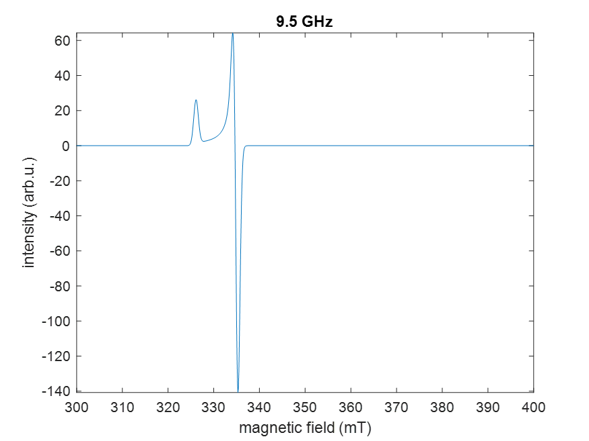


Slide 24
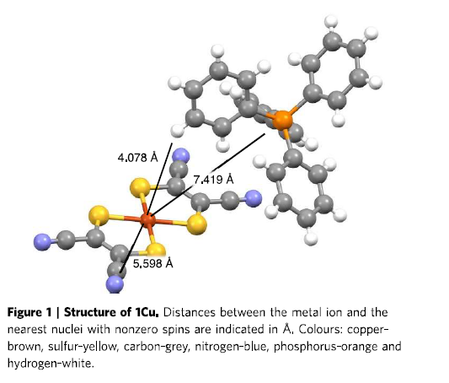
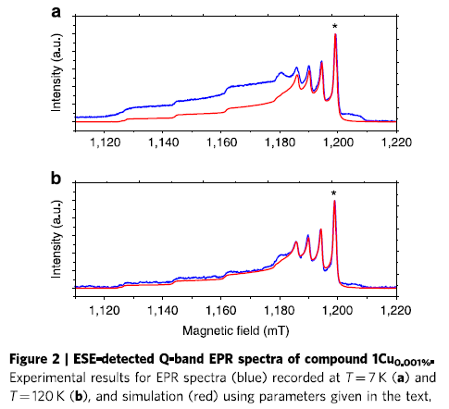
Addenda
Room Temperature Copper Qubit Article Extracts
These pictures show extracts from the article about a Room Temperature Cu qubit referred to earlier . Fig.1 shows the structure of the molecule studied and some interatomic distances. The copper is in an essentially square planar geometric configuration. Fig. 2 shows the Electron Paramagnetic Resonance (EPR) spectrum and simulation fits to the spectrum at two different temperatures. The spectrum is shown as a function of the applied magnetic field. Typically, a fixed RF/Microwave frequency is used and as the magnetic field is varied the energy differences go in and out of resonance with the electromagnetic radiation. Spectral finer details are related to the Cu atom spin and its couplings to nuclear spins.

Slide 25
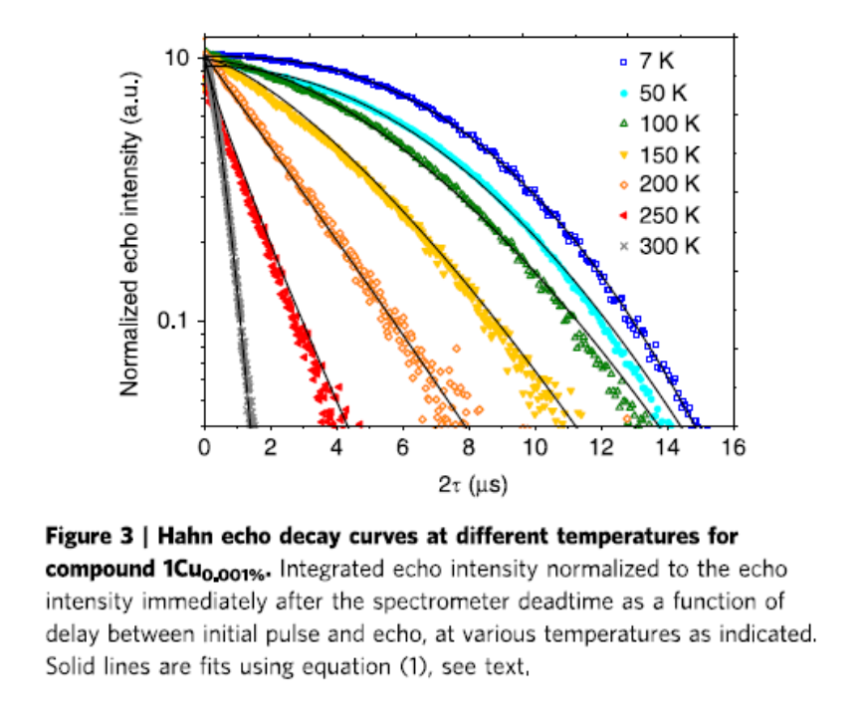
Room Temperature Copper Qubit Article Extracts
Presence of a spin echo in an EPR experiment is an indicator of coherence. This data shows that the coherence is much better at very low temperatures, but that some coherence is maintained for a time of about 1 microsecond even at room temperature.

Slide 26
Methods Used in Room Temperature Copper Qubit Article

Slide 27
Energy Conversion Table
 | hartree | eV | cm⁻¹ | kcal/mol | kJ/mol | ºK | J | Hz
hartree | 1 | 27.2107 | 219 474.63 | 627.503 | 2 625.5 | 315 777. | 43.60 x 10⁻¹⁹ | 6.57966 x 10⁺¹⁵
eV | 0.0367502 | 1 | 8 065.73 | 23.060 9 | 96.486 9 | 11 604.9 | 1.602 10 x 10⁻¹⁹ | 2.418 04 x 10⁺¹⁴
cm⁻¹ | 4.556 33 x 10⁻⁶ | 1.239 81 x 10⁻⁴ | 1 | 0.002 859 11 | 0.011 962 7 | 1.428 79 | 1.986 30 x 10⁻²³ | 2.997 93 x 10⁺¹⁰
kcal/mol | 0.001 593 62 | 0.043 363 4 | 349.757 | 1 | 4.18400 | 503.228 | 6.95 x 10⁻²¹ | 1.048 54 x 10⁺¹³
kJ/mol | 0.000 380 88 | 0.010 364 10 | 83.593 | 0.239001 | 1 | 120.274 | 1.66 x 10⁻²¹ | 2.506 07 x 10⁺¹²
ºK | 0.000 003 166 78 | 0.000 086 170 5 | 0.695 028 | 0.001 987 17 | 0.008 314 35 | 1 | 1.380 54 x 10⁻²³ | 2.083 64 x 10⁺¹⁰
J | 2.294 x 10⁺¹⁷ | 6.241 81 x 10⁺¹⁸ | 5.034 45 x 10⁺²² | 1.44 x 10⁺²⁰ | 6.02 x 10⁺²⁰ | 7.243 54 x 10⁺²² | 1 | 1.509 30 x 10⁺³³
Hz | 1.519 83 x 10⁻¹⁶ | 4.135 58 x 10⁻¹⁵ | 3.335 65 x 10⁻¹¹ | 9.537 02 x 10⁻¹⁴ |  | 4.799 30 x 10⁻¹¹ | 6.625 61 x 10⁻³⁴ | 1

Slide 28
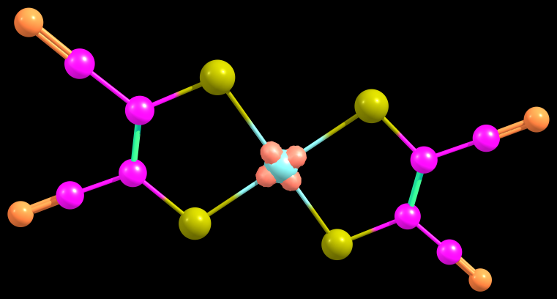
Spin Density

