Slide 1
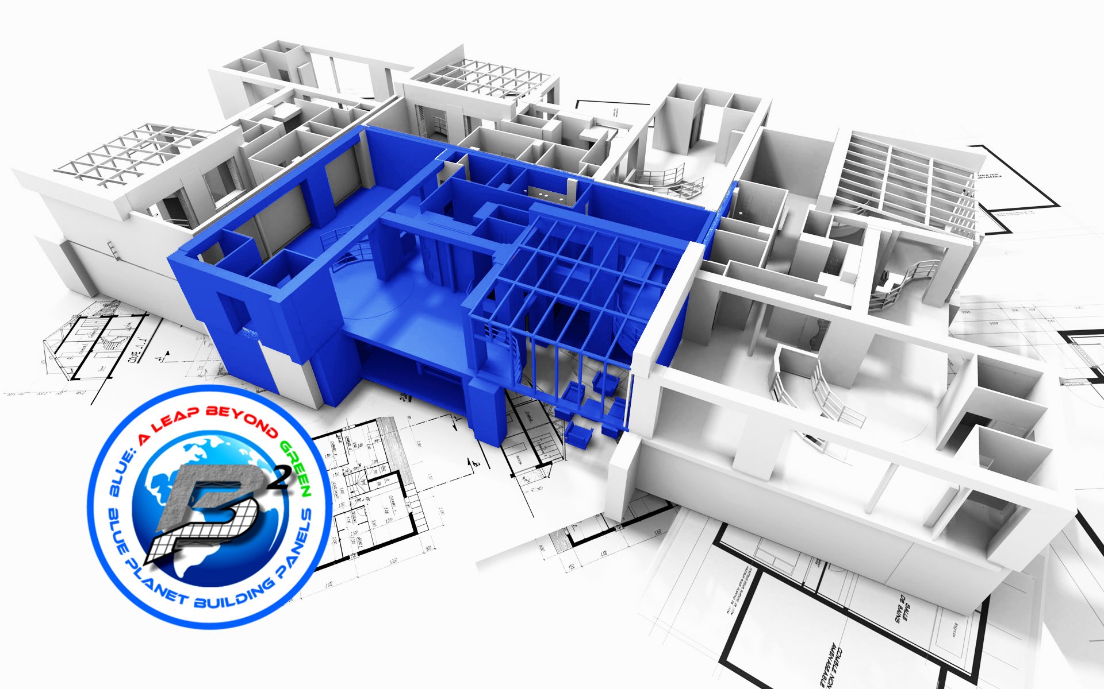
WELCOME
TO

Slide 2
BLUE PLANET
BUILDING PANELS

Slide 3
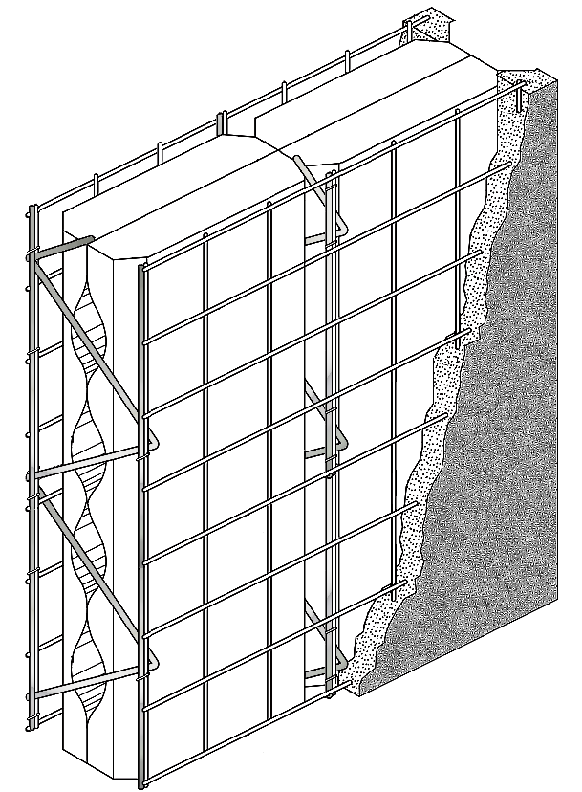
THIS SYSTEM OFFERS
TREMENDOUS VALUE:

Slide 4
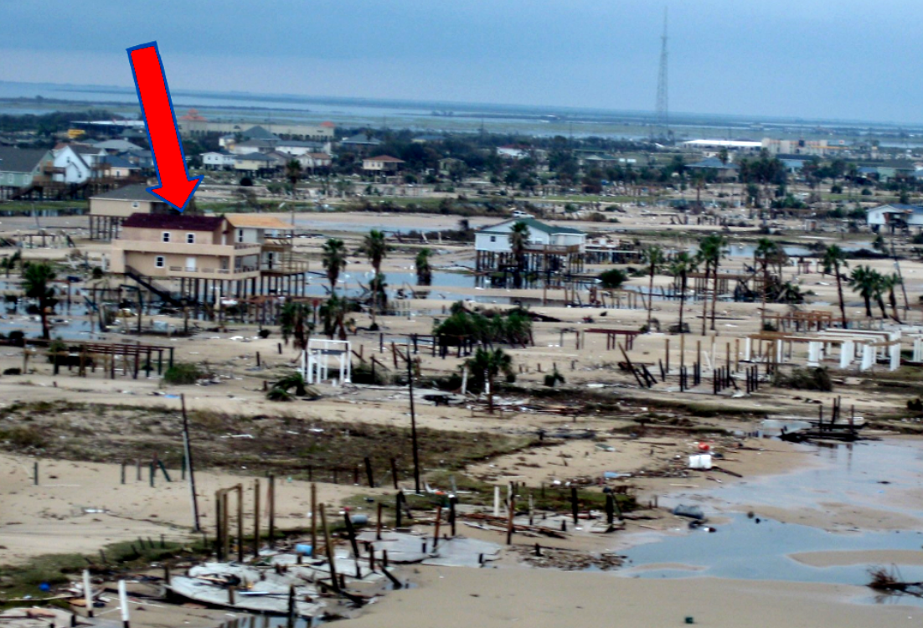
Value for Homeowner:
A Nearly Indestructible Home
Crystal Beach, TX
Built with SCIPs
HURRICANE IKE SURVIVOR

Slide 5
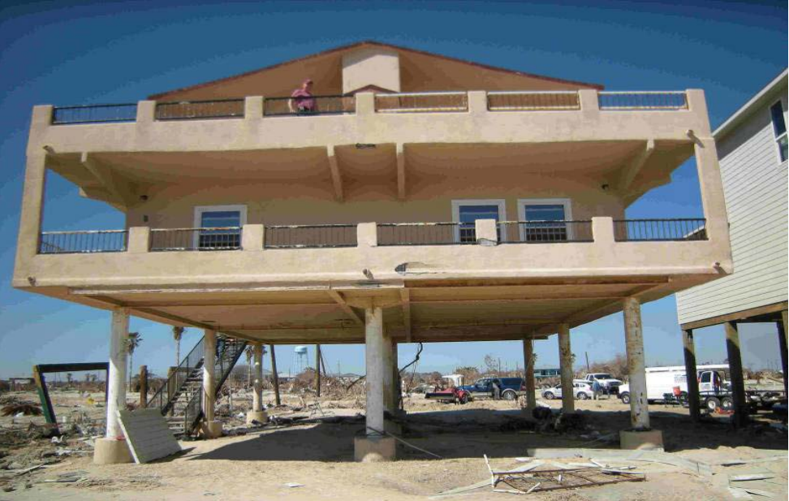
Value for Homeowner:
A Nearly Indestructible Home
THE HOUSE NEXT DOOR
WAS UTTERY DESTROYED
HURRICANE IKE SURVIVOR

Slide 6
EARTHQUAKE RESISTANCE to 8.0+ on the Richter Scale
FIRE RESISTANT to 1800F for at least 60 minutes – Mitigated Risk from Wildfires or Common Kitchen Fires
WIND RESISTANCE to 180 mph – Mitigated Risk from Hurricanes or Tornadoes
MOLD & MILDEW RESISTANT – Mitigated Risk from Flood Damage
WATERPROOF – Mitigated Risk from Flooding
SUPER-INSULATED R-40 Performance – 30% reduction in Energy Expenses
STC-50 SOUND RATED – Floors, Walls, and Roofing Panels Meet the UBC Requirement for Partition Walls between Multi-Family Units
PEST & VERMIN RESISTANT

Slide 7
Value for Contractor:
Improved Profit Margins
FEWER SUBCONTRACTOR TRADES to COORDINATE - Replaces the Following Trades/Components: Foundation Embeds, Framing, Framing Hardware, Sheer Sheathing, Vapor Barrier/ Water-Proofing Membranes, Insulation, Drywall Hanging & Taping, Stucco, CMU Block Masonry, Basement Foundations, Retaining Walls, Trusses, Floor Joists, Roofing Contractor, Crain Time & Traffic Control.
OFFERING the STRONGEST and most INTEGRATED BUILDING SYSTEM - Reduces the
need for costly components like Engineered Steel or Glulam Beams, Columns, and Headers.
MOST VERSATILE BUILDING SYSTEM - Field Fabrication & Modification could not be easier. The need to wait on Special Orders, Additional Materials, Hardware, or Components is virtually eliminated.
SPEED of CONSTRUCTION about 2X faster than Conventional.
MINIMAL LEARNING CURVE - Ease of Use promotes high levels of production quickly even with unskilled labor.
EXTREMELY COMPETITIVE with Conventional Construction
ADVANTAGE – Being a Certified Installer of the Greenest, Most Superior Building System available on the planet undoubtably will create opportunity and provide the edge to secure contracts

Slide 8
Value for Designers & Architects:
Optimized Design Palette
OPTIMIZED DESIGN PALETTE - Creative Versatility to expand Usable Space with the addition of Rooftop Garden Patios or to exploit enhanced architectural features such as Increased Flat Spans, Cantilevers, Curves, Vaults, or gravity defying Oblique Walls
INHERENT VERSATILE TENACITY - BP2 Panels can be custom fabricated to meet virtually any Structural Challenge such as Basement Walls, Cantilevered Patios, or even Rooftop Swimming Pools. Once the Skins have been applied to the Panels, it ties the Floor, Walls, Ceiling, and Roof together to create a Monolithic, Cementitious, Seamless Membrane that is Nearly Indestructible
HIGHEST LEED-RELi PERFORMANCE - Exceeds USGBCs Guidelines for “Platium”Certification. Bp2 Panels are simply the GREENEST Structural Building Material available. Our Recycled material content is 40% by weight and 60% by volume and all waste is 100% recyclable
THE SUPERIOR SOLUTION - Bp2 Panels are a LEAP BEYOND GREEN with our combination of INCOMBUSTABILITY + SUSTAINABILITY + DURABILITY Designers are able to provide their clients with the Most Superior Building Material available at any cost

Slide 9
Value for Environment
Highest Valued Building System
a. Incombustible Structures – Structure Fire or Wildfire
1-hour rating min. - Will withstand 1800 F for a minimum
of 60 minutes with no loss in structural integrity.
b. Lower Insurance Rates
Earthquake, Flood, and Fire Resistance - equates to the need
for Contents Only protection

Slide 10
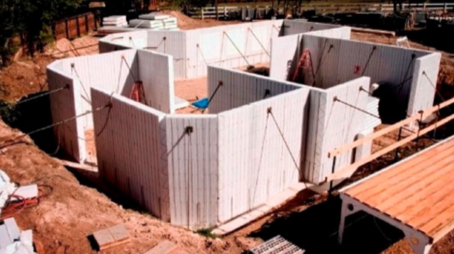
BLUE PLANET
BUILDING PANELS
Our Panels can be used for:
Basement Walls

Slide 11
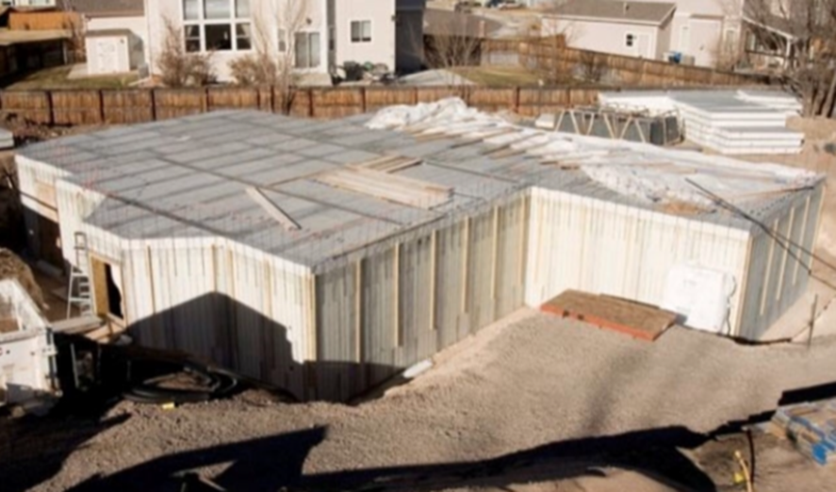
BLUE PLANET
BUILDING PANELS
Floors

Slide 12
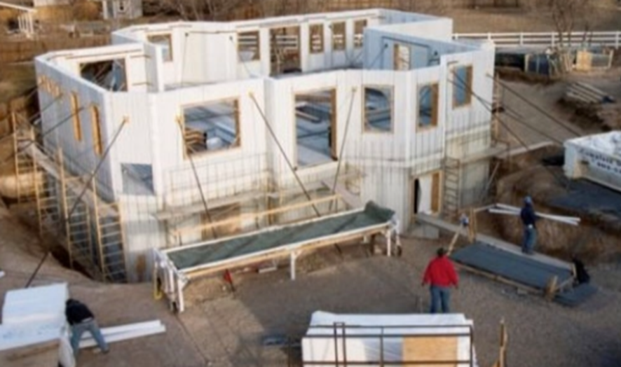
BLUE PLANET
BUILDING PANELS
Door & Window Headers

Slide 13
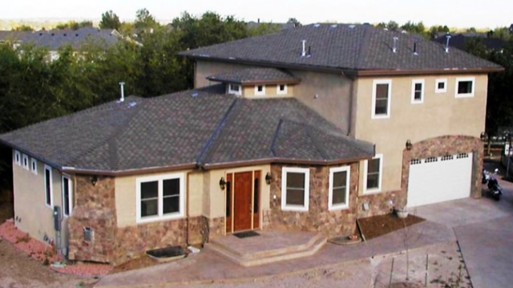
BLUE PLANET
BUILDING PANELS
Ceiling and Roof

Slide 14
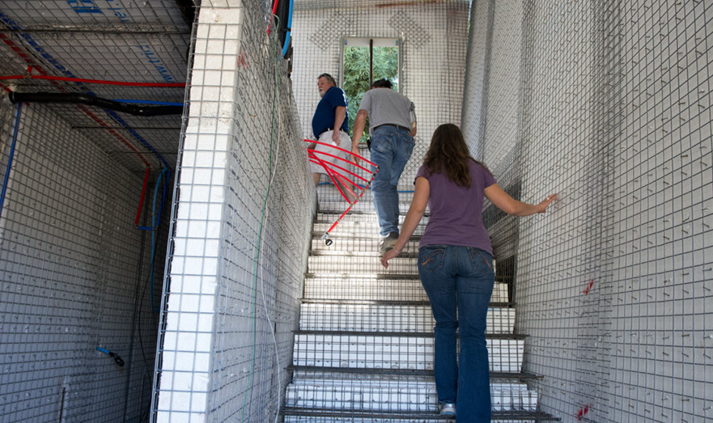
BLUE PLANET
BUILDING PANELS
Stair Applications

Slide 15
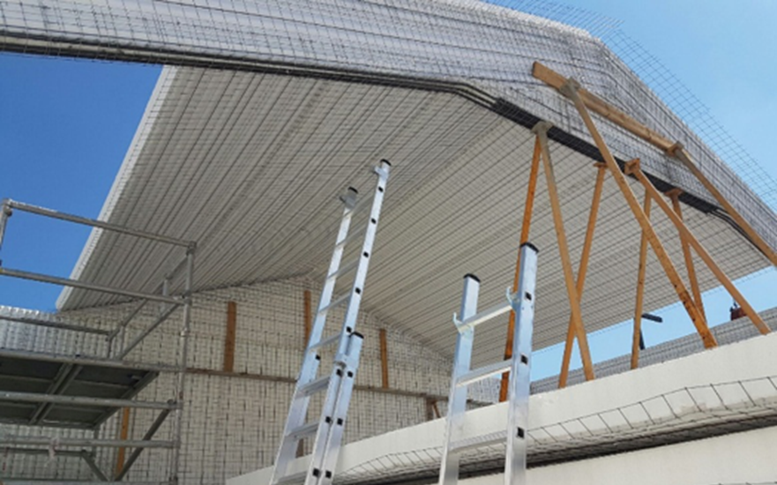
BLUE PLANET
BUILDING PANELS
Structural Ridge Beams

Slide 16
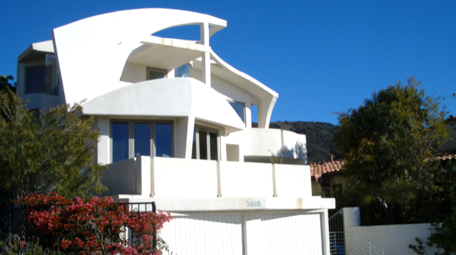
BLUE PLANET
BUILDING PANELS
Can Be Curved

Slide 17
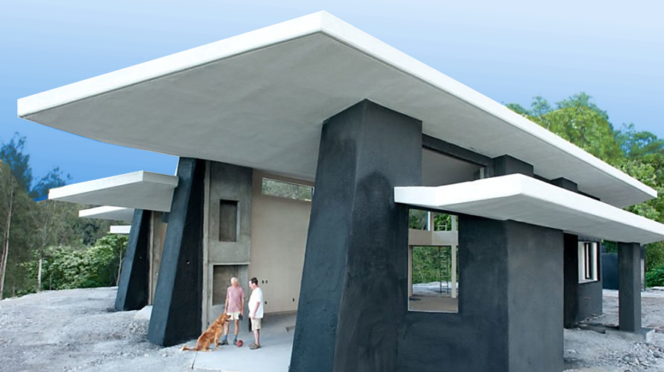
BLUE PLANET
BUILDING PANELS
Cantilevered

Slide 18
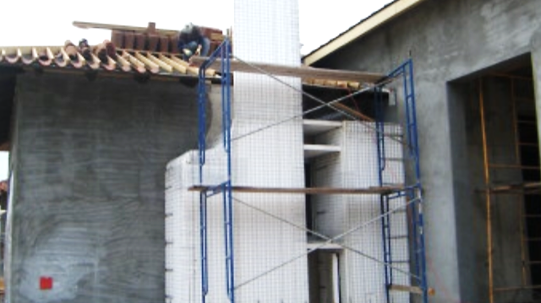
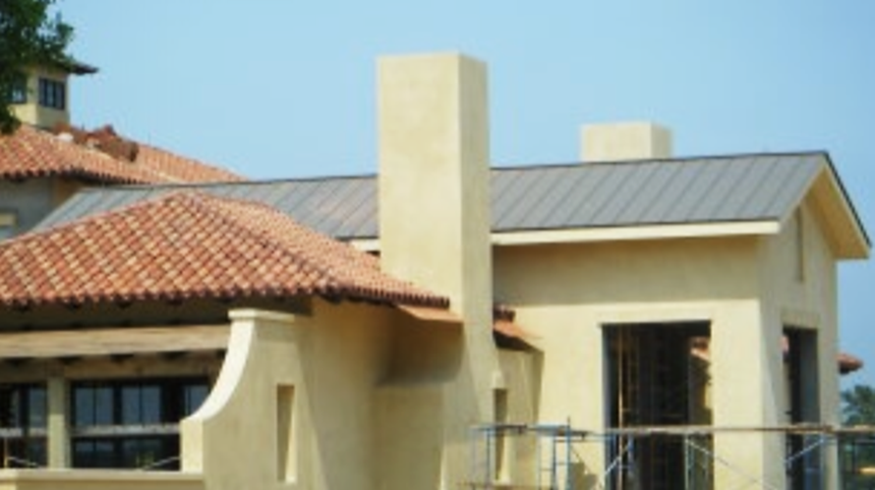
BLUE PLANET
BUILDING PANELS
Fireplace Applications

Slide 19
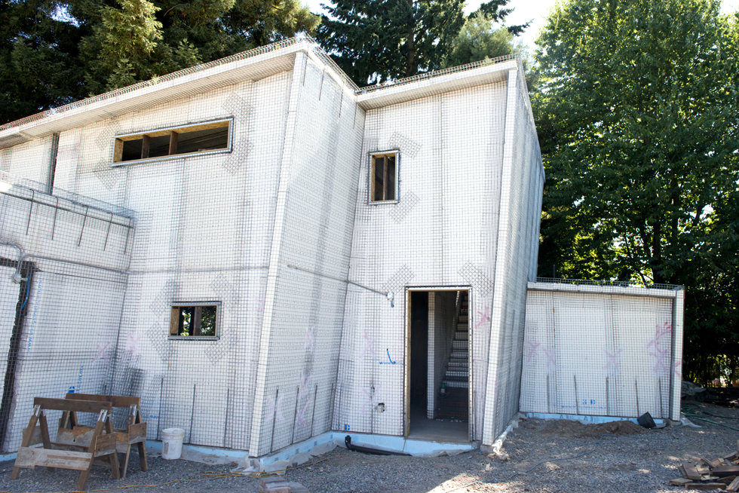
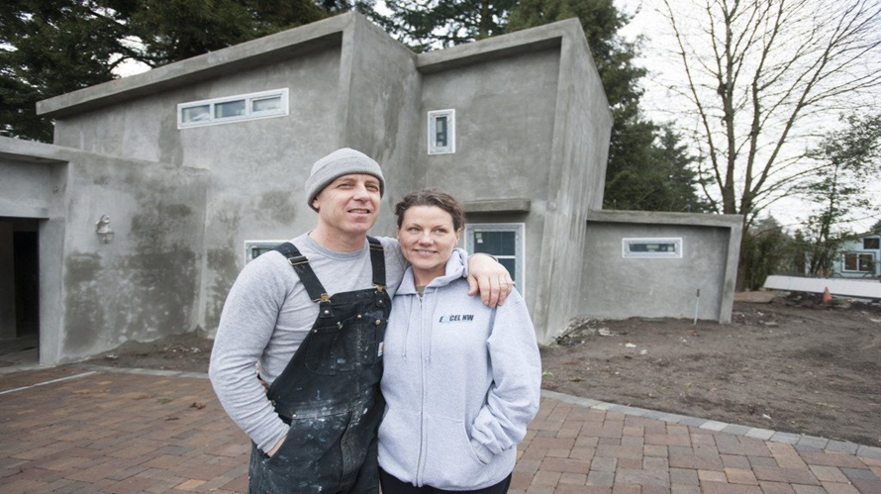
BLUE PLANET
BUILDING PANELS
Oblique Walls

Slide 20
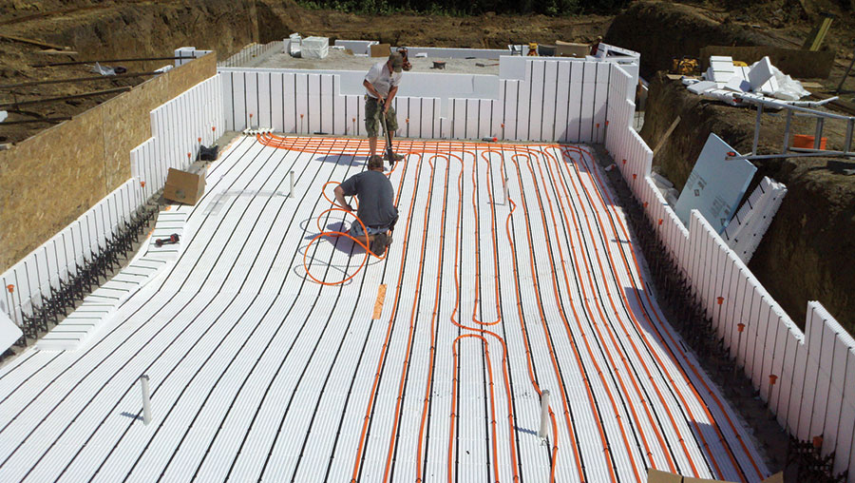
BLUE PLANET
BUILDING PANELS
In-Ground Swimming Pools

Slide 21
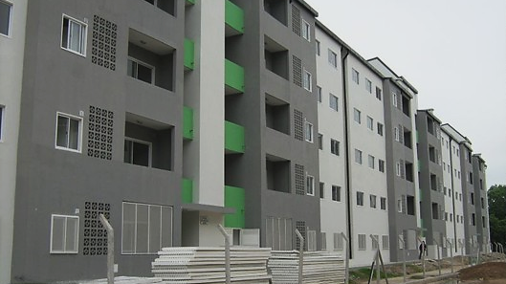
BLUE PLANET
BUILDING PANELS
Multiple Stories

Slide 22
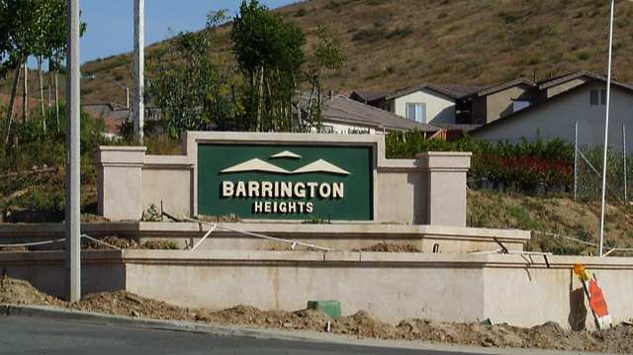
BLUE PLANET
BUILDING PANELS
Decorative Walls

Slide 23
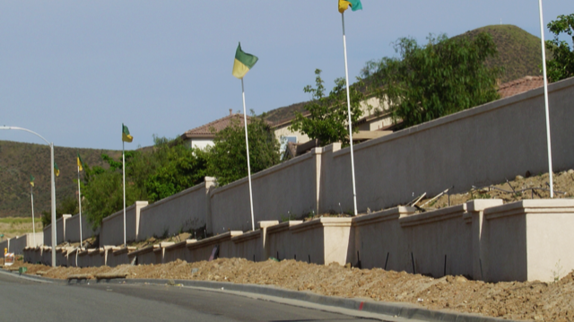
BLUE PLANET
BUILDING PANELS
Retaining Walls

Slide 24
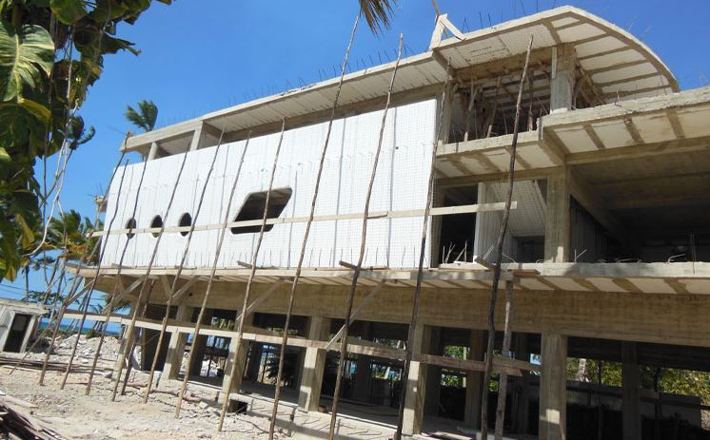
BLUE PLANET
BUILDING PANELS
Unlimited Possibilities

Slide 25
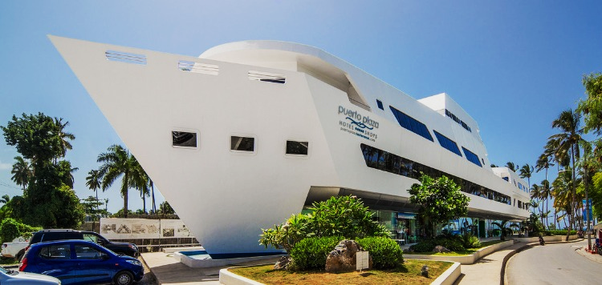
BLUE PLANET
BUILDING PANELS
Puerto Plaza Las Terrenas

Slide 26
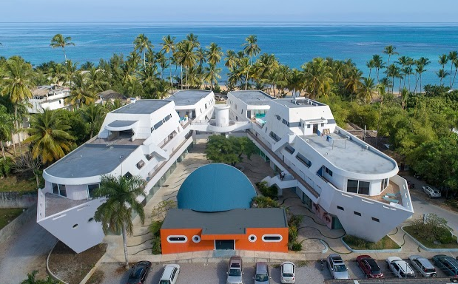
BLUE PLANET
BUILDING PANELS
was built with SCIPs

Slide 27
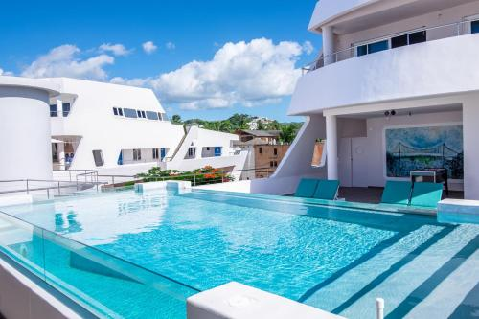
BLUE PLANET
BUILDING PANELS
and included rooftop pools

Slide 28
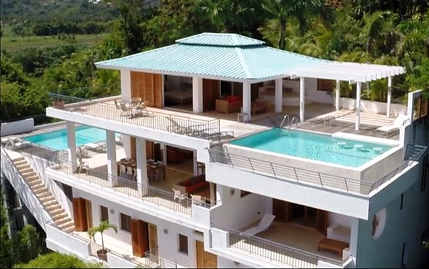
BLUE PLANET
BUILDING PANELS
SCIPs Built Home with a Rooftop Pool

Slide 29
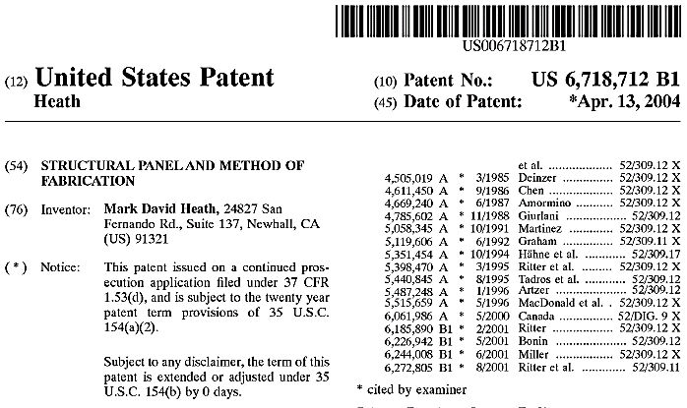
Intellectual Property

Slide 30
Intellectual Property
a. Existing Patent
i. US Patent #6,718,712 B1
1. 20-year patent with 4 years remaining
2. Result of USPTO request to bifurcate original filing - Product
3. Current Valuation of $1,029,375
ii. Patent Pending Application #: 16597614
1. Result of USPTO request to bifurcate original filing – Process
2. Includes 3D Printing on BP2 SCIPs
3. Current Valuation of $6,117,750
Clayton M. Christensen: NOTED: disruptive innovations were technologically straightforward, consisting of off-the-shelf components put together in a product architecture that was often simpler than prior approaches.

Slide 31
The Competition
a. There are 5 Competitors Manufacturing SCIPs in the World:
i. EVG – 3D from Austria
ii. Emmedue – M2 from Italy
iii. Covingtech from Fontana, CA
iv. MetRock from Anniston, AL
v. Blue Planet Building Panels, ID and CA
b. Here is what sets us apart from The Competition:
i. We are the only “ENGINEERED” SCIPs panel available

Slide 32
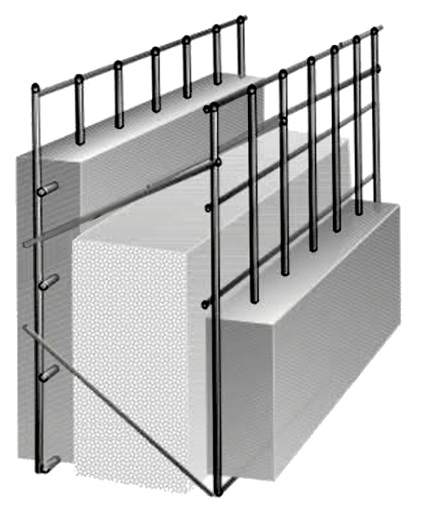
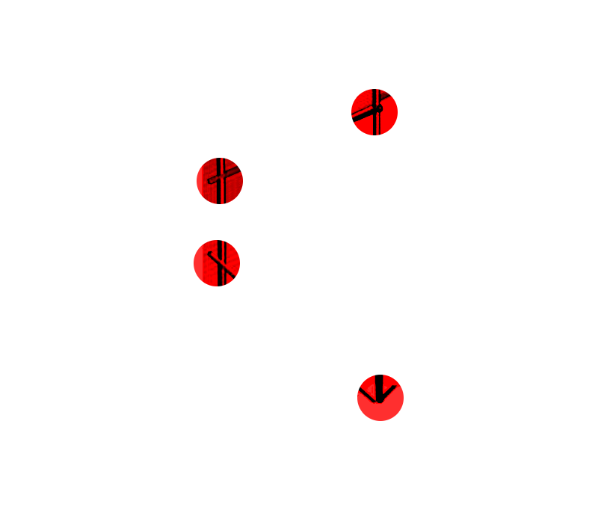
The Competition
EVG – 3D from Austria
Minimum of 4′Width to Maximum of 40′Length
Truss Spacing: 4″ (1)
Truss Gauge: 9 awg (1)
Mesh Spacing: 2”by 2” (1)
Mesh Gauge: 11 awg (1)
Panel Thickness: 3.25″, 3.75″, 5.25″& 6.25″ (4)
ONLY VARIATIONS Available: (4)
PROBLEMS:
Cost of Panel Machine
Truncated Truss Strength
Minimal Variations
No Mobile Manufacturing Ability
Thicker Shell Requirements
No Utility Chase

Slide 33
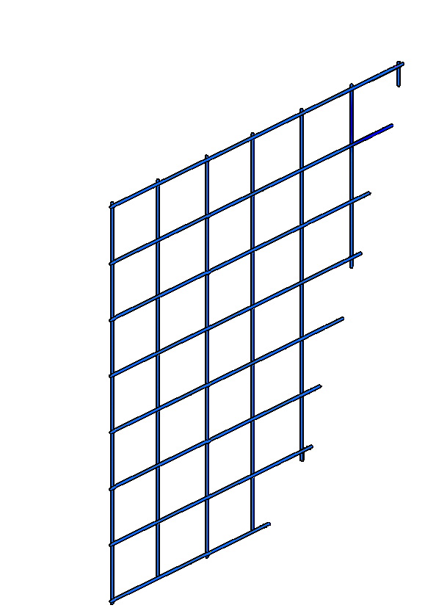
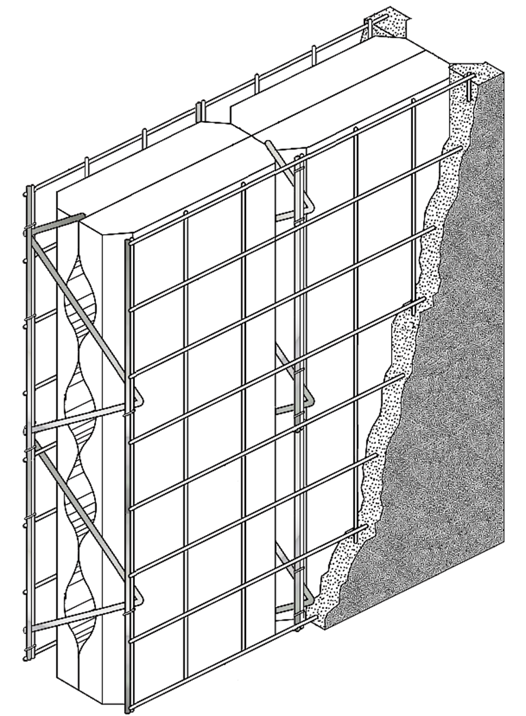
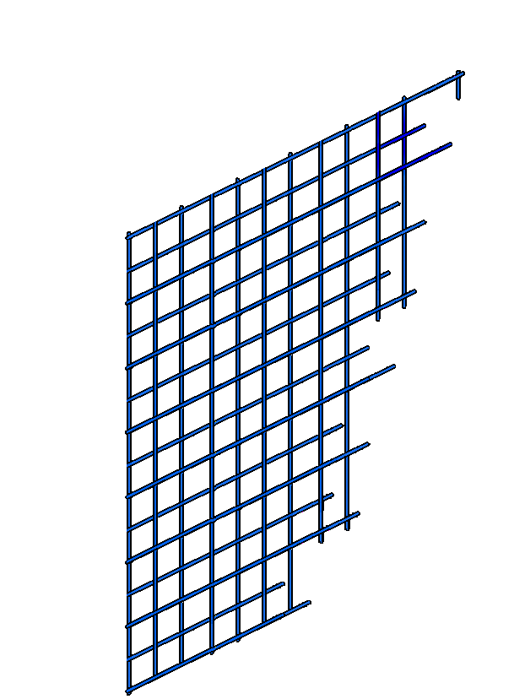
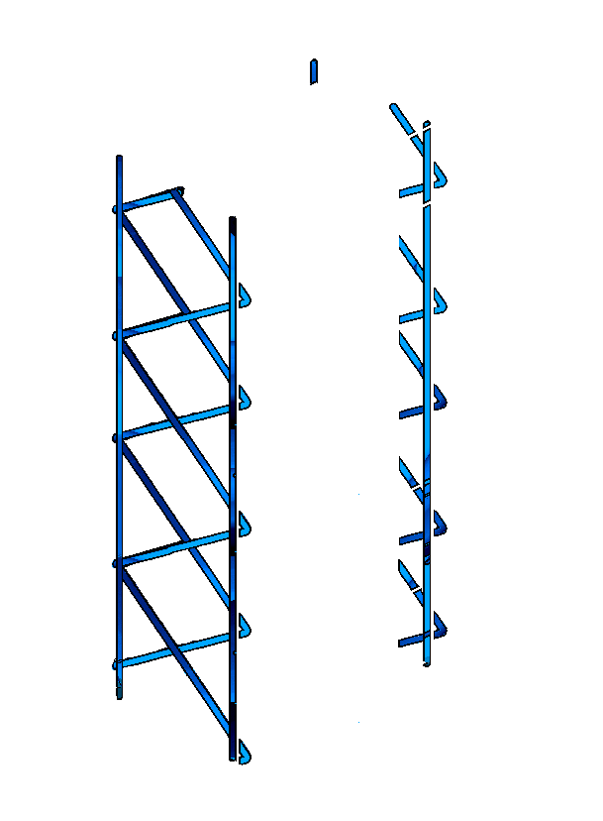
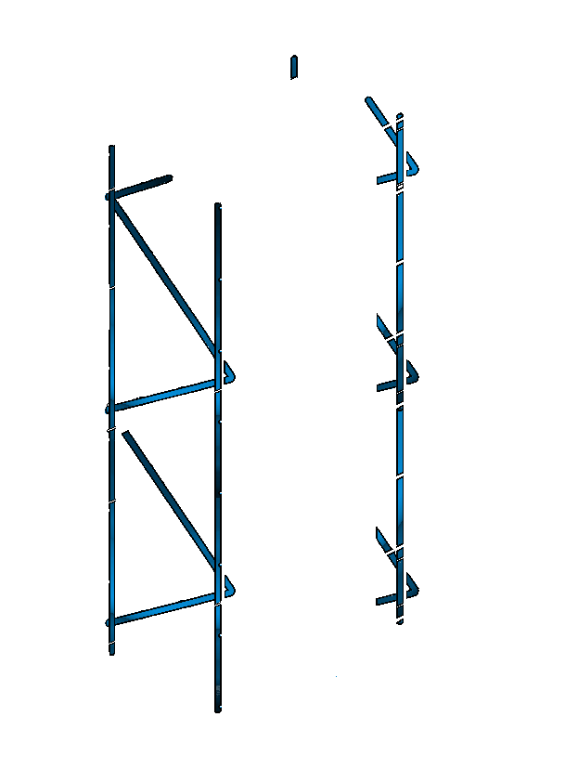
The Comparison
We are the only “ENGINEERED” SCIPs panel available.
Variable Truss Configurations:
1 ea. 9-6 Gauge Steel – Warren Truss @ 2-12”o.c.
1 ea. 9-6 Gauge Steel – Ladder Truss @ 2-12”o.c.
1 ea. 9-6 Gauge Steel – Warren Truss @ 2-12”o.c.
Variable Face Mesh Configurations:
2”X 2” (14-10 Gauge) Welded Wire Steel Mesh
1”X 1” (16-12 Gauge) Welded Wire Steel Mesh
Multiple Sized Panel Configurations:
From 3”to 18”Depth, to .05’X 8’Width, and 8’X 48’Length
Our Patent Covers Multiple: Layers, Sizes, & Gauges of
Trusses & Face Mesh – as well as Biomass or Other Cores
Patent Pending includes 3D Printing

Slide 34
The Comparison
Greatest Number of SCIPs Variations Available.
Variable Truss Spacings @: Factor of
2”, 4”, 6”, 8”, 10”, & 12” (6)
Variable Truss Permutations @:
Warren / King Post Warren / Compound Warren (3)
Variable Truss Gauges @:
9 - (0.114) to 6 - (0.162) (2)
Variable Mesh Spacings @:
1”by 1”and 2”by 2” (2)
Variable Mesh Gauges @:
14 (0.0641) to 12 (0.0808) (2)
Variable Depth/Thickness @:
3”, 5”, 7”, 9”, & 11” (5)
Standard Variations: 720
3”to 18”Depth, to 0.5’X 8’Width, and 8’X 48’Length

Slide 35
The Competition
a. There are 5 Competitors Manufacturing SCIPs in the World:
i. EVG – 3D from Austria
ii. Emmedue – M2 from Italy
iii. Covingtech from Fontana, CA
iv. MetRock from Anniston, AL
v. Blue Planet Building Panels, ID and CA
b. Here is what sets us apart from The Competition:
i. We are the only “ENGINEERED” SCIPs panel available
ii. Utility Chases

Slide 36
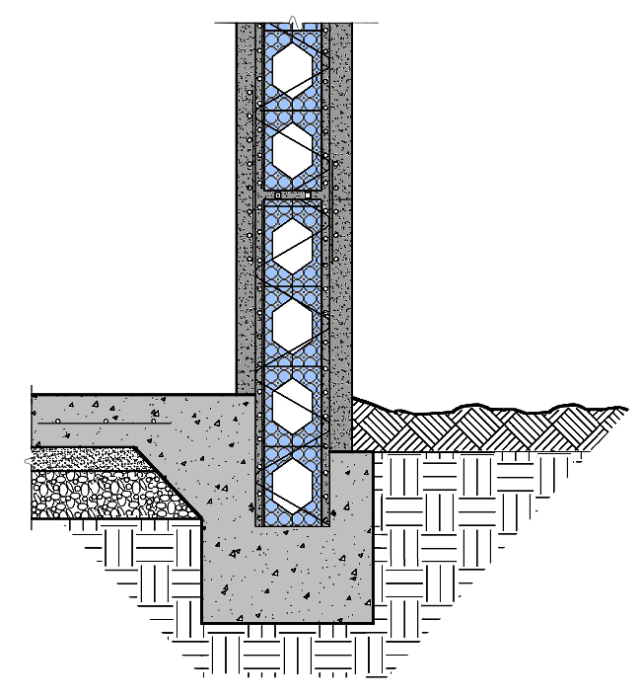
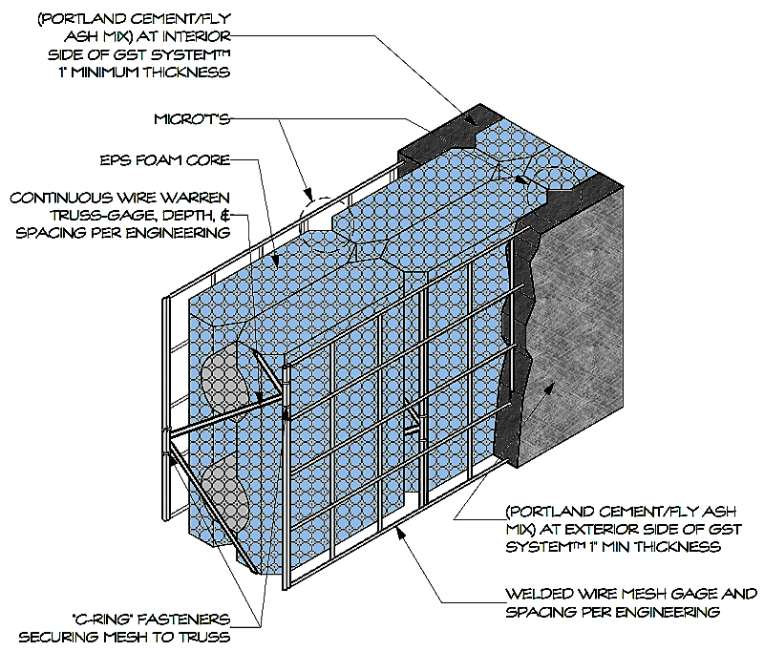
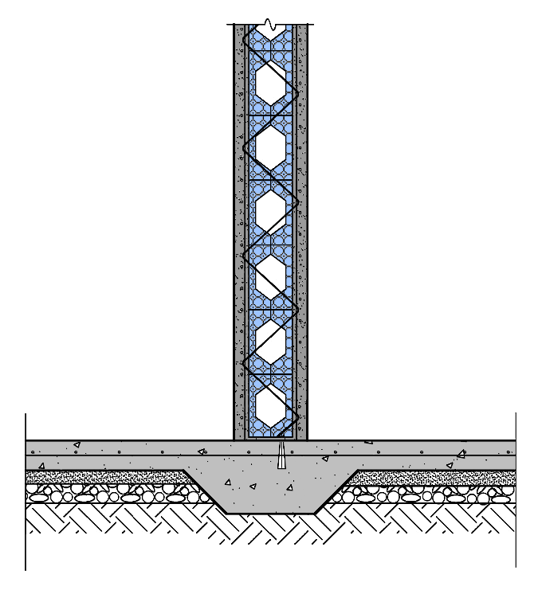
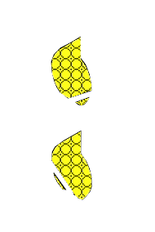
The Comparison
We are the only SCIPs with Integral Utility Chases.

Slide 37
The Competition
b. Here is what sets us apart from The Competition:
i. We are the only “ENGINEERED” SCIPs panel available
ii. Utility Chases
iii. Only SCIPs Panel available through Certified Constructors
Certified Blue Planet Panel Constructors Program and Support.
Virtual Education Program with Online HD Videos and Monthly Webinars.
Certified Builder Project Verification, Tracking, and Construction Assistance.
QA/QC Building Registration and Rating system from Bronze to Platinum.

