Slide 1
So, What Can I Do?
Selecting a job goal after a stroke.

Slide 2
Surving a Stroke Means
We have serious impairments that prevent us from doing certain things that most other people can do
We have to do things differently because of those impairments
People may think less of our capabilities simply because we have an obvious disability, or they might know that we bear the label “disability”

Slide 3
Surviving a Stroke Does NOT Mean
We can’t
work
learn
be independent
be successful
get a job, be successful in it and have a very rewarding, exciting and meaningful career (and life)

Slide 4
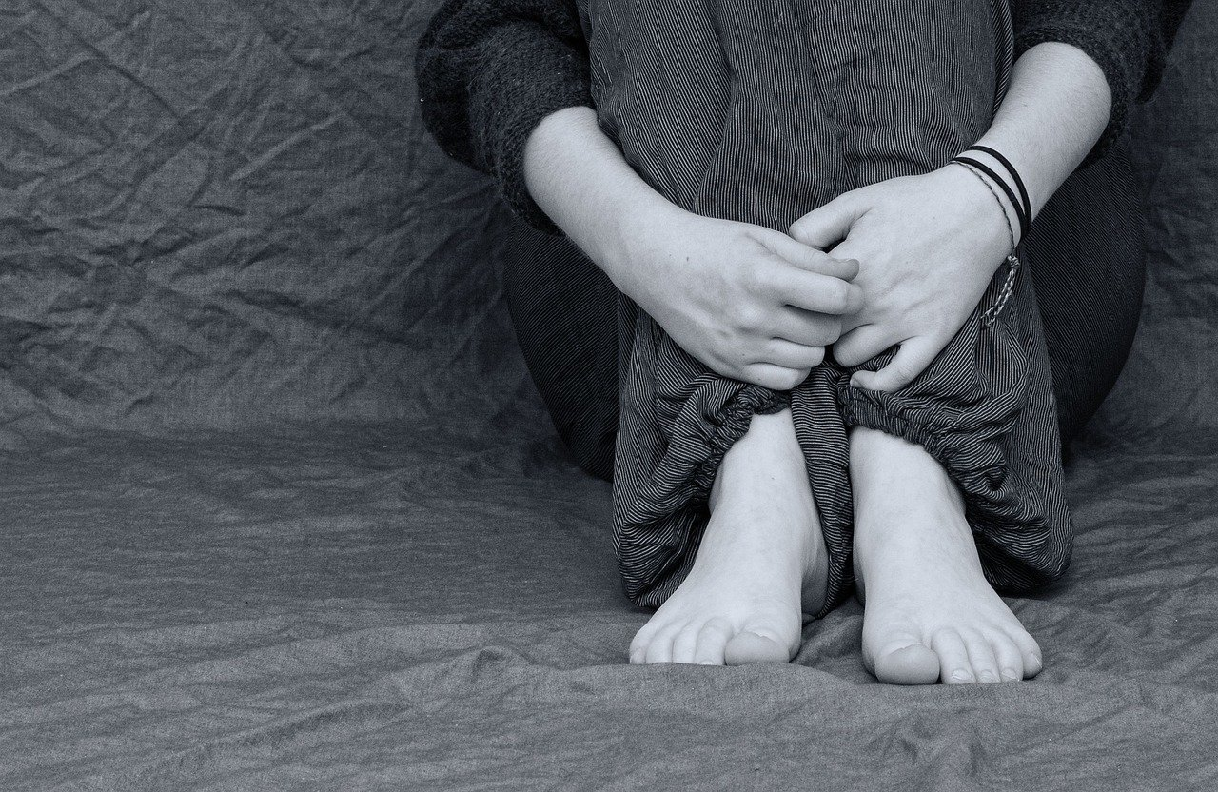
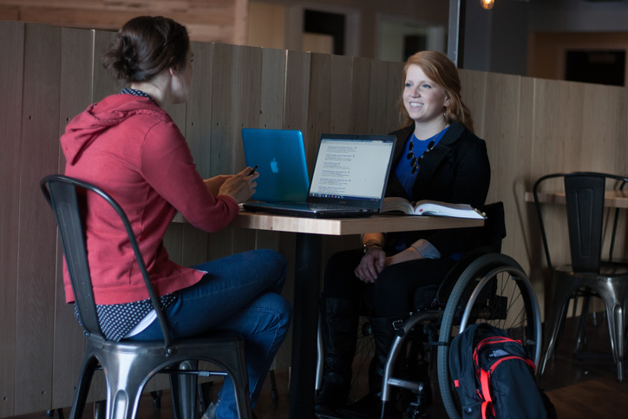
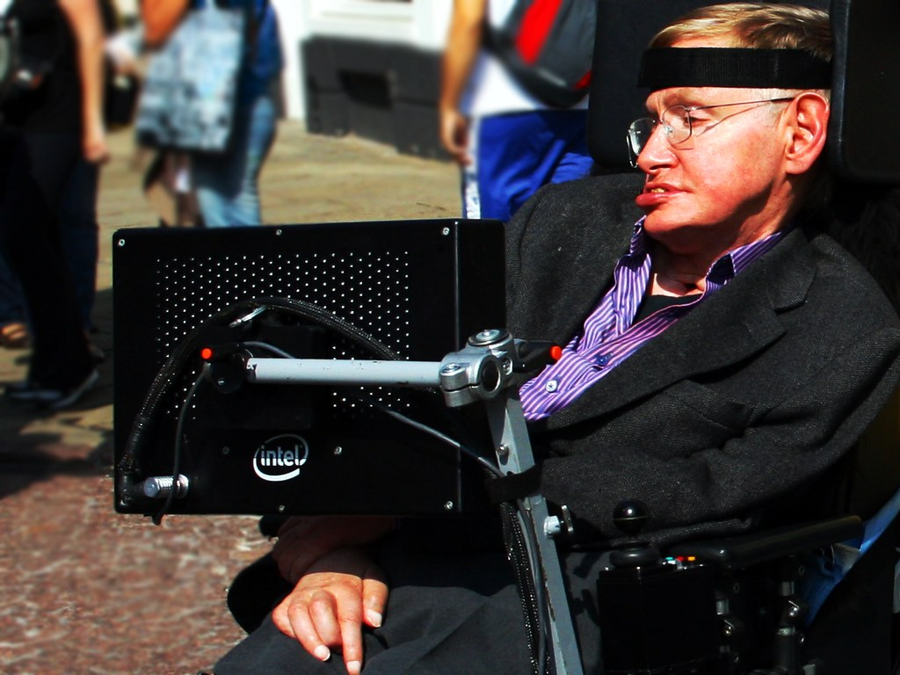
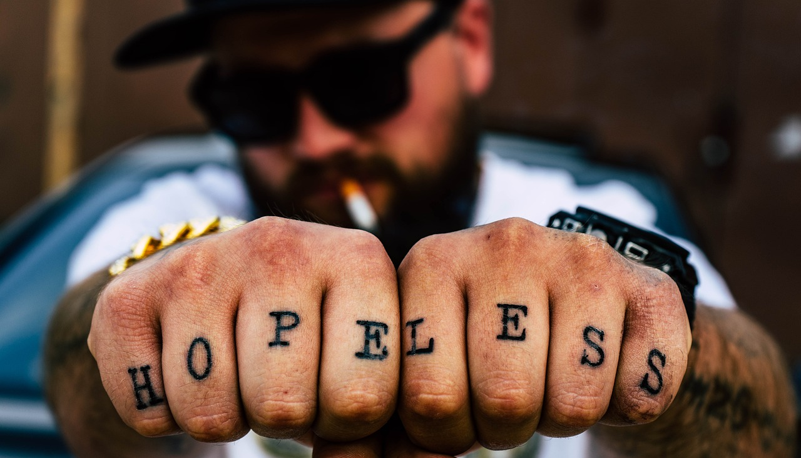

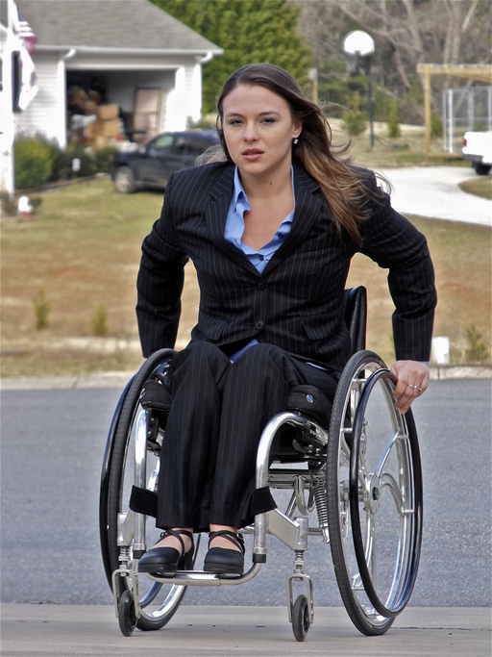
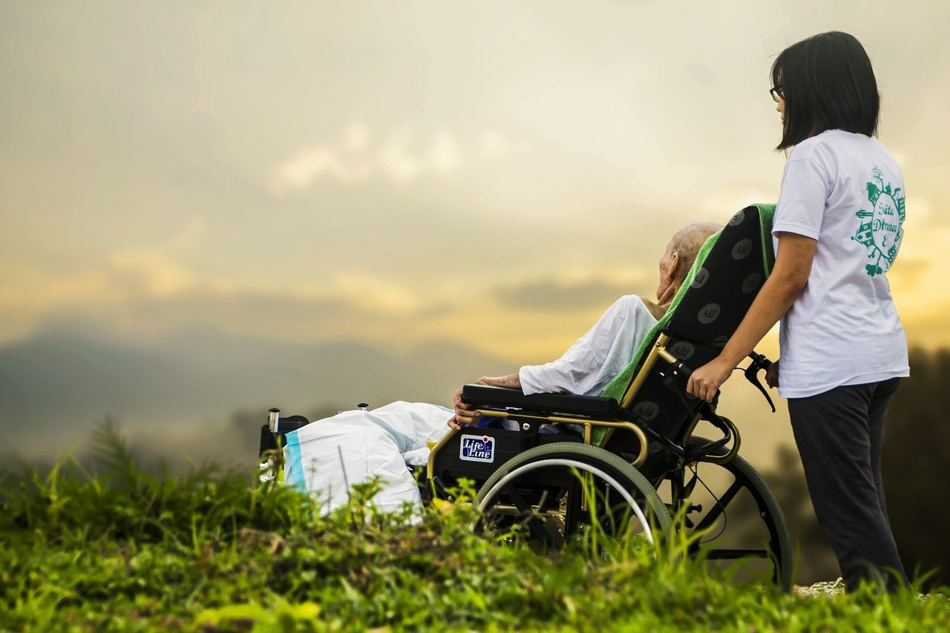

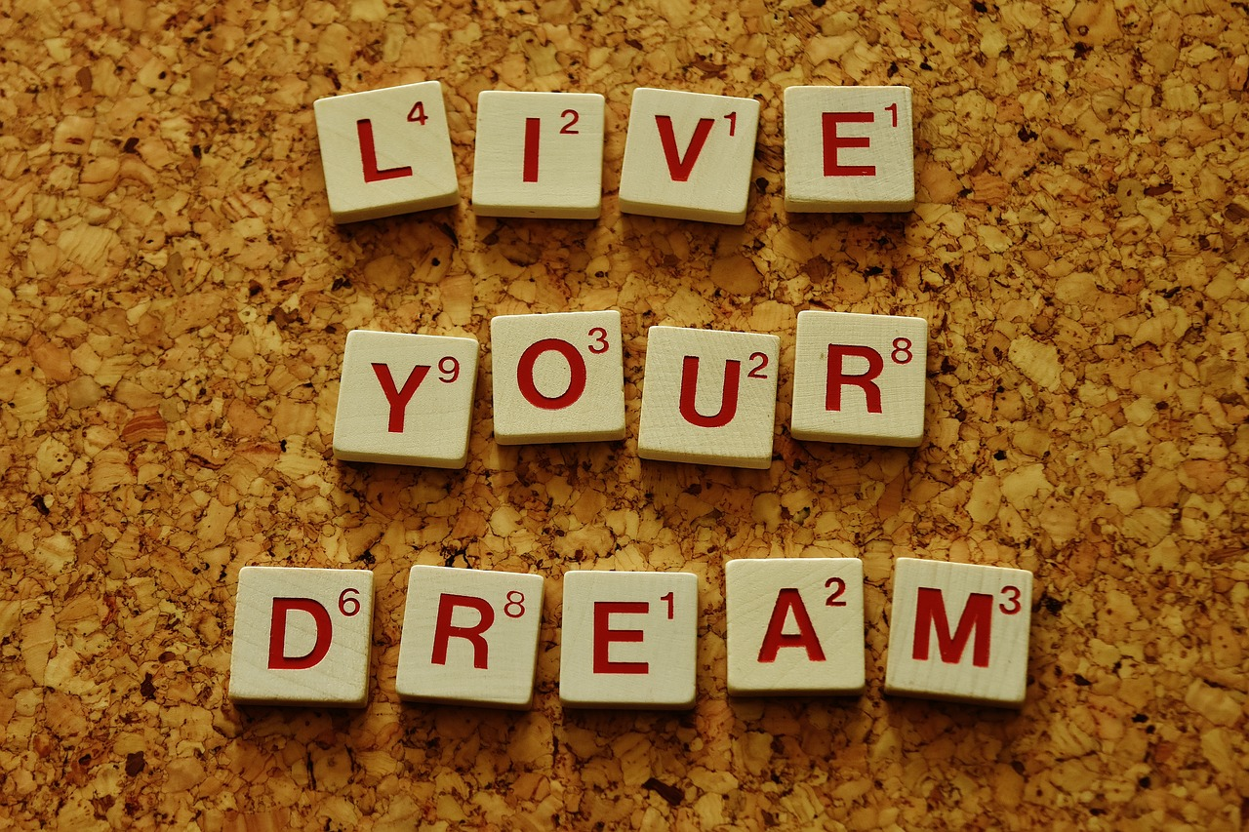
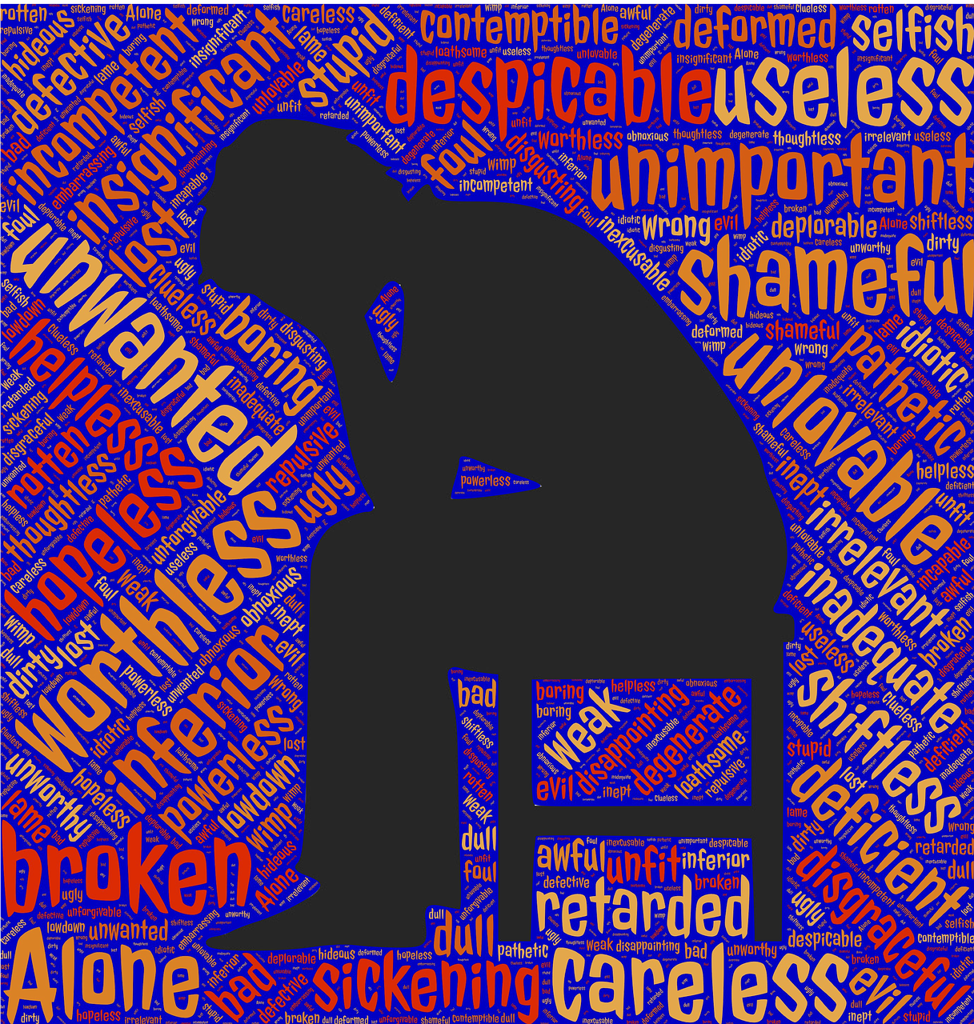
But we are the only ones that can change this
To this

Slide 5
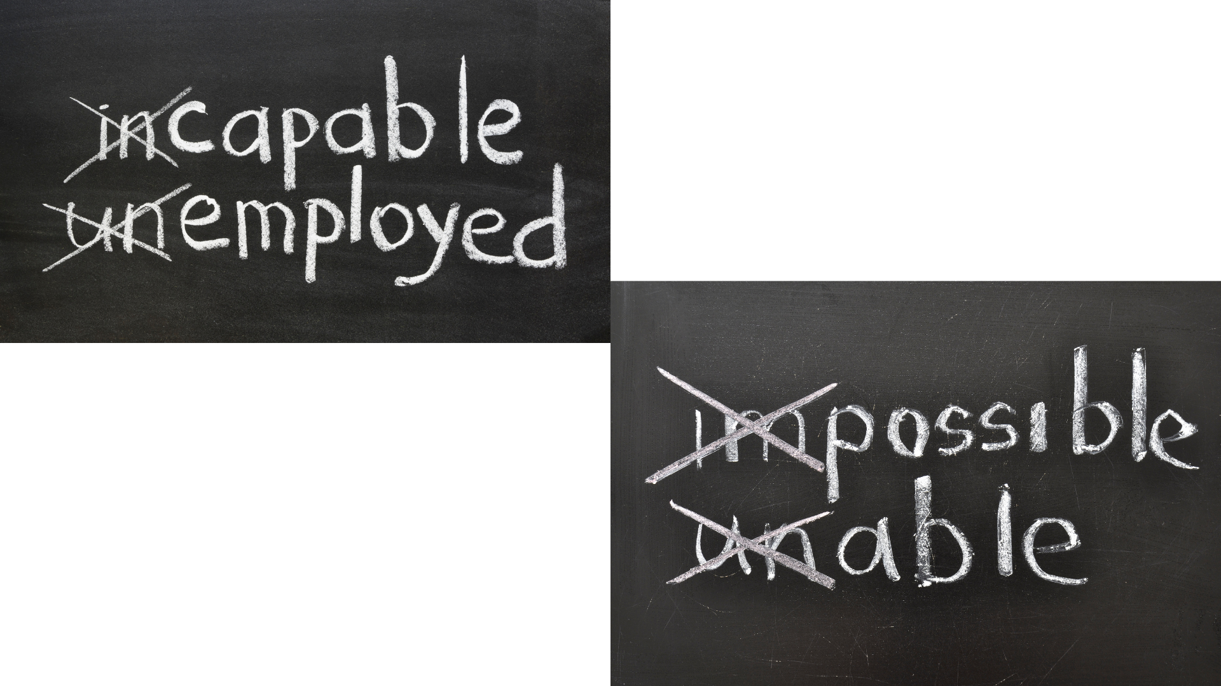

Slide 6
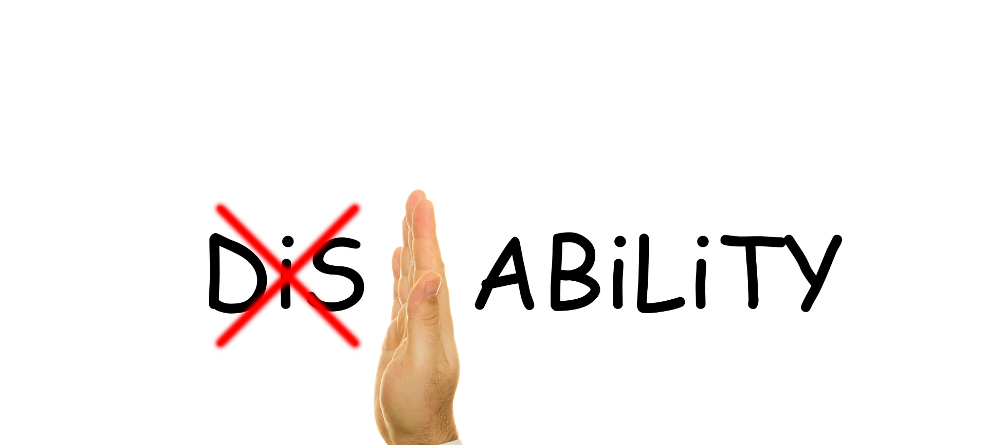

Slide 7
You Can Do Almost Anything
Yes, there are many things you can’t do. Or are so hard to do that they may not be worth the effort
But it’s up to you

Slide 8
How do you decide what to do?
Generate a list of potentials based on interests
There are, literally, thousands of sites online that can take you through traits, interests and aptitude
They have great inventories and surveys to help you narrow down areas of ideas
Start a list, create a vision board
Then narrow down the list by considering what each job is really like – start informational interviews of people who are in those fields, have those jobs. What is the day-to-day reality really like?
Narrow the list a little more based on that information

Slide 9
THEN Consider what you CAN do
If being an astronaut is attractive to you, but you are terrible in math, you may want to consider something else... Or if you don’t like small spaces... Then astronaut is probably not a great choice... BUT if it’s still what you want, then...
Investigate what you would need to be successful:
  Start a list:
    1. Learn what’s typical. If astronaut is your interest, college degree is needed and what will you need to obtain that degree (money, good test scores, study assistance, therapy to get over your claustrophobia, etc.)
    2. Consider the physical requirements and determine what you need to be able to do them (gym membership, therapy to use both arms, or adaptive equipment to do things one handed, )
    3. Living in the Houston or Kennedy Space Center area... What kind of apartment, transportation, etc would you need, what kind of salary can you expect?

Slide 10
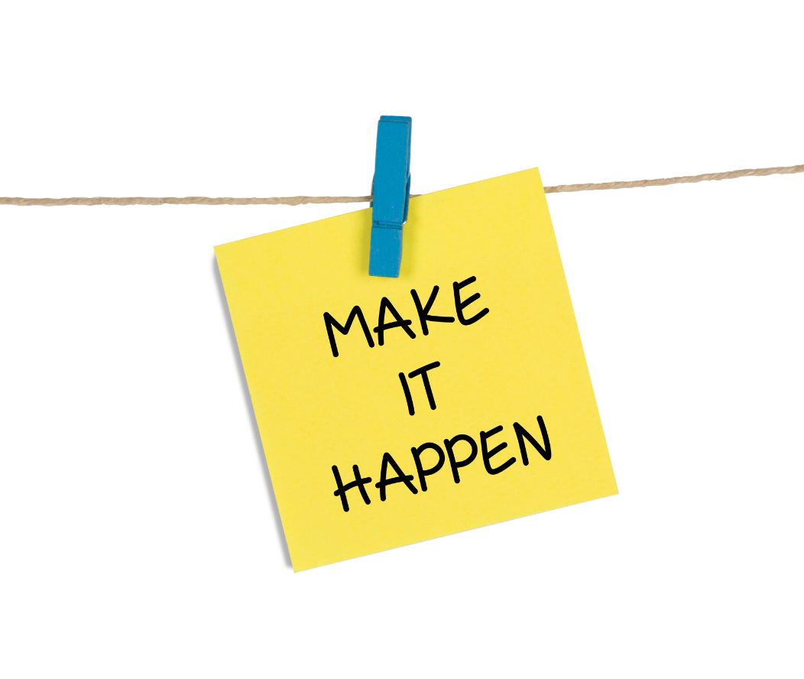
Then start a list of the steps you need to take
to accomplish everything on the previous slide.
Then do that for 10 other interests.
NOW, you can take reality into consideration
  Your speech is tough to understand
  You are left with little to no use of one or both arms
  Well then, astronaut might require too many accommodations:
    Since you need to be able to communicate quickly.
    And need agility and navigating in a space station may be tough....
BUT THEN AGAIN...

Slide 11
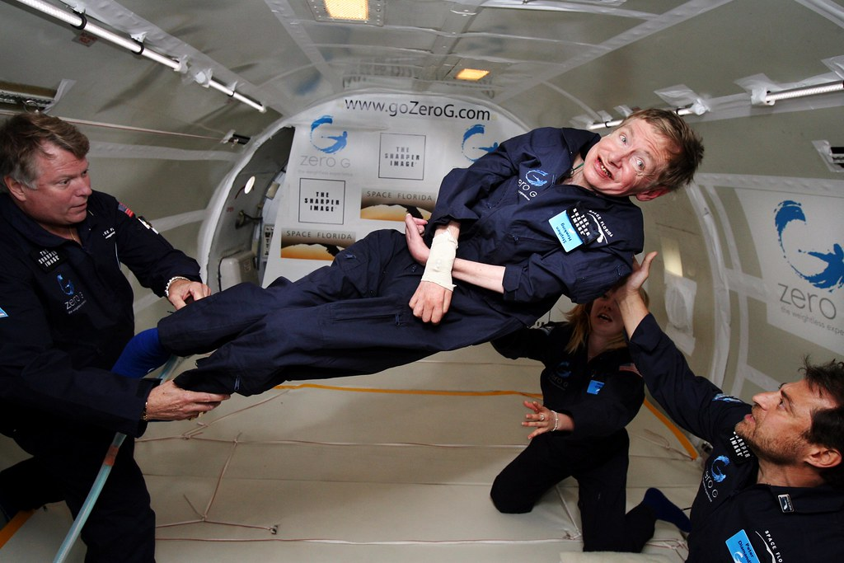
Sometimes even Reality can be overcome!!!
This is a picture of Stephen Hawking in zero gravity...

Slide 12
The point is
You can do or be almost anything, if you want to
And yes, I know Stephen Hawking didn’t have a stroke. But the cause of our disability is not what is holding us back, so use people with similar deficits as models of what you can be...

Slide 13
For the most part, the barrier is NOT
The physical or cognitive impairments from the stroke
Mindset, mental toughness, exhaustion, depression and lack of cognitive flexibility (open mindedness)
Those who love us, who have been scared by our stroke(s)
Our fear of the next stroke
Our dreams about who we dreamed to be (or were) prior to the stroke
Simply give up and accept where we are,..
But tends to be
And so, we can

Slide 14
OR
We can set a goal
Create a plan
Exert the effort to achieve the steps needed to get there and be flexible enough to pivot when other opportunities come around
Ask for help and keep pushing to get the help we need until we exhaust all options, then we start again and don’t give up
Then, if needed, we can pivot and pick a new goal and work toward that

Slide 15
My choice was:
Live in my mother’s house, have her drive me everywhere, listen to the world outside and collect social security
Or
Set my sights high, leverage any and all therapies (most importantly was emotional therapy), create plans and contingency plans and try everyday to get closer to the goal

Slide 16
Since then,
I achieved it, changed my goals, achieved them, set higher goals, achieved them and then pivoted and did it all over again. There is nothing special about me
What I had before and after my stroke is different than yours. But the things I had (AND you need) are hope, dreams, stubbornness and access to help
and if YOU don’t have that help right now, you need the hope, dreams, and stubbornness to get the access to find the help (especially the stubbornness)

Slide 17


Slide 18
IMPOSSIBLE
Becomes
I’M POSSIBLE

Slide 19
You can do and be anything, but no one is going to do it for you

