Slide 1
Effects of device-assisted practice of activities of daily living in a close-to-normal pattern on upper extremity motor recovery in individuals with moderate to severe stroke
Presented to: Stroke Learning Group
Presented on: 13 April 2022
Presented by: Ray Arceo, Research Study Coordinator

Slide 2
Study Basics
Clinical trial (NCT04077073)
Intervention study
Duration: 10-12 weeks, plus 3 month follow-up
1-2 weeks pre-intervention tests
8 week intervention
1-2 weeks post-intervention test
24 intervention sessions (1.5-2 hours per session)
Location: Downtown Chicago (645 N Michigan Ave)

Slide 3
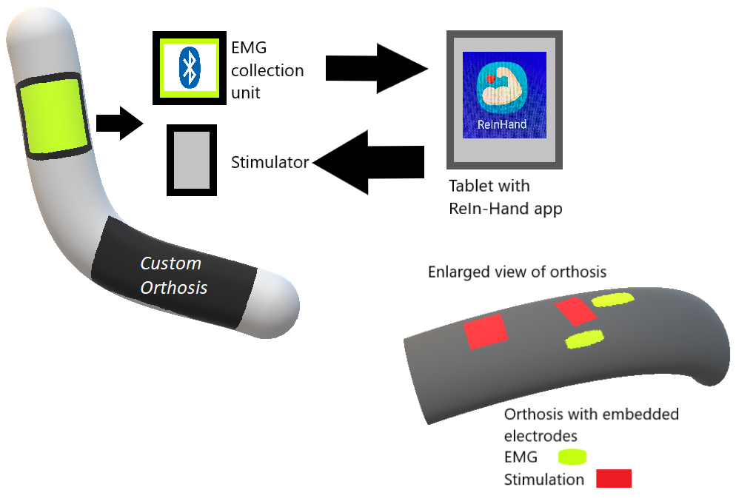
ReIn-Hand Device
Custom-made device with embedded electrodes
Created using 3D scan of your arm
Uses functional electrical stimulation
Sends information from your muscles through an algorithm to provide electrical stimulation to extensor muscles to drive hand opening
Covered completely by lab, created at no cost to you

Slide 4
Study Visits

Slide 5
Pre-intervention tests
Pre-intervention visit 1 (3 hours)
Eligibility testing
Pre-intervention visit 2 (3.5 hours)
Baseline testing
Device setup and fitting
MRI
Pre-intervention visit 3 (4 hours)
EEG

Slide 6
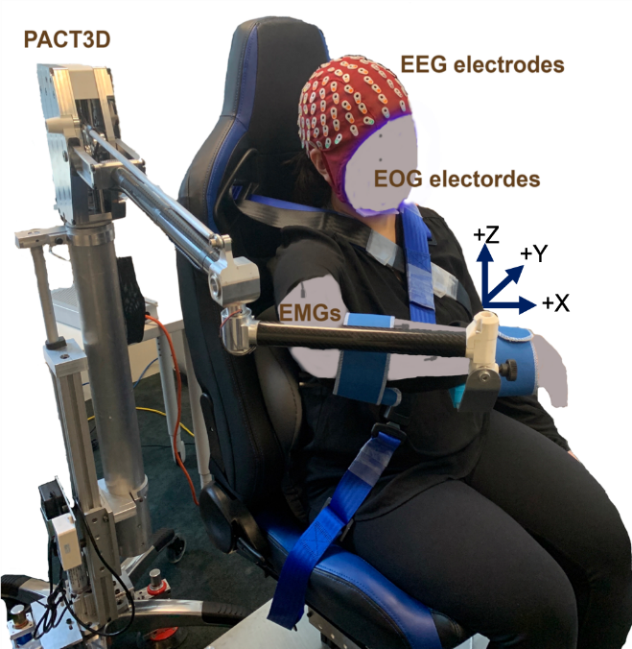
Intervention
24 interventions, usually 1.5-2 hours long each
40 trials with the device alone, or device + robot to help support upper arm
Grasping, reaching, retrieving task designed by physical therapist

Slide 7
Post-Intervention Tests
Post-intervention visit 1 (4 hours)
Clinical assessments
MRI
Post-intervention visit 2 (4 hours)
EEG

Slide 8
Inclusion and Exclusion Criteria

Slide 9
Inclusion Criteria
Age between 21-80
Paresis confined to one side, with substantial motor impairment of the upper limb and some residual voluntary movement
UE FMA = 10-40/66
CMSA_H stage of the hand section <=4
Capacity to provide informed consent
Ability to elevate their limb against gravity up to at least 75 degrees of shoulder flexion and to generate some active elbow extension
Ability to open hand with a thumb-to-index finger distance ≥4 cm, with the assistance of the ReIn-Hand device with the help of a physical therapist
MRI compatible
Discharged from all forms of physical rehabilitation
Intact skin on the hemiparetic arm
Be tolerate sitting for no less than 1 hour
Montreal Cognitive Assessment (MoCA) score >=23

Slide 10
Exclusion Criteria
Motor or sensory impairment in the non-affected limb
Any brainstem and/or cerebellar lesion
Severe concurrent medical problems
History of neurologic disorder other than stroke
Any acute or chronic painful condition in the upper extremities or spine
Using cardiac pacemaker, implanted cardioverter defibrillator, neurostimulation system inside the brain or spinal cord, bone growth box fusion stimulation
Seizure in the last 6 months
Severe upper extremity sensory impairment
Chemo denervation (6 months ago for botox, 12 months ago for phenol/alcohol block)
Notes:
Severe concurrent medical problems - (e.g. cardiorespiratory impairment, uncontrolled hypertension, inflammatory joint disease)
History of neurologic disorder other than stroke - (Parkinson's Disease, Acute Lateral Sclerosis, Multiple Sclerosis, Traumatic Brain Injury, peripheral neuropathy, Amyotrophic lateral sclerosis, spinal cord injury, Dementia)
Any acute or chronic painful condition in the upper extremities or spine, indicated by a score ≥5 on a 10-point visual analog scale
Severe upper extremity sensory impairment indicated by absent sensation on the tactile sensation subscale (light touch and pressure items) of the Revised Nottingham Assessment of Somato-Sensations (score<4)
Chemo denervation: botulinum toxin, dysport, or Myobloc or phenol block injection to any portion of the paretic UE within the last 6 months, or phenol/alcohol injections <12 months before participation

Slide 11
Exclusion Criteria
Pregnant or planning to become pregnant
Participating in any experimental rehabilitation or drug studies
Inability to attend intervention sessions 3 times a week during 8 weeks, as well as to assessments/evaluations and follow up
Unable to passively attain 90 degrees of shoulder flexion and abduction, measured using a goniometer based on adapted methods
Flexion contractures larger than 45 degrees in the elbow, wrist, metacarpophalangeal joints (MCP) and interphalangeal joints (IP) of thumb and index finger
Upper extremity musculoskeletal impairment limiting function prior to stroke
Currently using oxygen tank
Upper limb amputation
Notes:
Severe concurrent medical problems - (e.g. cardiorespiratory impairment, uncontrolled hypertension, inflammatory joint disease)
History of neurologic disorder other than stroke - (Parkinson's Disease, Acute Lateral Sclerosis, Multiple Sclerosis, Traumatic Brain Injury, peripheral neuropathy, Amyotrophic lateral sclerosis, spinal cord injury, Dementia)
Any acute or chronic painful condition in the upper extremities or spine, indicated by a score ≥5 on a 10-point visual analog scale
Severe upper extremity sensory impairment indicated by absent sensation on the tactile sensation subscale (light touch and pressure items) of the Revised Nottingham Assessment of Somato-Sensations (score<4)
Chemo denervation: botulinum toxin, dysport, or Myobloc or phenol block injection to any portion of the paretic UE within the last 6 months, or phenol/alcohol injections <12 months before participation

Slide 12
FAQs
What types of transportation are covered by the study?
Public transportation
PACE
Parking at a garage close to our office
How much is the compensation for taking part in the study?
$20/hr
Paid via check
Until when is the study recruiting?
2024

Slide 13
FAQs
What are my responsibilities if I choose to take part in the research?
Keep communication with research team
Try your best to keep to your scheduled time
What are some possible benefits for taking part in the study?
We cannot promise any benefits, but possible benefits include: decreasing spasticity, improving muscle strength and range of motion
What is the goal of the research?
We would like to find out if using a device will help people who have had a stroke improve movements used in daily activities, with regular practice.

Slide 14
For further information
Ray Arceo
Email address: ray.arceo@northwestern.edu
Office phone: 312-908-0847
Cell phone: 312-529-0699
Jun Yao, PhD
Email address: j-yao4@northwestern.edu
Our lab website: https://www.feinberg.northwestern.edu/sites/pthms/research/faculty-labs/yao.html

Slide 15
Want to participate or help us recruit? Here is the recruitment flyer. Your help is highly appreciated!

