Slide 1
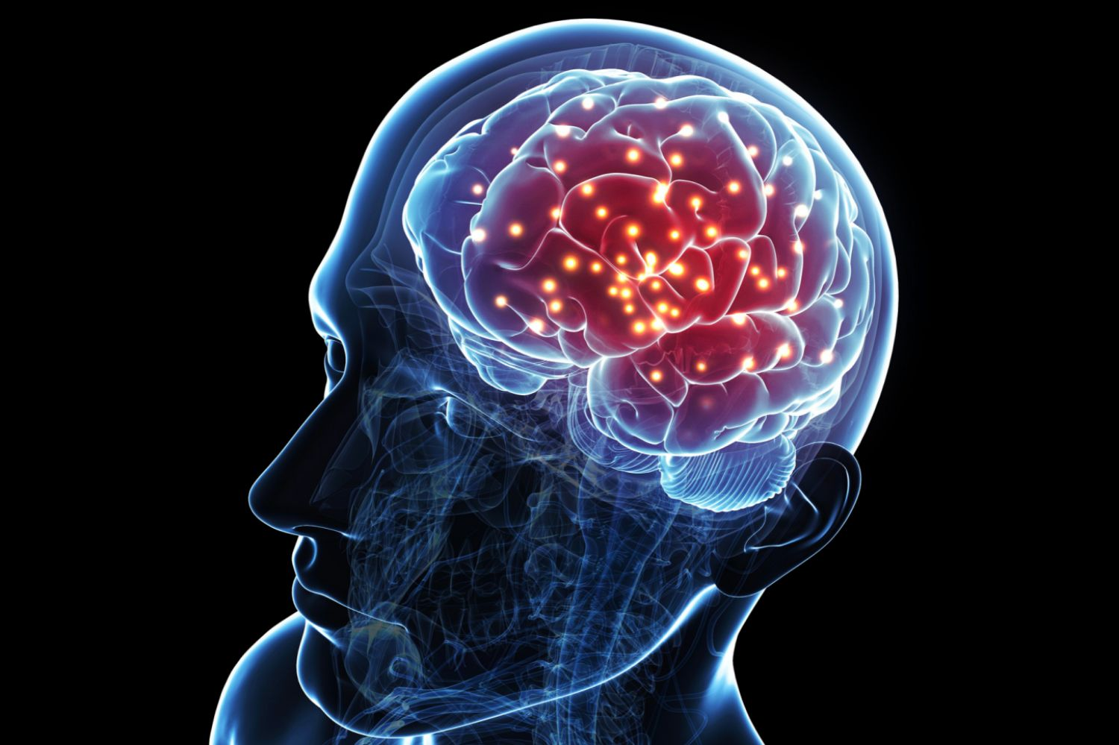
Stroke “Brain Attack”
“BRAIN ATTACK”
ACMC
Notes:
1
INTRODUCTION:
My Name is ____________________
I am a (job title) and/or a stroke education champion
This presentation is provided in part by a grant from Midwest Stroke Alliance to Stroke Survivors Empowering Each Other, (SSEEO)
Thank you for giving me the opportunity to be here with you today to discuss some important information on the signs and symptoms of stroke.
Once you are aware of what to look for, you will have a better idea of what you can do if you or someone you know experiences a stroke.

Slide 2
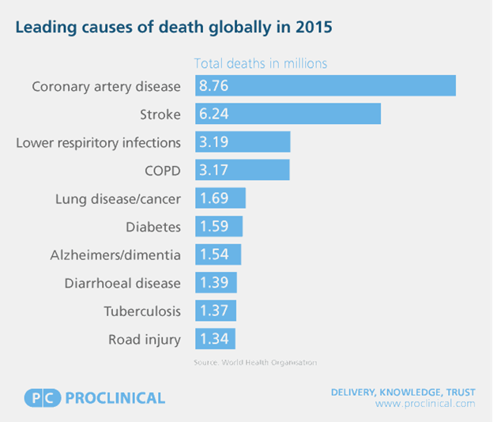
Stroke Death Rates
Notes:
STROKE STATISTICS Worldwide
According to the World Health Organization 15 million people suffer a stroke worldwide each year, of these 5 million die and another 5 million are permanently disabled.
STROKE STATISTICS IN THE UNITED STATES:
According to the American Heart Association and the US Dept. of Health and Human Services,
More than 795,000 Americans have strokes every year.
Stroke is the leading cause of long term disability.
Stroke is the fifth leading cause of death in the US.
Every 40 seconds someone experiences a stroke.
These statistics show the impact stroke has on the U.S.
So you can imagine the impact stroke has on the entire population of the world.

Slide 3
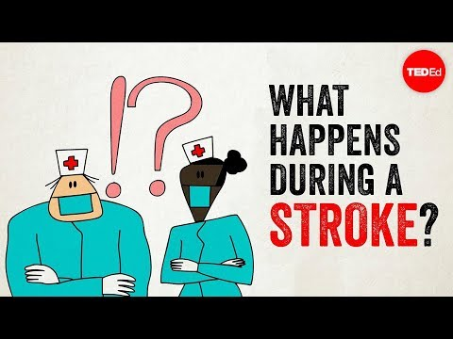
What is a Stroke?
Watch this TED Talk for a clear and thorough explanation. TED.com
Notes:
STROKE Image
Ask participants to visualize the person they think will suffer from a stroke.
Grandparents
Elderly

Slide 4
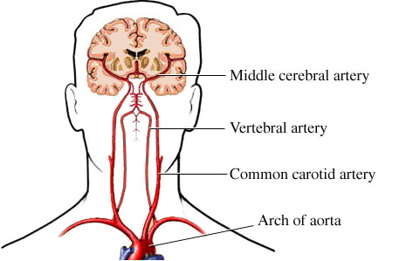
Definition of Stroke
Sudden interruption in the flow of blood carrying oxygen and nutrients to the brain, killing the brain cells in the immediate areas.
Notes:
DEFINITION OF STROKE:
Sudden interruption in the flow of
blood carrying oxygen and nutrients
to the brain, killing the brain cells in
the immediate areas.
•During a stroke, approximately 32,000 brain cells die every second.
•So it’s very important to get the blood flow restored to the brain
as soon as possible.

Slide 5
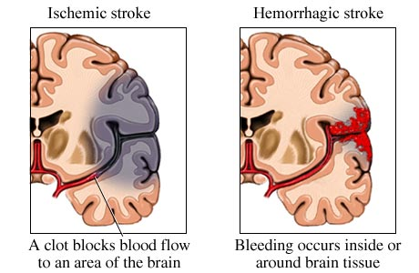
Types of Stroke
TIA or Warning Stroke = comes and goes
ISCHEMIC = blockage interrupting blood flow
HEMORRHAGIC = rupture
bleeding into the brain
CHEMIC = blockage interrupting blood flow
Ischemic Stroke
Hemorrhagic Stroke
A clot blocks blood flow to an area of the brain
Bleeding occurs inside
or around brain tissue
Notes:
TYPES OF STROKE:
TIA or Warning stroke:
A TIA is a brain attack that comes and goes usually within hours;however, few people realize it because they get better and their symptoms go away.
In fact, according to the American Academy of Neurology, approximately half of all patients who experienced a TIA did not report it to their doctors. These attacks are warning signs of a possible stroke and should be treated as a medical emergency, even if the symptoms do not last.
An ischemic stroke (blockage) is the most common type of stroke (87%).
It occurs when there is a blockage in a blood vessel or artery.
A hemorrhagic stroke (bleeding) is usually more severe (13%).
It occurs when a blood vessel breaks, causing blood to leak into the brain.

Slide 6

Who is at Risk?
Notes:
Who is at risk?
•Stroke is not an old person’s disease;
in fact, it can affect anyone in any age group, in both sexes, and in all races in every country.
•Even a baby can have a stroke before it’s born, inside the mother’s womb.
•We are all at risk of having a stroke to some degree.
•That is why it is important for each of us to know our individual risk factors so they can be treated or controlled.

Slide 7
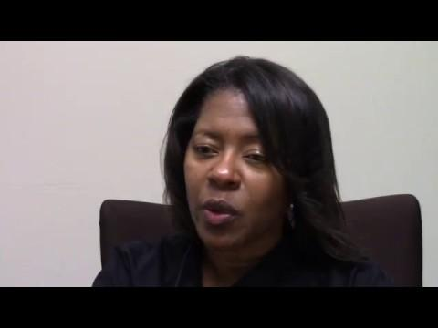
African Americans and Stroke
Notes:
African Americans have double the stroke rates of Caucasians
Twice as likely to die from stroke and have first stroke at much younger age
One in three African Americans suffer from high blood pressure
Much less likely to have blood pressure managed as well as Caucasian Americans
Sickle Cell Anemia, most common African American genetic disorder increases strokes (Sickle shaped cells block blood vessel to brain)
Smoking and vaping
Reference American Stroke Associtation

Slide 8

Non-Modifiable Risk Factors
Age
Gender
Ethnicity
Family History
Heart Disease
Previous Stroke/TIA
  Ethnic
Notes:
Non-Modifiable Risk Factors:
The risk for having a stroke depends on a person’s traits.
Traits that cannot be changed include:
Age – the risk of having a stroke increases as we get older, it doubles after the age of 65.
Gender- more men than women have strokes, however more women die from strokes.
Ethnicity/Race-the stroke risk for African Americans and Hispanics are higher than for Caucasians.
Family history-the risk for having a stroke increases if close blood relatives have had them.
Heart disease -People with coronary artery disease, heart failure, or heart defects are more likely to
have strokes than those with hearts that work normally.
Previous Stroke or TIA- If you have already had a stroke or a transient ischemic attack,
you have a 25-40% chance of having another stroke in the next 5 years.

Slide 9
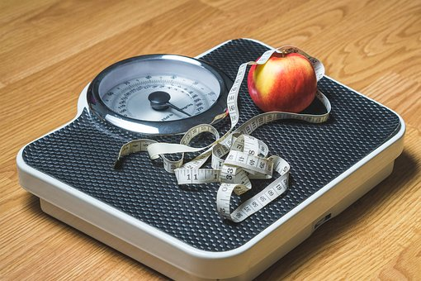
Modifiable Risk Factors
High Blood Pressure
High Cholesterol
Atrial Fibrillation
Diabetes
Tobacco Smoke & Vaping
Physical Inactivity
Obesity
Alcohol / Drugs
Notes:
9
Modifiable Risk Factors:
The risk for having a stroke can be reduced when lifestyle habits are changed or controlled with treatment.
High blood pressure (hypertension) – is sometimes called the “silent killer” because people may have it without knowing it.
It causes the heart to pump harder to move blood throughout the body.
Left untreated, high blood pressure is one of the most common causes for stroke.
High Cholesterol - is a condition where fatty deposits in the blood clog the arteries, preventing the blood to flow to the brain.
Atrial Fibrillation - or an irregular heartbeat happens when the heart's upper chambers quiver instead of beating effectively.
This can cause the blood to pool in a chamber and form clots that are carried to the brain.
Diabetes - is an independent risk factor that causes vessels to become fragile.
Many people with diabetes also have high blood pressure, high blood cholesterol and are overweight.
Tobacco smoke and vaping - damages blood vessel walls with the build up of nicotine and carbon monoxide. If a woman smokes, has a history of migraines, and takes oral contraceptives, her stroke risk is increased as much as 34 times.
Physical inactivity & Obesity - puts a strain on the entire circulatory system.
Alcohol & Drug - use has been linked to blood clots, heart complications and stroke, especially in the young population.

Slide 10

Staggering Stroke Rates in Minorities

Slide 11
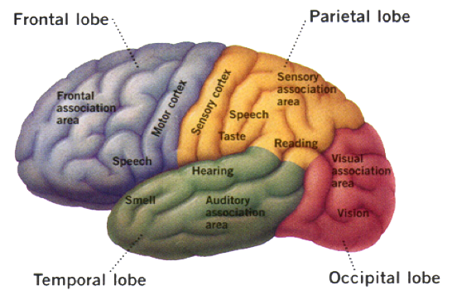
Effects of Stroke
Notes:
11
Effects of Stroke
The effects of stroke are different from person to person based on the type, severity, and location of the stroke.
If a stroke occurs and blood flow can't reach the area that controls a particular body function; that part of the body won't work as it should.
Effects to Right & Left Brain
The effects of a stroke depend on its location . One side of the brain controls the opposite side of the body.
Left Brain Functions
If the stroke occurs in the left side of the brain, the right side of the body is affected.
Damage to the left side of the brain can cause problems with speech & language, or low, cautious behavior,
and memory loss.
Right Brain Functions
For example, if the stroke occurs in the brain's right side, the left side of the body is effected.
Damage to this side of the brain can cause vision problems, impulsive behavior, or memory loss.

Slide 12
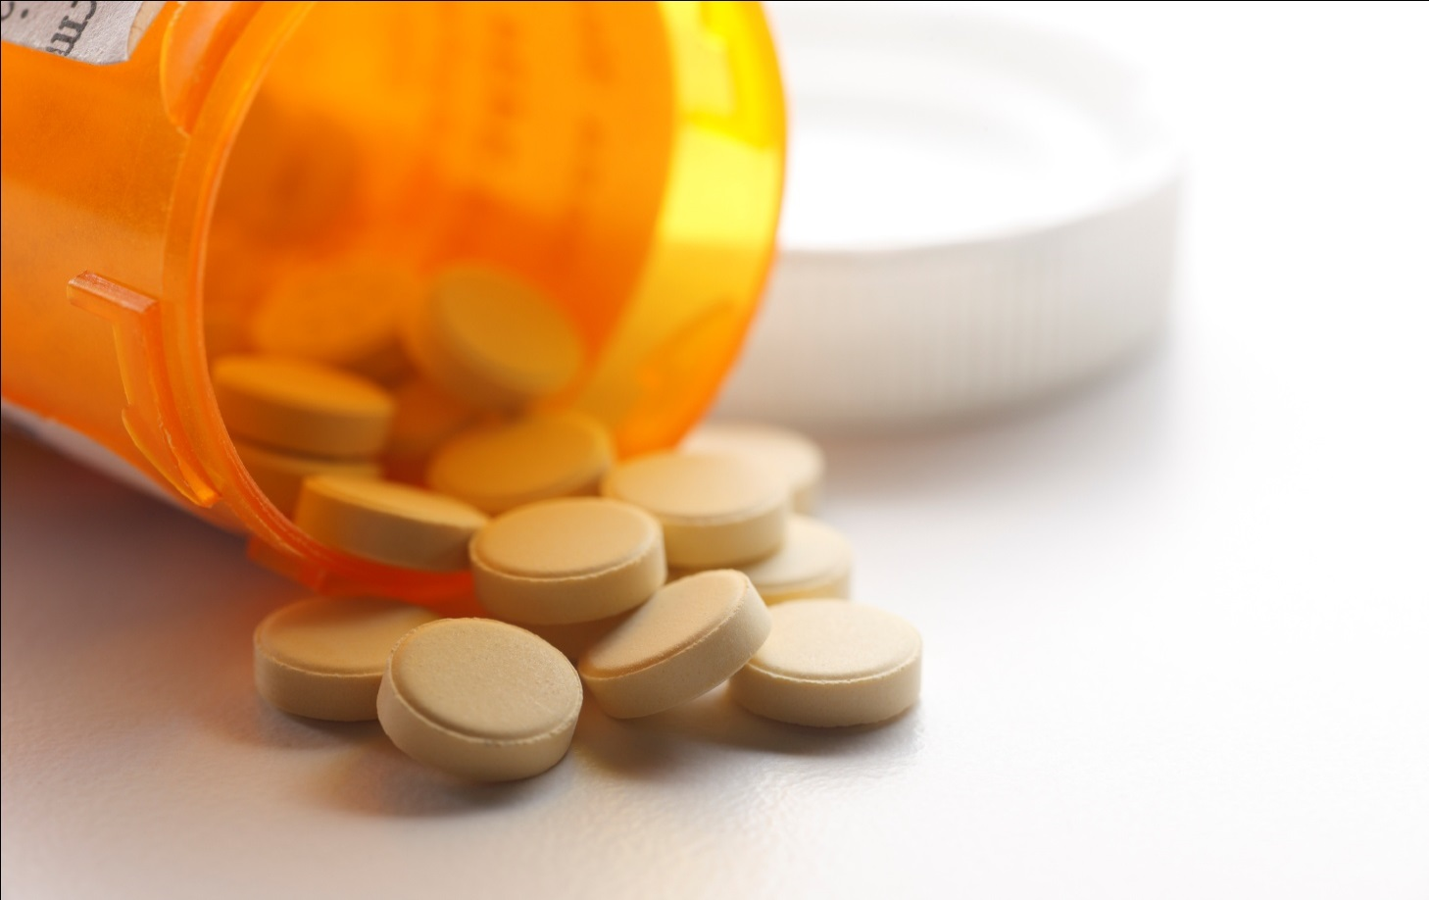
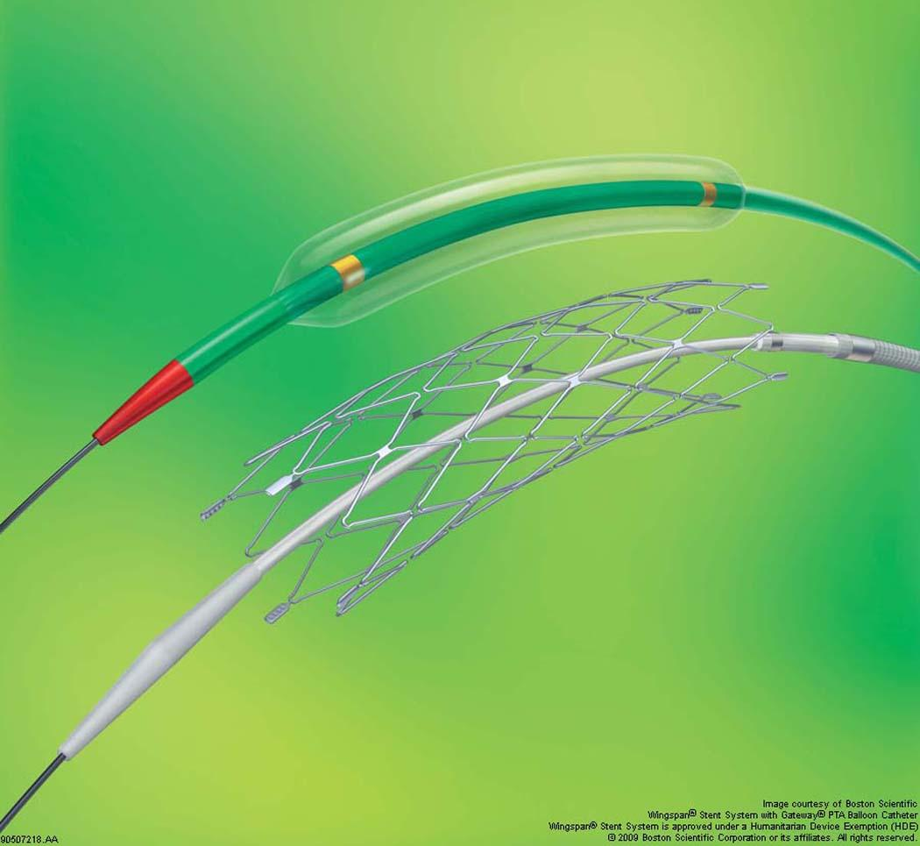
Treatment
Antithrombotics or Blood Thinners
Aspirin, Plavix, Aggrenox,
Heparin, Lovenox, Coumadin
Clot buster
t-PA (Tissue Plasminogen Activase)
Angioplasty
Stent
Carotid Endarterectomy
Others
Notes:
TREATMENT
There are several “blood thinning” medications that are given for stroke prevention.
•Antithrombotics (ex. aspirin) is a very common medication that is used to prevent the blood from forming clots, however, even though you do not need a prescription to buy it, you must first consult with your doctor before taking aspirin.
•t-PA (Tissue Plasminogen Activase) is another medication that has been approved by the FDA to dissolve clot clots, however, it must be given within a short time after symptoms begin because there is a risk to develop a hemorrhage.
For patients who can be treated within 3 hours of stroke onset, alteplase (IV r-tPA) can lead to better recovery after stroke
For select patients who are eligible to be treated up to 4.5 hours after stroke onset, alteplase (IV r-tPA) can also improve outcomes
Alteplase (IV r-tPA) has been proven to save lives and decrease disability when administered in a timely manner
RISKS
Bleeding of the brain, gums or other tissues are major risks
Some of the same surgeries that are recommended to open the blood vessels in the heart can also be used on the brain.
•Angioplasty and Stents are procedures that unclog arteries by inserting devices to open arteries and restore blood flow to the brain.
For those patients who are eligible to be treated up to 24 hours after stroke onset, mechanical thrombectomy has proven to be effective in lowering disability from stroke.
RISKS
Bleeding (the most common associated risk) or tearing of the inner lining of the blood vessel
•A Carotid Endarterectomy is the name of a surgical procedure that is used to remove the plaque that causes narrowing (stenosis) of the carotid arteries.
Relatively new treatments, approved by the FDA for stroke, and are less invasive than brain surgery.
•MERCI RETRIEVER is a corkscrew shaped instrument used to remove a clot from a large blood vessel in the brain.
•COILING is used for hemorrhagic strokes. This device reinforces an aneurysm’s weakened wall by filling it with a coiling wire.
PENUMBRA SYSTEM is a device used to breakdown and remove the clot using suction.

Slide 13





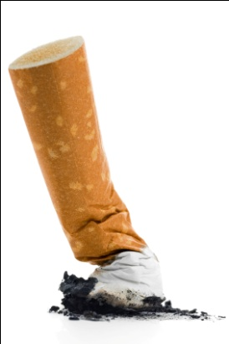
What You Can Do …?
Notes:
What you can do…
Remember, 80% of all strokes can be prevented!
Know the signs & symptoms - so you can react fast to get the appropriate care
Know your risk factors - especially focus on the ones you can change
Know your numbers - this includes your blood pressure, cholesterol, blood sugar, & weight
Improve diet & exercise - eat a healthy diet containing five or more servings of fruits & vegetables per day.
-try to get a total of at least 30 minutes of activity 5-6 days per week.
See your doctor - you should take all the medications that are prescribed by the doctor to control your individual risk factors
AND Stop smoking and vaping now!

Slide 14
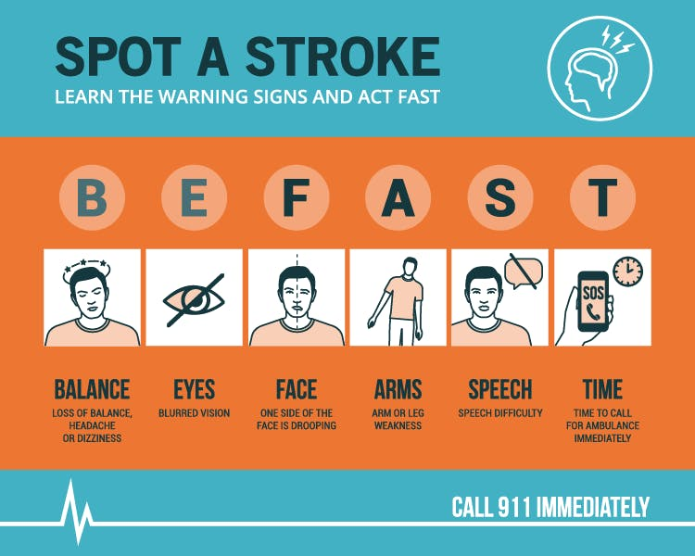
Check These Signs B.E.F.A.S.T
Notes:
CHECK THESE SIGNS B.E.F.A.S.T: (image Joe Niekro Foundation)
Many people experiencing a stroke may not realize it; or they may not be able to call 911 on their own.
That is why everyone should know the signs/symptoms of stroke and the importance of acting fast.
B. E. F. A. S. T. is a simple way to recognize and respond to stroke symptoms by calling 9-1-1!
Balance Does the person have a sudden loss of balance?
Eye Has the person lost vision in one or both eyes?
Face Does the face look uneven? Ask them to smile.
Arm Does one arm drift down? Ask them to raise both arms.
Speech Does their speech sound strange? Ask them to repeat a phrase.
Time It is time to call 9-1-1

Slide 15
Resources
A.D.A.M., Inc.
www.adameducation.com
American Academy of Neurology
www.aan.com
American Journal of Epidemiology
www.aje.oxfordjournals.org
American Heart Association
www.americanheart.org
American Stroke Association
www.strokeassociation.org
Brain Attack Coalition
www.stroke-site.org
Crain’s Chicago Business
www.crain.com
Genentech, Inc.
www.gene.com
Stroke Survivors Empowering Each Other, SSEEO
www.sseeo.org
Internet Stroke Center
www.strokecenter.org
Journal of the American Medical Association
www.jama.ama-assn.org
Morbidity & Mortality Weekly Report
www.cdc.org/mmwr
National Heart Lung & Blood Institute
www.nhlbi.nih.gov
National Institutes of Health
www.nih.gov
National Institute of Neurological Disorders & Stroke
www.ninds.nih.gov
New England Journal of Medicine
www.nejm.org
U.S. Dept of Health & Human Services
www.hhs.gov
Smoking and Vaping resources
Text Quit 4748
800-Quit-Now 800-784-8669
National Cancer Institute Live Help-line Chat
www.Livehelp.cancer.gov
Notes:
Stroke Resources

Slide 16
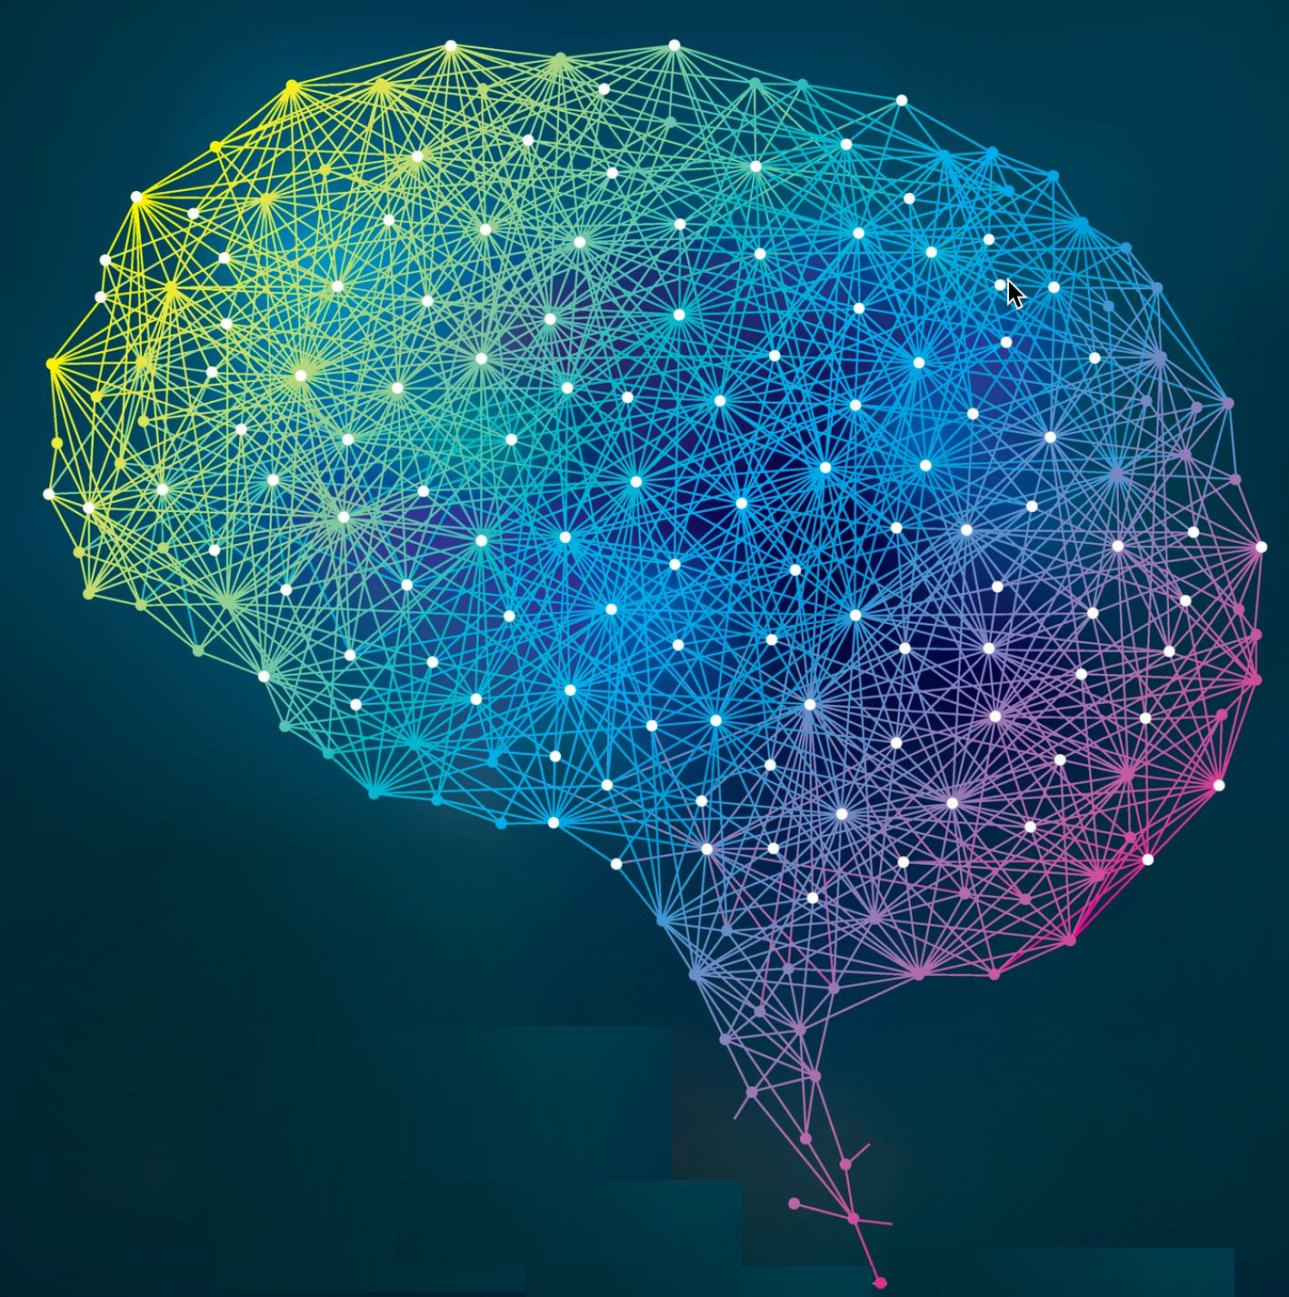
Thank-you!
Notes:
Questions?

