Slide 1

Corporate Digital Responsibility
What is the International CDR Manifesto
Rob Price, July 2025

Slide 2












Definition used CC BY ND from corporatedigitalresponsibility.net
Definition of CDR
Corporate Digital Responsibility (CDR) is a set of practices and behaviours that help an organisation use data and digital technologies in ways that are perceived as socially, economically, and environmentally responsible.
Environmental
Sustainability
Digital
Ethics
Inclusion,
Accessibility & Diversity
Privacy, Safety Online

Slide 3

The International CDR Manifesto
A collaboration between the founders of the various CDR Definitions produced 2018-2020
Rob Price
Dr Saskia Dörr
Professor Michael Wade
Christopher Joynson
Tim Frick
Oliver Merx
With the support of Ethos Foundation
Images used CC BY ND from corporatedigitalresponsibility.net

Slide 4
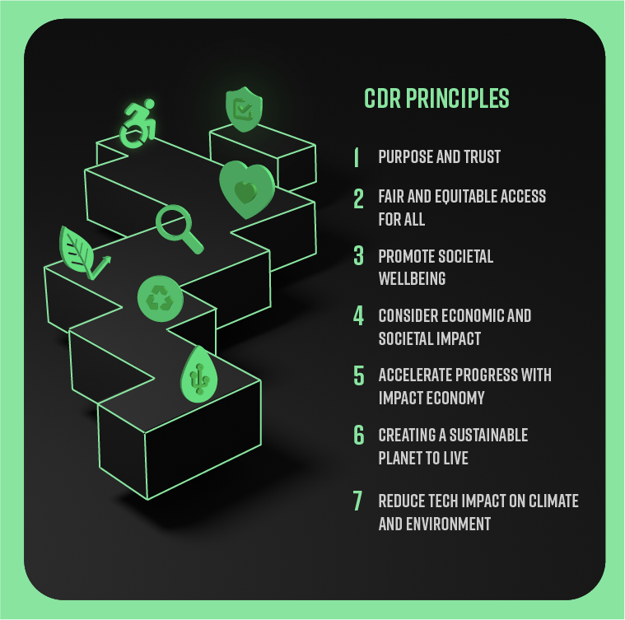
Introducing the
Seven Principles of CDR
Images used CC BY ND from corporatedigitalresponsibility.net

Slide 5
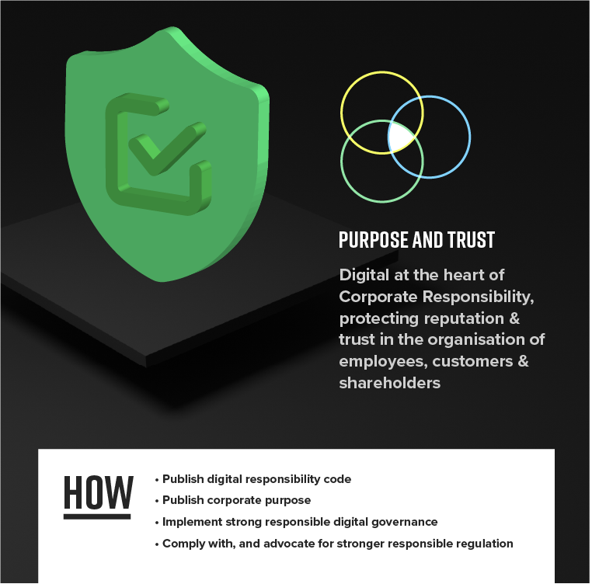
Images used CC BY ND from corporatedigitalresponsibility.net
Principle 1: Purpose and Trust
1.1
Facilitate & earn public trust by establishing and adhering to a Digital Responsibility Code that publicly, and transparently, declares position around, for example as described by Ethos Foundation
Governance through a CDR or Digital Ethics Council/ Advisory Board
Technology / Digital monitoring
Cybersecurity – Data / IP Privacy and data protection
Ethical rules understood and applied for use of digital / AI
Social Responsibility awareness for Digital Transformation
Principles of reducing carbon footprint.
1.2
Define & Agree Corporate Purpose and consider alignment to support Social Value and Sustainability in the Digital Age. Build an organisational culture that enables responsible actions of employees and leaders
1.3
Implement Strong Digital Governance, for example a Digital Ethics Board with due consideration to its make up and governance, including accountability and reporting
1.4
Exceed, and Advocate for Stronger Responsible Regulation, by adhering to, advocating for evolution of, and raise visibility of appropriate legal, regulatory and ethical rules per geography & markets (e.g. data/AI), certifications (e.g. security/safety online)

Slide 6
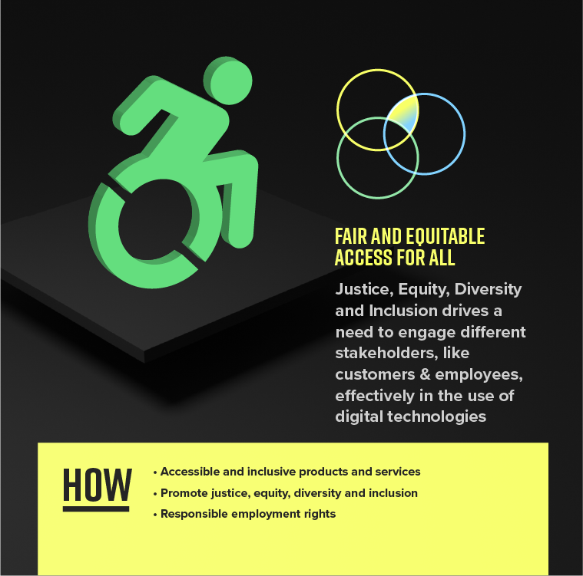
Images used CC BY ND from corporatedigitalresponsibility.net
Principle 2: Fair and Equitable Access for All
2.1
Innovative, Accessible and Inclusive Products & Services
Ensure all parts of society have access to digital technologies (connectivity, tools and know-how)
Ensure that products and services are inclusive by design, user-centric, convenient and accessible design for all
Facilitate improvements in social innovation through digital tools and technologies
2.2
Promote Justice, Equity, Diversity & Inclusion
Promote diversity and diverse thinking, integrated into product and service design, avoiding tech/AI driven bias exacerbating societal perspectives
Actively avoid discrimination within digital transformation of business
2.3
Responsible Employment Rights
Ensure human and employee rights are maintained with responsible outsourcing of work to the gig economy
Responsible employment rights across (digital) supply chain
Respecting employee rights for privacy and human dignity at the digitalised workplaces

Slide 7
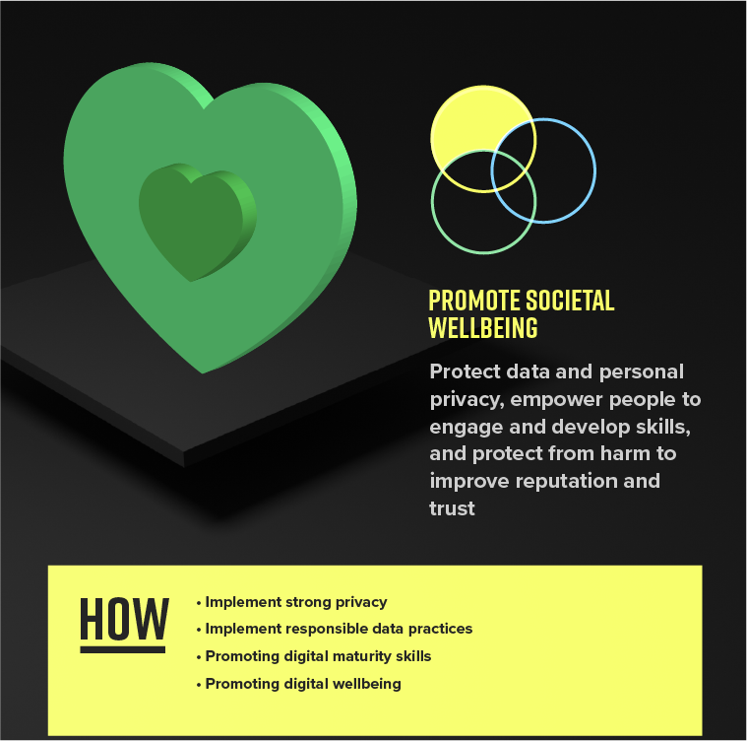
Images used CC BY ND from corporatedigitalresponsibility.net
Principle 3: Promote Societal Wellbeing
3.1
Implement Strong Privacy
Ensure data privacy protection for employees, customers, citizens and all stakeholders
3.2
Implement Responsible Data Practices
Follow responsible data validation & disposal practices, including transparency of use & processing of external data
Implement responsible cybersecurity protection and response practices
Informing proactively when using tracking, scoring and profiling and giving opportunity to avoid
Refrain from harmful behavioural manipulation by using data, tech and digital tools
3.3
Promoting Digital Maturity Skills
Addressing digital poverty & promoting inclusion (access to digital, access to digital finance)
Promote improvements in societal digital maturity (skills, trust and understanding)
3.4
Promoting Digital Wellbeing
Pursuing socially ethical digital practices – to reduce amplification of ‘fake news’ & inappropriate digital influence (harm and digital wellbeing)
Promoting physical & mental healthy lifestyle, supported or enhanced by digital products or services

Slide 8
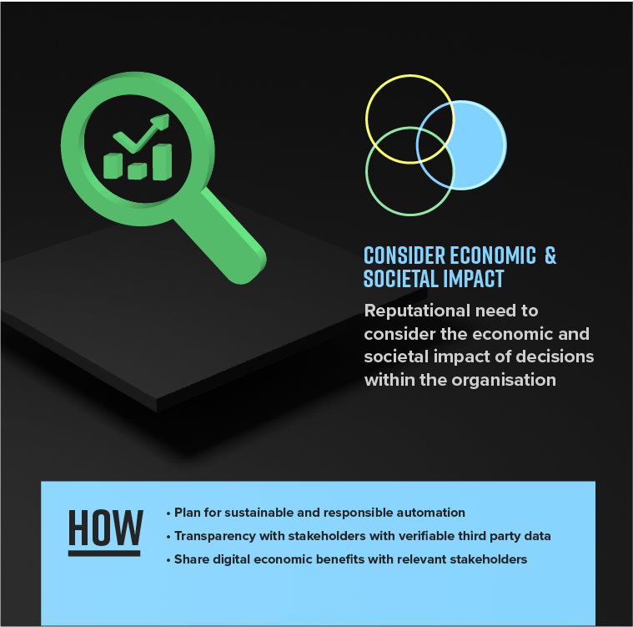
Images used CC BY ND from corporatedigitalresponsibility.net
Principle 4: Consider Economic & Societal Impact
4.1
Plan for Sustainable & Responsible Automation
Replacing jobs done by humans in a responsible way, consideration of retraining/reskilling programmes
Ensure ethical and unbiased, explainable AI decision making algorithms
Enable employees to understand the ethical dilemma and societal impact of tech and digital transformation through awareness training
Actively engage with employee opinion and feedback in digital transformation, automation and tech implementation
4.2
Transparency with Stakeholders with Verifiable 3rd Party Data and Algorithms
Ensure organisations & consumers understand sources of collected data, where it is, what is done with it, including scoring, profiling, reporting
Understand authenticity and transparency of utilised 3rd party AI algorithms
4.3
Share Digital Economic Benefits with Relevant Stakeholders
Sharing economic benefits of digital work with society, for example through appropriate taxation
Respecting personal data ownership rights, reduce data piracy and enable individual monetization
Promote open data to enable broad innovation by all (including opening Right to Repair)

Slide 9
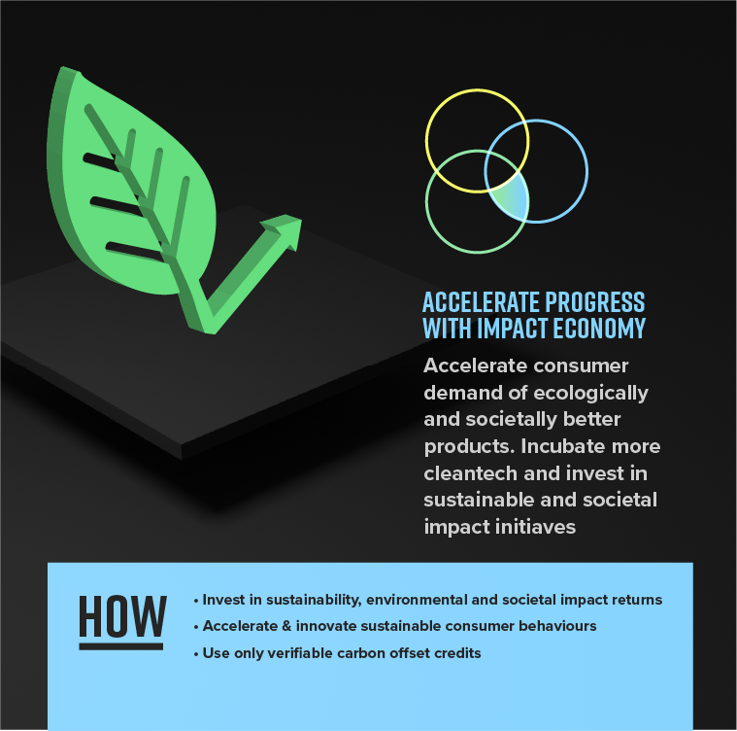
Images used CC BY ND from corporatedigitalresponsibility.net
Principle 5: Accelerate Progress with Impact Economy
5.1
Invest in Sustainability / Environmental / Impact returns
Look to partner ecosystems across supply chain, engaging (and measuring impact of) ecotech, cleantech digital solutions
Position for growth in environmental markets that align to purpose and positive planet impact
5.2
Use Verifiable Offset
Understand Carbon Credit market and if using offset, look to use verifiable offset or digitally enabled natural carbon sequestration (like e.g. reforestation and afforestation)
5.3
Accelerate & Innovate Sustainable Consumer Behaviours
Use Digital products to enable, for example, price discriminating digital tools that promote sustainable practices
Consideration of economic models that are more conducive to sustainable practices

Slide 10
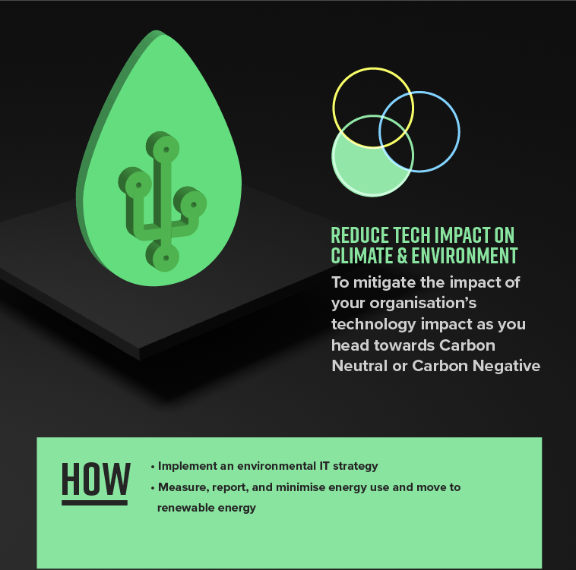
Images used CC BY ND from corporatedigitalresponsibility.net
Principle 7: Reduce Tech Impact on Environment
7.1
Implement an Environmental IT Strategy
Following responsible recycling practices for digital technologies – target zero waste, promote circular economy
Following responsible disposal practices for digital technologies, including extending tech life span, e.g. of smartphones and using refurbished IT
Design in Environmental considerations in the use of digital technologies – e.g. Sustainable Web Design & IT Strategy
7.2
Measure, Report, Minimise Energy use & move to Renewable Energy
Reduce consumption by measuring & actively reducing Scope 1, 2 and 3 emissions using Digital tech
In your data centres, and supply chain data centres, direct and indirect
In your offices & business facilities
In your travel & vehicle fleets
In your decentralised asset base

Slide 11
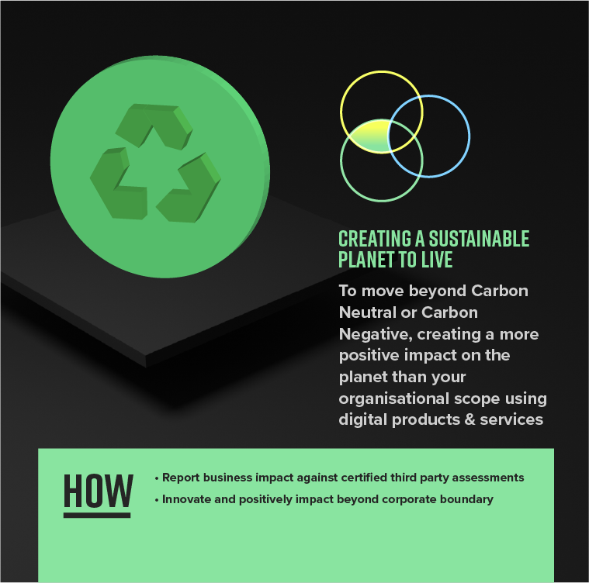
Images used CC BY ND from corporatedigitalresponsibility.net
Principle 6: Creating a Sustainable Planet to Live
6.1
Report impact of business against 3rd party impact assessments
Promote transparent, sustainable and ethical working practices across the supply chain linked to a recognized sustainability reporting standard such as UN Global Compact, Global Reporting Initiative, SASB, ESG frameworks or BCorp, including digital responsibility practices
6.2
Innovate & Positively Impact Beyond Corporate Boundary
Using Digital technologies or services, look to innovate and create new product lines or business capabilities that tangibly and positively impact
Economic Sustainability - of supply chain, of people, of business
Societal Sustainability – social cohesion, trust and privacy
Environmental Sustainability (climate change, biodiversity, waste, resources)
Introduce Circular Economy principles in Product Design
For example, contribution of data or APIs, or utilization of other technologies with data science of analytics to create new societal & environmental benefits

Slide 12
Used CC BY ND from corporatedigitalresponsibility.net
Making CDR accessible Worldwide
English
Italian
French
German
Portuguese
Spanish
Catalan
Dutch
Greek
Polish
Swedish
Norwegian
Finnish
Lithuanian
Romanian
Arabic
Japanese
Korean
Hindi
Turkish
Slovenian
Hungarian
Slovakian
Czech
Bosnian
Montenegrin
Serbian (Cyrillic)
Serbian (Latin)
Croatian

Slide 13

https://corporatedigitalresponsibility.net
”A New Digital Responsibility” podcast
https://www.linkedin.com/in/rob-price-4a44884/

