Slide 1

School Accountability
CNMI PSS
Principal’s Toolkit

Slide 2
What is school accountability?
Definition
  The process of evaluating school performance and improvement and directing resources to provide support
  (Look at definition from manual)
Policy
  The CNMI State Board of Education approved the CNMI PSS Accountability System Policy on March 23, 2023.
  The CNMI PSS will produce annual Accountability School Reports to be used to showcase the progress students and schools are making toward high expectations (e.g., academic proficiency and college and career readiness). The CNMI PSS Accountability System Reports will be published by the end of each Fiscal Year (September 30th).
Notes:
Check with manual

Slide 3
What is school accountability?
Purpose
  To serve as a flashlight
    To understand what is good
    To see what needs improvement
  To start or deepen meaningful conversations about school performance
Goals
  To help answer the question:
    What supports can be given to these schools?
  Focus on glows & growth
    Looks at student achievement
  Not a hammer
    Not punitive
    Not meant to compare schools against each other
  Promotes transparency and building better partnership with stakeholders
Notes:
What is the point? And how should we interpret the scores/rating?
Write about policy

Slide 4
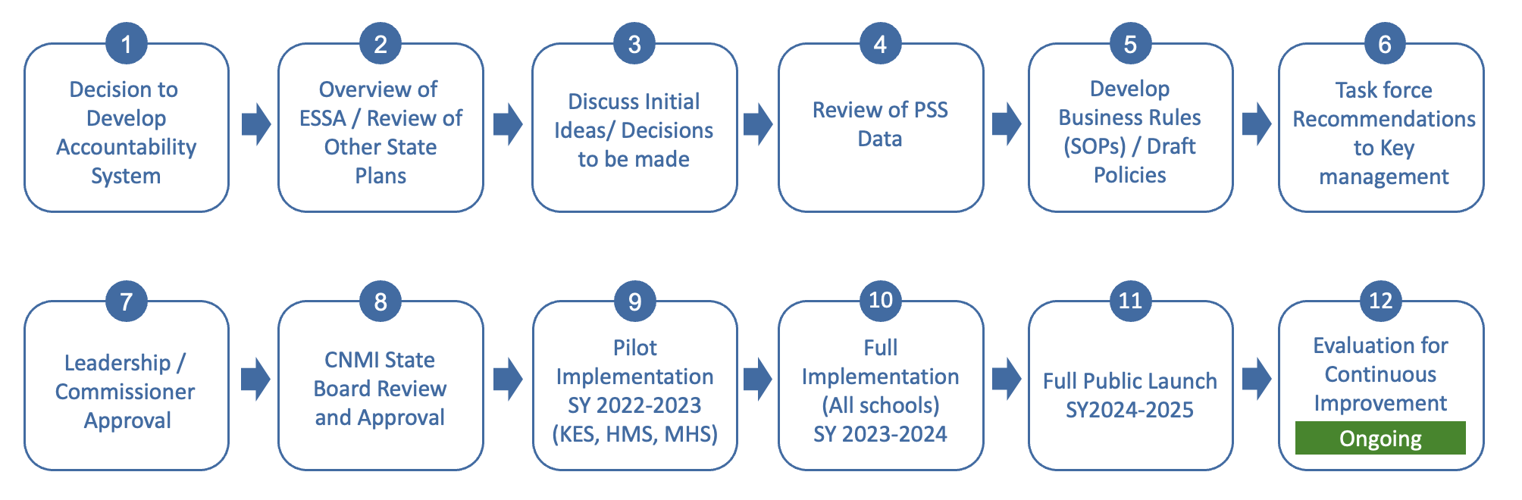
PSS Accountability Journey

Slide 5
How did PSS build a school accountability system?
We asked ourselves…
What are the things that indicate success at meeting or achieving our community values ?
How do we measure what we value at each school?
How important or how much weight should we put into each of those measures?

Slide 6
Indicators
First Phase (SY 2023-2024)
ELA Performance
Math Performance
Attendance
High School Graduation
In Discussion for Future
Multilingual Students
Social and Emotional Learning
Extracurricular Activities
College Preparedness
Student Growth Suggestions?

Slide 7
Measures
ELA Performance
  ELA Test Scores (STAR Reading/ STAR Early Literacy)
Math Performance
  Math Test Scores (STAR Math)
Attendance
  Attendance Rate (Infinite Campus: Average Daily Rate)
High School Graduation
  4-Year Adjusted Cohort Graduation Rate (ACGR)

Slide 8
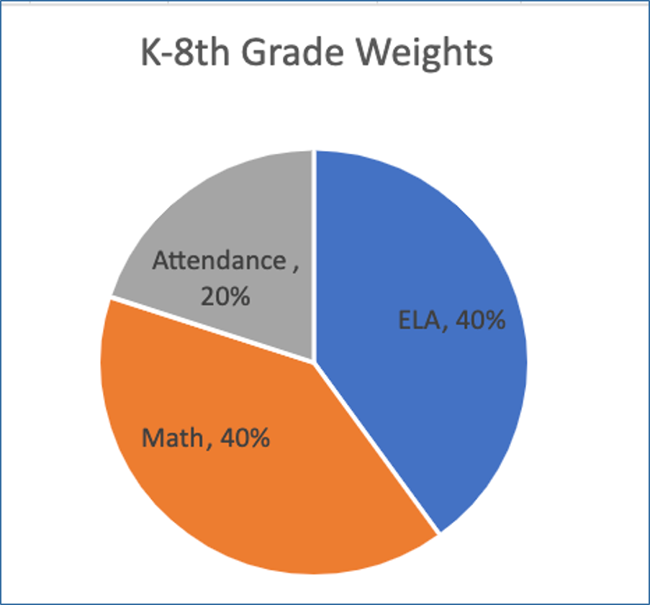
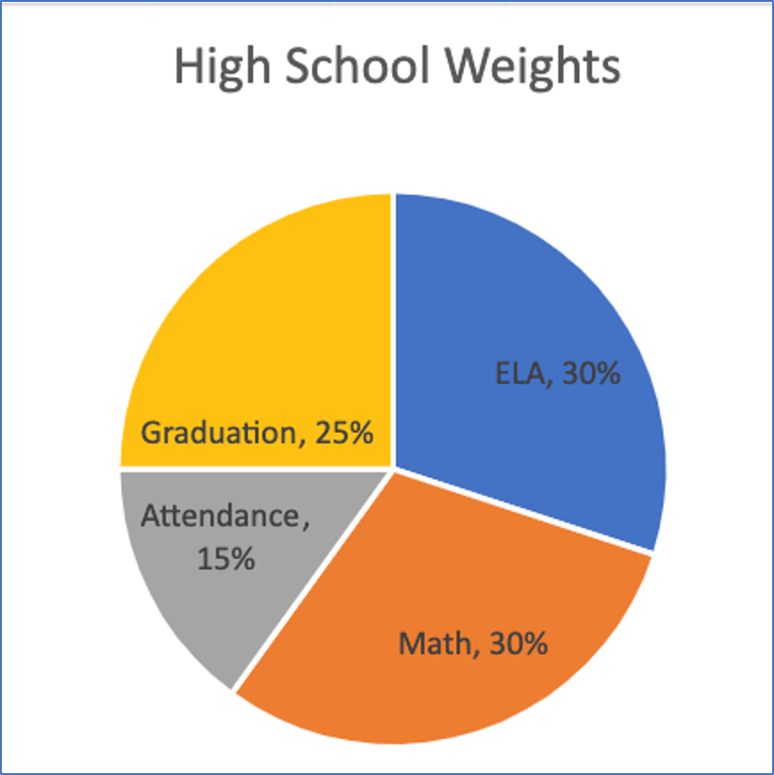
Weights
Notes:
Add why the proportions are the way they are.
- K-8 does not have graduation rate

Slide 9

How do we find out the results?
School Accountability Dashboard:
  https://slds.cnmipss.org/

Slide 10
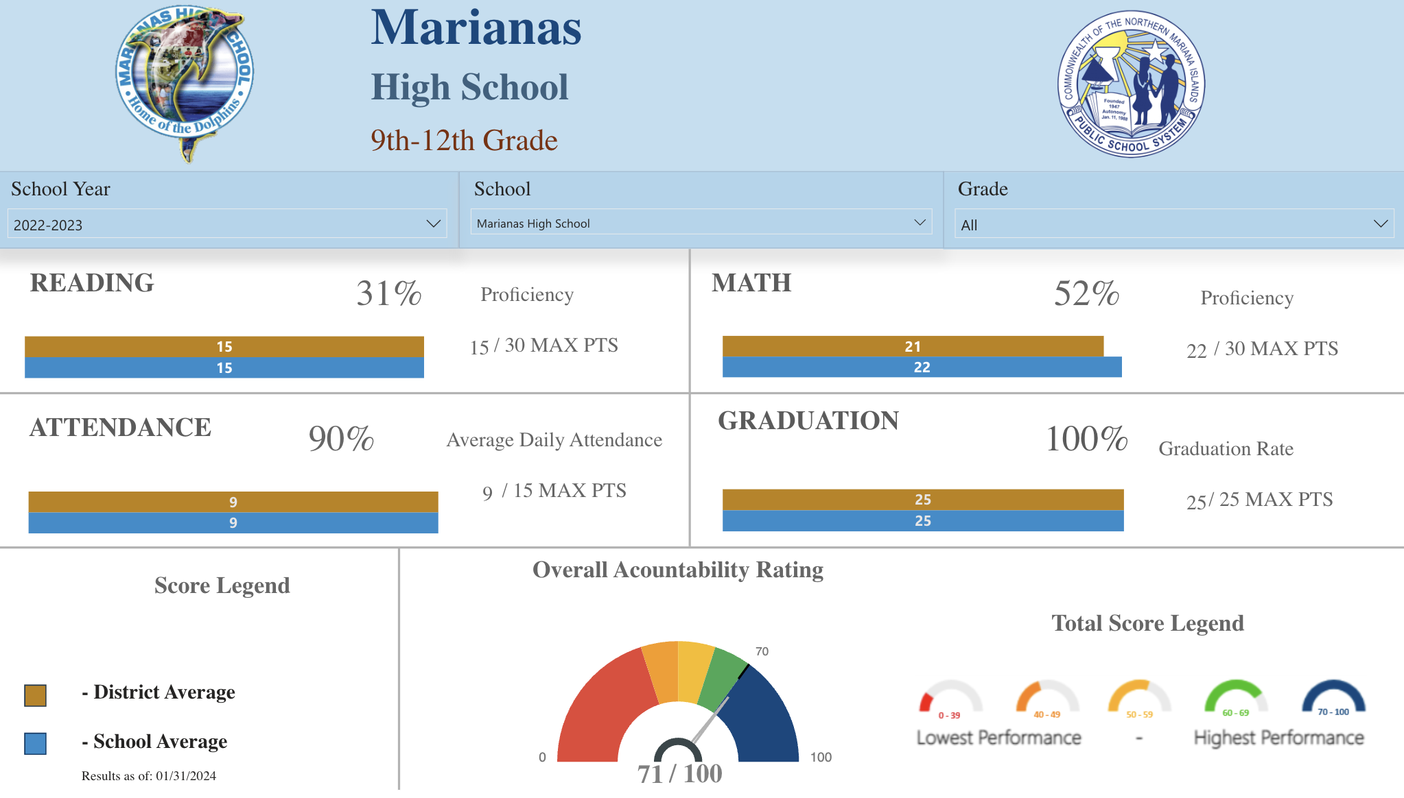
What will the results look like?
Important

Slide 11
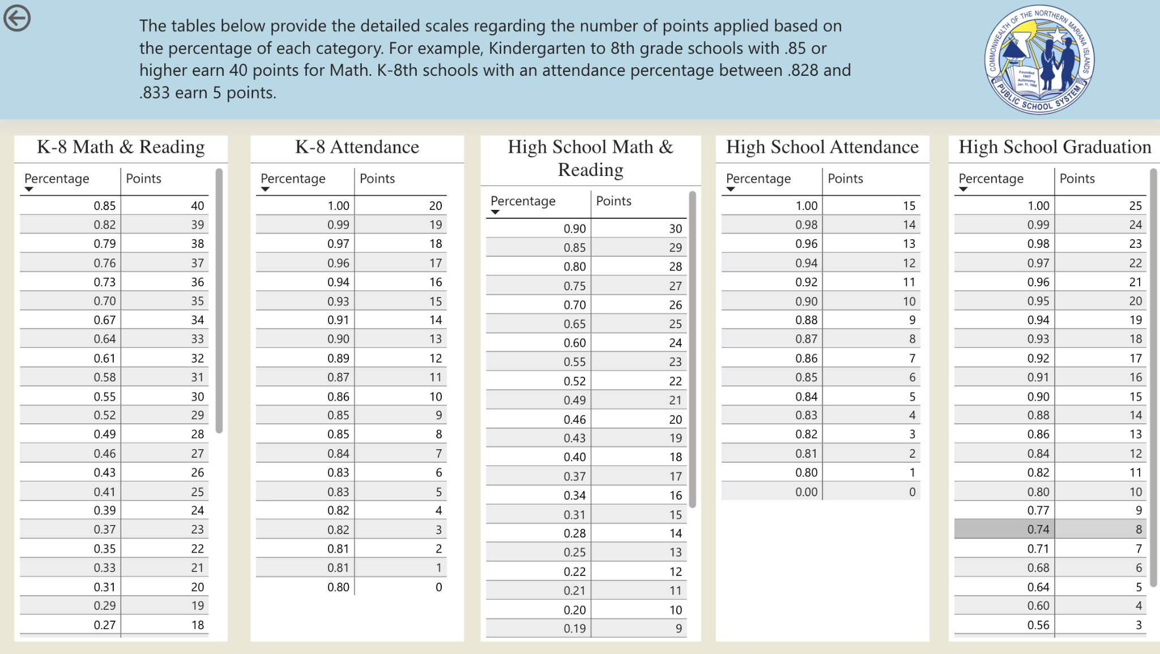
Accountability Point System

Slide 12
How does this affect you?
School Staff
Families & Students
Need to keep good track of attendance
Focus on improving what the communities value
Tie to SWP (change text)
Deepen conversations with the school
Student and family ownership of how they contribute to our school success
Homework for Principals:
- Brainstorm how will this affect communities and ways to address concerns

Slide 13
Next Steps
Examples – Please edit and customize with real dates
  Data night
    Community conversation about school results
    Opportunity for caregivers to ask questions
  Staff conversations
    Are the results surprising?
    What can we celebrate?
    What changes might we make?
  Operational SY2024-2025
    What does this mean?
    What will be different this school year?
  Suggestions to PSS
    Letter to PSS on ways to improve system

