Slide 1
The First Step for Improved Critical Thinking Educational Design
Susan K. Wolcott, PhD, CPA, CMA
Independent Scholar
Email: swolcott@WolcottLynch.com
Website: www.WolcottLynch.com
www.linkedin.com/in/susankwolcott

Slide 2

Use student responses to a short essay assignment as a formative assessment to identify students’ stages of cognitive development
Explore reasons for differences in cognitive development across students, assignments, courses, and programs
Use formative assessment results to plan the design of learning activities and provide effective feedback
Leverage ideas from this session in your own courses
Susan Wolcott, CTLA Critical Thinking III, San Diego, July 30, 2022

Slide 3

AICPA Faculty Guide
Authored by Susan Wolcott
Available at https://thiswaytocpa.com/program/CriticalThinking

Slide 4
AICPA Faculty Guide: Critical Thinking Model

Slide 5


Let’s Look at Samples of Student Writing
Susan Wolcott, CTLA Critical Thinking III, San Diego, July 30, 2022

Slide 6

Wake-Up Coffee: Budgeting Hourly Labor Costs
You have recently been hired by Wake-Up Coffee, which owns and operates a chain of retail coffee shops. You work in the finance department, and your first assignment is to develop a budget for fixed and variable costs for the retail stores. You are having difficulty deciding how to handle labor costs for hourly workers. Each store manager sets a weekly schedule for hourly workers, adjusting the schedule over time for sales volumes. In addition, the store manager can send workers home early if sales on a particular day are lower than expected. Hourly labor was treated as a variable cost in previous budgets. However, a certain number of workers is needed to run the store, and managers are reluctant to send workers home early too often for fear of losing good employees. Accordingly, you are wondering whether hourly labor costs should be treated as a fixed cost in next year’s budget.
Required:
Your boss wants your recommendation about how hourly labor costs should be treated in next year’s budget. Turn in a one-paragraph answer.
Susan Wolcott, CTLA Critical Thinking III, San Diego, July 30, 2022

Slide 7

Given the Design of This Assignment, What Student Performance Would You Expect?
Susan Wolcott, CTLA Critical Thinking III, San Diego, July 30, 2022

Slide 8
Response of Student #1
Take-Home Assignment
My idea would be to make it a variable cost and not change it. Since there is no set amount of time someone could be there they cannot be certain it would be a fixed cost. For this reason it would have to stay as a variable. No matter how much they can try to make certain set hours, it would be divided among several people instead of one. For this reason it would be hard to make it a fixed because it would involve several accounts as opposed to one set account.
Susan Wolcott, CTLA Critical Thinking III, San Diego, July 30, 2022

Slide 9
Annotated Response: Student #1
Student Response | Assessment Comments
My idea would be to make it a variable cost and not change it. Since there is no set amount of time someone could be there they cannot be certain it would be a fixed cost. For this reason it would have to stay as a variable. No matter how much they can try to make certain set hours, it would be divided among several people instead of one. For this reason it would be hard to make it a fixed because it would involve several accounts as opposed to one set account. | Plans to keep the existing method Identifies uncertainty about amount of worker time and uses it as a reason for continuing the existing method. The next sentence denies uncertainty, suggesting the student does not understand that the cost classification is uncertain. Discussion suggests the student understands the basic difference between fixed and variable costs. Provides illogical/confusing reason against the alternative classification.
Susan Wolcott, CTLA Critical Thinking III, San Diego, July 30, 2022

Slide 10
AICPA Critical Thinking Skills Rubric: Student #1
Component of Critical Thinking Model : | Level 1 Little/No Critical Thinking (Confused Fact-Finder) | Level 2 Partial Critical Thinking (Biased Jumper) | Level 3 Emergent Critical Thinking (Perpetual Analyzer) | Level 4 Competent Critical Thinking (Pragmatic Performer)
Identify | Recites purpose as given, or Identifies an inappropriate problem | Identifies the clearly-evident problem Recognizes that the problem is open-ended/ambiguous | Identifies the main purpose Identifies relevant stakeholders and their possible goals/ preferences Identifies relevant accounting knowledge, concepts and techniques | In addition to Stage 3: Identifies important embedded, subsidiary problem(s)
Analyze | Applies calculations, definitions, or other “textbook” concepts Presents irrelevant information Misinterprets calculation(s) and/or concept(s) | Applies and describes the effects of relevant calculations and/or concepts Partially analyzes alternatives, focusing on information supporting own viewpoint Discounts other viewpoint(s) | Thoroughly and objectively applies and interprets relevant calculation(s) and concept(s) Explores causes, stakeholder effects and interrelationships Questions the quality of information and assumptions Thoroughly discusses the pros and cons of viable alternatives | Objectively analyzes the most important relevant information, implications, consequences and viewpoints Evaluates the quality of information and assumptions, and adapts interpretations (as needed) Summarizes the most important pros and cons of viable alternatives
Conclude | Instead of a conclusion, provides facts, definitions, or other “authoritative” statements | Reaches a biased conclusion that is consistent with analyses | Reaches no conclusion, or Provides a conclusion with little or no justification | Identifies/develops appropriate criteria, and uses the criteria to reach convincing conclusion(s) If appropriate, provides value-added advice (e.g., identifies implementation issues)

Slide 11
Response of Student #2
Take-Home Assignment
My recommendation for next year’s budget is that hourly labor costs should be fixed, rather than the past variable. If there needs to be a certain number of workers to run the store at all times, then schedule as many workers as needed and do send them home early if sales start to slow down for the day. This might make some good employees that are needed angry and quit. To avoid this, schedule less workers in the already known slow periods of the day, rather than just sending someone home. Also, if next year’s budget is changed to fixed costs, the boss won’t have to keep figuring out different totals—but instead have the same numbers to work with every time. This would allow more time for improving the store and insuring good customer service.
Susan Wolcott, CTLA Critical Thinking III, San Diego, July 30, 2022

Slide 12
Annotated Response: Student #2
Student Response | Assessment Comments
My recommendation for next year’s budget is that hourly labor costs should be fixed, rather than the past variable. If there needs to be a certain number of workers to run the store at all times, then schedule as many workers as needed and do send them home early if sales start to slow down for the day. This might make some good employees that are needed angry and quit. To avoid this, schedule less workers in the already known slow periods of the day, rather than just sending someone home. Also, if next year’s budget is changed to fixed costs, the boss won’t have to keep figuring out different totals—but instead have the same numbers to work with every time. This would allow more time for improving the store and insuring good customer service. | Clear recommendation. Seems to believe it is easy to know how many workers are needed. Recognizes at least some uncertainty about sales volumes. Recognizes potential impact of work schedules on employee satisfaction. Implicitly recognizes the distinction between fixed and variable costs. Seems to believe managers can perfectly foresee when slow periods will occur (lack of uncertainty). Re-casts the problem from classifying labor costs to “correcting” management so that costs are always fixed. Seems confused about what it means for costs to be classified in the budget versus the actual calculations of labor costs. Not clear who the student is talking about—the manager or the other employees.
Susan Wolcott, CTLA Critical Thinking III, San Diego, July 30, 2022

Slide 13
AICPA Critical Thinking Skills Rubric: Student #2
Component of Critical Thinking Model : | Level 1 Little/No Critical Thinking (Confused Fact-Finder) | Level 2 Partial Critical Thinking (Biased Jumper) | Level 3 Emergent Critical Thinking (Perpetual Analyzer) | Level 4 Competent Critical Thinking (Pragmatic Performer)
Identify | Recites purpose as given, or Identifies an inappropriate problem | Identifies the clearly-evident problem Recognizes that the problem is open-ended/ambiguous | Identifies the main purpose Identifies relevant stakeholders and their possible goals/ preferences Identifies relevant accounting knowledge, concepts and techniques | In addition to Stage 3: Identifies important embedded, subsidiary problem(s)
Analyze | Applies calculations, definitions, or other “textbook” concepts Presents irrelevant information Misinterprets calculation(s) and/or concept(s) | Applies and describes the effects of relevant calculations and/or concepts Partially analyzes alternatives, focusing on information supporting own viewpoint Discounts other viewpoint(s) | Thoroughly and objectively applies and interprets relevant calculation(s) and concept(s) Explores causes, stakeholder effects and interrelationships Questions the quality of information and assumptions Thoroughly discusses the pros and cons of viable alternatives | Objectively analyzes the most important relevant information, implications, consequences and viewpoints Evaluates the quality of information and assumptions, and adapts interpretations (as needed) Summarizes the most important pros and cons of viable alternatives
Conclude | Instead of a conclusion, provides facts, definitions, or other “authoritative” statements | Reaches a biased conclusion that is consistent with analyses | Reaches no conclusion, or Provides a conclusion with little or no justification | Identifies/develops appropriate criteria, and uses the criteria to reach convincing conclusion(s) If appropriate, provides value-added advice (e.g., identifies implementation issues)

Slide 14
Response of Student #3
In-Class Assignment
There are many uncertainties such as: How to treat overtime, which employees are benefited, are employees salaried or hourly, and how are benefit costs incurred and handled? Fixed costs are the simplest and least expensive to calculate. However, the fixed cost method may not be as accurate as variable cost method for budgeting. I would like to compare actual variable cost to budgeted variable cost for last year to estimate whether there is a potential for cost reduction by keeping more involved records.
Susan Wolcott, CTLA Critical Thinking III, San Diego, July 30, 2022

Slide 15
Annotated Response: Student #3
Student Response | Assessment Comments
There are many uncertainties such as: How to treat overtime, which employees are benefited, are employees salaried or hourly, and how are benefit costs incurred and handled? Fixed costs are the simplest and least expensive to calculate. However, the fixed cost method may not be as accurate as variable cost method for budgeting. I would like to compare actual variable cost to budgeted variable cost for last year to estimate whether there is a potential for cost reduction by keeping more involved records. | Lists a number of uncertainties that affect the classification. Uses evidence from the case to provide a pro and con for each approach. Does not provide a recommendation. Implicitly demonstrates an understanding of the distinction between fixed and variable costs. Relates classification to the task at hand—budgeting. Begins to provide a strategy for obtaining additional relevant information, but then seems confused about how to use that information for classifying costs in the budget.
Susan Wolcott, CTLA Critical Thinking III, San Diego, July 30, 2022

Slide 16
AICPA Critical Thinking Skills Rubric: Student #3
Component of Critical Thinking Model : | Level 1 Little/No Critical Thinking (Confused Fact-Finder) | Level 2 Partial Critical Thinking (Biased Jumper) | Level 3 Emergent Critical Thinking (Perpetual Analyzer) | Level 4 Competent Critical Thinking (Pragmatic Performer)
Identify | Recites purpose as given, or Identifies an inappropriate problem | Identifies the clearly-evident problem Recognizes that the problem is open-ended/ambiguous | Identifies the main purpose Identifies relevant stakeholders and their possible goals/ preferences Identifies relevant accounting knowledge, concepts and techniques | In addition to Stage 3: Identifies important embedded, subsidiary problem(s)
Analyze | Applies calculations, definitions, or other “textbook” concepts Presents irrelevant information Misinterprets calculation(s) and/or concept(s) | Applies and describes the effects of relevant calculations and/or concepts Partially analyzes alternatives, focusing on information supporting own viewpoint Discounts other viewpoint(s) | Thoroughly and objectively applies and interprets relevant calculation(s) and concept(s) Explores causes, stakeholder effects and interrelationships Questions the quality of information and assumptions Thoroughly discusses the pros and cons of viable alternatives | Objectively analyzes the most important relevant information, implications, consequences and viewpoints Evaluates the quality of information and assumptions, and adapts interpretations (as needed) Summarizes the most important pros and cons of viable alternatives
Conclude | Instead of a conclusion, provides facts, definitions, or other “authoritative” statements | Reaches a biased conclusion that is consistent with analyses | Reaches no conclusion, or Provides a conclusion with little or no justification | Identifies/develops appropriate criteria, and uses the criteria to reach convincing conclusion(s) If appropriate, provides value-added advice (e.g., identifies implementation issues)

Slide 17
Response of Student #4
In-Class Assignment
The costs of the labor should be both fixed and variable. The trick is determining minimal staffing levels. The managers, through experience and data, should decide on a minimum hours all employees should work or the manager could set a minimum number of employees needed regardless of sales volume. These costs for labor are fixed the rest are variable. The information that would be nice to have is staffing levels over time (#people/hours worked) to establish fixed staff level.
Susan Wolcott, CTLA Critical Thinking III, San Diego, July 30, 2022

Slide 18
Annotated Response: Student #4
Student Response | Assessment Comments
The costs of the labor should be both fixed and variable. The trick is determining minimal staffing levels. The managers, through experience and data, should decide on a minimum hours all employees should work or the manager could set a minimum number of employees needed regardless of sales volume. These costs for labor are fixed the rest are variable. The information that would be nice to have is staffing levels over time (#people/hours worked) to establish fixed staff level. | Recommends treating the costs as mixed. Identifies a key classification difficulty (implicitly recognizes uncertainty about classification). Recommends practical approach for managers to divide the cost between fixed and variable. Approach demonstrates an understanding of the distinction between fixed and variable. Would like historical information to improve estimation of fixed versus variable portions. Implicitly recognizes uncertainty about what amounts should be classified as fixed versus variable. Does not address pros and cons. Instead, goes for a “solution” and focuses only on it. This student might be operating at Performance Pattern 3, but has not articulated his/her underlying thinking sufficiently to be classified at that level.
Susan Wolcott, CTLA Critical Thinking III, San Diego, July 30, 2022

Slide 19

Difficulties in Using the Rubric Because of the Assignment Design
Susan Wolcott, CTLA Critical Thinking III, San Diego, July 30, 2022

Slide 20
Wake-Up Coffee:
How the Assignment Was Originally Designed
Analyze Information
The following questions will help you analyze the information for this problem. Do not turn in your answers to these questions unless your professor asks you to do so.
Explain the difference between fixed and variable costs.
Identify uncertainties about how labor costs should be treated in the budget.
Discuss pros and cons of alternative treatments.
Identify additional information you might like to have.
Required: Written Assignment
Your boss wants your recommendation about how hourly labor costs should be treated in next year’s budget. Turn in a one-paragraph answer.
Susan Wolcott, CTLA Critical Thinking III, San Diego, July 30, 2022

Slide 21
Wake-Up Coffee:
Better Design
Analyze Information
The following questions will help you analyze the information for this problem. Do not turn in your answers to these questions unless your professor asks you to do so.
Explain the differences among fixed, variable, and mixed costs.
Identify uncertainties about how labor costs should be treated in the budget.
Discuss pros and cons of alternative treatments.
Identify additional information you might like to have.
Required: Written Assignment
Your boss wants your recommendation about how hourly labor costs should be treated in next year’s budget. Use the information you learned from the preceding analyses to write a memo with your recommendation. As you write the memo, consider what information your boss will need from you to help make the final decision.
Susan Wolcott, CTLA Critical Thinking III, San Diego, July 30, 2022

Slide 22
Design Assignments for Critical Thinking
Open-Ended Problems
Questions for Multiple Levels
Student Responses
by Level
Support and Feedback
Many Opportunities to Practice
Allow for Slow
and Unstable Development Within and Across Courses
Add Information Including Uncertainties that Prevent Single Correct Answer(s)
Target Student Cognitive Level(s)
Including:
Critical Thinking Model
Rubric
Provide Support for Development:
Level 2
Level 3
Level 4 (Maybe)
Level 5 (Maybe)
Susan Wolcott, CTLA Critical Thinking III, San Diego, July 30, 2022

Slide 23
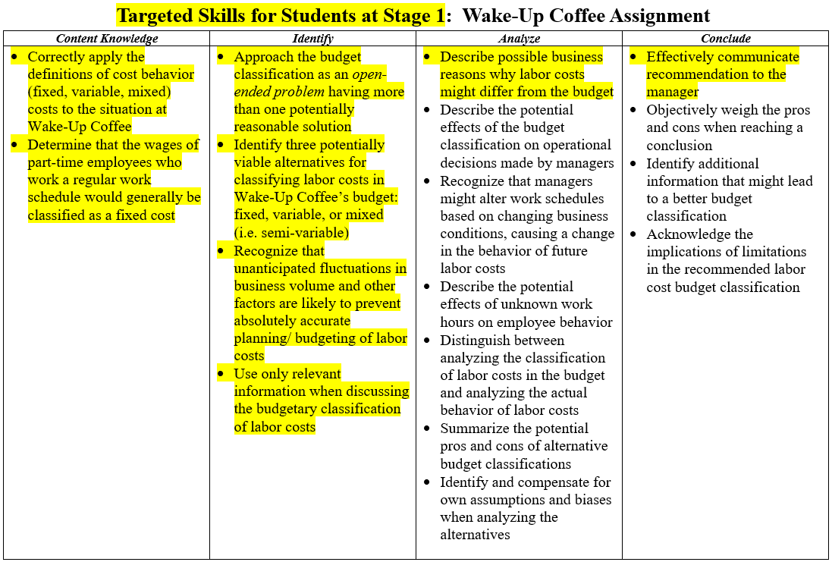
Targeted Skills for Students at Level 1: Wake-Up Coffee
Susan Wolcott, CTLA Critical Thinking III, San Diego, July 30, 2022

Slide 24
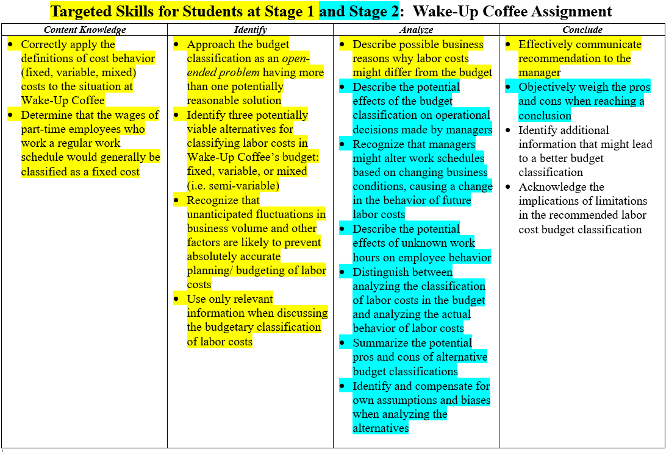
Targeted Skills for Students at Level 1 and Level 2: Wake-Up Coffee
Susan Wolcott, CTLA Critical Thinking III, San Diego, July 30, 2022

Slide 25

Learn More at Upcoming Sessions!
AAA:
ELS – Monday 3:00 pm-4:30 pm
4.06 Hints for Changing the Accounting Curriculum
Virtual AAA:
5.03 Faculty Experiences Using the AICPA Critical Thinking Resources
Susan Wolcott, CTLA Critical Thinking I, San Diego, July 30, 2022

Slide 26
Additional Resources
.
Status of Critical Thinking Research in Accounting:
Wolcott, S., and M. Sargent. (2021). Critical Thinking in Accounting Education: Status and Call to Action. Journal of Accounting Education 56.
AICPA Faculty Guide and Webinars:
Wolcott, S. (2020). How to Help Your Students Become Better Critical Thinkers. Durham, NC: AICPA. Available at Critical Thinking Resources : ThisWayToCPA : AICPA
Slides from AICPA webinars available at AICPA Resources (wolcottlynch.com)
Materials from CTLA, AAA, and Virtual AAA Sessions will be available at https://wolcottlynch.com/aaa-2022 AFTER each conference
CPA Canada Student Resources:
CPA Canada. (2015). The CPA Way: An approach for addressing professional problems, available at The CPA Way: An approach for addressing professional problems (cpacanada.ca) [Materials include decision-making checklists created for pre-certification students at CPA Canada by Susan Wolcott]
Susan Wolcott, CTLA Critical Thinking I, San Diego, July 30, 2022

