Slide 1
Financial Accounting Review Project with Simple Ratio Analysis
…They stumble upon critical thinking
Marla Lockhart, North Seattle College

Slide 2
Financial Accounting Review Project with Simple Ratio Analysis
Create Simple Financial Statements
Make an Initial Observation
Calculate Depreciation and Create the Classified Balance Sheet
How’s the Company Doing? Make Ratio Calculations
How’s the Company Doing? Analyze Ratio Calculations

Slide 3
Timing and Assumptions
About halfway through their first Financial Accounting course. They should be familiar with how to:
Create very simple financial statements from jumbled data for professional services company (no SCF)
Make simple straight-line depreciation calculations
Modify financial statements to include depreciation
Create a Classified Balance Sheet
Make basic ratio calculations (Cash, Liquidity, A/R Turnover, ROA, Dividends)*
Make basic observations*
*Can modify the complexity to include deeper cognitive levels

Slide 4
Create Simple Financial Statements
Accounts Payable | 67,000
Accounts Receivable | 124,200
Advertising Expense | 14,000
Building | 164,100
Cash | 42,200
Common Stock | 26,000
Dividends | 43,000
Equipment | 18,000
Insurance Expense | 32,400
Interest Expense | 7,200
Land | 109,000
Notes Payable (Long-term) | 150,000
Office Supplies | 28,000
Professional Services Revenue | 375,000
Property Tax Expense | 23,300
Rent Expense | 13,000
Retained Earnings, December 31, 2023 | 52,000
Salaries Expense | 153,000
Salaries Payable | 101,400

Slide 5
Create Simple Financial Statements
Executive Employment Services
Income Statement
Year Ended, December 31, 2024
Revenues
Professional Services Revenue | $ 375,000
Total Revenues |  | $ 375,000
Expenses
Advertising Expense | $ 14,000
Insurance Expense | 32,400
Interest Expense | 7,200
Property Tax Expense | 23,300
Rent Expense | 13,000
Salaries Expense | 153,000
Total Expenses |  | $ 242,900
Net Income |  | $ 132,100

Slide 6
Create Simple Financial Statements
Executive Employment Services
Statement of Retained Earnings
Year Ended, December 31, 2024
Retained Earnings, December 31, 2023 |  | $ 52,000
Net Income for Year |  | 132,100
 |  | 184,100
Less Dividends |  | (43,000)
Retained Earnings, December 31, 2024 |  | $ 141,100
Executive Employment Services
Balance Sheet
December 31, 2024
Assets |  | Liabilities
Cash | $ 42,200 | Accounts Payable | $ 67,000
Accounts Receivable | 124,200 | Salaries Payable | 101,400
Office Supplies | 28,000 | Notes Payable (Long-term) | 150,000
Land | 109,000 | Total Liabilities | $ 318,400
Building | 164,100
Equipment | 18,000 | Stockholders' Equity
 |  | Common Stock | $ 26,000
 |  | Retained Earnings | 141,100
 |  | Total Stockholders' Equity | $ 167,100
Total Assets | $ 485,500 | Total Liabilities and Stockholders' Equity | $ 485,500

Slide 7
“Quick overall impression: Do you think that the company is doing a good job and in good shape, based on what you see on the financial statements? Give a brief (one sentence or so) reason for your answer.”
Create Simple Financial Statements
Make an Initial “Gut” Observation

Slide 8
Create Simple Financial Statements
Executive Employment Services
Income Statement
Year Ended, December 31, 2024
Revenues
Professional Services Revenue | $ 375,000
Total Revenues |  | $ 375,000
Expenses
Advertising Expense | $ 14,000
Insurance Expense | 32,400
Interest Expense | 7,200
Property Tax Expense | 23,300
Rent Expense | 13,000
Salaries Expense | 153,000
Total Expenses |  | $ 242,900
Net Income |  | $ 132,100

Slide 9
Create Simple Financial Statements
Executive Employment Services
Statement of Retained Earnings
Year Ended, December 31, 2024
Retained Earnings, December 31, 2023 |  | $ 52,000
Net Income for Year |  | 132,100
 |  | 184,100
Less Dividends |  | (43,000)
Retained Earnings, December 31, 2024 |  | $ 141,100
Executive Employment Services
Balance Sheet
December 31, 2024
Assets |  | Liabilities
Cash | $ 42,200 | Accounts Payable | $ 67,000
Accounts Receivable | 124,200 | Salaries Payable | 101,400
Office Supplies | 28,000 | Notes Payable (Long-term) | 150,000
Land | 109,000 | Total Liabilities | $ 318,400
Building | 164,100
Equipment | 18,000 | Stockholders' Equity
 |  | Common Stock | $ 26,000
 |  | Retained Earnings | 141,100
 |  | Total Stockholders' Equity | $ 167,100
Total Assets | $ 485,500 | Total Liabilities and Stockholders' Equity | $ 485,500

Slide 10
“At first glance this company looks to be doing well. Retained Earnings year over year has increased by over double. Revenues is higher than expenses creating a net income for the year.” “Based on my observation, it looks like the company is in a healthy financial position. Total revenues are more than expenses, so they have a net income. Net income for the year is more than dividends so they have retained earnings. Their total assets are more than their total liabilities.” “I believe that the company is doing fairly well. They had a net income and their assets outweigh their liabilities. “ “It doesn’t seem like the company is doing anything terribly wrong. Their total assets are greater than their total liabilities so that’s a good thing at a minimum. Also retained earnings are very nice, but that could mean they aren’t spending as good as they could be.” “Yes I do because this business is very profitable.” “I would say this company is doing reasonably well. They are up over $100k on the year in terms of net income which shows that they don’t have any expenses to pay or have any debt.” “I think that the company is in good shape because they have a good ratio between assets and liabilities.”
Create Simple Financial Statements
Make an Initial “Gut” Observation

Slide 11
“Based off the significant increase in Retained Earnings, it seems the company is doing well!” “In my opinion, this year the company did better than the previous year. It can be seen from its net income that looks high and the company able to pay its liabilities from its revenues. The retained earnings also increases significantly than last year. That’s why I think that the company is doing a good job based on these financial statements.” “This company seems to be doing a good job based on their net income, vs liabilities and assets. They are in the positive” “Really a good job! Revenue came from stable main business income and reasonable expenses, so retained earnings were up 171% year on year, which was a good result. Otherwise, if accounts receivable be noticed to increase cash flow would be better.” “Net income looks good. Retained earnings are increasing. Personnel are the major expense of the business. The company is carrying a mortgage on its facility. Accounts receivable are higher by proportion of assets than is ideal.” “On initial impression, the company appears to be doing well and growing. Retained earnings were $52,000 at the end of 2023 and $141,100 at the end of 2024, meaning the company retained $89,100 in 2024 alone which is a good increase from $52,000 up to that point. It also has more assets ($485,500) than liabilities ($318,400).”
Create Simple Financial Statements
Make an Initial “Gut” Observation (p. 2)

Slide 12
Equipment, Land, Building Students are expected to answer that there is no depreciation for land, and then calculate straight-line annual depreciation for Building, and Equipment. They should be familiar with Accumulated Depreciation, Depreciation Expense, and how to calculate Book Value. (This also serves as a review opportunity.)
Create Simple Financial Statements
Make an Initial “Gut” Observation
Calculate Depreciation and Create the Classified Balance Sheet

Slide 13
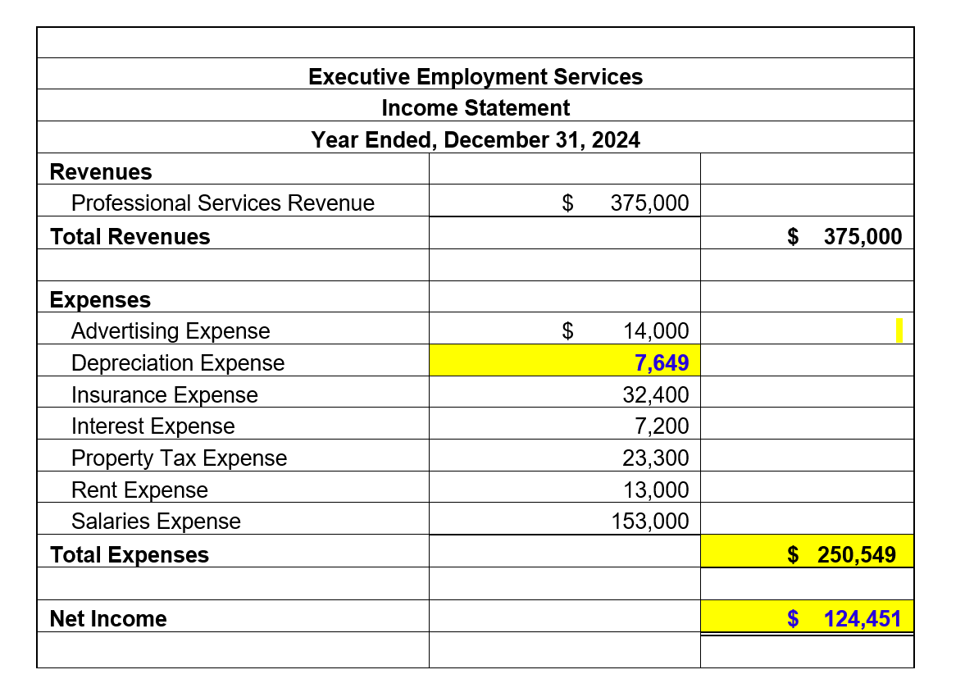
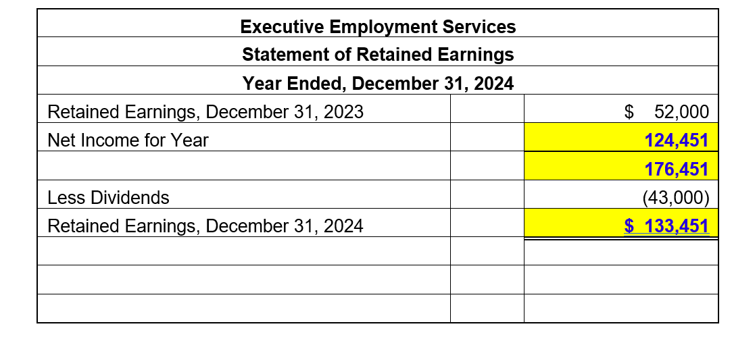
Create Simple Financial Statements
Make an Initial “Gut” Observation
Calculate Depreciation and modify the financial statements, including a Classified Balance Sheet.

Slide 14
We previously had a Classified Balance Sheet assignment, (and they bombed), So we’re revisiting. I created a template to provide more guidance.
Create Simple Financial Statements
Make an Initial “Gut” Observation
Calculate Depreciation and modify the financial statements, including a Classified Balance Sheet.

Slide 15
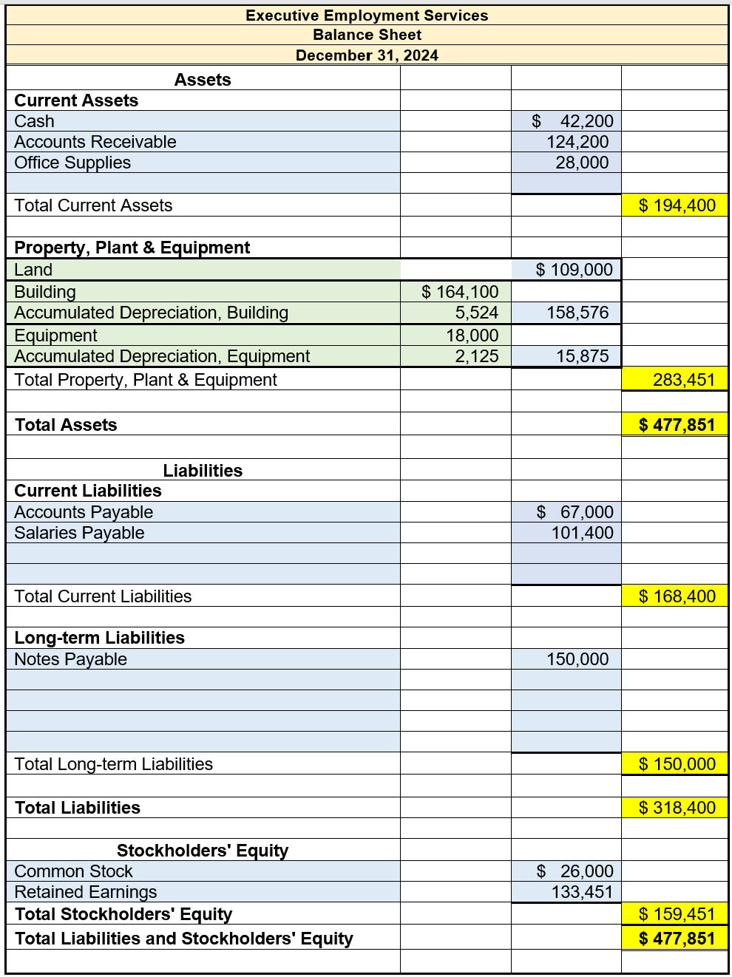
Create Simple Financial Statements
Make an Initial “Gut” Observation
Calculate Depreciation and modify the financial statements, including the Classified Balance Sheet.

Slide 16
Ratio Calculations “While just a few simple ratio calculations will not give the full picture of the company’s financial health, it is a good beginning. Keep in mind that a thorough analysis of the company’s financial health always includes comparisons with other companies in their same industry. “ This is where scaffolding the assignment to include the next cognitive critical thinking levels can take place.
Create Simple Financial Statements
Make an Initial “Gut” Observation
Calculate Depreciation, Modify the Financial Statements, and Create the Classified Balance Sheet
How’s the Company Doing? Make Ratio Calculations

Slide 17
Level 5 (Expert) Skills: Financial Statement Ratio Analysis
←Less Complex More Complex →
Content Knowledge | Identify | Analyze | Conclude and Anticipate
Find formulas and calculate ratios Locate financial information used in ratio calculations Explain why higher/lower ratios are generally associated with greater: profitability, liquidity, stability, activity, etc. Describe the mechanical impact of accounting entries on ratio results Locate information for comparable companies/industry Recognize and adjust calculations for differences in ratio formulas from different sources | Identify situational reason(s) for evaluating financial statement ratios Identify internal and/or external stakeholders who might be interested in ratio information Explain why ratios are not “perfect” measures of profitability, liquidity, stability, activity, etc. Explain why higher/lower ratios do not always indicate better/worse performance or higher/lower risk Identify situational factors that cause ratio values to differ across companies and across years for the same company Identify relevant information that might be useful for interpreting a company’s ratios including competitor/ industry ratios, accounting methods/ estimates, and non-financial information Explain how it is possible for financial experts to disagree about the interpretation of a company’s ratios | Evaluate possible business reasons for ratios to vary across companies and across years Explore the possible strengths and weaknesses indicated by the time trend and/or competitor comparison of a company’s ratios Describe the pros and cons of using ratios to evaluate a company Explain how different stakeholders might view ratios differently Incorporate non-ratio information in the interpretation of ratios Adjust for and evaluate the impact of alternative accounting methods/ estimates on ratio interpretations Identify and evaluate the quality of assumptions underlying alternative interpretations of a company’s ratios Identify and compensate for biases in ratio information and interpretation | Provide a valid interpretation of ratios for a given situation Prioritize the strengths and weaknesses of the company’s ratios and other data to reach conclusions about the company’s profitability, liquidity, stability, activity, etc. Describe limitations to a conclusion resulting from a ratio analysis about a company’s profitability, liquidity, stability, activity, etc. Proactively develop a plan for monitoring a company’s performance in the future Investigate and work toward future implementation of new, superior methods of ratio analysis

Slide 18
Targeted Skills Level 1 ➔ Level 2: Financial Statement Ratio Analysis
←Less Complex More Complex →
Content Knowledge | Identify | Analyze | Conclude and Anticipate
Find formulas and calculate ratios Locate financial information used in ratio calculations Explain why higher/lower ratios are generally associated with greater: profitability, liquidity, stability, activity, etc. Describe the mechanical impact of accounting entries on ratio results | MAJOR LEARNING OBJECTIVES: LEVEL 1 Identify existence of ambiguities/ uncertainties that prevent a single "correct" answer Identify possible reasons for evaluating financial statement ratios Identify stakeholders who might be interested in ratio information Explain why ratios are not “perfect” measures of profitability, liquidity, stability, activity, etc. Explain why higher/lower ratios do not always indicate a better/worse company Identify factors that cause ratio values to differ across companies and across years for the same company | MAJOR LEARNING OBJECTIVES: LEVEL 1 Recognize that multiple perspectives are valid Describe possible business reasons for ratios to vary across companies and across years Explore the possible strengths and weaknesses indicated by the time trend and/or competitor comparison of a company’s ratios | MAJOR LEARNING OBJECTIVES: LEVEL 1 Form own conclusion and support it with evidence/arguments Effectively communicate your interpretation for a given setting and audience

Slide 19
Targeted Skills Level 2 ➔ Level 3: Financial Statement Ratio Analysis
←Less Complex More Complex →
Content Knowledge | Identify | Analyze | Conclude and Anticipate
Find formulas and calculate ratios Locate financial information used in ratio calculations Explain why higher/lower ratios are generally associated with greater: profitability, liquidity, stability, activity, etc. Describe the mechanical impact of accounting entries on ratio results Locate information for comparable companies/industry Recognize and adjust calculations for differences in ratio formulas in different sources | Identify possible reasons for evaluating financial statement ratios Identify stakeholders who might be interested in ratio information Explain why ratios are not “perfect” measures of profitability, liquidity, stability, activity, etc. Explain why higher/lower ratios do not always indicate a better/worse company Identify situational factors that cause ratio values to differ across companies and across years for the same company Identify information that might be useful for interpreting a company’s ratios including competitor/ industry ratios, accounting methods employed, and non-financial information Explain how it is possible for financial experts to disagree about the interpretation of a company’s ratios | MAJOR LEARNING OBJECTIVES: LEVEL 2 Delay judgment until thorough analysis is completed Identify and control biases that interfere with objective and thorough critical thinking Conduct thorough, high-quality analyses from multiple viewpoints Describe possible business reasons for ratios to vary across companies and across years Explore the possible strengths and weaknesses indicated by the time trend and/or competitor comparison of a company’s ratios Describe the pros and cons of using ratios to evaluate a company Explain how different stakeholders might view ratios differently Incorporate non-ratio information in the interpretation of ratios Adjust for and evaluate the impact of alternative accounting methods on ratio interpretations Identify and evaluate the quality of assumptions underlying alternative interpretations of a company’s ratios Identify and compensate for own biases in ratio interpretation | Effectively communicate your interpretation for a given setting and audience

Slide 20
Targeted Skills Level 3 ➔ Level 4: Financial Statement Ratio Analysis
←Less Complex More Complex →
Content Knowledge | Identify | Analyze | Conclude and Anticipate
Find formulas and calculate ratios Locate financial information used in ratio calculations Explain why higher/lower ratios are generally associated with greater: profitability, liquidity, stability, activity, etc. Describe the mechanical impact of accounting entries on ratio results Locate information for comparable companies/industry Recognize and adjust calculations for differences in ratio formulas in different sources | Identify possible reasons for evaluating financial statement ratios Identify stakeholders who might be interested in ratio information Explain why ratios are not “perfect” measures of profitability, liquidity, stability, activity, etc. Explain why higher/lower ratios do not always indicate a better/worse company Identify situational factors that cause ratio values to differ across companies and across years for the same company Identify information that might be useful for interpreting a company’s ratios including competitor/ industry ratios, accounting methods employed, and non-financial information Explain how it is possible for financial experts to disagree about the interpretation of a company’s ratios | Describe possible business reasons for ratios to vary across companies and across years Explore the possible strengths and weaknesses indicated by the time trend and/or competitor comparison of a company’s ratios Describe the pros and cons of using ratios to evaluate a company Explain how different stakeholders might view ratios differently Incorporate non-ratio information in the interpretation of ratios Adjust for and evaluate the impact of alternative accounting methods on ratio interpretations Identify and evaluate the quality of assumptions underlying alternative interpretations of a company’s ratios Identify and compensate for own biases in ratio interpretation | MAJOR LEARNING OBJECTIVES: LEVEL 3 Focus on the most important information, stakeholders, and consequences for the situation Tentatively solve complex problems in a pragmatic way using available information Develop and apply decision criteria to reach a conclusion Prioritize the strengths and weaknesses of the company’s ratios and other data in reaching a conclusion about the company’s profitability, liquidity, stability, activity, etc. Effectively communicate your interpretation for a given setting and audience Effectively encourage others to take a specific action (e.g., grant a loan) based upon the ratio analysis

Slide 21
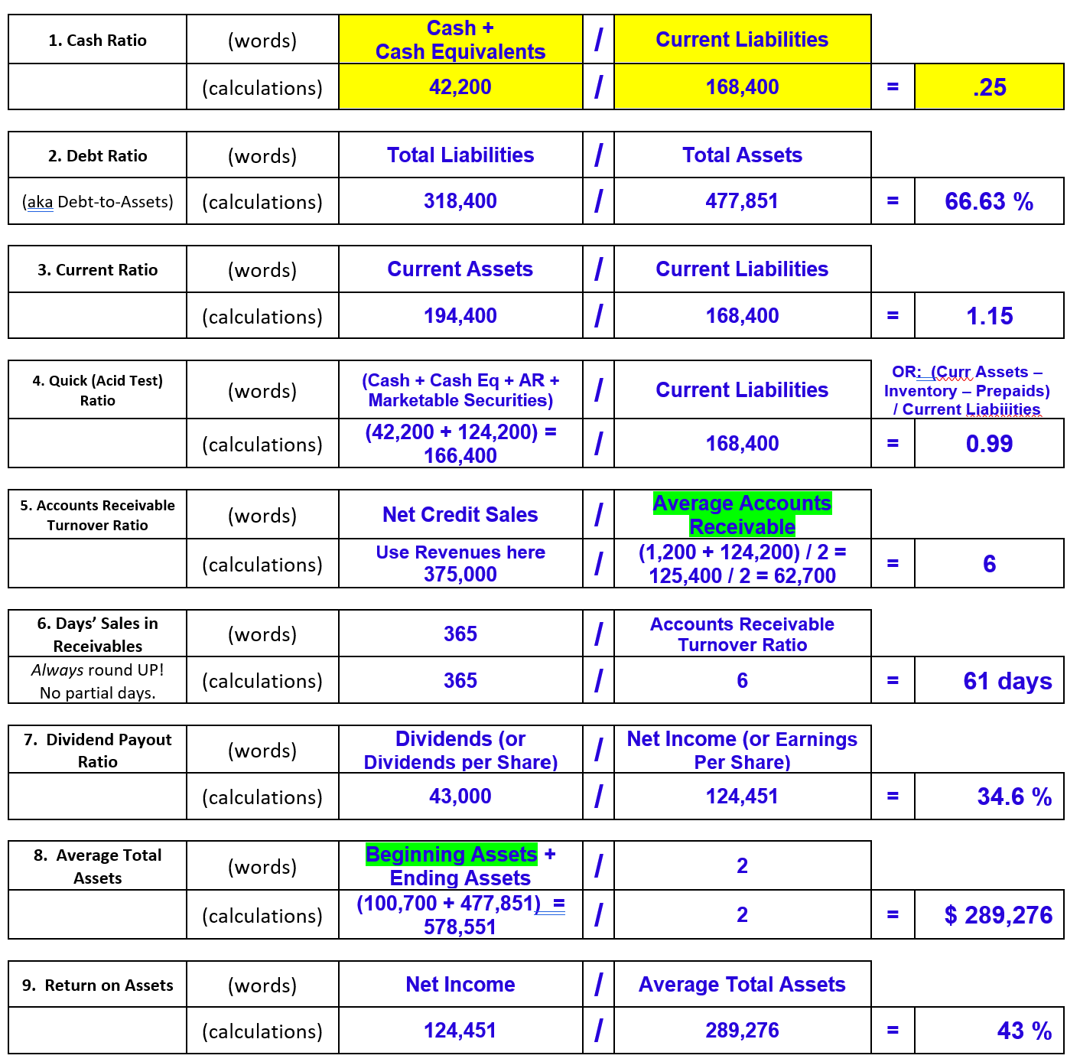
Note: Last year’s Account’s Receivable was $1,200, and Total Assets were $100,700 Example for the Cash Ratio shown below.
Create Simple Financial Statements
Make an Initial “Gut” Observation
Calculate Depreciation, Modify the Financial Statements, and Create the Classified Balance Sheet
How’s the Company Doing? Make Ratio Calculations

Slide 22
Ratio Analysis
1. Cash Ratio | .25
2. Debt Ratio | 66.63 %
(aka Debt-to-Assets)
3. Current Ratio | 1.15
4. Quick (Acid Test) Ratio | 0.99
5. Accounts Receivable Turnover Ratio | 6
6. Days’ Sales in Receivables | 61 days
7. Dividend Payout Ratio | 34.6 %
8. Average Total Assets | $ 289,276
9. Return on Assets | 43 %
Create Simple Financial Statements
Make an Initial “Gut” Observation
Calculate Depreciation, Modify the Financial Statements, and Create the Classified Balance Sheet
How’s the Company Doing? Make Ratio Calculations
How’s the Company Doing? Analyze Ratio Calculations

Slide 23
Questions:
What is your opinion of the Cash position of the company – Do they have enough cash to cover their current liabilities? Refer to the calculations above and provide an opinion.
Would you loan money to this company? Do you think that the company is in a good position to keep up with their current debt obligations? Refer to the calculations above and provide a opinion. Support your opinion.
Let’s assume that the industry standard for collections on Accounts Receivable is 30 days. How is this company doing? Refer to the calculations above and provide an opinion.
What is your opinion of the percentage of Assets that are funded by Debt? Refer to the calculations above and provide an opinion.
In your opinion, will investors be happy with the Return on Assets? Refer to the calculations above and provide an opinion. What is your basis for comparison?
How do you think investors will feel about the percentage of net income that the company paid in dividends, and why? Refer to the calculations above and provide an opinion.
Ratio Analysis
1. Cash Ratio | .25
2. Debt Ratio | 66.63 %
(aka Debt-to-Assets)
3. Current Ratio | 1.15
4. Quick (Acid Test) Ratio | 0.99
5. Accounts Receivable Turnover Ratio | 6
6. Days’ Sales in Receivables | 61 days
7. Dividend Payout Ratio | 34.6 %
8. Average Total Assets | $ 289,276
9. Return on Assets | 43 %

Slide 24
“Have you changed your mind about the health of the company compared to your initial observation? Explain why, based on the calculations and observations that you have made.”

Slide 25
Create Simple Financial Statements
Make an Initial “Gut” Observation
Calculate Depreciation and and Update the Financial Statements, Including the Classified Balance Sheet
How’s the Company Doing? Make Ratio Calculations
How’s the Company Doing? Analyze Ratio Calculations
Did they change their mind from their initial “gut” observation?

Slide 26
…Suddenly they realize…they learned something.
Create Simple Financial Statements
Make an Initial “Gut” Observation
Calculate Depreciation and and Update the Financial Statements, Including the Classified Balance Sheet
How’s the Company Doing? Make Ratio Calculations
How’s the Company Doing? Analyze Ratio Calculations
Did they change their mind from their initial “gut” observation?

Slide 27
“Yes, based off the ratios I have changed my mind. I initially thought this company looked to be doing well, but based off the ratios I have changed my mind.” “Yes. I thought this company was far better than what I saw in the financial statements. It is risky to invest in a company with a high debt load. At some point, this debt must be collected. It seems like they are not moving inventory as fast as they should. They don’t have a lot of cash to cover their short-term investments.” “I no longer think this company is making good decisions regarding its purchases, and even though their return is great, the assets are manly financed through debt, which is very risky since it is such a high debt ratio number. “I don’t think its as healthy as I initially did. The main reason being how far behind the industry this company’s days’ sales in receivables is, however, I think they can change that with slight tweaks to production and service methods. They should also come up with some smart places to spend their large portion of retained earnings, perhaps to fix their days’ sales in receivables issue.” “I think my observation of this company has changed a little, I feel a little less optimistic about this company than before.” “Yes, I have changed my mind. This company seems like they are in debt but doing things such as giving investors a big dividend to help them try and stay afloat.” “With a low cash ratio of 0.25 and a high debt ratio of 0.67 along with a low return on assets, I have changed my mind about the health of this company compared to my initial observation. The health of this company is not good.”
“Have you changed your mind about the health of the company compared to your initial observation? Explain why, based on the calculations and observations that you have made.”

Slide 28
“Yes - it’s receivables and 2/3 of their assets are funded by debt. They should work to pay down their longterm debts and maybe taking the company a long time to collect hoard some cash.” “Based on the number on financial statements, I thought the company are doing really good but based on all of the calculations that I took, It turned out that the company isn’t doing that good.” “There are some ratios where they are doing really good like return on assets and current ratio. On the other hand, days sales in receivables is really high means that it takes very long for them to collect its receivables. So this company is not doing that good on this period and need to change some things so all the ratios can be better in the future but I still have to compare it with industry average to really see how the company is really doing.”
“Have you changed your mind about the health of the company compared to your initial observation? Explain why, based on the calculations and observations that you have made.” (p. 2)

Slide 29
These students’ minds were not changed: “No, I still feel like the company is doing well.” “No，it is healthy as a good ratio of Return on Assets,debt ratio and Dividend Payout Ratio. Quick Ratio is so normal. Although cash ratio is low, but as a quick days’ Sales in Receivables, this problem will be solve through accounts management.” “My opinion of the company is that it remains moderately healthy, but carries too much of its assets as short-term receivables. This is a management issue. If the company could be brought up to industry benchmarks the health of the company would improve.” “I am still optimistic about this company after analyzing its financial statements. The company seems to be growing rapidly based on last year’s retained earnings, accounts receivable, and total assets compared to this year’s. However, it may take a few more years of financial data showing stable growth and a higher percentage of current assets for me to feel safe investing in the company due to the large jump from last year and the high debt-to-assets ratio.”
“Have you changed your mind about the health of the company compared to your initial observation? Explain why, based on the calculations and observations that you have made.” (p. 3)

Slide 30
Final Thoughts and Questions

Slide 31
Thank you!!

