Slide 1
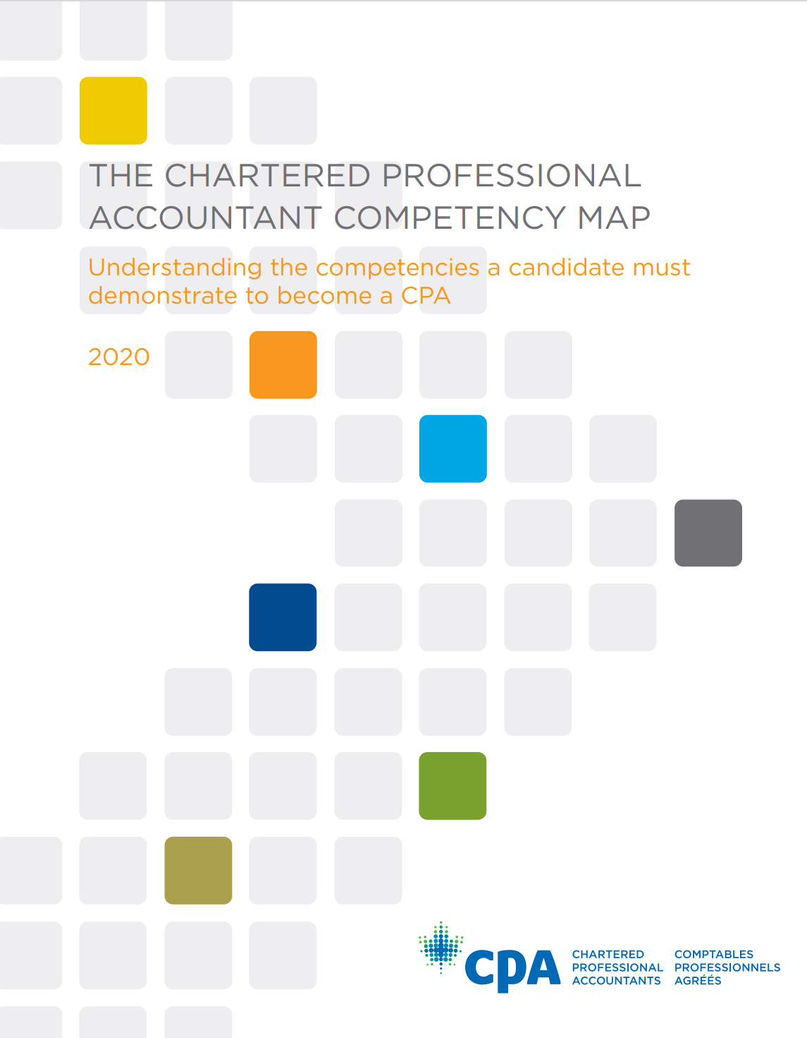
CPA Canada’s Competency Maps
2020 Version
Downloadable at The 2020 CPA Competency Map (cpacanada.ca)
Foresight Initiative: Competency Map 2.0
Downloadable at Competency Map 2.0: Learn today. Lead tomorrow. (cpacanada.ca)

Slide 2
2020 “Enabling” Competencies
1. Acting Ethically and Demonstrating Professional Values 1.1 Ethical Behaviour 1.2 Integrity and Trustworthiness 1.3 Questioning Mindset 1.4 Due Care 1.5 Objectivity
2. Leading 2.1 Strategic Focus 2.2 Risk Management 2.3 Organizational Culture Advocacy 2.4 Influence and Consensus Building
3. Collaborating 3.1 Inclusivity 3.2 Relationship Building 3.3 Teamwork 3.4 Team and Project Management
4. Managing Self and Others 4.1 Adaptability and Resilience 4.2 Initiative 4.3 Continuous Improvement 4.4 Talent Management
5. Adding Value 5.1 Business Context 5.2 Creativity and Innovation 5.3 Performance Evaluation and Accountability
6. Solving Problems and Making Decisions 6.1 Issue Identification 6.2 Analysis 6.3 Recommendations 6.4 Implementation and Change Management
7. Communicating 7.1 Audience and Effectiveness 7.2 Active Listening 7.3 Communication Media
Newest

