Slide 1
Faculty Experiences Using the AICPA
Critical Thinking Resources
Panelists
Susan Wolcott CPA, CMA, PhD Independent Scholar (Semi-Retired) swolcott@WolcottLynch.com | Marla Lockhart CPA, MAFM Full-Time Accounting Faculty North Seattle College Marla.Lockhart@seattlecolleges.edu | Markus Ahrens CPA, CGMA Professor; Chair, Accounting, Business and Economics St. Louis Community College, Meramec mahrens@stlcc.edu
AAA Virtual Annual Meeting, August 12, 2022

Slide 2

Susan Wolcott
Overview
Need for Stronger Critical Thinking
AICPA Faculty Resources
Wolcott, Lockhart, Ahrens: AICPA Critical Thinking Resources

Slide 3
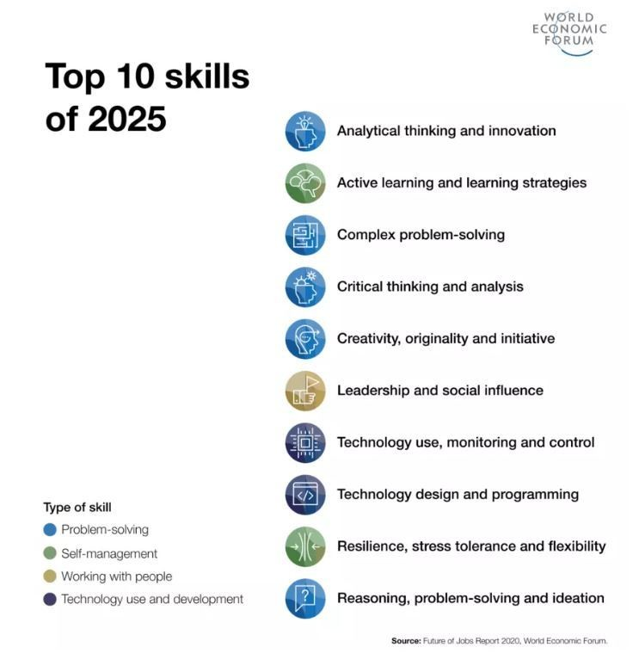
Demand for higher cognitive skills such as creativity, critical thinking and decision making, and complex information processing, will grow through 2030 at cumulative double-digit rates.

Slide 4
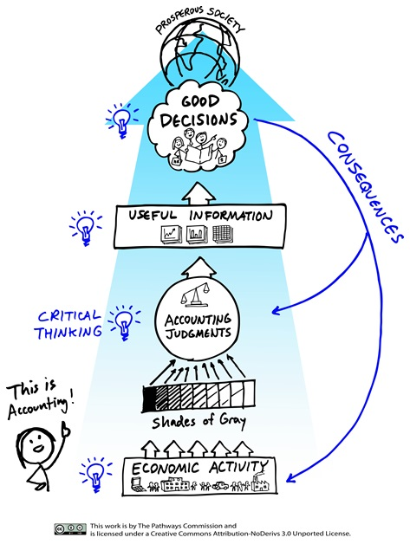
Pathways Vision Model
Introduce Critical Thinking in Accounting
Design Complexity of Assignments
(See Later Slide)
https://aaahq.org/Pathways-Commission
Wolcott, Lockhart, Ahrens: AICPA Critical Thinking Resources

Slide 5

AICPA Faculty Guide
Authored by Susan Wolcott
Available at: https://thiswaytocpa.com/program/CriticalThinking https://wolcottlynch.com/aicpa-resources

Slide 6

On the Next Slide, I Will Briefly Describe 4 Levels of Critical Thinking
Your Task: Type 1, 2, 3, or 4
in the Chat Box to Indicate the Level That Best Describes Your Average Student Upon Entry to the Accounting Profession
Wolcott, Lockhart, Ahrens: AICPA Critical Thinking Resources

Slide 7
Adult Levels (or Stages) of Critical Thinking
For more details, see AICPA Faculty Guide Figure 4, p. 9
Beyond Entry-Level
Level 1
Confused Fact-Finder
Looks for Only One Correct Answer
Confused by Uncertainties
Level 2
Biased
Jumper
Biased and Overly Strong Conclusions
Level 3
Perpetual Analyzer
Strong Analysis
Weak or No Conclusions
Level 4
Pragmatic Performer
Level 5
Strategic Revisioner
Strong Analysis
Well-Founded Conclusions Using Valid Priorities
In Addition to Level 4, SYSTEMATICALLY:
Creates New Knowledge
Addresses Limitations
Unable to Prioritize
Little/No Critical Thinking
Weak Analysis
Partial Critical Thinking
Emergent Critical Thinking
Competent Critical Thinking
Expert Critical Thinking
X
Wolcott, Lockhart, Ahrens: AICPA Critical Thinking Resources

Slide 8

Brief Introduction to Cognitive Development
Students’ Beliefs About Knowledge Influence How/Whether They Engage in Learning Activities
For More Details, See: Wolcott & Sargent, 2021, Critical Thinking in Accounting Education: Status and Call to Action, Journal of Accounting Education 56
Wolcott, Lockhart, Ahrens: AICPA Critical Thinking Resources

Slide 9
KEY Epistemological Beliefs
For more details, see AICPA Faculty Guide Figure 4, p. 9
Level 1:
Confused
Fact-Finder
Supporting one conclusion denies the legitimacy of other valid viewpoints
Level 2:
Biased
Jumper
Level 3:
Perpetual Analyzer
All problems are “black and white”
Open-ended problems cannot be solved by anyone, including “experts”
Open-ended problems can be solved tentatively and pragmatically based on available information
Level 4:
Pragmatic Performer
The student’s job is to find the correct answer as provided by experts
No generalized principles or procedures exist for further investigation/ improvement
It is sufficient to generate arguments to support one’s own position
At Each Level: Students will not develop higher-level critical thinking skills until their beliefs change ➔ We need to focus on critical thinking skills AND beliefs
Wolcott, Lockhart, Ahrens: AICPA Critical Thinking Resources

Slide 10

My Own Experiences
When I Started Teaching, I Knew Nothing About:
  Cognitive Development
  How to Design My Courses to Build Critical Thinking Skills
I Learned That I Could:
  Use Quick Classroom Assessments to Learn About My Students’ Levels of Thinking
    See “Quick One-Paragraph Assessment,”
    AICPA Faculty Guide p. 34
  Modify Learning Activities to Focus on My Students’ Needs
Wolcott, Lockhart, Ahrens: AICPA Critical Thinking Resources

Slide 11
AICPA Faculty Guide: Critical Thinking Model
Wolcott, Lockhart, Ahrens: AICPA Critical Thinking Resources

Slide 12
AICPA Faculty Guide: Critical Thinking Skills Rubric
Component of Critical Thinking Model : | Level 1 Little/No Critical Thinking (Confused Fact-Finder) | Level 2 Partial Critical Thinking (Biased Jumper) | Level 3 Emergent Critical Thinking (Perpetual Analyzer) | Level 4 Competent Critical Thinking (Pragmatic Performer)
Identify | Recites purpose as given, or Identifies an inappropriate problem | Identifies the clearly-evident problem Recognizes that the problem is open-ended/ambiguous | Identifies the main purpose Identifies relevant stakeholders and their possible goals/ preferences Identifies relevant accounting knowledge, concepts and techniques | In addition to Stage 3: Identifies important embedded, subsidiary problem(s)
Analyze | Applies calculations, definitions, or other “textbook” concepts Presents irrelevant information Misinterprets calculation(s) and/or concept(s) | Applies and describes the effects of relevant calculations and/or concepts Partially analyzes alternatives, focusing on information supporting own viewpoint Discounts other viewpoint(s) | Thoroughly and objectively applies and interprets relevant calculation(s) and concept(s) Explores causes, stakeholder effects and interrelationships Questions the quality of information and assumptions Thoroughly discusses the pros and cons of viable alternatives | Objectively analyzes the most important relevant information, implications, consequences and viewpoints Evaluates the quality of information and assumptions, and adapts interpretations (as needed) Summarizes the most important pros and cons of viable alternatives
Conclude | Instead of a conclusion, provides facts, definitions, or other “authoritative” statements | Reaches a biased conclusion that is consistent with analyses | Reaches no conclusion, or Provides a conclusion with little or no justification | Identifies/develops appropriate criteria, and uses the criteria to reach convincing conclusion(s) If appropriate, provides value-added advice (e.g., identifies implementation issues)
Wolcott, Lockhart, Ahrens: AICPA Critical Thinking Resources

Slide 13
Assignment Complexity to Support Development to Next Level
Pathways Vision Model: | Level 1 Confused Fact-Finder Little/no critical thinking | Level 2 Biased Jumper Partial critical thinking | Level 3 Perpetual Analyzer Emergent critical thinking
Good Decisions | Few stakeholders and uncomplicated decisions | Multiple stakeholders and decisions involving multiple factors | Many stakeholders with divergent interests and complex decisions
Useful Information | Information is either useful or not useful (i.e., relevant or irrelevant) | Questions exist about the degree of information usefulness | Many questions exist about information usefulness
Accounting Judgments | Few accounting judgments | Several accounting judgments | Many accounting judgments
Shades of Gray | Few sources of uncertainty | Multiple sources and degrees of uncertainty | Many sources and degrees of uncertainty
Economic Activities | Straightforward, easily understood events and circumstances | Moderate scope and interaction of events and circumstances | Realistic scope of activities that may be highly complex
Consequences | Few consequences with clear-cut cause and effect relationships | Some uncertain cause and effect relationships | Many complex and uncertain cause and effect relationships
See AICPA Faculty Guide Figure 19, p. 32
Wolcott, Lockhart, Ahrens: AICPA Critical Thinking Resources

Slide 14
Learning Activities to Scaffold Development
Level 1
Confused
Fact-Finder
Level 2
Biased
Jumper
Level 3
Perpetual Analyzer
Level 4
Pragmatic Performer
Scaffold 1➔2
Key Skills:
Identify and describe uncertainties
Read about conflicting opinions
Identify open-ended problems (i.e., those having no single “correct” solution)
List available information and identify which information is relevant for a given problem
List potential issues, points of view, and solutions
Form own opinion/thesis and use evidence/arguments to support it
Scaffold 2➔3
Key Skills:
Identify and analyze for alternatives: pros/cons, advantages/disadvantages, strengths/weaknesses
Discuss strengths and weaknesses of evidence
Identify and analyze assumptions
Explore different viewpoints/perspectives
Compare and contrast theories/perspectives
Organize information into meaningful categories
Identify stronger/weaker responses to an open-ended problem
Identify and attempt to control for own biases
Scaffold 3➔4
Key Skills:
Identify most important issues, risks, or evidence
Justify selection of assumptions
Prioritize and clarify values used to judge across alternatives
Establish plan for communication/ implementation/action that adequately addresses concerns/needs of others
Wolcott, Lockhart, Ahrens: AICPA Critical Thinking Resources

Slide 15
Markus Ahrens
Examples for Intermediate to Advanced Courses
Wolcott, Lockhart, Ahrens: AICPA Critical Thinking Resources

Slide 16
Financial Accounting Review Project with Simple Ratio Analysis
…They stumble upon critical thinking
Marla Lockhart, North Seattle College
Wolcott, Lockhart, Ahrens: AICPA Critical Thinking Resources

Slide 17

Additional Thoughts and Ideas
Wolcott, Lockhart, Ahrens: AICPA Critical Thinking Resources

Slide 18
Design Course Materials for Critical Thinking
Add Information Including Uncertainties that Prevent Single Correct Answer(s)
Open-Ended Problems
Questions for Multiple Levels
Student Responses
by Level
Support and Feedback
Many Opportunities to Practice
Allow for Slow
and Unstable Development Within and Across Courses
Target Student Cognitive Level(s)
Including:
Critical Thinking Model
Rubric
Support Development for:
Level 2
Level 3
Level 4
Level 5 (Maybe)
Summarize % of Students Who Perform Well on Questions for Each Cognitive Level
Wolcott, Lockhart, Ahrens: AICPA Critical Thinking Resources

Slide 19
Build on Bloom’s Taxonomy to Develop Student Critical Thinking
Revised Bloom’s Taxonomy: | Level 1 Confused Fact-Finder | Level 2 Biased Jumper | Level 3 Perpetual Analyzer | Level 4 Pragmatic Performer
Apply Carry out or use a procedure in a given situation | Carry out a well-defined procedure in a familiar setting | Use relevant information to carry out a familiar procedure | Use relevant information to carry out a procedure in an unfamiliar setting | Efficiently carry out a procedure in a highly unfamiliar setting
Analyze Break material into its constituent parts and determine how the parts relate to one another and to an overall structure or purpose | Locate information and viewpoints in a well-defined problem | Distinguish between relevant and irrelevant information; focus on support for own viewpoint | Thoroughly and objectively explore relevant information, viewpoints, and assumptions; outline evidence for and against alternatives | Distinguish between important and unimportant parts; thoroughly and objectively integrate important information and viewpoints
Evaluate Make judgments based on criteria and standards | Detect correct solutions/ conclusions for a well-defined problem | Determine own viewpoint/conclusion | Detect reasoning within individual viewpoints; discover limitations; delay or avoid concluding across viewpoints | Determine and apply overarching criteria/ priorities for drawing conclusions; detect key limitations
Create Put elements together to form a coherent or functional whole; reorganize elements into a new pattern or structure | Reorganize procedures (e.g., rearrange a spreadsheet) when performing a well-defined task | Generate a work plan based on own preferences | Generate new hypotheses to explore observations or results | Develop new criteria or methods for distinguishing between hypotheses or selecting among alternative models or procedures
Adapted from Anderson et al. (2001), especially Table 5.1 (pp.67-68). This table presents only the verbs that are usually considered to require critical thinking. Accordingly, the verbs Remember and Understand are omitted.
Wolcott, Lockhart, Ahrens: AICPA Critical Thinking Resources

Slide 20

What Questions Do You Have for the Panelists?
Wolcott, Lockhart, Ahrens: AICPA Critical Thinking Resources

