Slide 1


How to Design an Accounting Course that Develops Critical Thinking
Susan K. Wolcott, PhD, CPA, CMA
Independent Scholar
Bellevue, WA, USA
Email: swolcott@WolcottLynch.com
Website: www.WolcottLynch.com

Slide 2


Major Recommendations
Expect slow and unstable development
Embed critical thinking in every course
Coordinate development across curriculum
Use cognitive development to guide learning & assessment
Focus on the student
Start small
Susan Wolcott, Accounting Cafe, Sept 8, 2026

Slide 3
Epistemological Beliefs ➔ Cognitive Level
Level 1
Confused Fact-Finder:
Tell me the right answer
Level 2
Biased Jumper:
Here’s what I think…
Level 3
Perpetual Analyzer:
I can look at the issues this way…
and that way…
and another way…
Level 4
Pragmatic Performer:
Given these key issues, pros/ cons, and stakeholders, I recommend xxx because zzz
Level 5
Strategic Revisioner:
Although I recommend xxx today, we need to monitor zzz and consider future changes
Based on Stages 3-7 of the Reflective Judgment Model (King & Kitchener 1994)
Susan Wolcott, Accounting Cafe, Sept 8, 2026

Slide 4
Cognitive Level ➔ Critical Thinking Skills
Little/No Critical Thinking
Strong analysis
Partial Critical Thinking
Emergent Critical Thinking
Competent Critical Thinking
Weak or no conclusions
Strong analysis
Professional Critical Thinking
Weak analysis
Overly strong conclusions
Weak conclusions
Strong, well-founded conclusions
Automatically address limitations
Seek new knowledge over time
No analysis
Confused
Fact-Finder
Biased Jumper
Perpetual Analyzer
Pragmatic Performer
Strategic Revisioner
Based on Stages 3-7 of the Reflective Judgment Model (King & Kitchener 1994)
Susan Wolcott, Accounting Cafe, Sept 8, 2026

Slide 5
Cognitive Level ➔ Critical Thinking Skills
Little/No Critical Thinking
Partial Critical Thinking
Emergent Critical Thinking
Competent Critical Thinking
Professional Critical Thinking
Automatically address limitations
Seek new knowledge over time
Strong analysis
Strong, well-founded conclusions
Strong analysis
Weak conclusions
Weak analysis
Overly strong conclusions
No analysis
Weak or no conclusions
Confused
Fact-Finder
Biased Jumper
Perpetual Analyzer
Pragmatic Performer
Strategic Revisioner
Expected entry level required by the profession
Based on Stages 3-7 of the Reflective Judgment Model (King & Kitchener 1994)
Susan Wolcott, Accounting Cafe, Sept 8, 2026

Slide 6
Cognitive Level ➔ Critical Thinking Skills
Little/No Critical Thinking
Partial Critical Thinking
Emergent Critical Thinking
Competent Critical Thinking
Professional Critical Thinking
Automatically address limitations
Seek new knowledge over time
Strong analysis
Strong, well-founded conclusions
Strong analysis
Weak conclusions
Weak analysis
Overly strong conclusions
No analysis
Weak or no conclusions
Confused
Fact-Finder
Biased Jumper
Perpetual Analyzer
Pragmatic Performer
Strategic Revisioner
Most introductory students and many intermediate
Most undergraduates on completion
Many Masters and average advanced doctoral
Expected entry level required by the profession
Based on Stages 3-7 of the Reflective Judgment Model (King & Kitchener 1994)
Susan Wolcott, Accounting Cafe, Sept 8, 2026

Slide 7
Summary of Learning Activities to Scaffold Development
Level 1
Little/No
Critical Thinking
Level 2
Partial
Critical Thinking
Level 3
Emergent
Critical Thinking
Level 4
Competent
Critical Thinking
Scaffold 1➔2
Key Skills:
Identify and describe uncertainties
Read about conflicting opinions
Identify open-ended problems (i.e., those having no single “correct” solution)
List available information and identify which information is relevant for a given problem
List potential issues, points of view, and solutions
Form own opinion/thesis and use evidence/arguments to support it
Scaffold 2➔3
Key Skills:
Identify and attempt to control for own biases
Identify stronger/weaker responses to an open-ended problem
Identify and analyze for alternatives: pros/cons, advantages/disadvantages, strengths/weaknesses
Discuss strengths and weaknesses of evidence
Identify and analyze assumptions
Explore different viewpoints/perspectives
Compare and contrast theories/perspectives
Organize information into meaningful categories
Scaffold 3➔4
Key Skills:
Identify most important issues, risks, or evidence
Justify selection of assumptions
Prioritize and clarify values used to judge across alternatives
Establish plan for communication/ implementation/action that adequately addresses concerns/needs of others
Susan Wolcott, Accounting Cafe, Sept 8, 2026

Slide 8

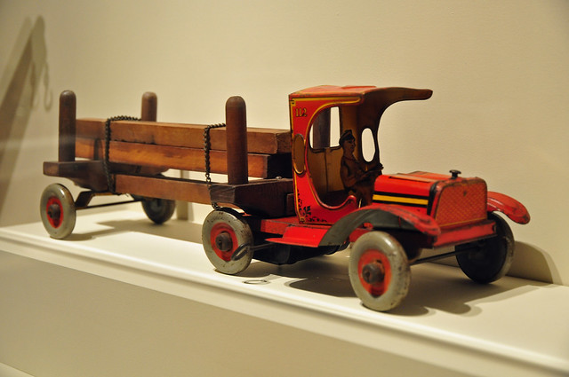
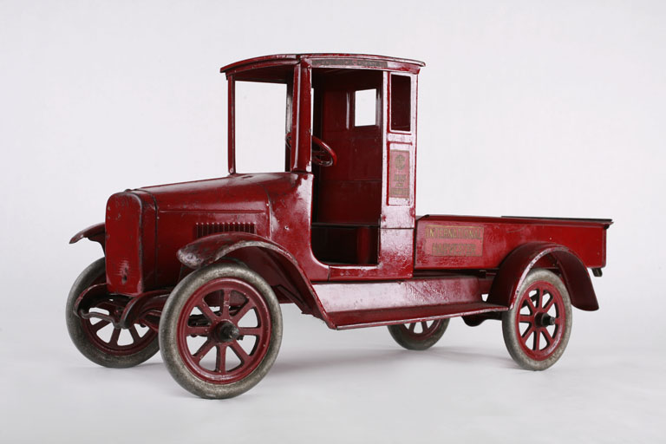
Tennant Vintage Trucks
Tennant Vintage Trucks produces and sells to retailers a line of 25 collectible metal toy trucks that are vintage truck replicas. Sales have deteriorated during the economic recession resulting in negative cash flows, and the company’s managers are seeking ways to increase sales. One proposal is to launch a series of limited-edition trucks to increase sales to collectors. The first limited edition would consist of 200 Ready Red classic fire trucks for a wholesale price of $150 each. Manufacturing costs per unit are as follows: Direct materials $25 Direct labor 45 Variable overhead 20 Fixed overhead 65 The per-unit costs include variable overhead licensing fees of $13 for use of the Ready Red name. Fixed overhead includes $55 per unit for truck design, manufacturing specifications, and customized die-cast molds. Traditionally, the company has used each die-cast mold set to manufacture only one product. Required: (Typical Well-Defined Textbook Problem) Should the company launch the limited edition of Ready Red trucks? Provide appropriate calculations and explain your answer.
Susan Wolcott, Accounting Cafe, Sept 8, 2026

Slide 9
Level 1 ➔ Level 2
Tennant Trucks: Question Examples
Assume students have already completed the well-defined problem as homework.
Identify and explain each accounting term and calculation used in your homework answer.
Are all fixed costs relevant for this decision? Why or why not?
For each component of your calculations, identify and briefly explain at least one reason why actual revenues/costs/quantities might differ from the estimates.
In the “real world,” is this decision likely to be well-defined or open-ended? Discuss.
Susan Wolcott, Accounting Cafe, Sept 8, 2026

Slide 10
Level 2 ➔ Level 3
Tennant Trucks: Question Examples
Assume students have already completed the well-defined problem as homework.
Is the proposed Ready Red product likely to be viable? Why or why not? Is the company likely to have any other viable options at this time?
New Information: Based on the advice of five long-time customers, the marketing manager established the proposed wholesale price of $150. These five customers also made preliminary commitments to purchase 50 limited-edition Ready Red trucks. The marketing manager is confident that the remaining 150 trucks can be sold easily. Discuss the reasons for and implications of possible bias in setting a $150 wholesale price for Ready Red.
Do you have any personal preferences that might influence how you analyze this problem? If so, how might your preferences affect your analyses?
What additional information might help the managers make their decision?
Susan Wolcott, Accounting Cafe, Sept 8, 2026

Slide 11
Level 3 ➔ Level 4
Tennant Trucks: Question Examples
Assume students have already completed the well-defined problem as homework.
What criteria did you use to recommend a decision in the initial (well-defined) problem? Explain.
New Information: Company managers believe that vintage truck replicas are more important to the company’s customer-oriented strategy than the company’s existing lines of metal toy trucks. Discuss whether/how this information affects the decision criteria in the Ready Red decision.
Identify and explain several actions that the company will need to take if it decides to launch the Ready Red product.
If you were a manager working on this decision, what additional information might you like to have and how might it be obtained?
Susan Wolcott, Accounting Cafe, Sept 8, 2026

Slide 12
Level 4 ➔ Level 5
Tennant Trucks: Question Examples
Assume students have already completed the well-defined problem as homework.
Assume that the company launches the Ready Red truck. How might the management team use information about Ready Red to improve future limited-edition product decisions?
New Information: Based on the advice of five long-time customers, the marketing manager established the proposed wholesale price of $150. These five customers also made preliminary commitments to purchase 50 limited-edition Ready Red trucks. After carefully evaluating the marketing manager’s estimated price and uncertainties about product demand and costs, the management team concluded that the Ready Red product should be launched only if the wholesale price can be set at $175. How might the company anticipate and address possible dissatisfaction of the five customers who made preliminary commitments at the lower price?
Susan Wolcott, Accounting Cafe, Sept 8, 2026

Slide 13
Level 4 (Entry-Level) Skills: Financial Statement Ratio Analysis
←Less Complex More Complex →
Content Knowledge | Identify | Analyze | Conclude
Find formulas and calculate ratios Locate financial information used in ratio calculations Explain why higher/lower ratios are generally associated with greater: profitability, liquidity, stability, activity, etc. Describe the mechanical impact of accounting entries and/or methods on ratio results Locate information for comparable companies/industry Recognize and adjust calculations for differences in ratio formulas from different sources | Identify possible reasons for evaluating financial statement ratios Identify stakeholders who might be interested in ratio information Explain why ratios are not “perfect” measures of profitability, liquidity, stability, activity, etc. Explain why higher/lower ratios do not always indicate better/worse performance or higher/lower risk Identify factors that cause ratio values to differ across companies and across years for the same company Identify relevant information that might be useful for interpreting ratios including competitor/ industry ratios, accounting methods employed, and non-financial information Explain how it is possible for financial experts to reasonably disagree about the interpretation of a company’s ratios | Identify possible business reasons for ratios to vary across companies and across years Identify possible strengths and weaknesses indicated by the time trend and/or competitor comparison of a company’s ratios Describe the pros and cons of using ratios to evaluate a company Explain how different stakeholders might view ratios differently Incorporate non-ratio information in the interpretation of ratios Adjust for and evaluate the impact of alternative accounting methods/ estimates on ratio interpretations Identify and evaluate the quality of assumptions underlying alternative interpretations of a company’s ratios Identify and compensate for own biases in ratio interpretation | Provide valid conclusion(s) based on analyses Prioritize the strengths and weaknesses of the company’s ratios and other data to reach conclusions about the company’s profitability, liquidity, stability, activity, etc. Describe limitations to a conclusion resulting from a ratio analysis about a company’s profitability, liquidity, stability, activity, etc.
This list of skills is long and complicated! How can you prioritize skills to enhance student learning?
Susan Wolcott, Accounting Cafe, Sept 8, 2026

Slide 14
Targeted Skills Level 1 ➔ Level 2: Financial Statement Ratio Analysis
←Less Complex More Complex →
Content Knowledge | Identify Information & Issues | Analyze Alternatives | Conclude
Find formulas and calculate ratios Locate financial information used in ratio calculations Explain why higher/lower ratios are generally associated with greater: profitability, liquidity, stability, activity, etc. Describe the mechanical impact of accounting entries and/or methods on ratio results Locate information for comparable companies/industry Recognize and adjust calculations for differences in ratio formulas from different sources | Identify possible reasons for evaluating financial statement ratios Identify stakeholders who might be interested in ratio information Explain why ratios are not “perfect” measures of profitability, liquidity, stability, activity, etc. Explain why higher/lower ratios do not always indicate better/worse performance or higher/lower risk Identify factors that cause ratio values to differ across companies and across years for the same company Identify relevant information that might be useful for interpreting ratios including competitor/ industry ratios, accounting methods employed, and non-financial information Explain how it is possible for financial experts to reasonably disagree about the interpretation of a company’s ratios | Identify possible business reasons for ratios to vary across companies and across years Identify possible strengths and weaknesses indicated by the time trend and/or competitor comparison of a company’s ratios Describe the pros and cons of using ratios to evaluate a company Explain how different stakeholders might view ratios differently Incorporate non-ratio information in the interpretation of ratios Adjust for and evaluate the impact of alternative accounting methods/ estimates on ratio interpretations Identify and evaluate the quality of assumptions underlying alternative interpretations of a company’s ratios Identify and compensate for own biases in ratio interpretation | Provide valid conclusion(s) based on analyses Prioritize the strengths and weaknesses of the company’s ratios and other data to reach conclusions about the company’s profitability, liquidity, stability, activity, etc. Describe limitations to a conclusion resulting from a ratio analysis about a company’s profitability, liquidity, stability, activity, etc.
Crossed-Out: Students at Level 1 are not yet capable of working on these skills
Susan Wolcott, Accounting Cafe, Sept 8, 2026

Slide 15
Targeted Skills Level 2 ➔ Level 3: Financial Statement Ratio Analysis
←Less Complex More Complex →
Content Knowledge | Identify Information & Issues | Analyze Alternatives | Conclude
Find formulas and calculate ratios Locate financial information used in ratio calculations Explain why higher/lower ratios are generally associated with greater: profitability, liquidity, stability, activity, etc. Describe the mechanical impact of accounting entries and/or methods on ratio results Locate information for comparable companies/industry Recognize and adjust calculations for differences in ratio formulas from different sources | Identify possible reasons for evaluating financial statement ratios Identify stakeholders who might be interested in ratio information Explain why ratios are not “perfect” measures of profitability, liquidity, stability, activity, etc. Explain why higher/lower ratios do not always indicate better/worse performance or higher/lower risk Identify factors that cause ratio values to differ across companies and across years for the same company Identify relevant information that might be useful for interpreting ratios including competitor/ industry ratios, accounting methods employed, and non-financial information Explain how it is possible for financial experts to reasonably disagree about the interpretation of a company’s ratios | Identify possible business reasons for ratios to vary across companies and across years Identify possible strengths and weaknesses indicated by the time trend and/or competitor comparison of a company’s ratios Describe the pros and cons of using ratios to evaluate a company Explain how different stakeholders might view ratios differently Incorporate non-ratio information in the interpretation of ratios Adjust for and evaluate the impact of alternative accounting methods/ estimates on ratio interpretations Identify and evaluate the quality of assumptions underlying alternative interpretations of a company’s ratios Identify and compensate for own biases in ratio interpretation | Provide valid conclusion(s) based on analyses Prioritize the strengths and weaknesses of the company’s ratios and other data to reach conclusions about the company’s profitability, liquidity, stability, activity, etc. Describe limitations to a conclusion resulting from a ratio analysis about a company’s profitability, liquidity, stability, activity, etc.
Highlighted: Most important new skills. Crossed-Out: Students at Level 2 are not yet capable of working on these skills
Susan Wolcott, Accounting Cafe, Sept 8, 2026

Slide 16
Targeted Skills Level 3 ➔ Level 4: Financial Statement Ratio Analysis
←Less Complex More Complex →
Content Knowledge | Identify Information & Issues | Analyze Alternatives | Conclude
Find formulas and calculate ratios Locate financial information used in ratio calculations Explain why higher/lower ratios are generally associated with greater: profitability, liquidity, stability, activity, etc. Describe the mechanical impact of accounting entries and/or methods on ratio results Locate information for comparable companies/industry Recognize and adjust calculations for differences in ratio formulas from different sources | Identify possible reasons for evaluating financial statement ratios Identify stakeholders who might be interested in ratio information Explain why ratios are not “perfect” measures of profitability, liquidity, stability, activity, etc. Explain why higher/lower ratios do not always indicate better/worse performance or higher/lower risk Identify factors that cause ratio values to differ across companies and across years for the same company Identify relevant information that might be useful for interpreting ratios including competitor/ industry ratios, accounting methods employed, and non-financial information Explain how it is possible for financial experts to reasonably disagree about the interpretation of a company’s ratios | Identify possible business reasons for ratios to vary across companies and across years Identify possible strengths and weaknesses indicated by the time trend and/or competitor comparison of a company’s ratios Describe the pros and cons of using ratios to evaluate a company Explain how different stakeholders might view ratios differently Incorporate non-ratio information in the interpretation of ratios Adjust for and evaluate the impact of alternative accounting methods/ estimates on ratio interpretations Identify and evaluate the quality of assumptions underlying alternative interpretations of a company’s ratios Identify and compensate for own biases in ratio interpretation | Provide valid conclusion(s) based on analyses Prioritize the strengths and weaknesses of the company’s ratios and other data to reach conclusions about the company’s profitability, liquidity, stability, activity, etc. Describe limitations to a conclusion resulting from a ratio analysis about a company’s profitability, liquidity, stability, activity, etc.
Highlighted: Most important new skills.
Susan Wolcott, Accounting Cafe, Sept 8, 2026

Slide 17

Examples:
Describe uncertainties concerning ____________
List and describe uncertainties about the interpretation or significance of ____________
Explain why risk is associated with ____________ (e.g., a business decision)
Describe why there is no single, “correct” way to ____________
Explain reasons why ____________ might change or vary (e.g., over time or across companies)
Is it possible for managers to know with certainty whether ____________
QUICK UNCERTAINTIES ASSESSMENT
During the last 5 minutes of a class session, ask students to write one paragraph about why something in that day’s content is uncertain. Collect and read the responses (see next slide).
Susan Wolcott, Accounting Cafe, Sept 8, 2026

Slide 18
Questions I Have Asked My Students:
Introductory Financial Accounting (in addition to other questions about a small company’s allowance for bad debts). Explain why even the manager of the company might not know for sure what the allowance for bad debts should be.
Intermediate Financial Accounting (given short case involving an SEC inquiry). Explain why application of the segment reporting rules is uncertain for this company.
Cost Accounting (given short case requiring use of cost information). Identify uncertainties in the cost information collected by Janet and:
  Determine whether each cost is likely to be: (i) known for sure, (ii) estimated with little uncertainty, or (iii) estimated with moderate or high uncertainty.
  For each cost that is known for sure, explain where Janet would obtain the information.
  For each cost that must be estimated, explain why the cost can’t be known for sure.
Strategic Performance Management (given short case about a company’s use of a balanced scorecard). Explain why uncertainties exist about the best balanced scorecard measures for Frieda’s Fizz.
USING THE UNCERTAINTIES ASSESSMENT
Sort Student Responses Into 3 Categories and Calculate Percentages:
Level 1: Does not seem to understand the question and/or uncertainties
Level 2: Provides 1 or 2 valid ideas
Level 3+: Provides a reasonably comprehensive response
Susan Wolcott, Accounting Cafe, Sept 8, 2026

Slide 19

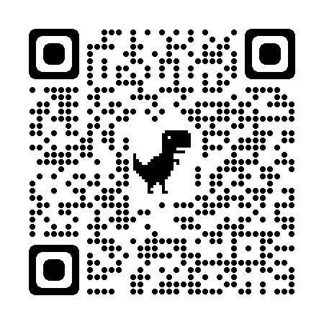
Also see: wolcottlynch.com/aicpa-resources
AICPA Faculty Guide
thiswaytocpa.com/program/CriticalThinking
Watch for the
new and improved faculty guide this fall
Susan Wolcott, Accounting Cafe, Sept 8, 2026

