Slide 1

Etiquette and Dress Codes

Slide 2
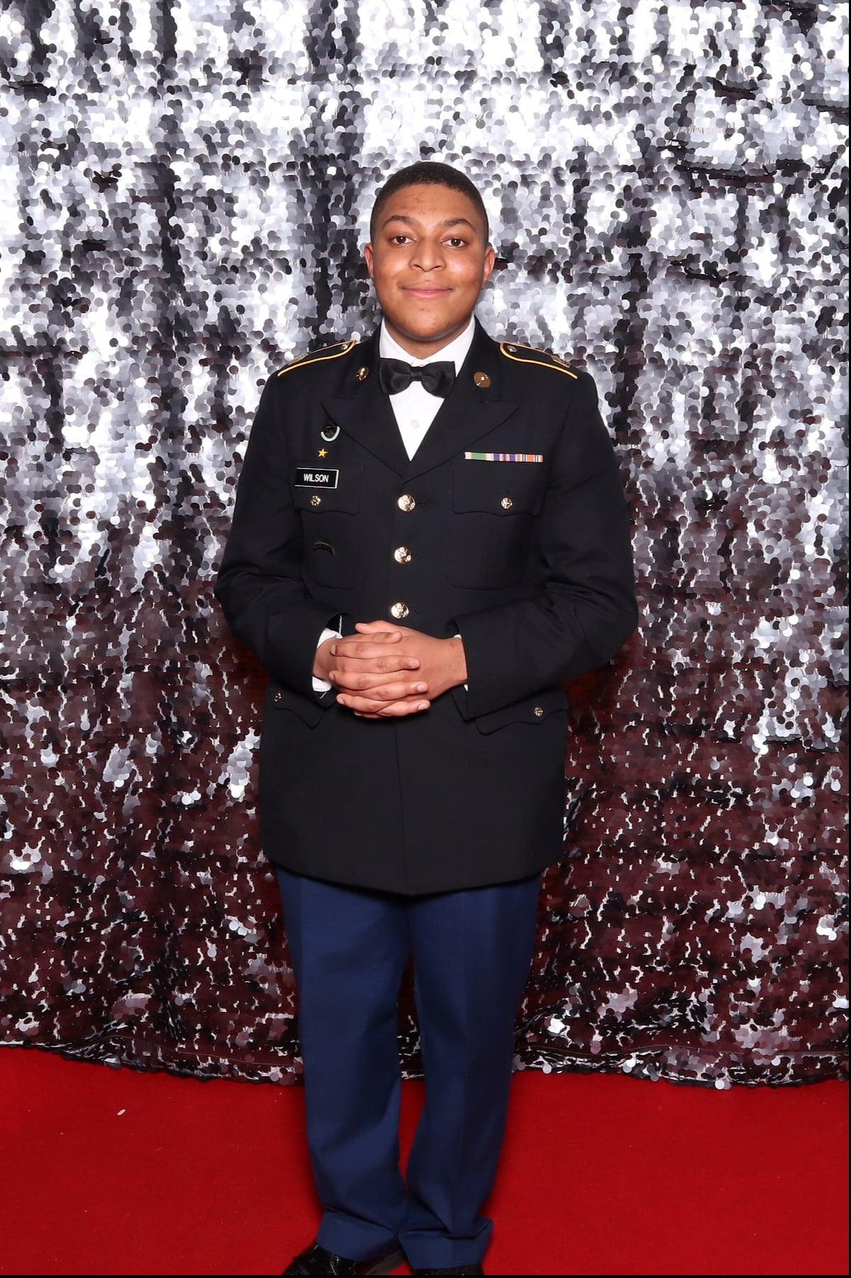
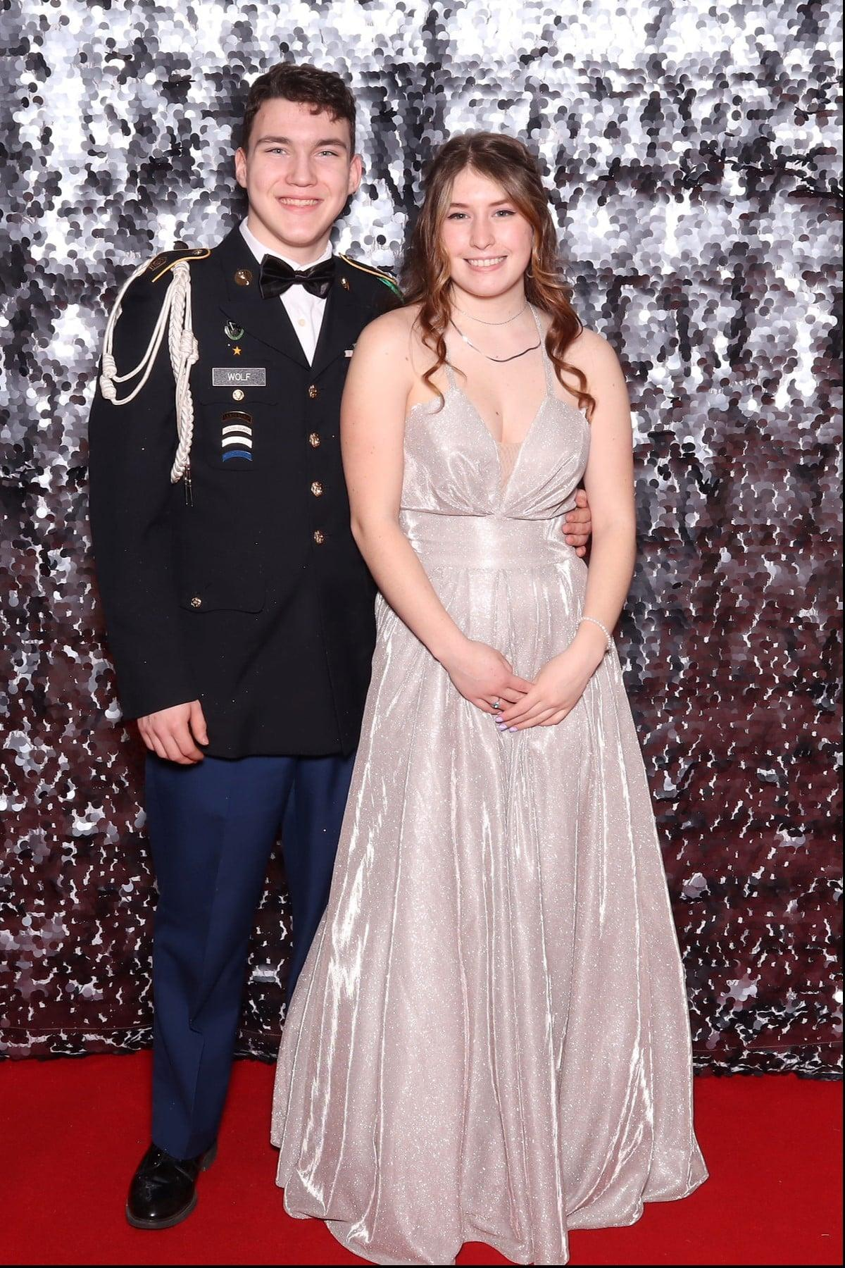
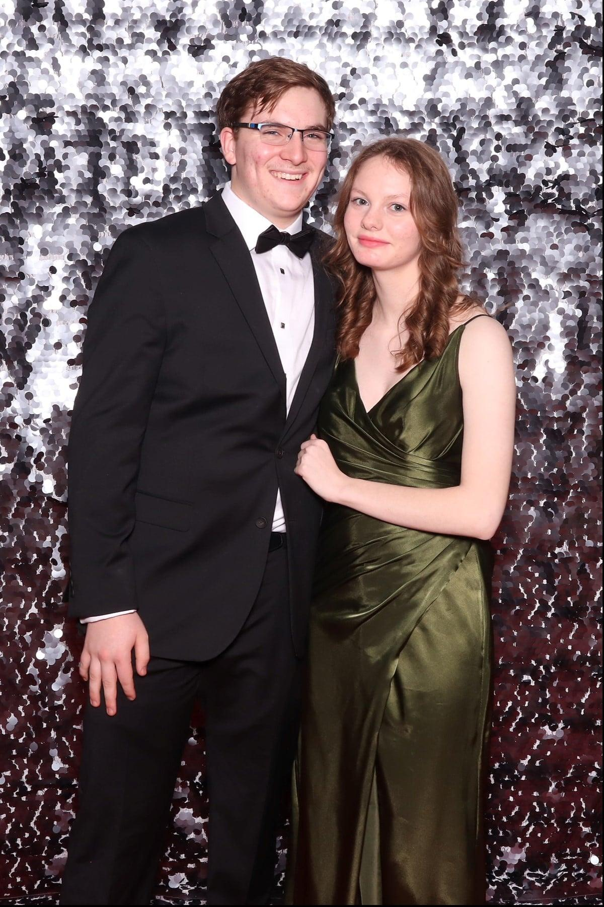
A Formal Event
Gentlemen – Chivalry
Ladies – Cinderella time
Notes:
An event steeped in military decorum and heritage
Not a school dance or a Prom
ASD rules of conduct apply
Instructors have the right to ask cadets to leave—instructor of the cadet’s program will be the authority
This is something to be proud of and an opportunity to positively represent your school and program
Participation in the Military Ball is an honor and a priviledge

Slide 3

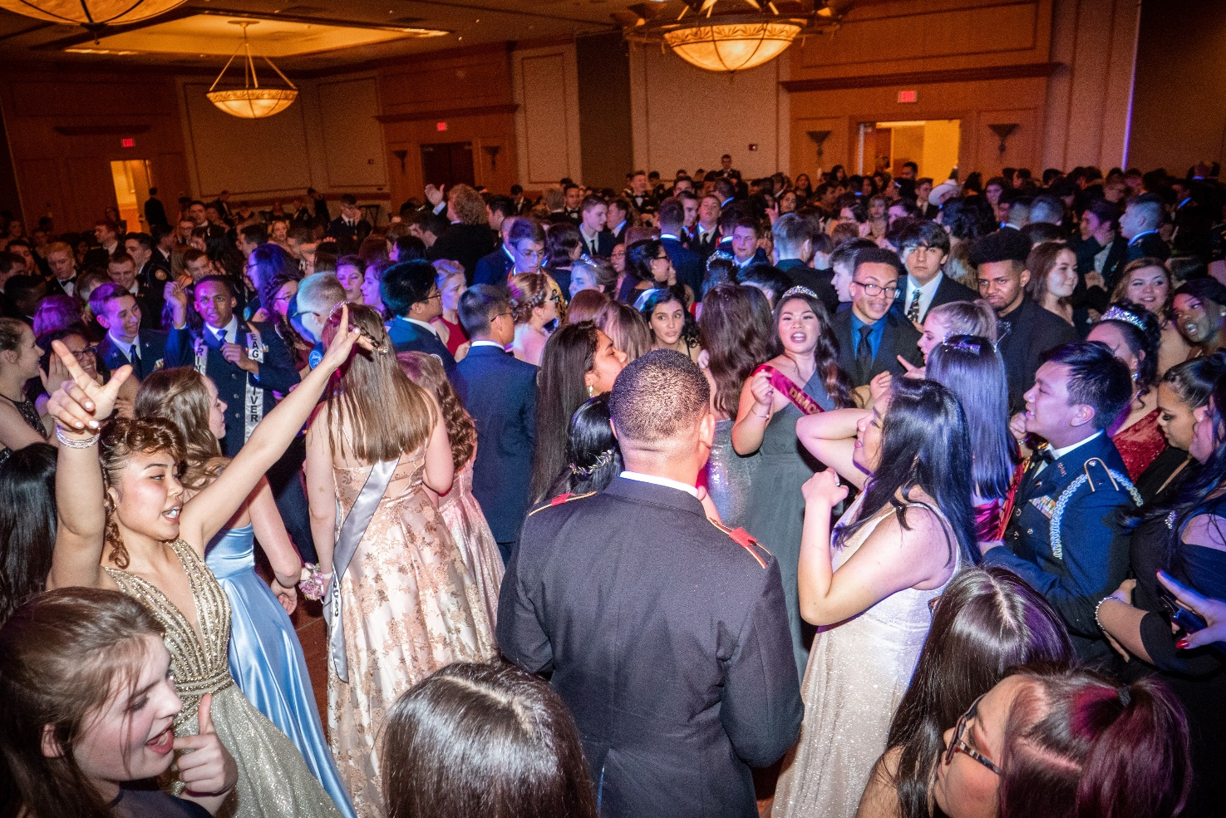
WHERE: Change Point Church
WHEN: Friday, 20 Feb 2026, CHS bus pick up 1630, 1800 – 2300 hrs, CHS bus drop off 2330.
COST: $25 per person
WHO: 700+ cadets and guests from all 10 schools from the ASD and Mat-Su districts

Slide 4
Fitzgerald Photography will be on-site taking candid as well as posed pictures at the dance. If you would like to be notified when the pictures are available to view and purchase online please text the access code below to the phone number 90738 or enter the access code in at my.photoday.com. If you purchase $35 or more of Advance Pay credit before picture day you will receive free shipping on your order.
ACCESS CODE: PGFA53574

Slide 5
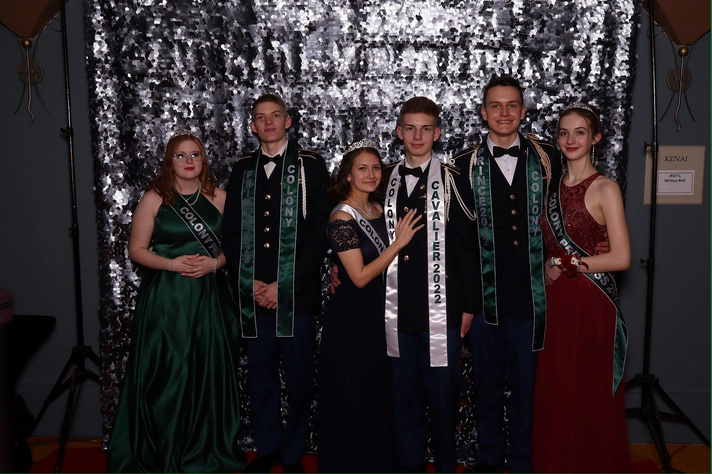
Sweetheart and Cavalier will be introduced and announced at 1930
Seniors will be introduced at 2000

Slide 6

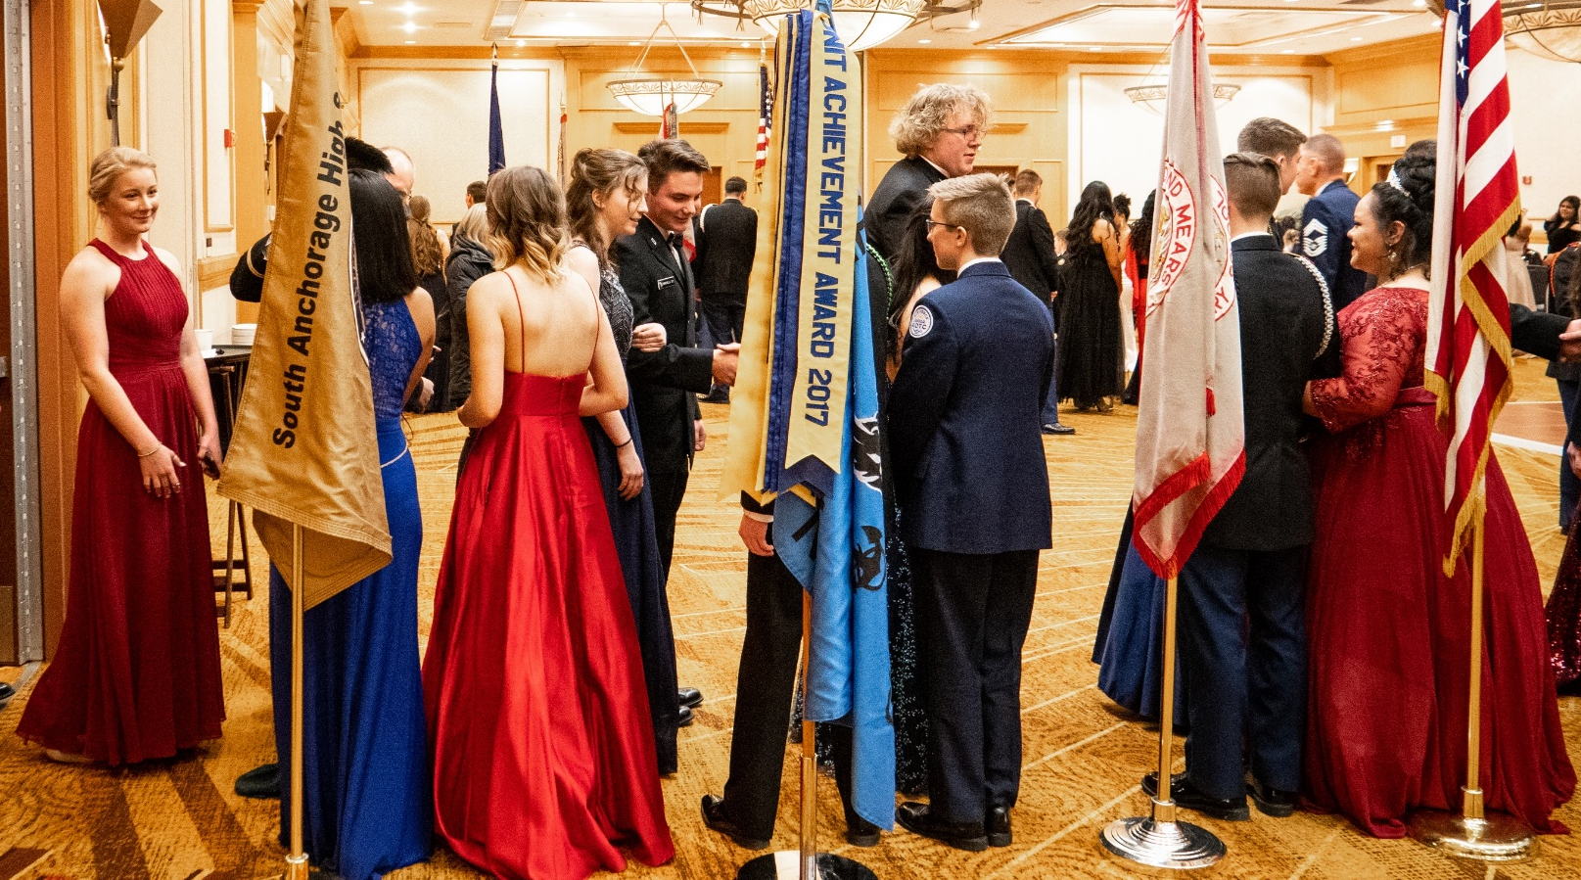
Be on time! Receiving Line opens at 6:30pm
Female/ranking cadet should be on the right‏
Introduce yourself and your guest
This is my guest/friend (name), and I am (rank)(name).
Shake hands with each of the commanders
Notes:
Cadet commanders should be in place by 1810
Cadets who wish to go to dinner prior to the event should plan ahead and be sure they are on site prior to the close of the receiving line
Once inside, please stay there until the end of the scheduled formalities

Slide 7

No Public Displays of Affection
(i.e. kissing or sitting on laps, etc)‏
NO DRAMA -- leave it at the door
NO foul language or inappropriate conversations
Do not sit on tables or window ledges.
No wandering or lounging around the Facility
Do not remove your shoes!
Utmost Courtesy and Politeness at all times
Towards the cadets, instructors and chaperones
Towards the Hotel staff and guests
Notes:
Represent your school, your uniform, and your program with distinction

Slide 8
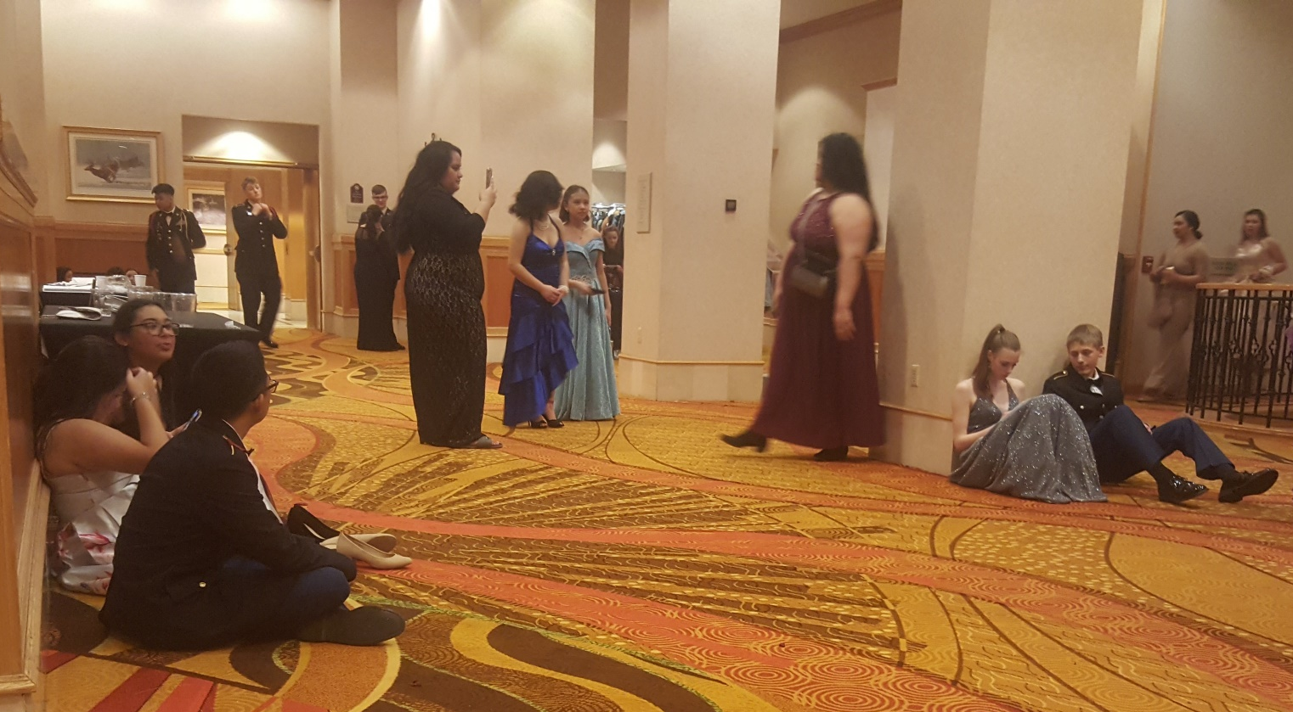
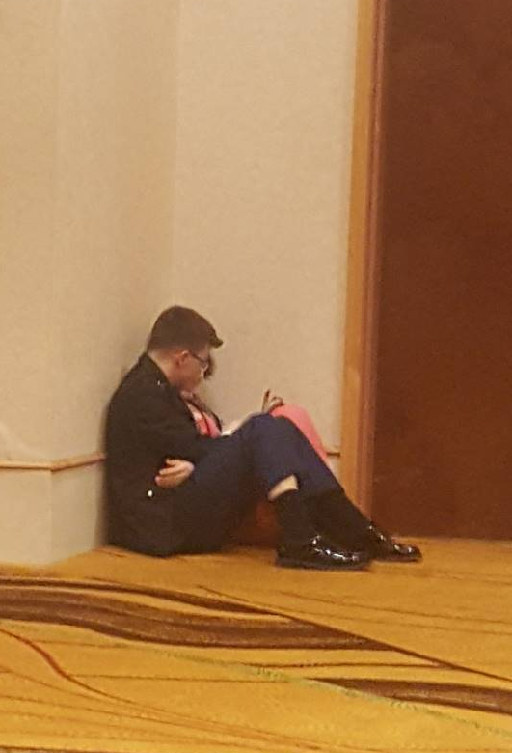

Slide 9
The food is not a buffet, don’t be greedy
One plate at a time, don’t stack two on an arm‏
Small portions
Use silverware when appropriate
Food stays in tabled area
Eat what you take
Servers will clear your table
Keep the tabled areas neat
Don’t leave half filled drinks unattended
Be cautious to avoid spills
No chewing gum

Slide 10
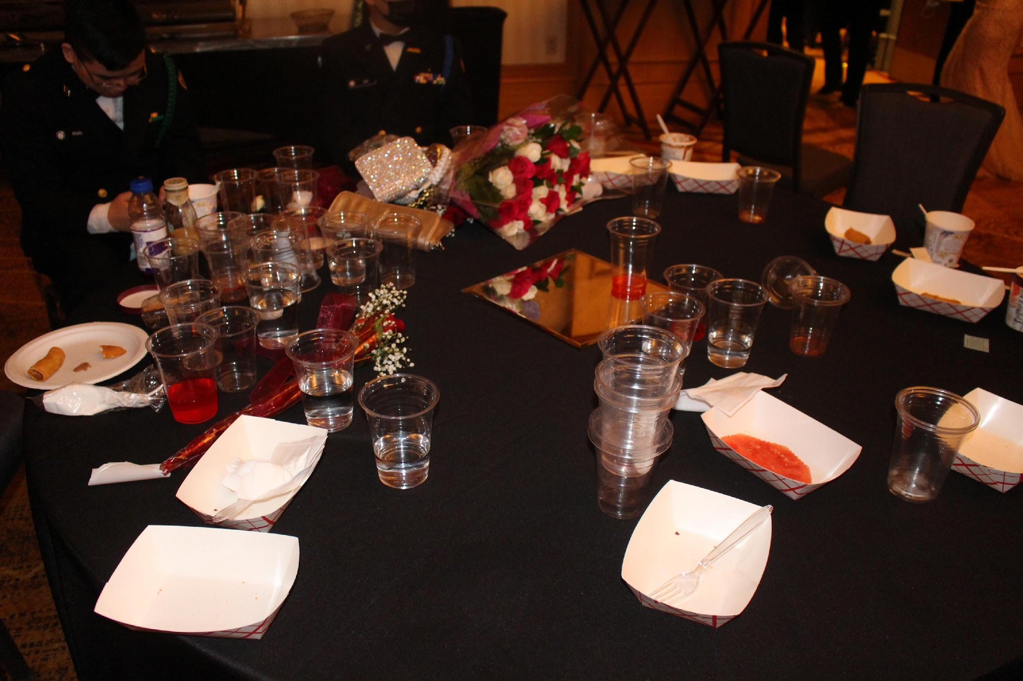
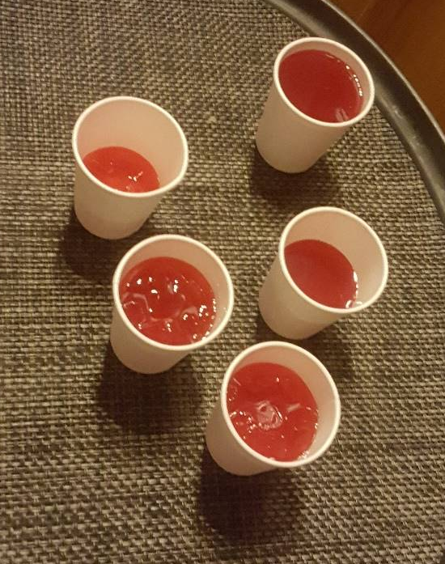

Slide 11
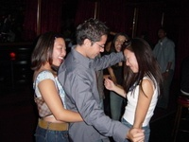
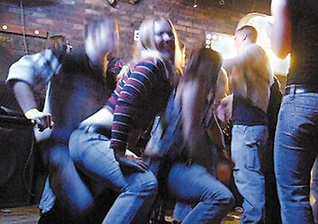
NO DIRTY DANCING (grinding or freaking)‏
Keep your feet on the floor
NO moshing (pushing & shoving)‏
NO being lifted onto shoulders or carried around
No Conga Lines
Be respectful when Instructors correct you
Notes:
Cadets may dance in a group but no back to front dancing
No dancing in the tabled areas—avoids tripping hazards and drink spillage
Pay heed to the advice of the instructors if dancing is considered questionable
No cadet should have to be told twice to change their behavior

Slide 12

Female cadets may choose to attend the Military Ball in their Formal Service Dress
Other option is to wear formal civilian attire, this option should not be minimized or considered out of the ordinary this is the standard procedure for active-duty military ball events

Slide 13
Dress must be floor length
Back of dress must not expose more than the start of the line of the bra across the back
No excessive cleavage
Strapless or one strap dresses are O.K. but must stay up!
No sheer or see-through sections of dress
DO NOT take off footwear! No flip flops, sandals, boots, sneakers or crocs. Toes covered is preferred. Heels should be no more than 3 inches and not platform. Flats are acceptable.

Slide 14
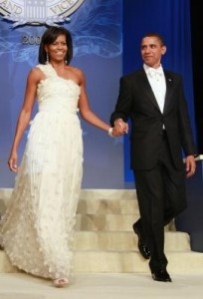
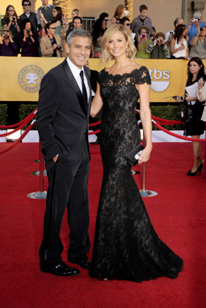

Slide 15

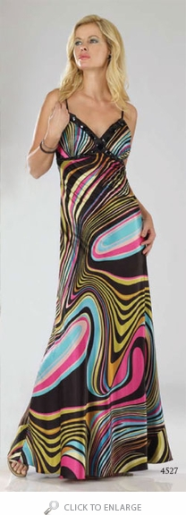

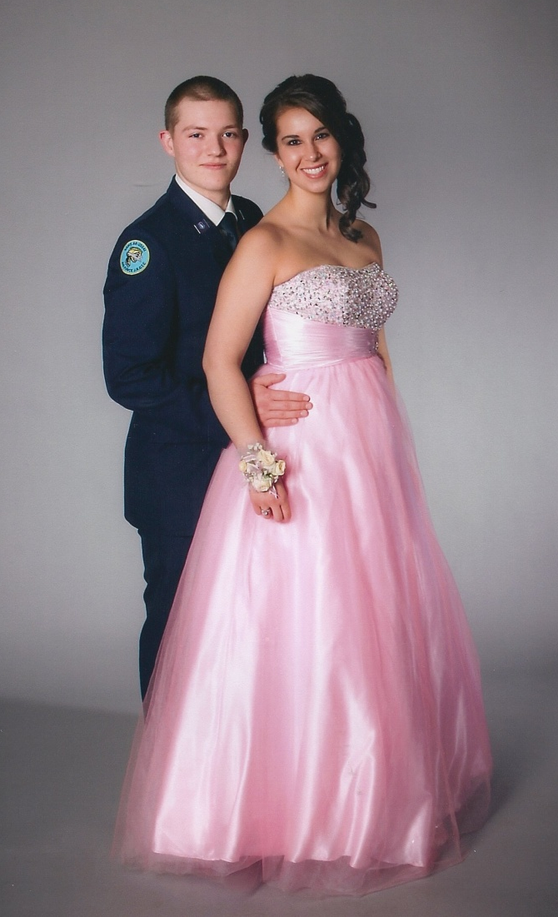

Slide 16
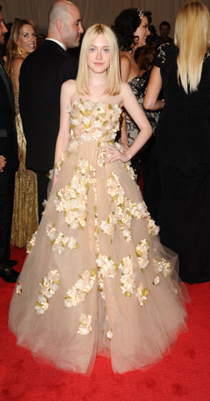
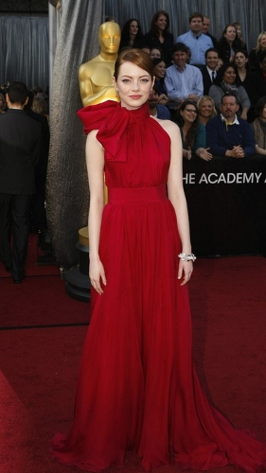
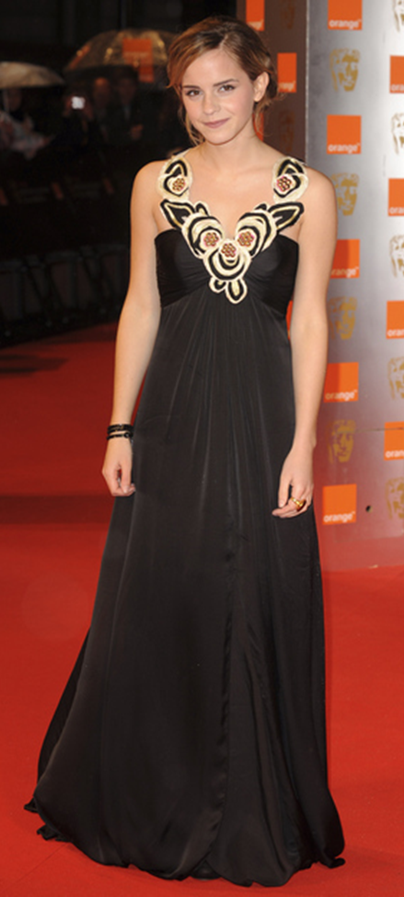
Notes:
Some examples that work
‹#›

Slide 17
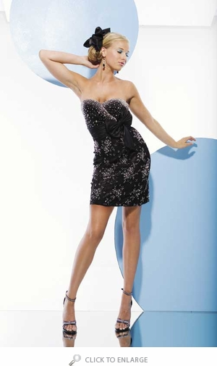
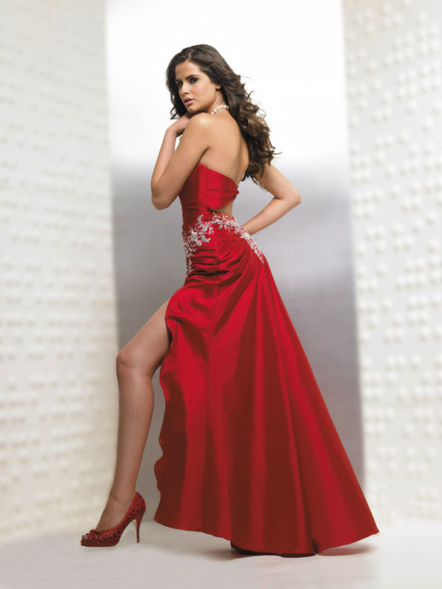

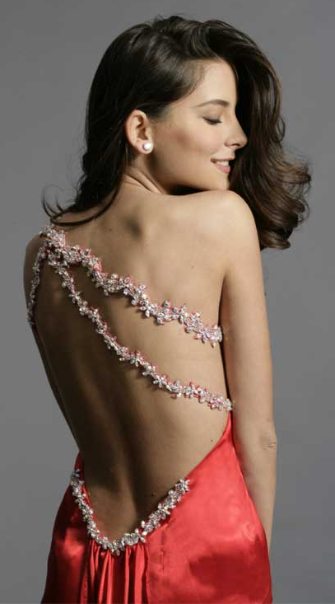
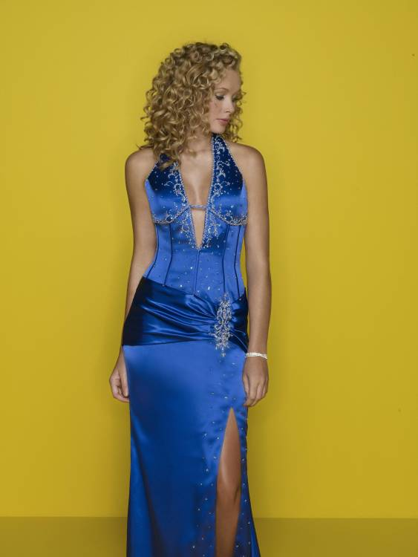
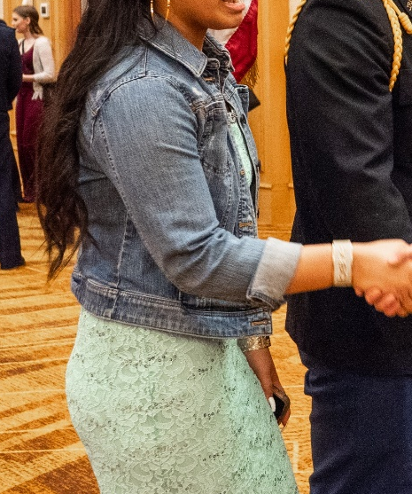
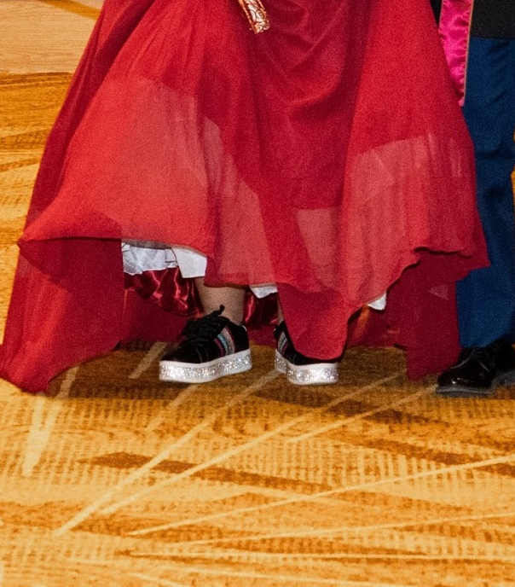

Slide 18
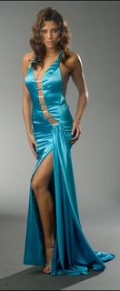
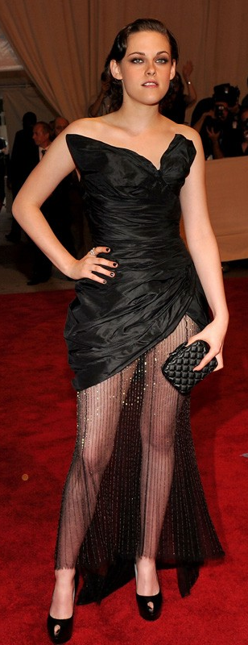
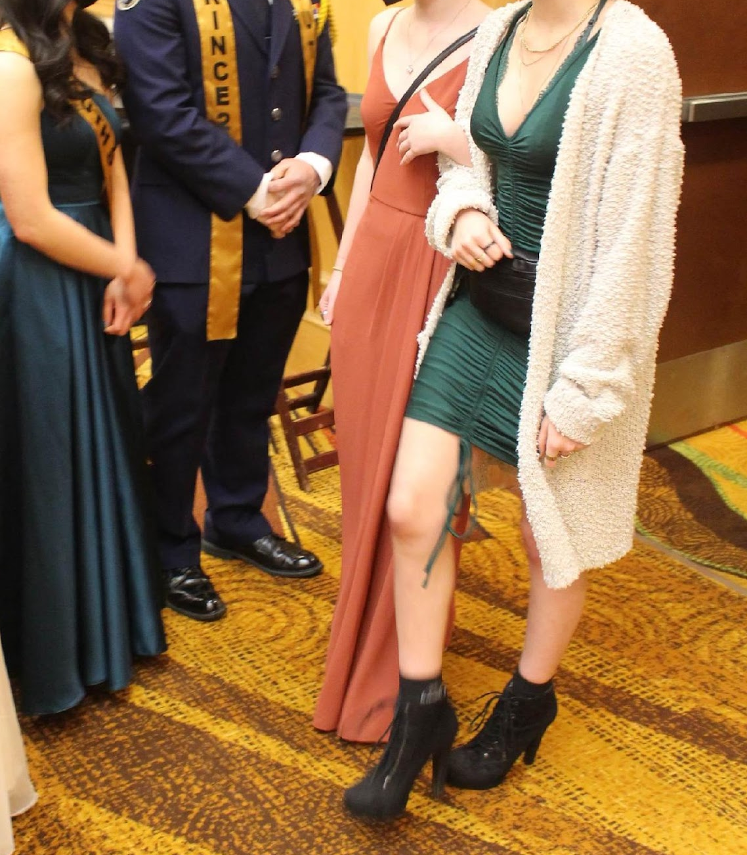
REALLY BAD
Notes:
#1 too much exposed skin
#2 Ridiculous
#3 Sheer in the front with a solid panel in the back

Slide 19
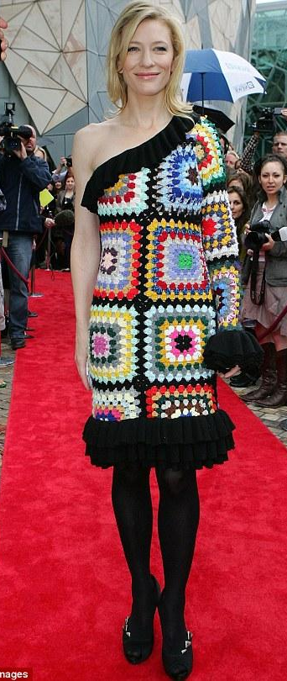
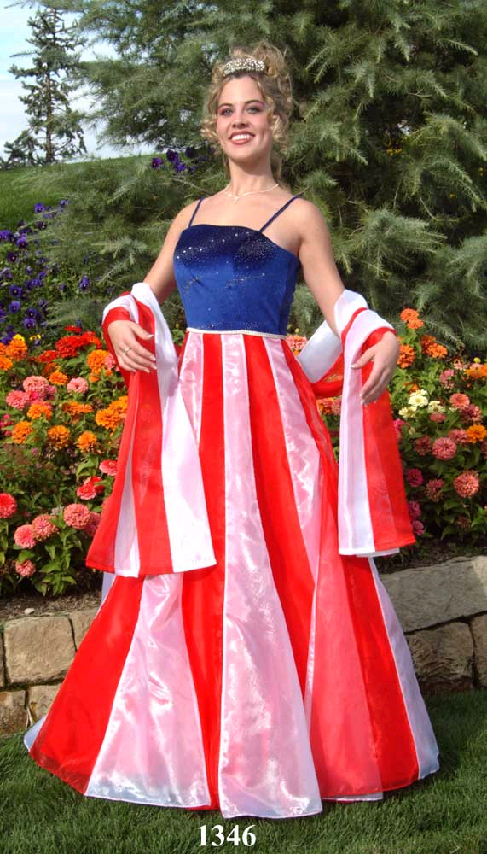
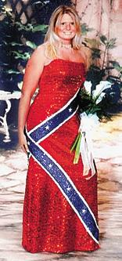
RIDICULOUS
Notes:
No costume Dresses

Slide 20
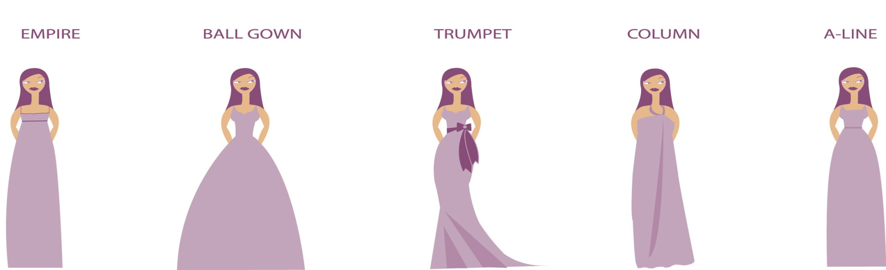
Flattering on you... | Empire | Ball Gown | Trumpet/ Mermaid | Column/ Sheath | A-Line
Bust - Large |  |  |  |  | X
Bust - Small | X | X |  |  | X
Curvy & Slim |  |  | X | X
Full Figure |  | X |  |  | X
Petite | X | X |  | X | X
Pregnant | X
Shape - Apple | X |  |  |  | X
Shape - Hourglass |  | X |  | X | X
Shape - Pear | X | X |  |  | X
Tall & Thin | X | X |  | X | X

Slide 21
Dress Shopping Options
Thrift stores
JCPenney, Nordstrom Rack, etc
On-Line Sites – www.poshmark.com
High School Graduates
Friends
Becca’s Closet
You don’t have to spend a lot
to look great!

Slide 22

We will be open to support the cadets and their guests attending the
JROTC Military Ball ONLY
Saturday 24 Jan 1100-1500, Wednesday 4 Feb 1700-2000
At the ASD Education Center
5530 E. Northern Lights Blvd
Becca’s Closet provides unused or lightly used formal dresses and accessories for FREE!
This would be a great time to drop off your tax-deductible donations as well.
Find us on Facebook at “Becca’s Closet Anchorage”
“The Anchorage School District does not endorse these materials or the viewpoints expressed in them.”

Slide 23

Male Attire (Uniformed Cadet)
Must always wear Service Dress Uniform
White button up dress shirt with clear buttons and issued ARMY necktie or black bow tie
Collar can not be a button down
Properly fitted shined, low quarters
Uniform should fit properly
Must have a haircut and clean shaved
No piercings! (Should not have to say that)
Wear your medals or ribbons
No cover (Beret)

Slide 24
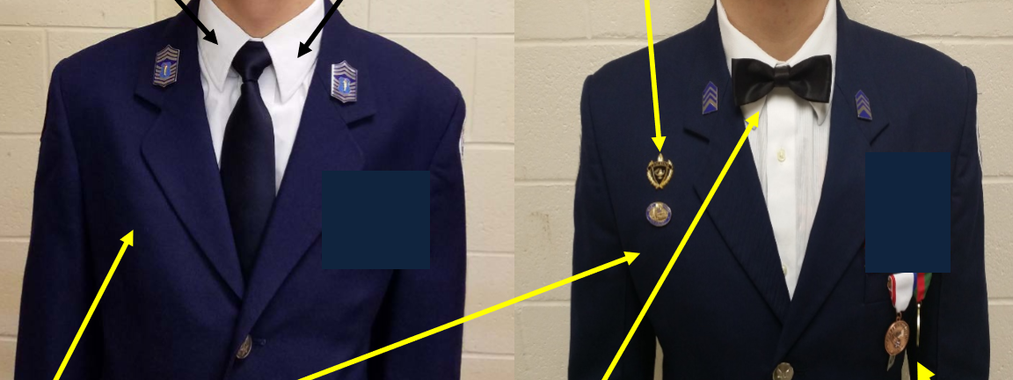
Semi Formal Dress code options.
Issued Black 4 in Hand Tie or Black Bowtie
Ribbons, medals, and badges should be worn
Notes:
White shirts – Keep it simple. Burlington Coat Factory, JCPenney, Walmart, Fred Meyers, Sears, etc Long sleeve or short sleeve are OK…cuflinks should be avoided.

Slide 25

Must have a dark suit/tuxedo
Must wear a Dark tie or bowtie
NO sneakers or street shoes
Black/Dark dress shoes only
NO baggy or sport jacket tuxedos
Boots are not appropriate

Slide 26
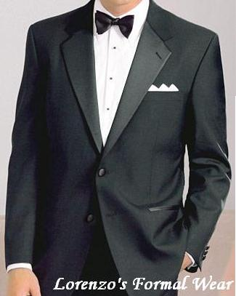
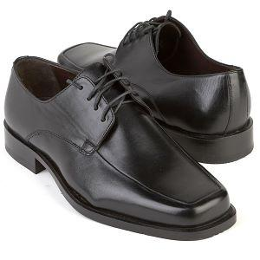
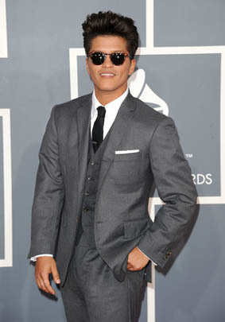

Slide 27
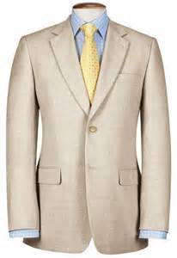
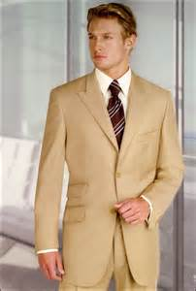
Light Colored Suits are Nice
but Not Favored

Slide 28
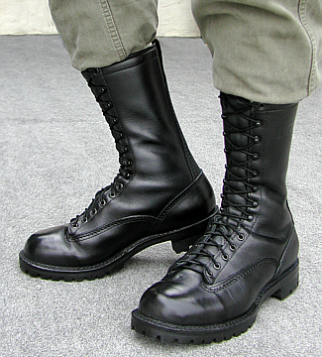
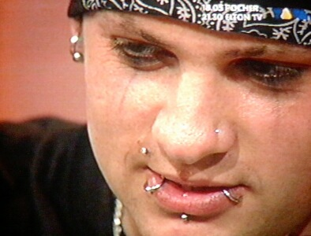
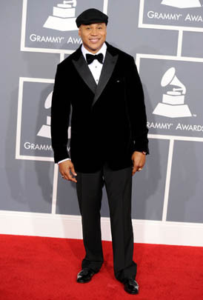
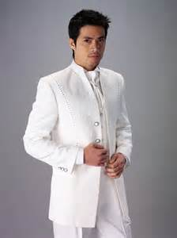
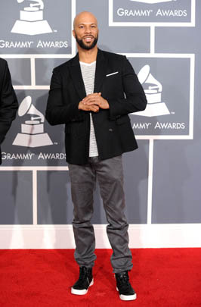

Slide 29
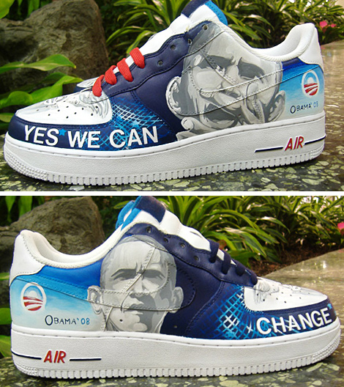
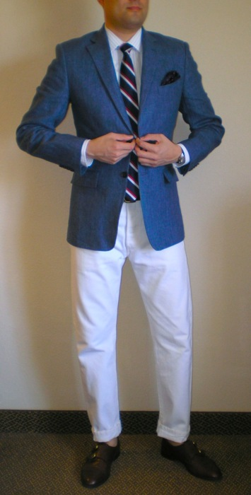
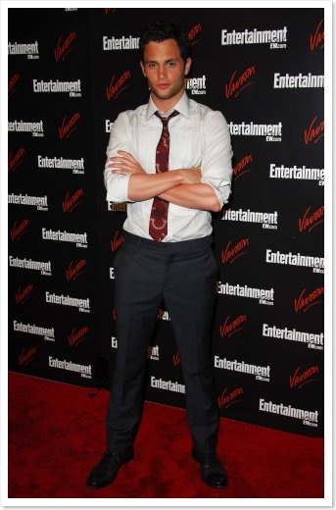
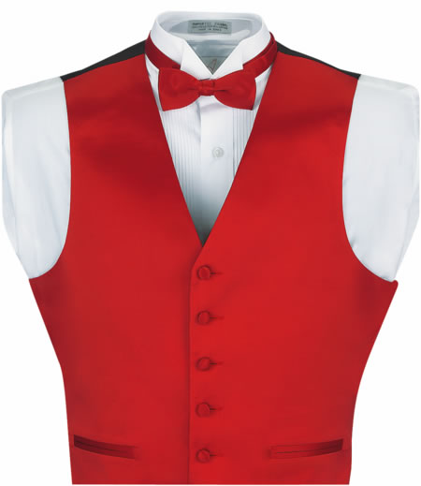

Slide 30
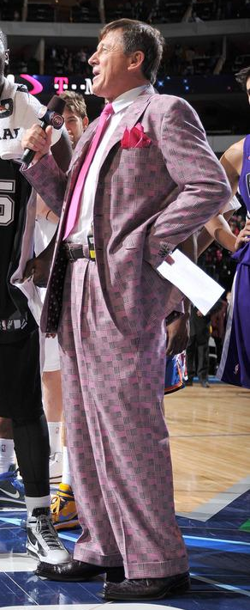
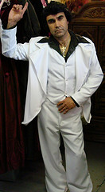
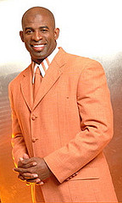
REALLY BAD

Slide 31



REALLY BAD

Slide 32


Slide 33


Slide 34


Slide 35


Slide 36


Slide 37



Slide 38


Slide 39




Slide 40


Slide 41


Slide 42


Slide 43
ENJOY THE BALL

