Slide 1

Luke 25:14-26
The Parable of the Talents
SUNDAY SERMON
BISHOP ANDY C. LEWTER, D. MIN.

Slide 2

OPENING VERSE
14 For the kingdom of heaven is as a man travelling into a far country, who called his own servants, and delivered unto them his goods.
15 And unto one he gave five talents, to another two, and to another one; to every man according to his several ability; and straightway took his journey.
16 Then he that had received the five talents went and traded with the same, and made them other five talents.
17 And likewise he that had received two, he also gained other two.
18 But he that had received one went and digged in the earth, and hid his lord's money.
LUKE 15:3-7

Slide 3
OPENING VERSE
24 Then he which had received the one talent came and said, Lord, I knew thee that thou art an hard man, reaping where thou hast not sown, and gathering where thou hast not strawed:
25 And I was afraid, and went and hid thy talent in the earth: lo, there thou hast that is thine.
26 His lord answered and said unto him, Thou wicked and slothful servant, thou knewest that I reap where I sowed not, and gather where I have not strawed:
27 Thou oughtest therefore to have put my money to the exchangers, and then at my coming I should have received mine own with usury.
28 Take therefore the talent from him, and give it unto him which hath ten talents.
LUKE 15:3-7

Slide 4




This is the third in a series of stories that Jesus is telling about being prepared for the end of days?

Slide 5

The Parable Begins
...and delivered to him his goods.
the owner of the property was leaving and did not tell his workers when he was going to return but left them “talents” to survive on during his absence
LUKE 15:4

Slide 6
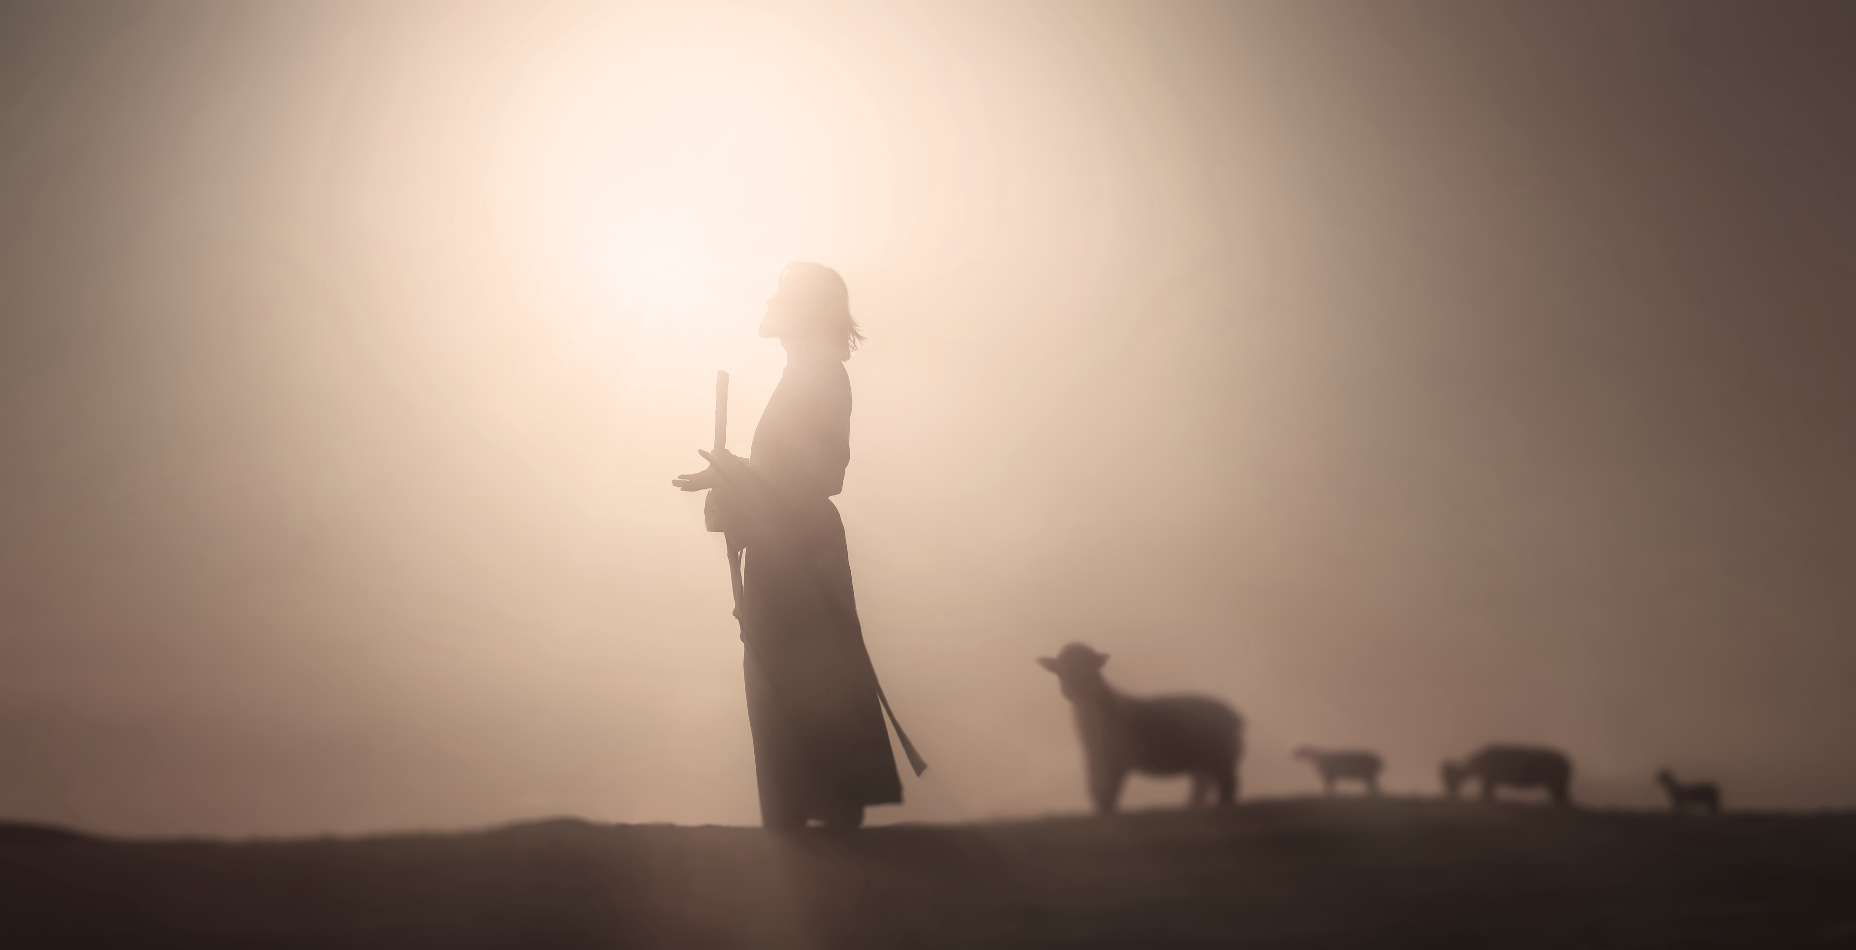

The Value of a “Talent”
According to Biblical scholarship, a talent was a year’s worth of wages
LUKE 15:5

Slide 7

The Return Was Unexpected
LUKE 15:6
19 After a long time the lord of those servants cometh, and reckoneth with them.
Remember, this story is about being ready for an unexpected return of the Lord. While we do not know how long the master had been away we do know that his servants did not know when he was to return

Slide 8


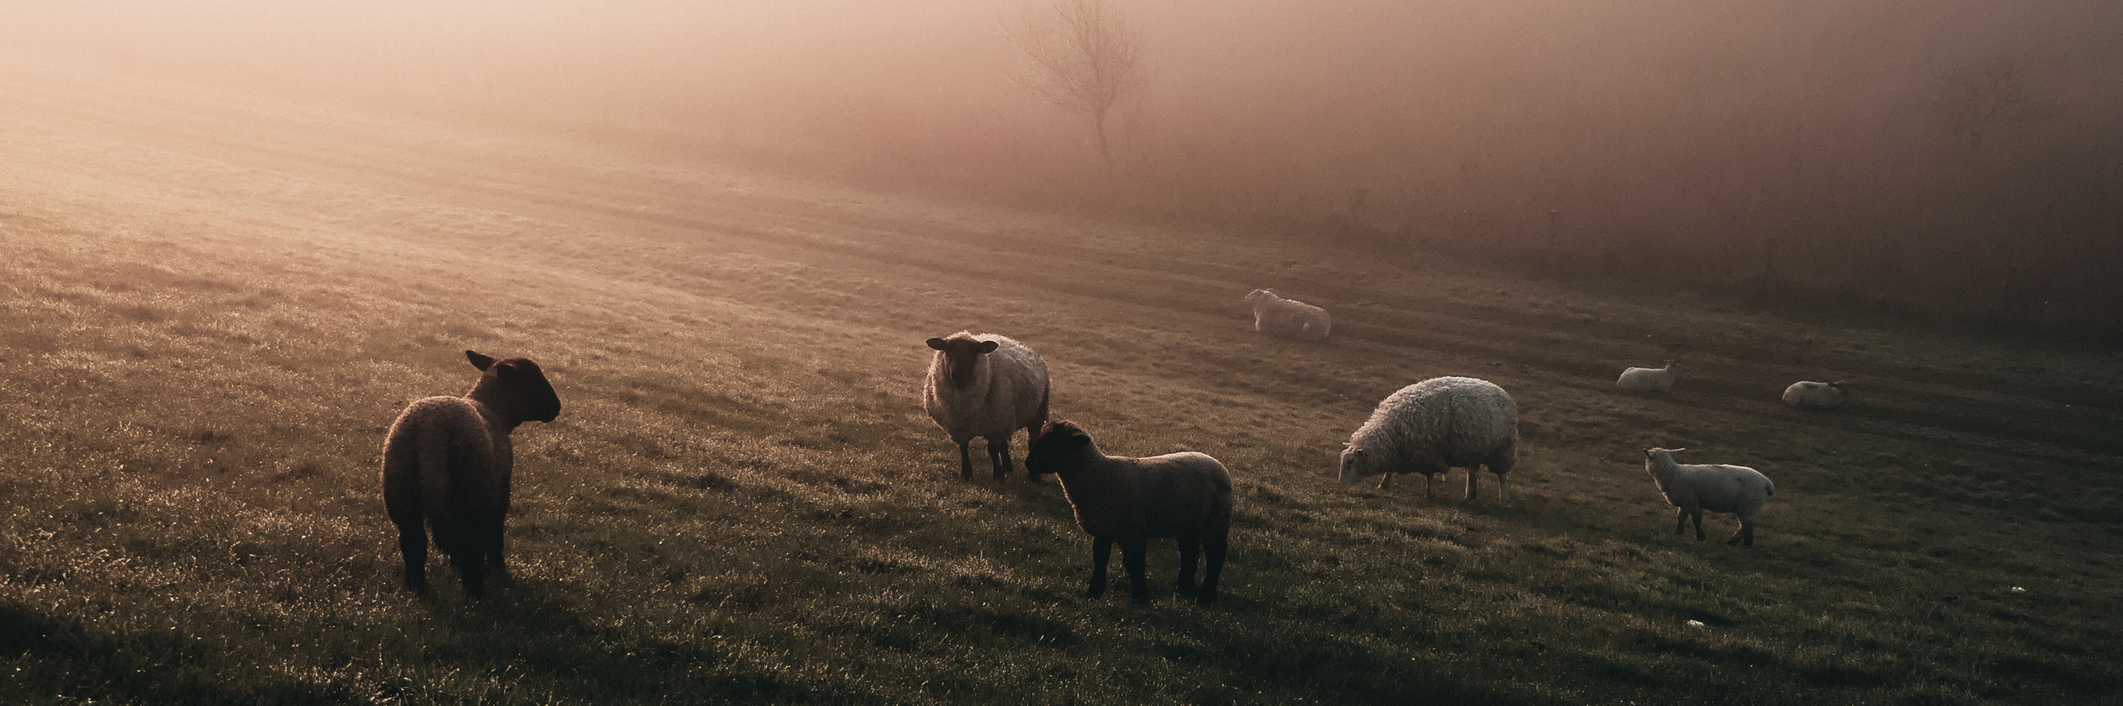
What Does the Master Call Them?
Need guidance
Lose our way
Feel unsure
The first two servants are both called “Good and Faithful”. They are not judged based upon what the other had, they were judged based upon what they did with what they were given

Slide 9



Lazy and Slothful
We are told that while the first two more than doubled what they were given, they did so in addition to whatever it took for them to live on while the master of the property was absent.
In contrast we are told that the third servant took what he had been given and hid it. The unspoken question is who was he hiding it from. The obvious answer is that he was hiding it from the other two servants who had been given the same thing even though the amount was different
LUKE 15:7
Unlike the first two, the third servant is cursed while the other two are blessed. He only returns what he had been given in the first place

Slide 10
The Final Judgement
28 Take therefore the talent from him, and give it unto him which hath ten talents.
29 For unto every one that hath shall be given, and he shall have abundance: but from him that hath not shall be taken away even that which he hath.
While I have read this story all my life I did not realize the real impact and import of the story until this past week. I am anxious to share it with you in case you missed it the same way that I have all these years.

Slide 11

The Hidden Blessing
The servants assumed they were holding their lord’s resources that would e returned to their lord but when the lord returned he allowed them to “KEEP” both the principle and the profit for themselves

Slide 12

Use What You Have
Time is too short to be worried or concerned about what others have compared to what you have. It may be that you don’t have more because you can not handle what you already have
Spend your time using what you have to the best of your ability. God will not judge you on what others have but on how well you take care of what you do have

