Slide 1
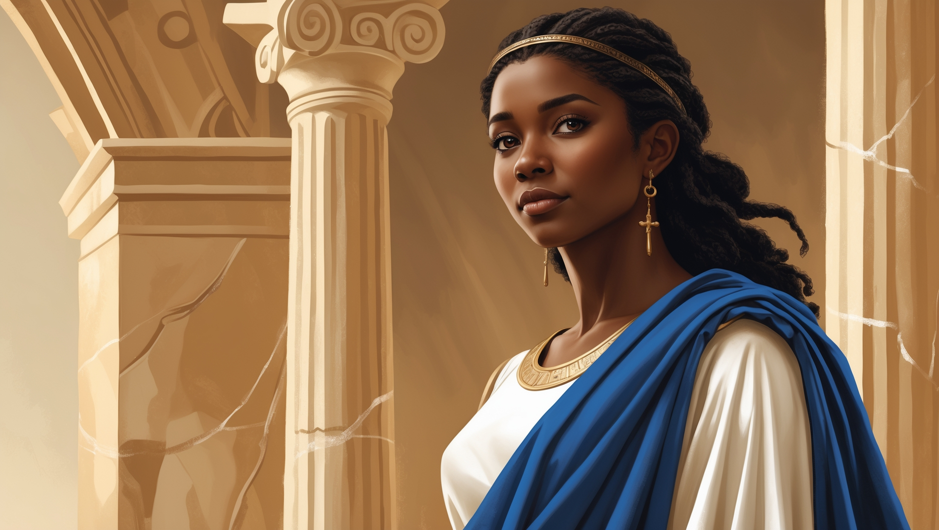
The Story of Phoebe
A Sermon by
Bishop Andy C. Lewter, D. Min

Slide 2
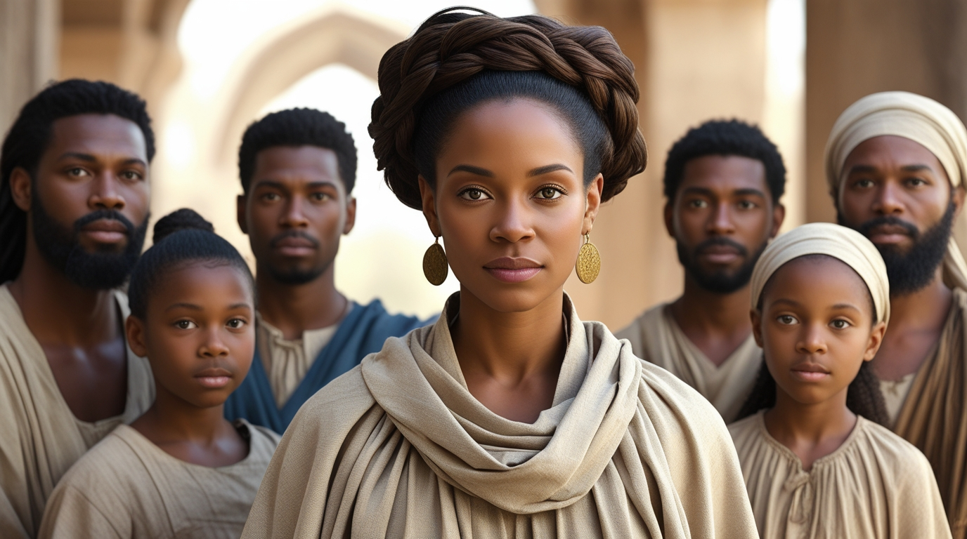

Introduction
This is my third sermon in this series that celebrates Women History Month. I am happy to have covered Deborah, Lydia and today I look at Phoebe

Slide 3
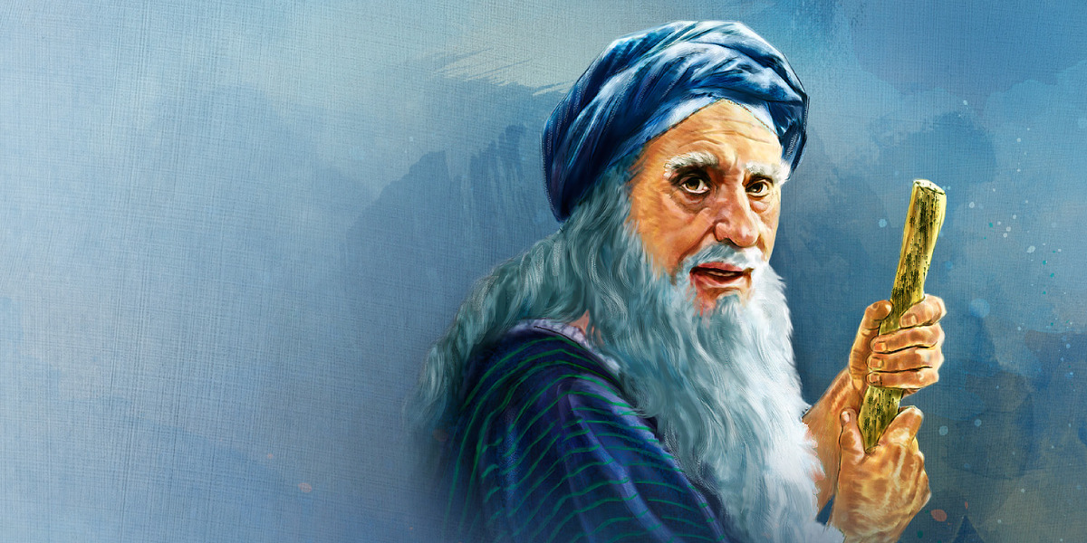
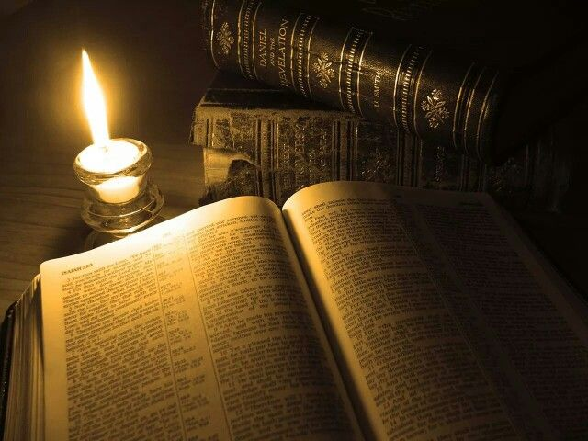
Scripture
16 I commend to you our sister Phoebe, a deacon of the church in Cenchreae. ² I ask you to receive her in the Lord in a way worthy of his people

Slide 4
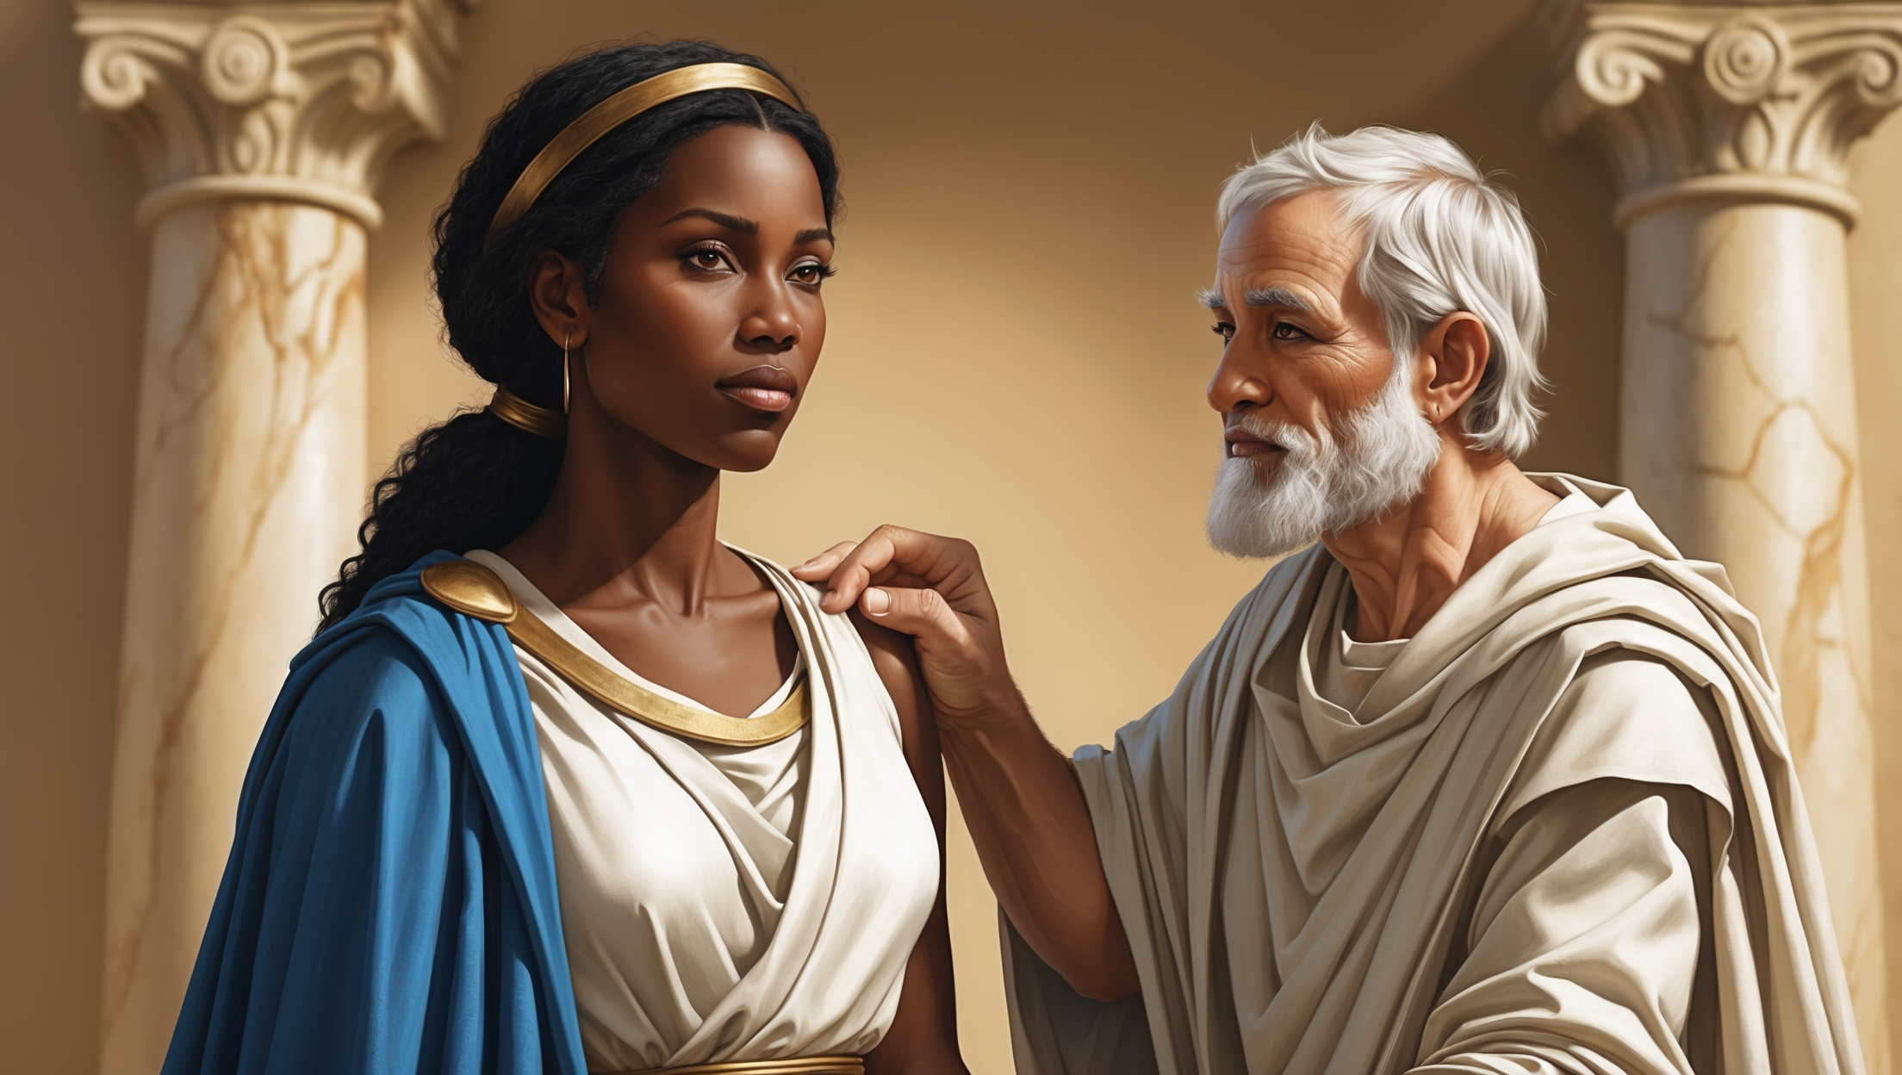
“deacon”
The term here is “diakonos” and it is the same word that the Greek uses for “Minister” it is clear that Paul was sending them a church leader and not just another member

Slide 5
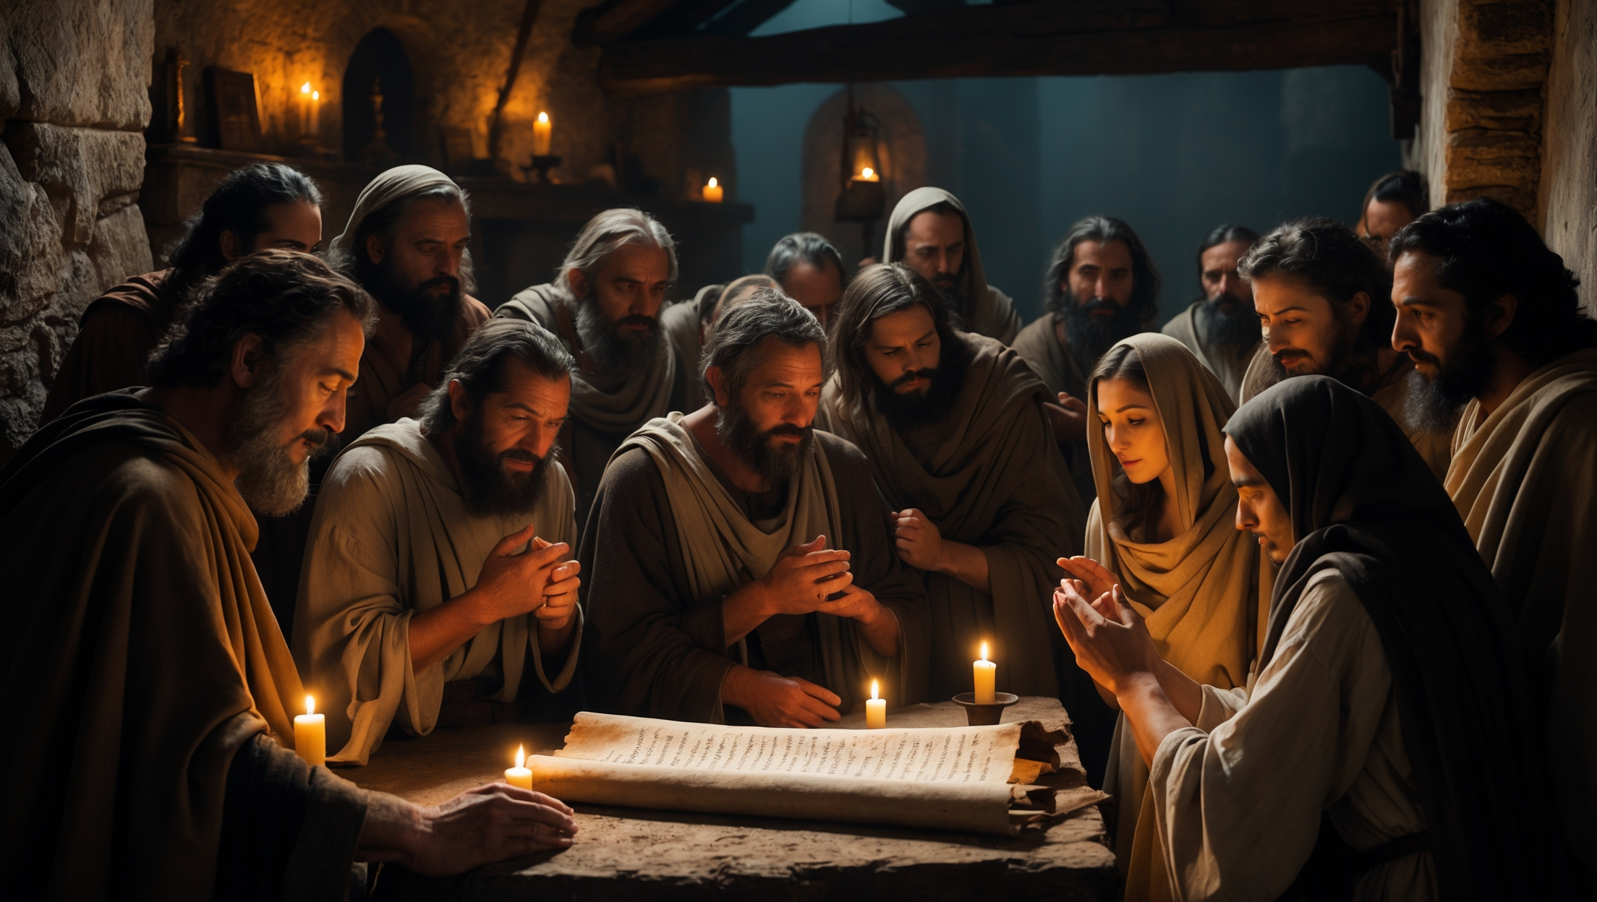
Commend vs Greet
Verses 4-15 lists all those whom Paul greets but Phoebe he commends. She is being sent to them to lead their congregation in Rome

Slide 6
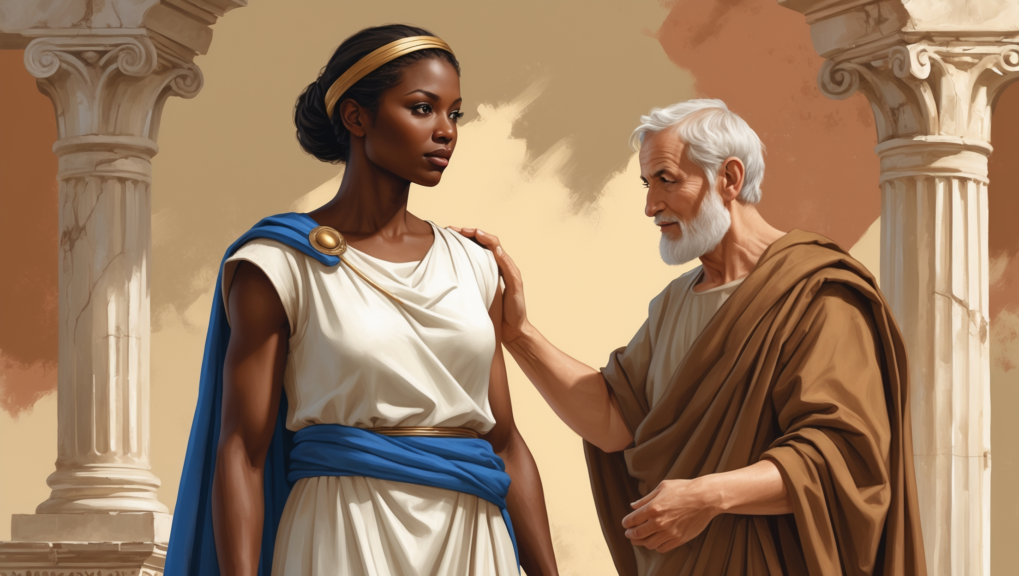
Receive her…
Paul makes clear that many, including himself have poured into her. Receive her not because of gender but because of her gifts (ancient craftsman)

Slide 7
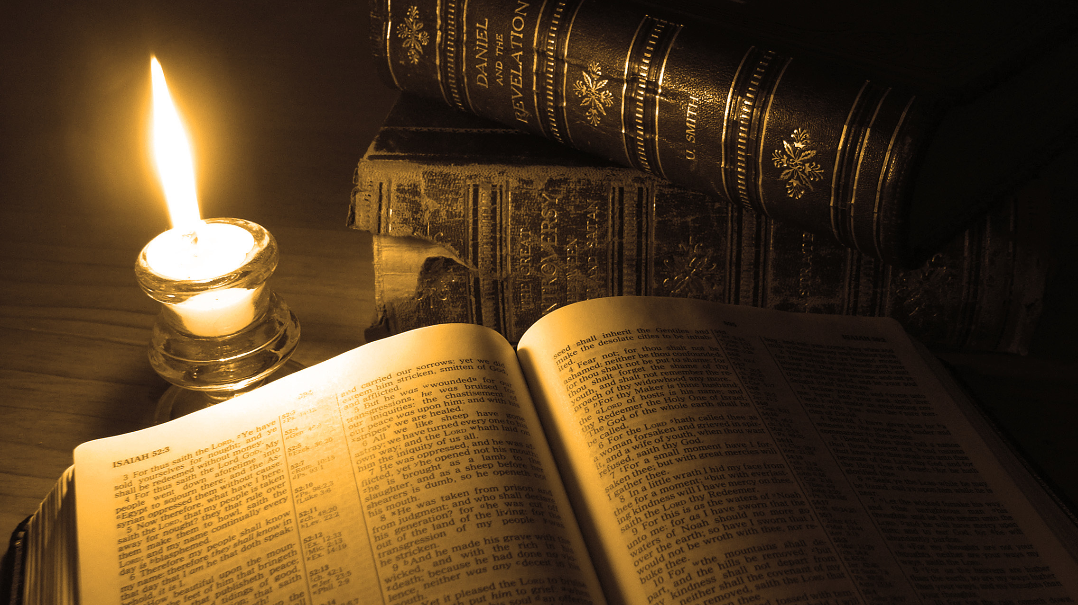
Thank You for Watching

