Slide 1
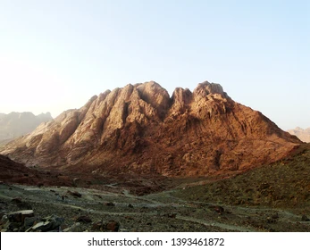
Moses on the Mountain
A Sermon By
Bishop Andy C. Lewter, D. Min

Slide 2
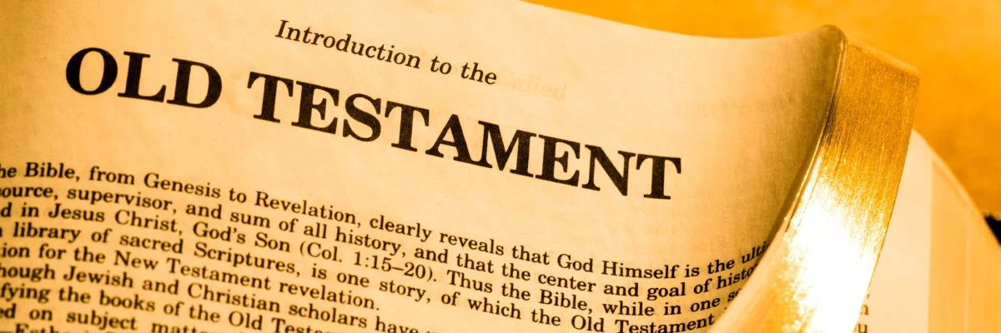

This Week
I would like to turn your attention to a most popular story from the pages of the Old Testament

Slide 3
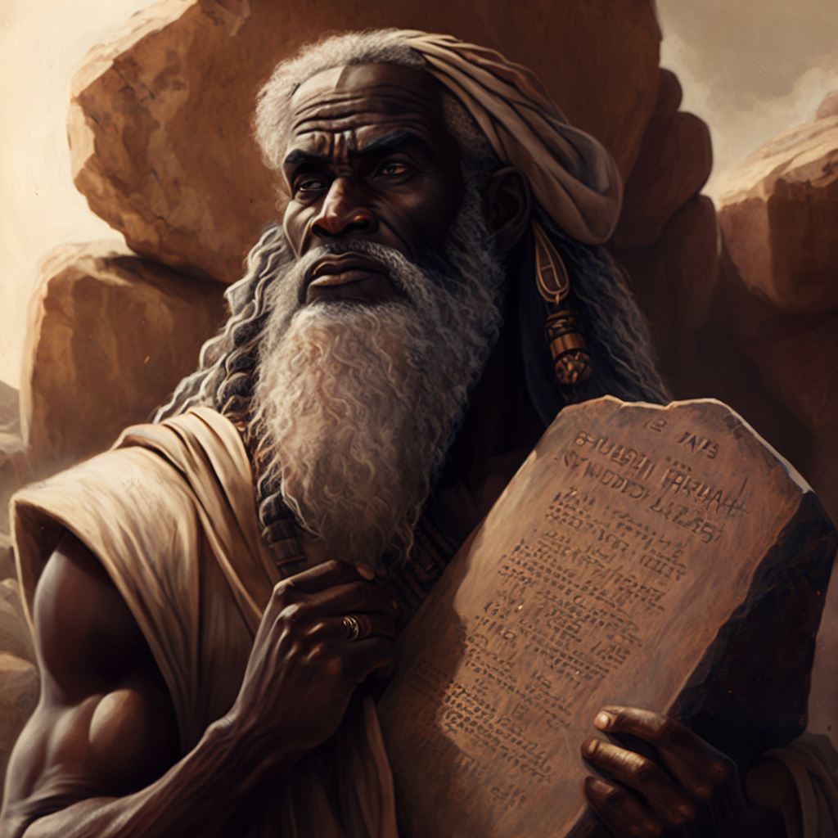
Moses
After being raised in Pharaoh’s house, Moses finds himself in Midia in the home of a priest by the name of Jethro

Slide 4
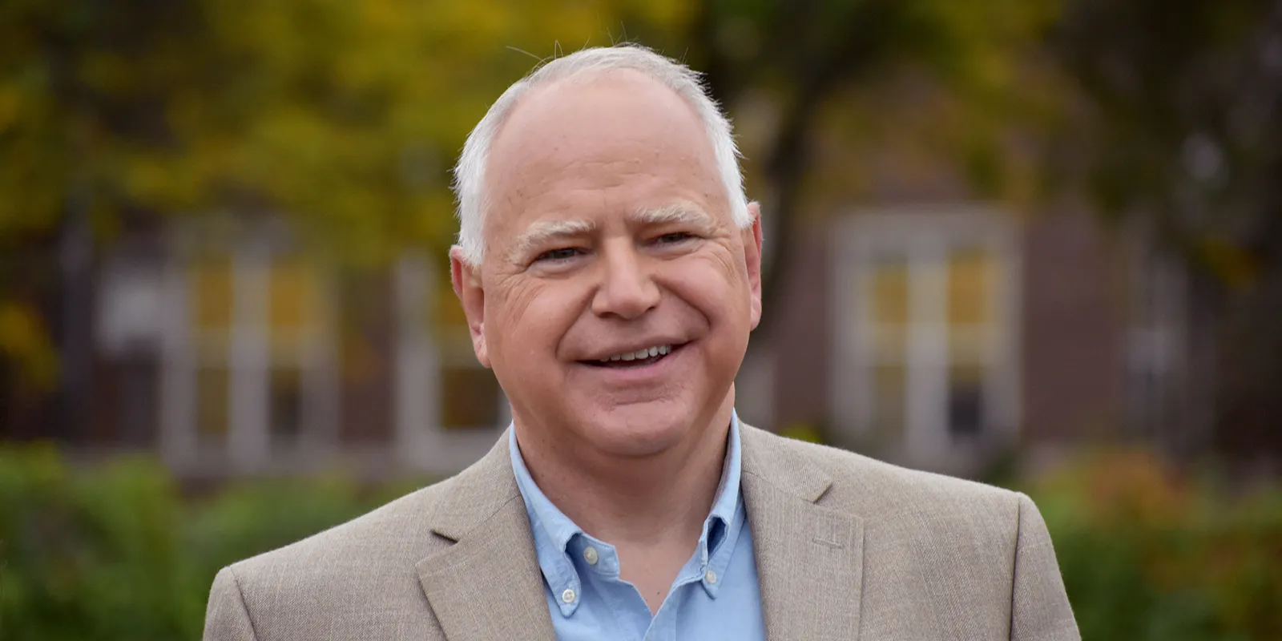
Governor Walz
Governor Walz has told us that in the Midwest their motto is to “Mind Your Own Business”

Slide 5
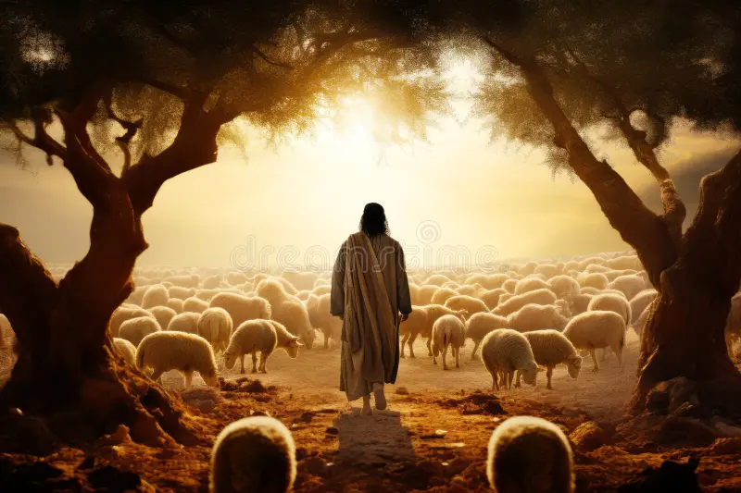
Exodus 3
That is what Moses is appearing to do when we come upon him in the book of Exodus, Chapter 3

Slide 6
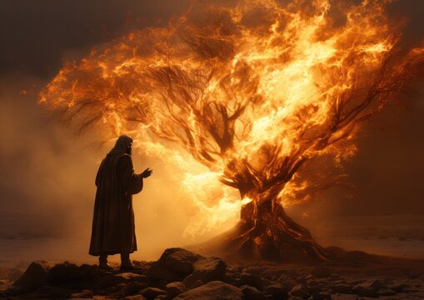
The Mountain
It is here that Moses is summoned to a mountain where he has the unique experience of seeing a bush on fire but not consumed

Slide 7
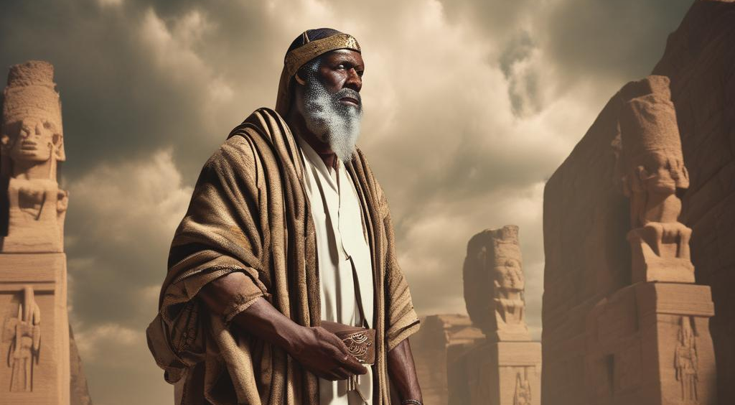
On a Mission
On the heels of that experience Moses returns to the land he had fled, forty years earlier, to tell Pharaoh to let God’s people go

Slide 8
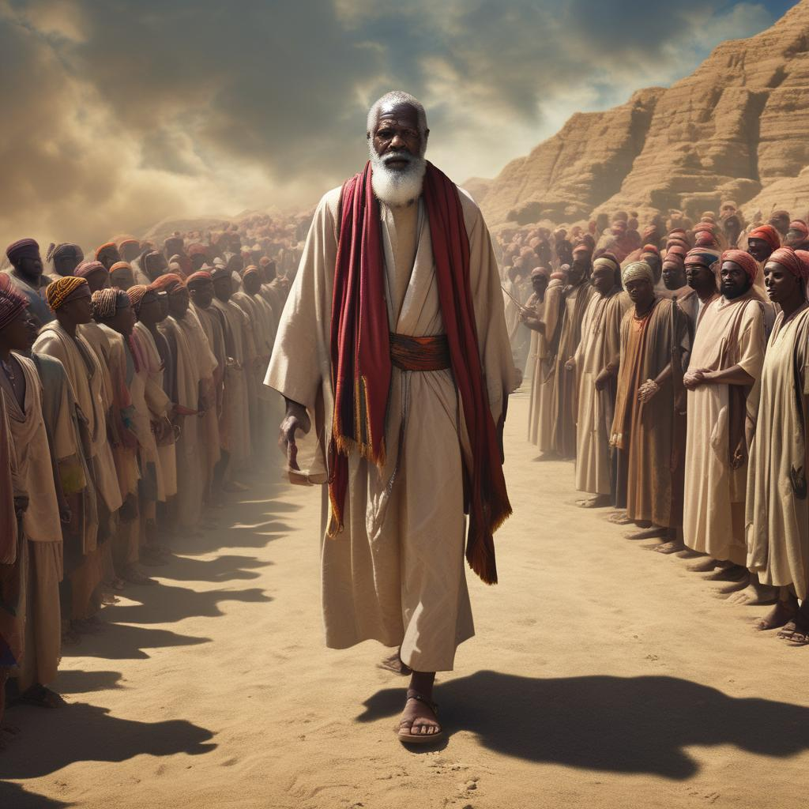
From Your Business
Moses goes from minding his own business to minding God’s business

Slide 9
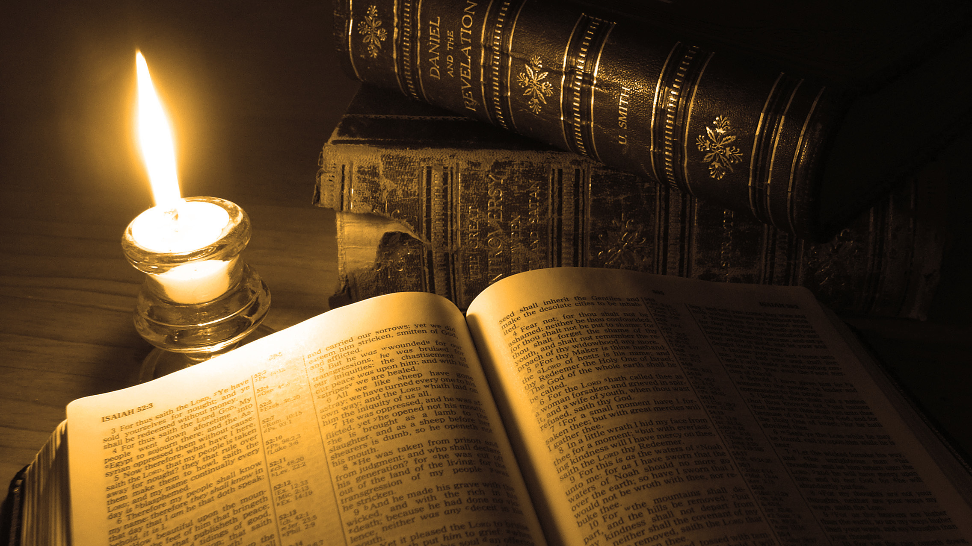
Thank You for Watching

